Slide 1
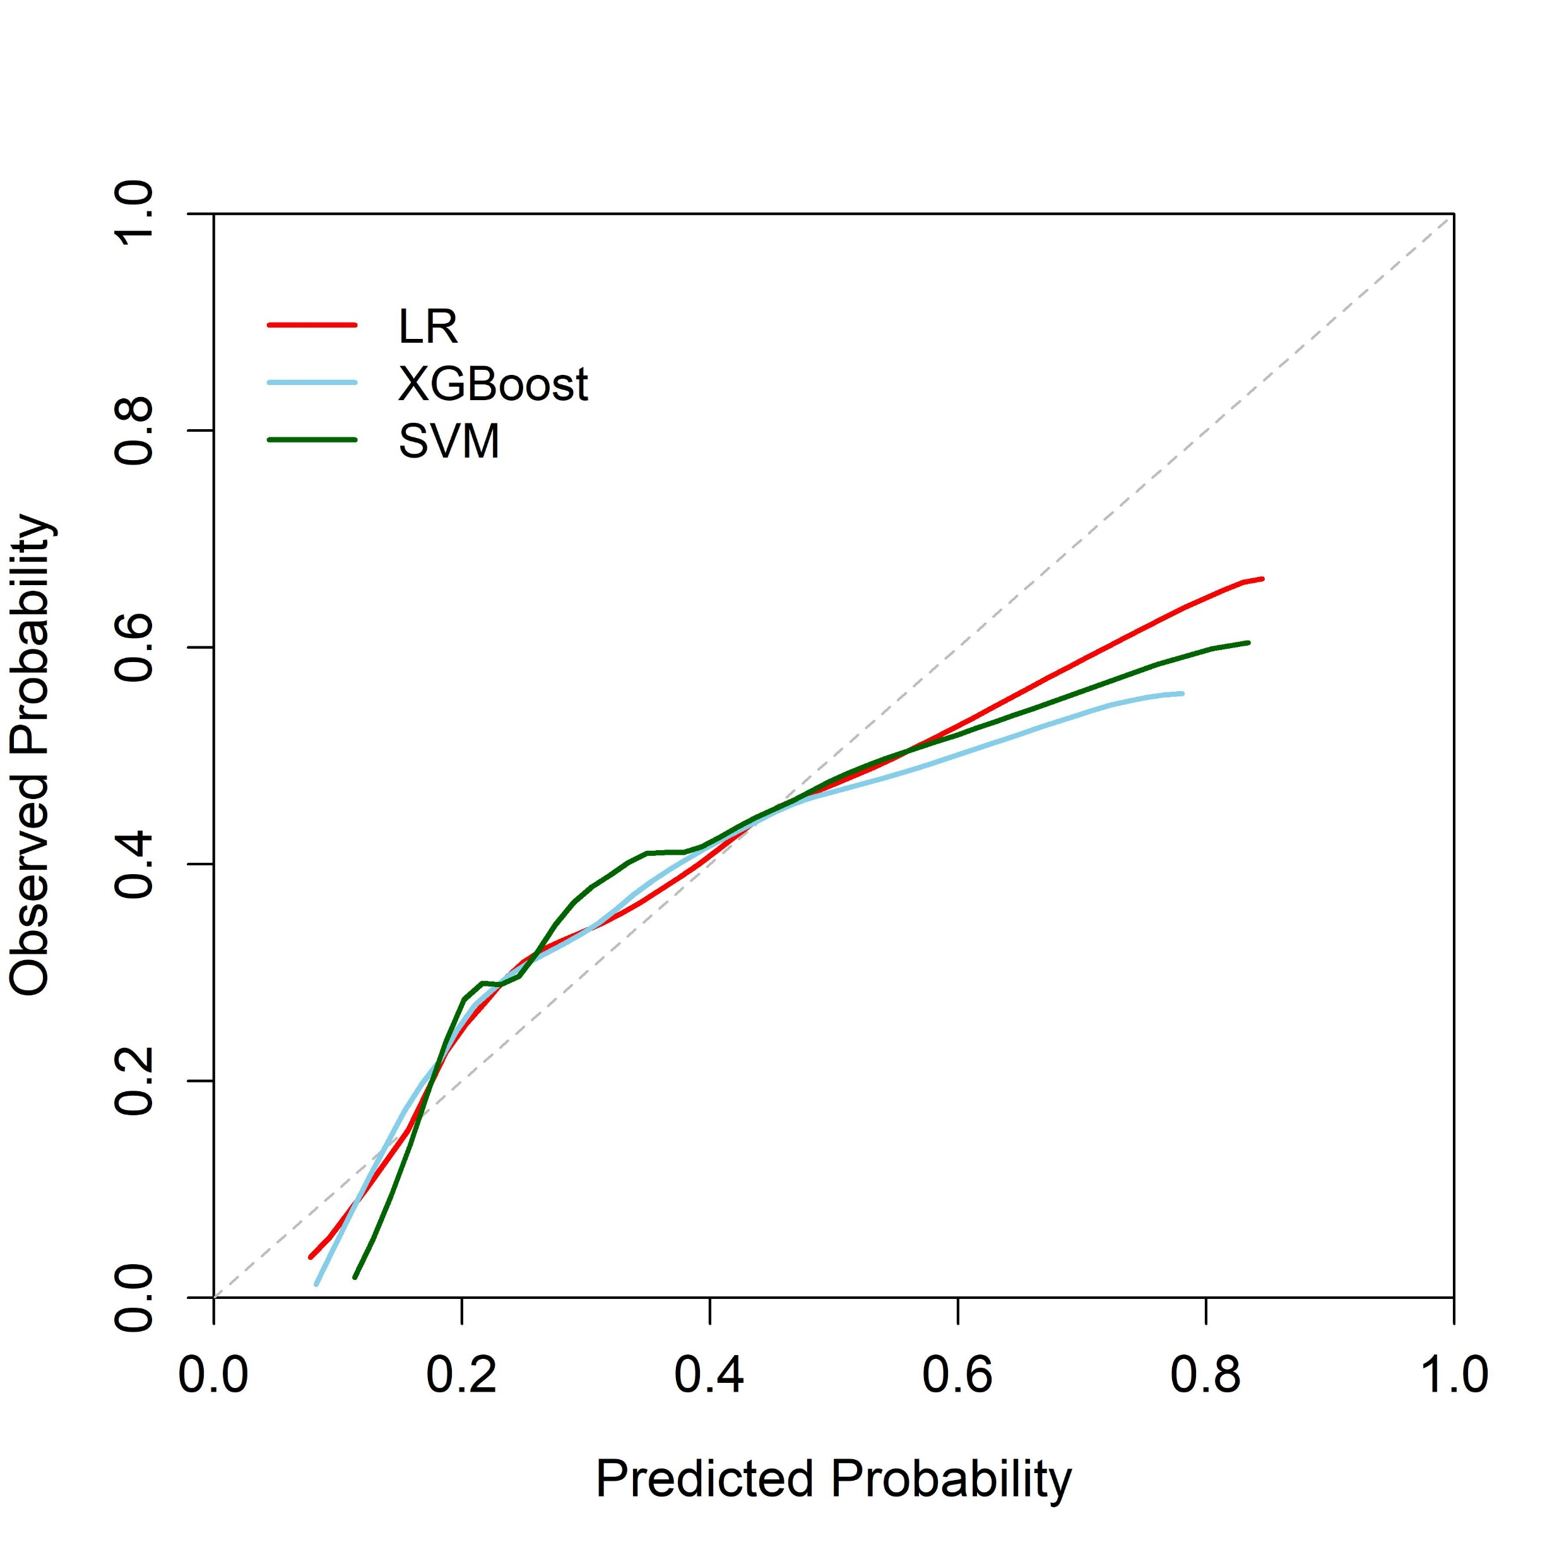
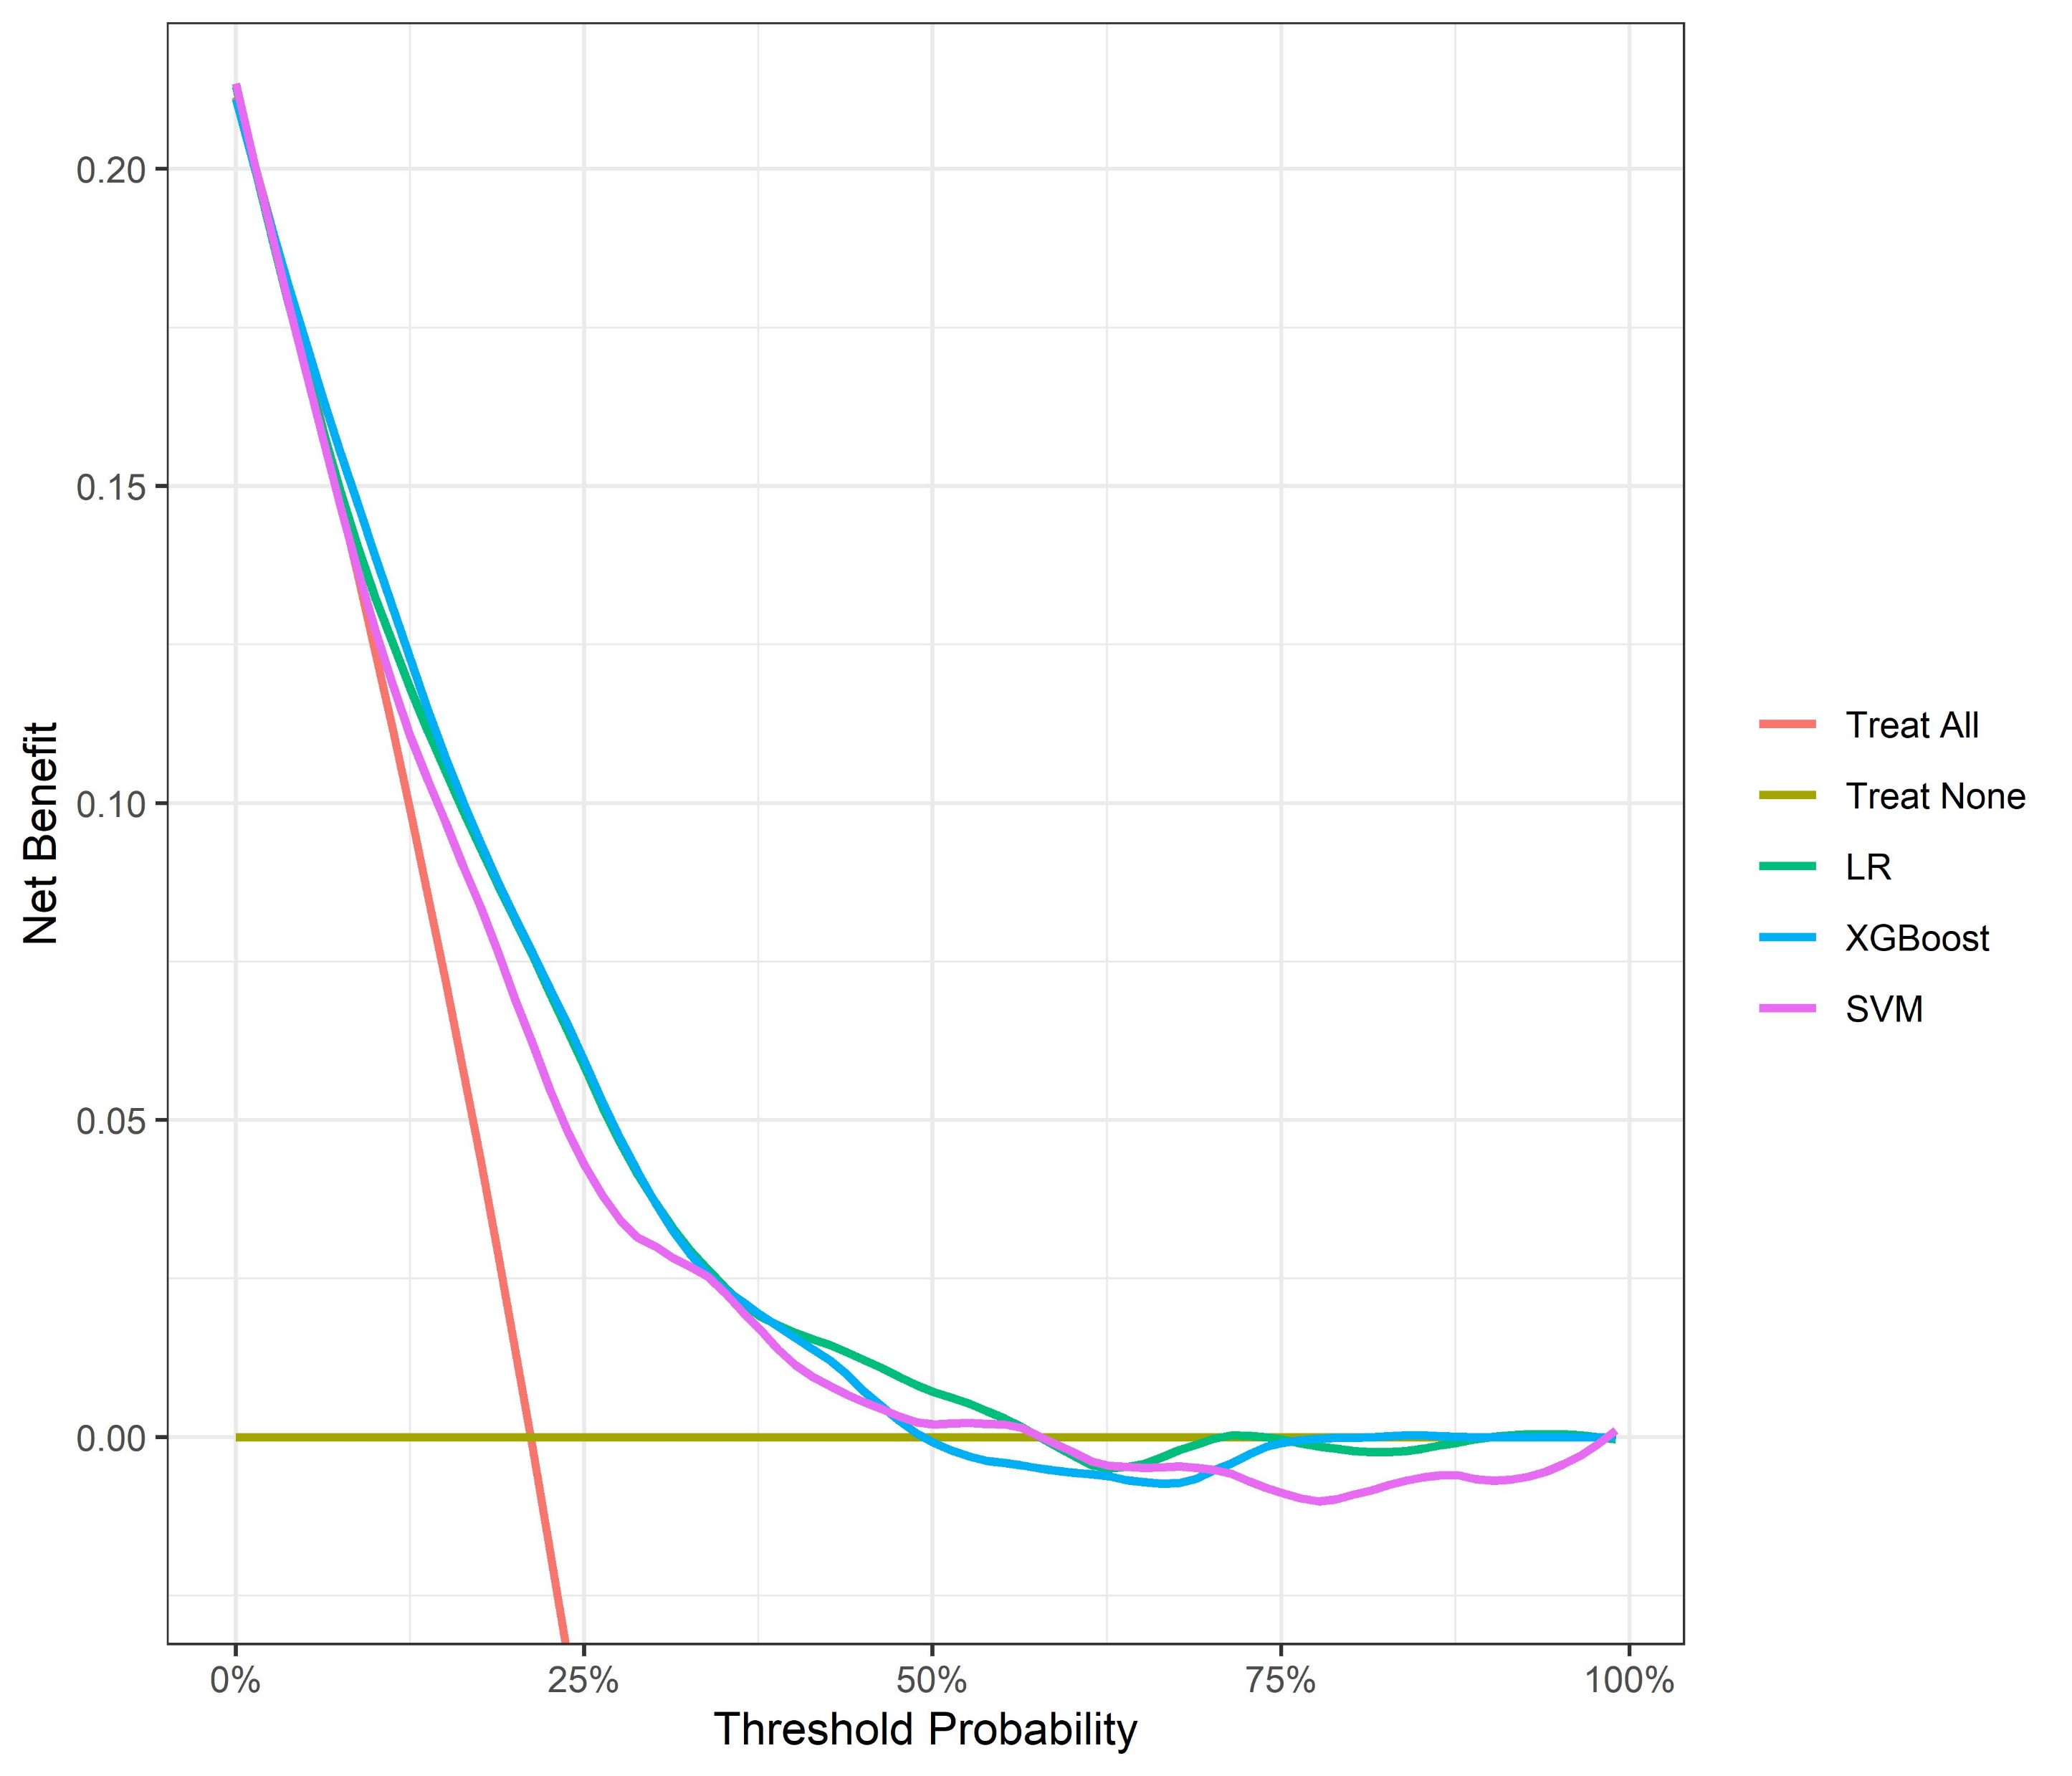
A
B
Figure 4：(A) Calibration curves of the LR, XGBoost, SVM models. (B) Decision curves of the LR, XGBoost, SVM models.
Abbreviations: LR: logistic regression model; XGBoost: extreme gradient boosting model; SVM: support vector machine model.

