Slide 1
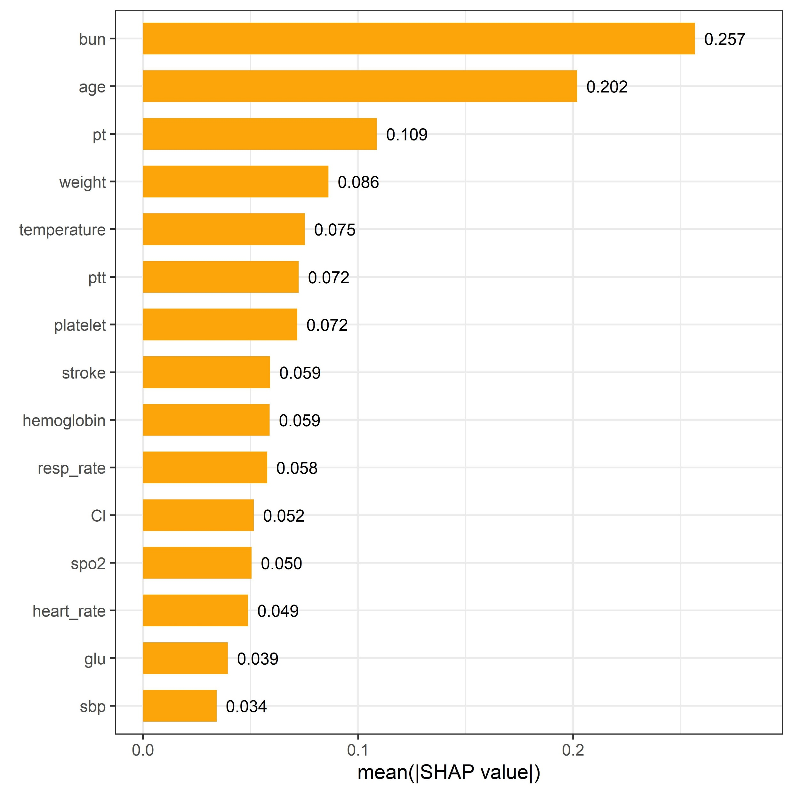
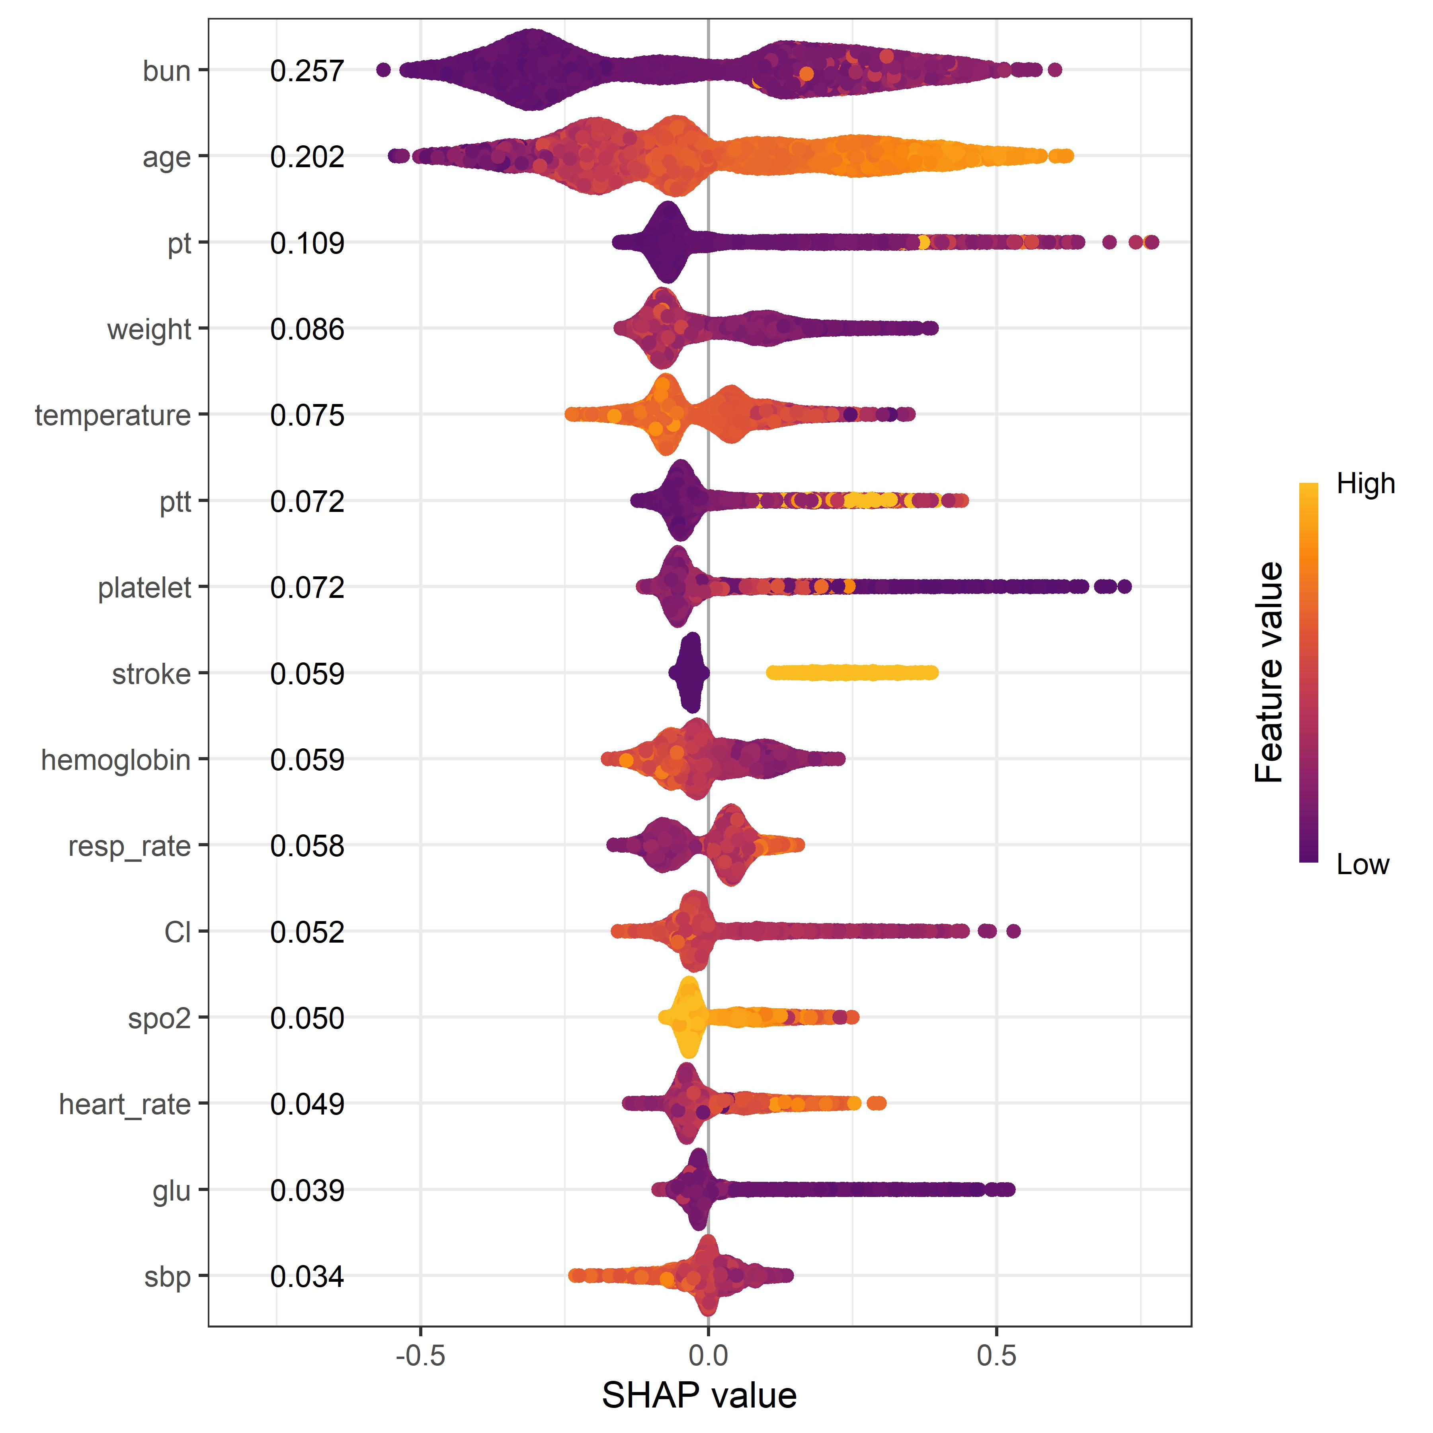
A
B
Figure 5：(A) Feature importance ranking plot of the XGBoost model (top 15 features). (B) SHAP summary plot of the XGBoost model (top 15 features).Abbreviations:
bun: blood urea nitrogen, pt: prothrombin time, ptt: partial thromboplastin time, resp_rate: respiratory rate, Cl: chloride, glu: glucose, sbp: systolic blood pressure.

