Slide 1
🎙️ Voice Command Recognition System
Keyword spotting with a convolutional neural network
on the Google Speech Commands dataset
Deep Learning — Course Project
Aditya

Slide 2
The problem: keyword spotting
Recognize short spoken commands in real time, on small devices
Voice assistants, smart TVs and IoT gadgets all need to hear a few dozen fixed commands — “stop”, “go”, “volume up” — instantly and offline.
Goal: given a 1-second audio clip, output which of 35 command words was spoken.
Constraints: tiny model (fits on a phone), fast inference, robust to background noise.
This is a classification problem — but the input is sound, not an image.

Slide 3
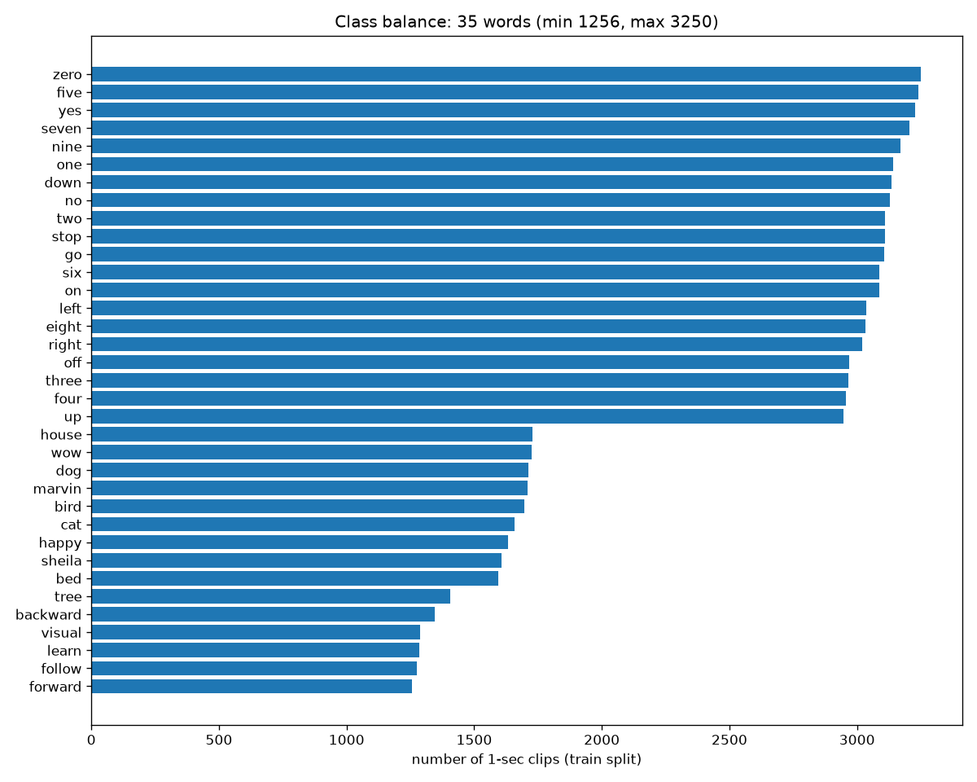
Dataset: Google Speech Commands v0.02
105,829 one-second clips, 16 kHz mono — words like “yes”, “no”, “up”, “down”, “stop”, “go”, plus digits.
35 word classes; official validation/test lists used (no random split) so results are comparable.
Classes are imbalanced — the smallest word class has ~2.6× fewer clips than the largest.
Ships with real background-noise recordings for the robustness study.

Slide 4
Approach: sound → image → CNN
Turn audio into a picture of pitch-over-time, then use image recognition
1. Waveform
16,000 samples
raw air-pressure
wiggle
2. Log-mel
spectrogram
40 × 101
pitch (mel) vs time;
log-scaled, normalized
3. CNN
~1.1M params
learns visual patterns:
hiss, bursts, vowels
4. Softmax
35 words
probability per word;
pick the max
▶
▶
▶
Why mel? It warps pitch the way human ears hear — fine detail at low frequencies, coarse at high ones.
Why log + normalize? Loudness is logarithmic, and neural nets train far better on zero-mean inputs.

Slide 5
Model architecture: KeywordCNN
1,132,707 trainable parameters — small enough to train on a laptop CPU
Input (1 × 40 × 101) log-mel spectrogram
Conv 1→64 (3×3) → BatchNorm → ReLU → MaxPool(2×2) → Dropout(0.25)
Conv 64→128 (3×3) → BatchNorm → ReLU → MaxPool(2×2) → Dropout(0.25)
AdaptiveAvgPool(4×8) → 4096 features (keeps time resolution)
Linear 4096→256 → ReLU → Dropout(0.5) → Linear 256→35 → Softmax
Convolutions detect local time-frequency patterns; pooling gives shift tolerance; dropout + batch-norm fight overfitting.

Slide 6
Training
Optimizer Adam (lr 1e-3), batch 256, cross-entropy loss, 15 epochs.
Learning rate halved automatically when validation accuracy plateaus.
Best checkpoint kept by validation accuracy — test set never touched during training.
Augmentation-free baseline: the numbers below are from clean training only.

Slide 7
Iteration: what the first model taught us
The first trained model stalled at 52.7% — debugging it was the most valuable step
Symptom: validation accuracy plateaued near 53% — under-capacity, not overfitting.
Diagnosis: two stacked 2×2 max-pools crushed the 40×101 spectrogram down to 10×25, throwing away the fine timing detail that separates “three” from “tree”.
Fix: replaced the aggressive pooling with AdaptiveAvgPool(4×8), keeping time-frequency resolution into the dense head.
Result: 52.7% → 63.3% test accuracy (+10.6 points) on the same 15-epoch budget.
Viva-ready lesson: when a model underfits, ask what information the architecture destroys.

Slide 8
Results
Test accuracy 63.33% on 11,005 held-out clips
KeywordCNN (this work)
63.33%
MFCC + linear SVM (classical baseline)
22.66%
Random guessing
2.86%
The CNN beats the classical pipeline by a clear margin — this gap is what deep learning buys us here.

Slide 9
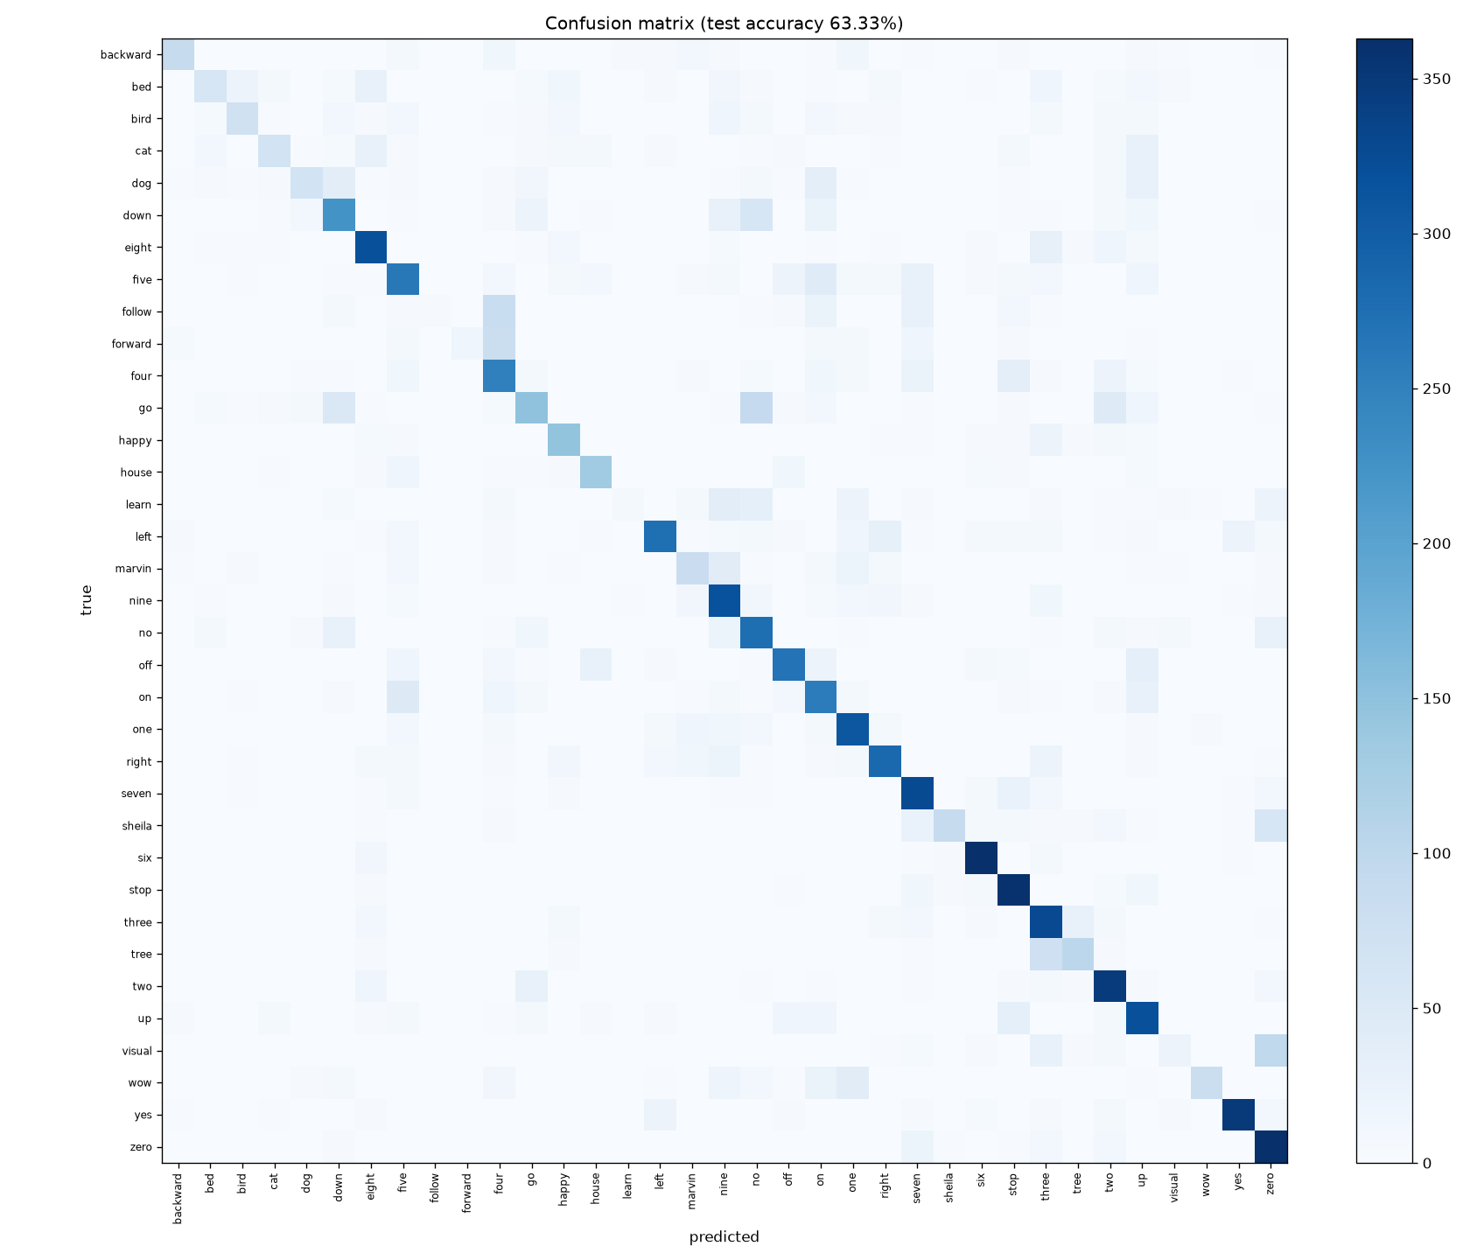
Where does it go wrong? Confusion matrix
Most confused pairs:
go <-> no : 105 confusions
three <-> tree : 100 confusions
visual <-> zero : 97 confusions
five <-> on : 90 confusions
down <-> no : 87 confusions
These are genuinely similar-sounding words — even humans mix them up.

Slide 10
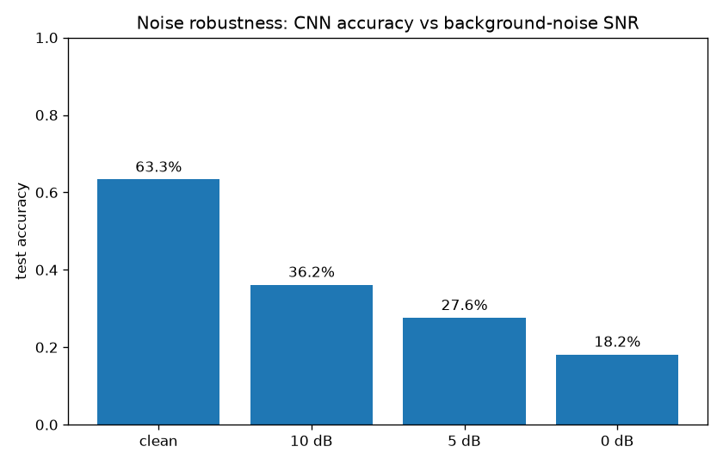
Noise robustness
Real background noise mixed into test clips at controlled SNRs
Accuracy degrades gracefully as noise rises — no cliff-edge failure.
Clean: 63.3% → 0 dB SNR: 18.2%
Practical takeaway: fine-tuning on noisy clips would be the next step.

Slide 11
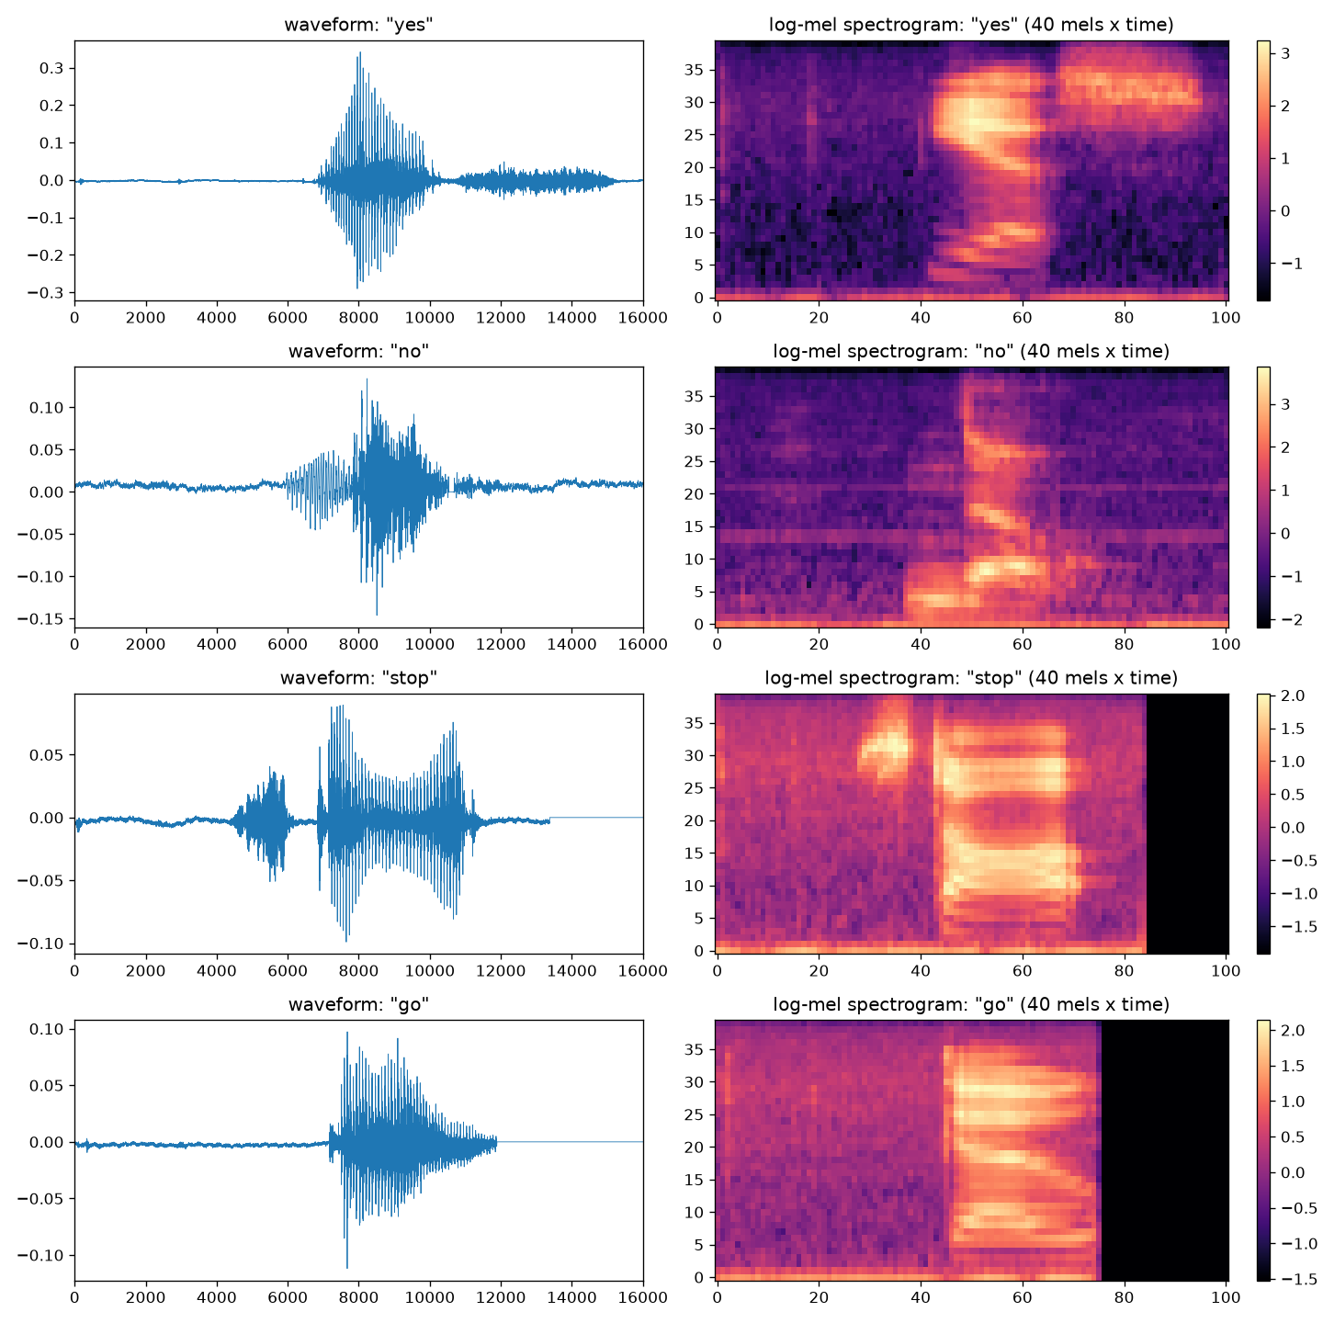
Live demo
Streamlit app — mic recording or .wav upload
Run: streamlit run app/streamlit_app.py
Records 1 second from the browser mic, computes the log-mel, shows top-3 predictions.
A “custom model” toggle loads your fine-tuned weights after you record your own voice.

Slide 12
Personalization & future work
The dataset is mostly North-American accents — record_custom.py + finetune_custom.py adapt the model to YOUR voice (new words become new output classes).
Next steps: train with noise augmentation; try the TinyTransformer in src/models.py; quantize to run on a microcontroller.
Key lesson: representation matters more than model size — a good spectrogram + a 1.1M-param CNN beats a bigger model on raw audio.

Slide 13
Thank you!
Code, docs & trained model: github.com/idityaGE/voice-command-recognition
Questions?

