Slide 1
Coursera Capstone Final Report:
Recommending Universities Based On Nearby Venues
By Isaiah Kaufman

Slide 2
Introduction
Problem:
A larger number of students transfer universities
Transfers are harmful to a university’s reputation and hurts them financially
Not liking the location is a common reason for transferring
Proposed Solution:
Create a model that recommends a university based on nearby venues compared to a location the user inputs
Could be used on site like Niche, which could increase traffic and boost advertising revenue
Universities may invest to target advertising and reduce costs from transfers

Slide 3
Data Sources
UniRank (https://www.4icu.org/us/)
Provides ranked list of accredited universities in the United States
Bing Maps (https://www.bing.com/maps)
Provides latitude and longitude for each unversity
Foursquare (https://developer.foursquare.com/)
Searches for venues near each university

Slide 4
Methods
UniRank, Bing Maps, and Frousquare used to create list of universities with venues.
K means clustering used to cluster universities into 8 clusters based on venues.
JupyterDash used to create dashboard to input the town to compare to universities.

Slide 5
Universities formed 5 clusters
Cluster 1: Parks, scenic spaces, and general natural places.
Cluster 2: High concentration of coffee shops and cafes.
Cluster 3: Breweries, bars, and pizza places.
Cluster 6: Many American restaurants as well as various other restaurant styles.
Cluster 7: Lots of pizza and sandwich place
Clusters 4, 5, and 8 only contained one university, so they were not useful for recommendations.

Slide 6

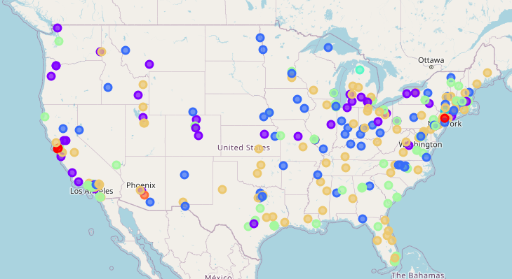
Clusters Mapped
Red: Cluster 1
Purple: Cluster 2
Blue: Cluster 3
Green: Cluster 6
Yellow: Cluster 7
Clusters 4, 5, and 8 are light blue, turquoise, and orange, respectively

Slide 7
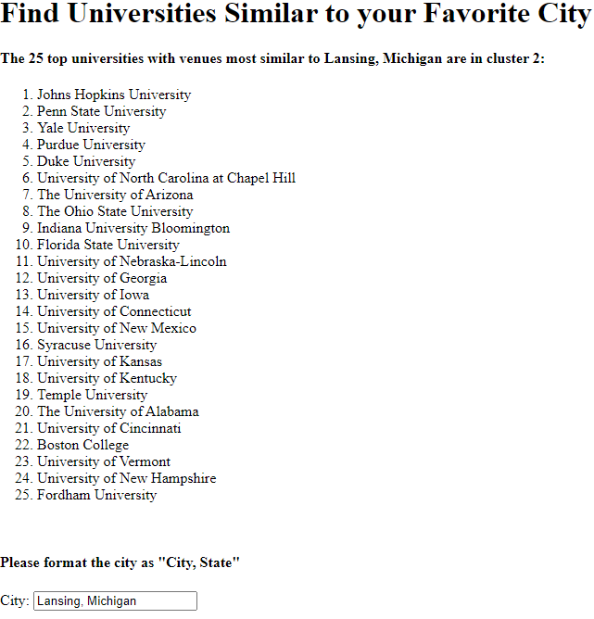
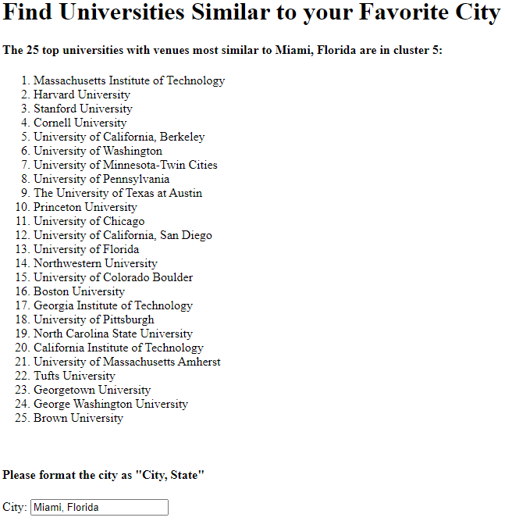
Dash App
Dash app worked as planned, finding cluster for the inputted town and then printing top universities from that cluster:
For example:
Lansing, MI is in cluster 2
Miami, FL is in cluster 5

Slide 8
Discussion
Advantages:
Predicting the cluster of an inputted location can be used to make university recommendations
Could potentially improve student choices
Drawbacks:
Only 5 possible recommendation lists
Clusters are not completely distinct, and universities in different clusters may be very similar
Improvements:
Weight important venues like parks and restaurants more heavily, and remove unhelpful venues like ATMs and intersections
Plot venue frequency values and use distance from inputted location to universities instead of clusters

Slide 9
Conclusion
Improving university recommendations could increase online traffic to sites like Niche and reduce the number of transfers.
I created a model that clusters universities based on venues and then recommends universities based on the venues at an inputted location
The model is limited in its ability to recommend universities based on the clusters.
It could be possible to improve student choice using a model like this one.

