Slide 1
Bluestock Mutual Fund Analytics
ETL, EDA, Performance Analytics, Risk Analytics, Recommender and Power BI Dashboard

Slide 2
Project Scope
Built end-to-end mutual fund analytics pipeline
Cleaned and validated NAV, AUM, SIP, investor, performance, benchmark and portfolio data
Designed SQLite star schema and analytical SQL queries
Created EDA, performance analytics, advanced analytics and Power BI dashboard

Slide 3
Technical Architecture
Raw CSV and live NAV data ingestion
Python-based cleaning and feature engineering
SQLite database with fact and dimension tables
Jupyter notebooks for EDA and analytics
Power BI dashboard for interactive insights

Slide 4
Key Metrics Computed
CAGR for 1-year, 3-year and 5-year periods
Sharpe Ratio and Sortino Ratio
Alpha and Beta using benchmark regression
Tracking Error and Maximum Drawdown
VaR, CVaR, rolling Sharpe and sector HHI

Slide 5
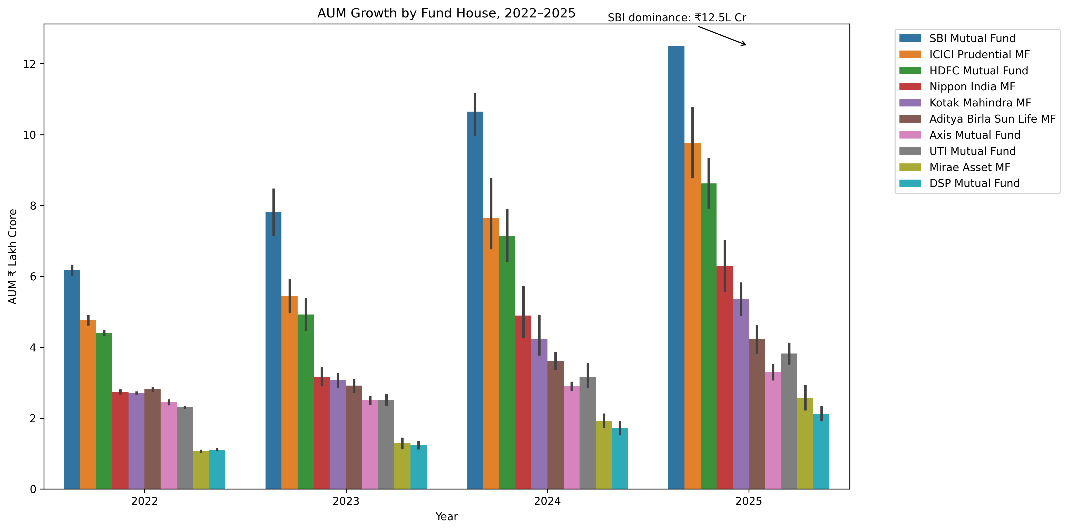
AUM Growth by Fund House

Slide 6
SIP Inflow Trend

Slide 7
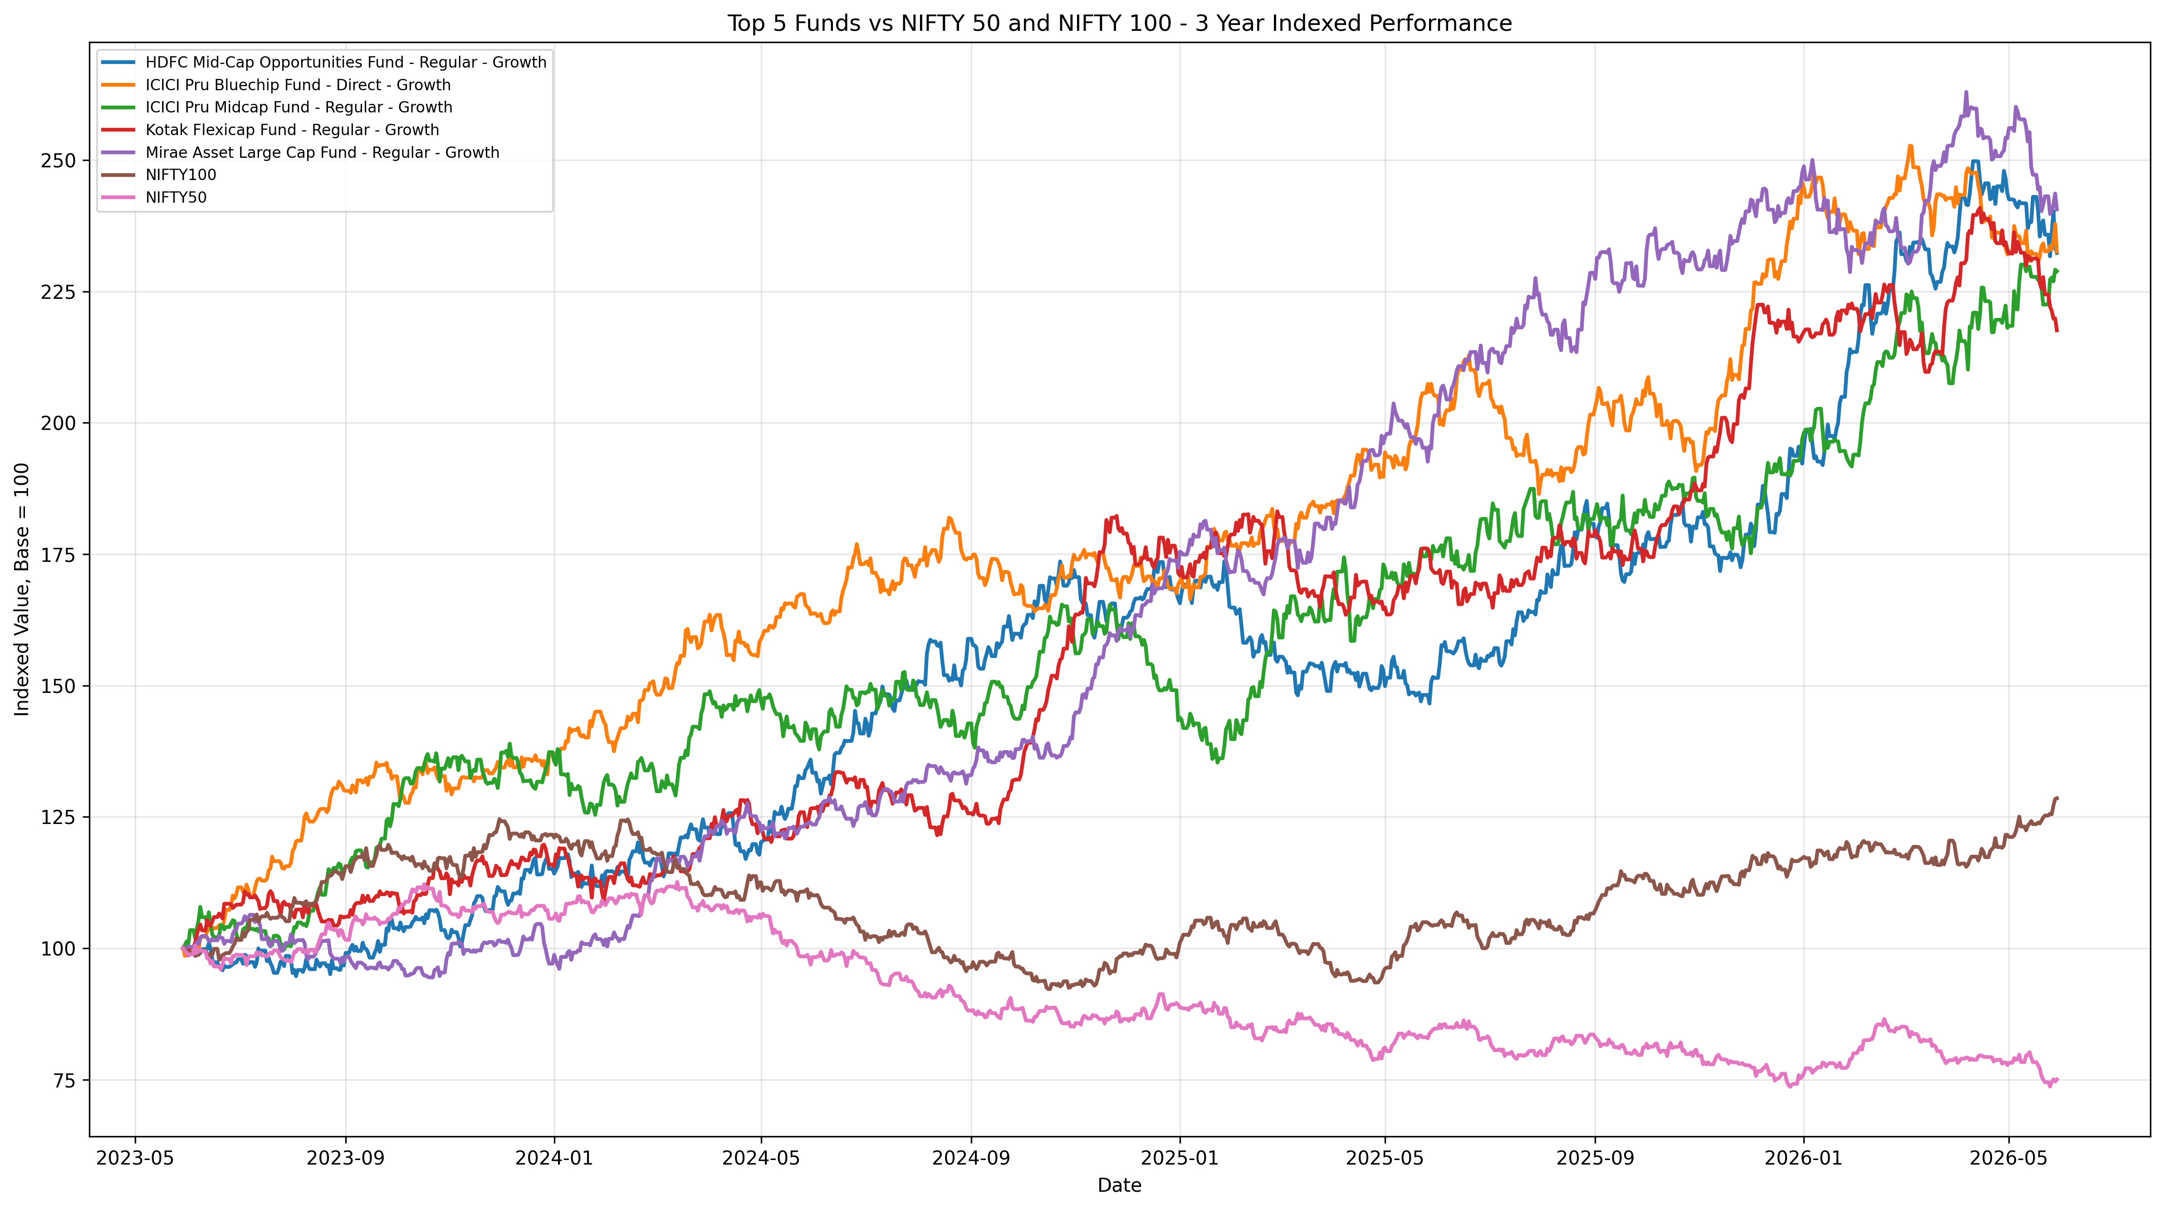
Benchmark Comparison

Slide 8
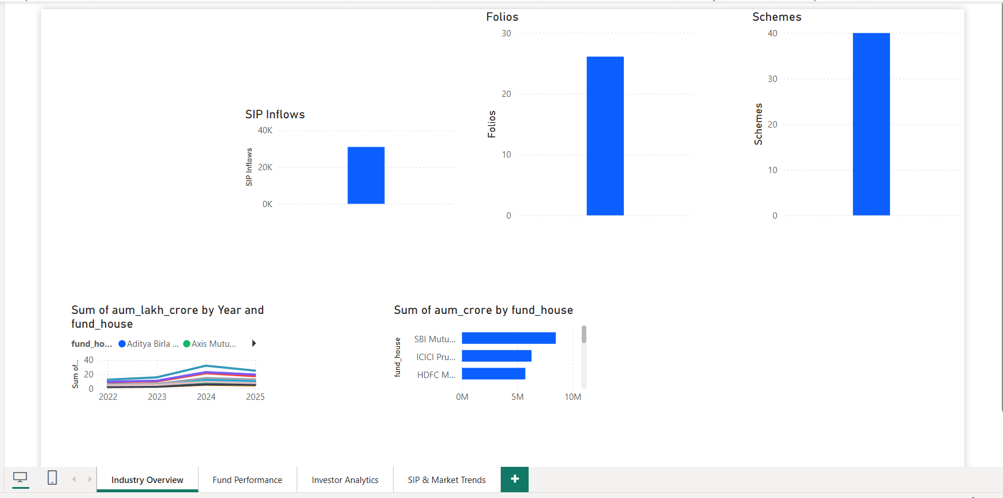
Dashboard: Industry Overview

Slide 9
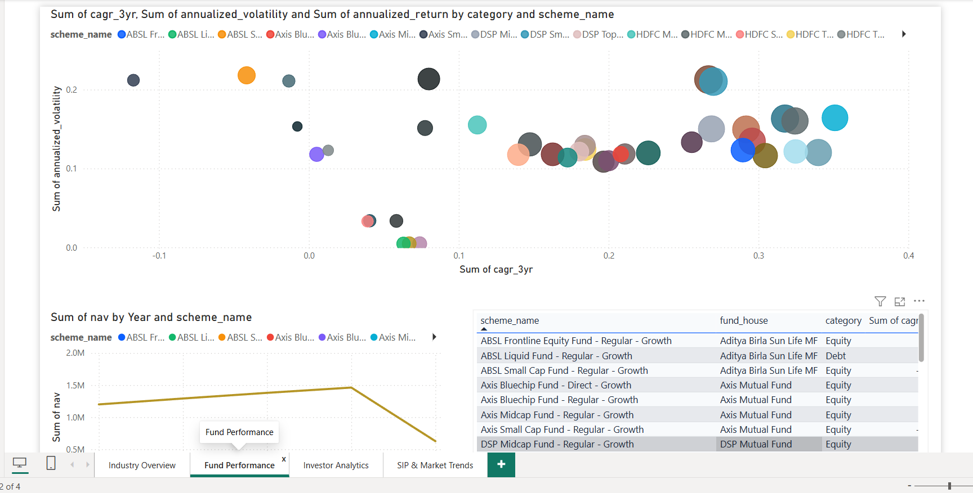
Dashboard: Fund Performance

Slide 10
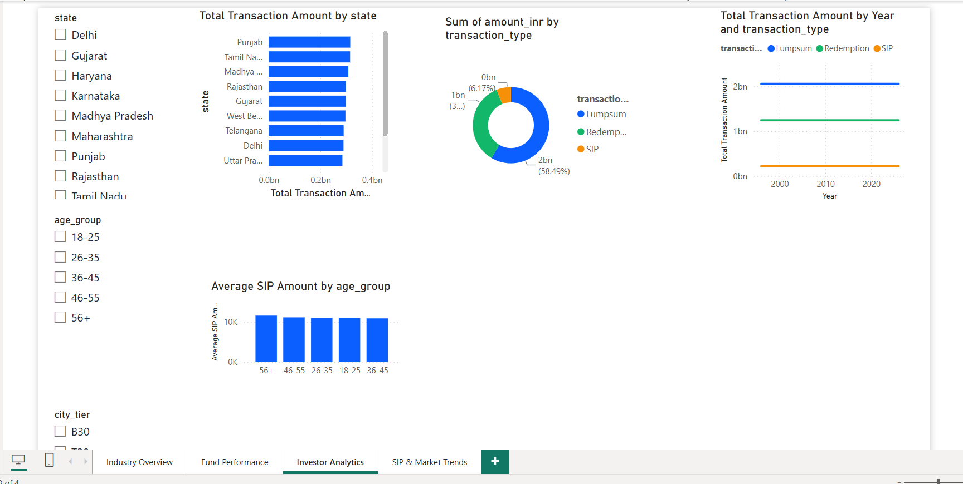
Dashboard: Investor Analytics

Slide 11
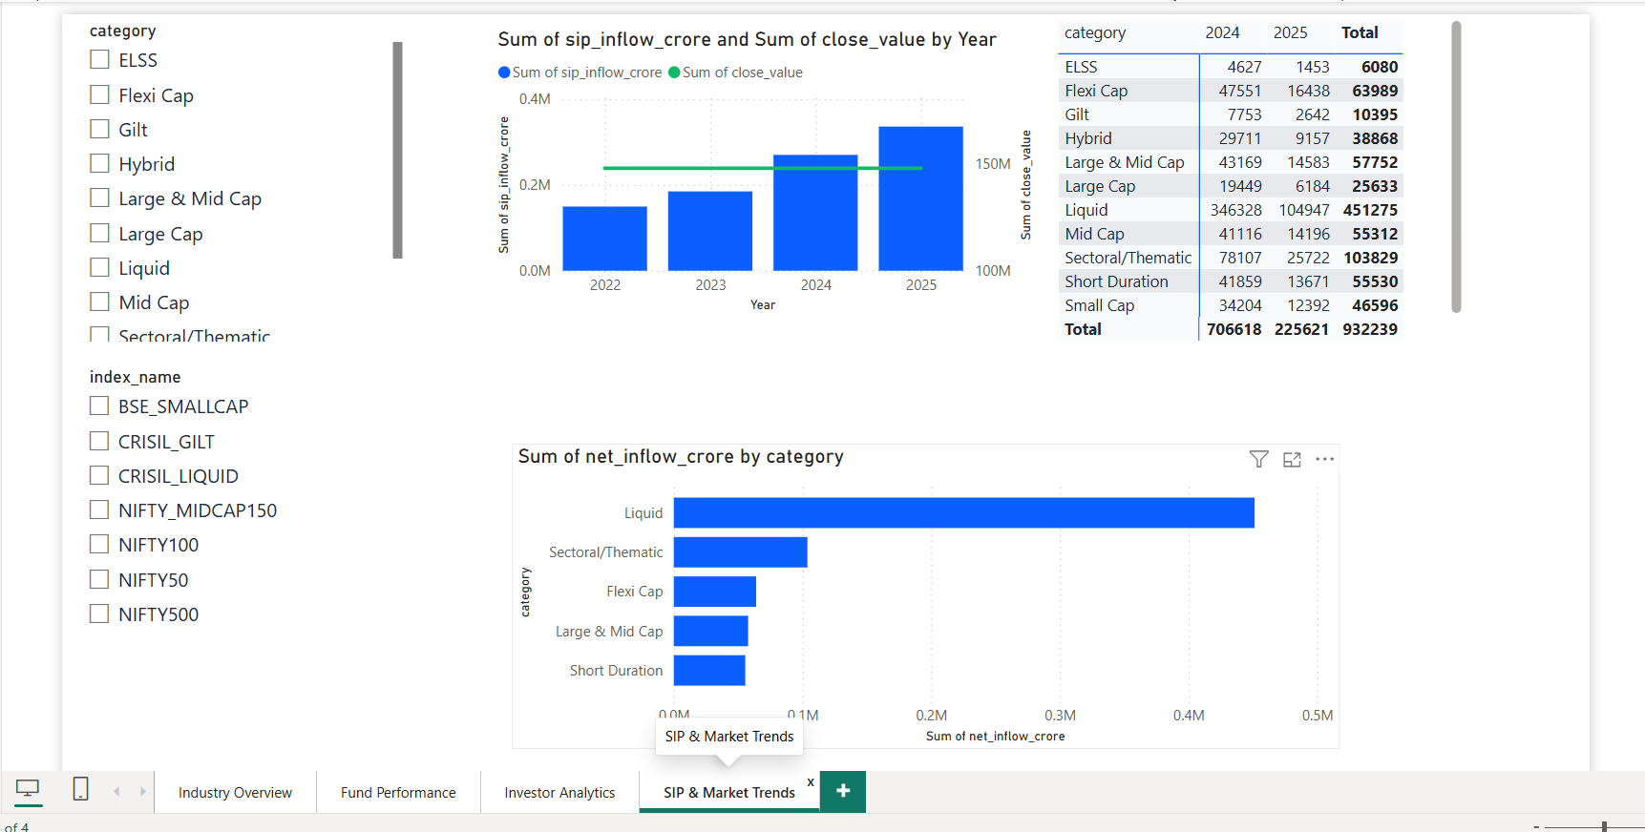
Dashboard: SIP & Market Trends

Slide 12
Advanced Analytics Insights
VaR and CVaR identify funds with higher downside risk
Investor cohort analysis shows year-wise investment behaviour
SIP continuity analysis flags at-risk investors
Sector HHI identifies concentrated equity fund portfolios
Risk appetite recommender suggests top funds by Sharpe Ratio

Slide 13
Conclusion
End-to-end analytics solution completed
Dashboard enables interactive business exploration
Risk and performance metrics improve fund comparison
Project structure is reproducible and submission-ready

