Slide 1

DROWSY DRIVER DETECTION USING MACHINE LEARNING
Technical Seminar
by
Vishak V Kotemane | 221039002
Sandesh B S | 221039004
Under the guidance of
Dr. Mohan Kumar J
Associate Professor
Manipal School of Information Science

Slide 2
Presentation Outline
Introduction
2. Objective
Methodology
Literature Review
Block Diagram
6. Completed Work
7. Inference
8. References

Slide 3
1. Introduction
Serious accidents are frequently caused by driver fatigue and microsleep. However, the early symptoms of weariness can be recognized before a serious problem develops. Real-time drowsiness detection is a basic solution for this problem.
Driver drowsiness is alerted using real-time image processing using open cv and python.

Slide 4
2. Objectives
1. To learn the drowsy driver image concepts and OpenCV.
2. To implement an algorithm for drowsy driver detection using OpenCV.
3. To implement a machine learning model to identify the drowsy driver.

Slide 5
3. Methodology
VIOLA-JONES ALGORITHM:
The program examines numerous tiny subregions of an image (this technique works on a grayscale image) and attempts to identify a face by looking for particular traits in each subregion. Due to the possibility of an image containing numerous faces of varied sizes, numerous places and scales must be checked. In their approach, Viola and Jones exploited Haar-like properties to find faces.
Haar-like features are digital image features used in object recognition. All human faces share some universal properties of the human face. The eye region is darker than its neighbor pixels, and the nose region is brighter than the eye region.
Input Image
Integral Image
Haar-Feature Selection
AdaBoost classifier
Cascading decision
Figure 1: Viola Jones algorithm

Slide 6
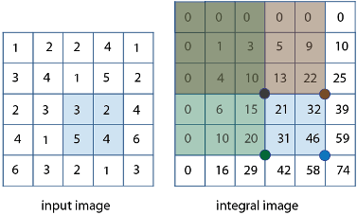

Integral image
A summed-area table is a data structure and algorithm for quickly and efficiently generating the sum of values in a rectangular subset of a grid.
where I(x,y) is the value of the pixel at (x,y).
(a)
(b)
Figure 2: (a)Input image (b) Integral image

Slide 7
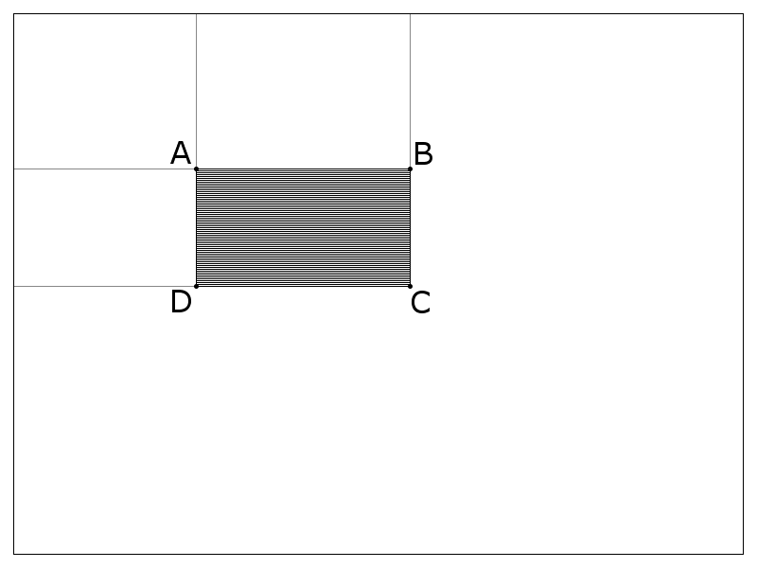
SELECTING HAAR-LIKE FEATURES:
A Haar-like feature considers adjacent rectangular regions at a specific location in a detection window, sums up the pixel intensities in each region, and calculates the difference between these sums. This difference is then used to categorize subsections of an image.
Sum = I(C) + I(A)-I(B)-I(D)
, where points A, B, C, and D belong to the integral image I, as shown in the figure.
Figure 3: Finding sum of shaded region

Slide 8
AdaBoost Classifier:
AdaBoost is used during the training phase of the Viola-Jones object detection algorithm to choose a subset of features and build the classifier.
A vast collection of photos is created, whose dimensions match those of the detection window.
Both positive and negative examples for the desired filter (such as just front views of faces) must be included in this set (nonfaces).

Slide 9
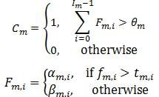
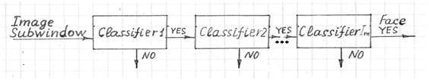
Cascading decision:
The classifier decision is defined as:
f_{m,i} is the weighted sum of the 2-D integrals. is the decision threshold for the i-th feature extractor. α_{m,i} and β_{m,i} are constant values associated with the i-th feature extractor. θ_{m} is the decision threshold for the m-th classifier.
Figure 4: Object detection via Viola Filter

Slide 10
4. Literature Review
Paper [1]:
In this experiment large number of videos were taken and their accuracy in determining eye blinks and drowsiness was tested.
When the webcam backlight was turned ON and the face is kept at an optimum distance, then the system is able to detect blinks as well as drowsiness with more than 95% accuracy
Paper [2]:
the program can detect the face region, eye region, and open eye region.
When the eyes are closed, the open eye region is not detected, which returns zero.
Alcohol sensor was also used.
Paper [3]:
Haar Cascade is used with Adaboost training, a machine learning adaptive algorithm to improve the accuracy and performance of the system.
This experiment has been done with Raspberrypi, Harr classifier cascades, and Circle Hough Transform in OpenCV.

Slide 11
5. Block Diagram
Webcam On
Detect Face and eyes
Extract features of eyes
eyes =closed
TRUE
Sound Alarm
(Duration 3secs)
FALSE
Figure 5: Block diagram for webcam detection

Slide 12
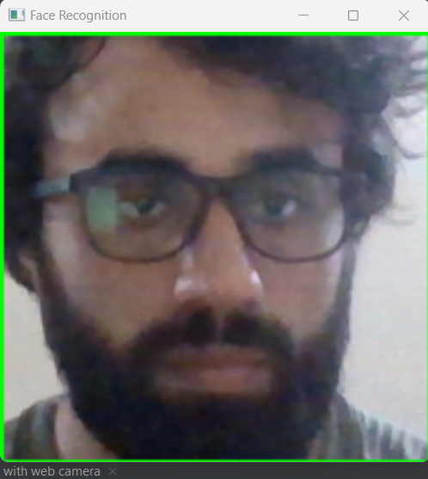
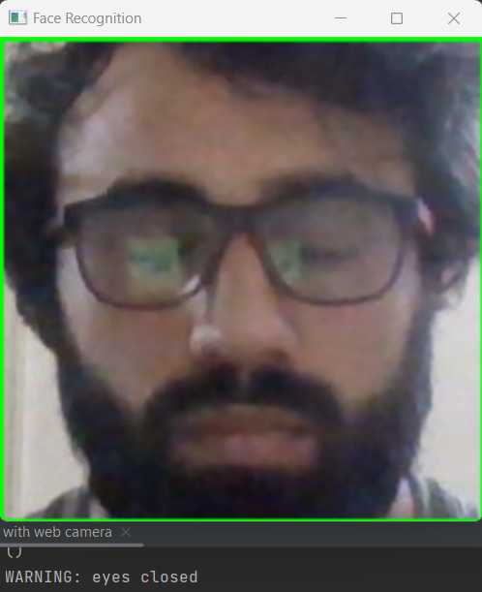
6. Completed Work
SIMULATION RESULTS:
Figure 6: Detection of face successful
Figure 7: code output for closed eyes

Slide 13
7. Inference
The driver's eyes are located, monitored, and used to quickly detect tiredness as part of the real-time drowsiness detection system.
This method enables the machine to recognize closed eyes (sleep condition).
After determining the sleep condition, the real-time system sounds an alert.

Slide 14
8.References
Danisman, T., Bilasco, I.M., Djeraba, C. and Ihaddadene, N., 2010, October. Drowsy driver detection system using eye blink patterns. In 2010 International Conference on Machine and Web Intelligence (pp. 230-233). IEEE.
Sarkar, D. and Chowdhury, A., 2014. A real time embedded system application for driver drowsiness and alcoholic intoxication detection. International Journal of Engineering Trends and Technology, 10(9), pp.461-465.
Musale, T. and Pansambal, B., 2016. Real Time Driver Drowsiness Detection system using Image processing. Research in Engineering Application & Management (IJREAM), 2(08).

Slide 15
Queries
&
Suggestions

Slide 16
THANK YOU…

