Slide 1

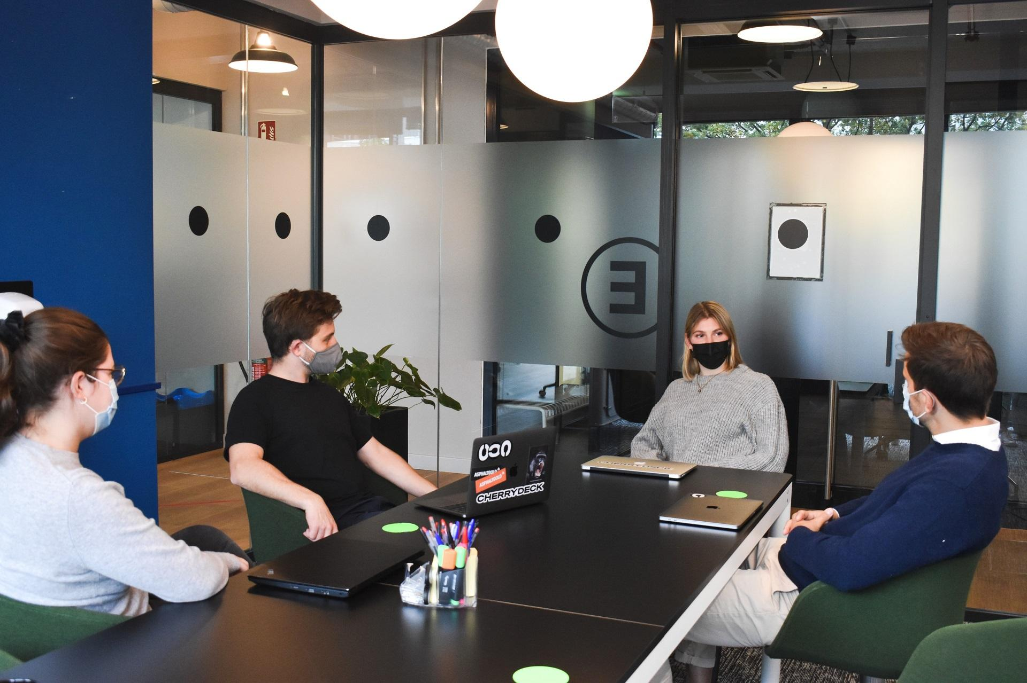
AUDIT MANAGEMENT SYSTEM
Guided By-
Dibakar Sanyal
Supervised By-
Aiswariya N

Slide 2
POD MEMBERS
PRANITHA BOKKOLLA (919512) (LEAD)
ARYAN (919730)
DEEPAK KUMAR SAHOO (919696)
SOHAIL AHEMAD MOHAMMAD (919182)

Slide 3
PROBLEM STATEMENT
A leading Supply chain Management Organization wants to automate the Audit processing, to make the management scalable and ensure clarity and ease of tracking. Organization want us to develop an audit management system. We were requested to develop and deploy four microservice and deploy them in Amazon web services(AWS). We were also needed to build UI on angular.

Slide 4












TECHNOLOGIES USED

Slide 5
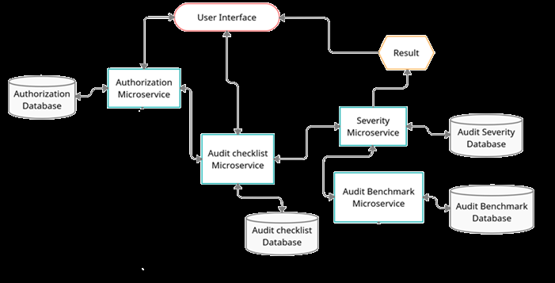
FLOW OF THE PROGRAM
User Interface
Result
Authorization database
Authorization
Microservice
Severity
Microservice
Audit severity database
Audit Checklist
Microservice
Audit Benchmark
Microservice
Audit Benchmark database
Audit checklist database

Slide 6
INDIVIDUAL MICROSERVICE’S FLOW-DIAGRAM
AuditBenchmark Microservice
Benchmark Service
Benchmark Repository
Severity Microservice
Get request
“/AuditBenchmark”
Benchmark Controller
getBenchmarks()
getBenchmarks()
getBenchmarks()
BenchmarkNoAnswers
BenchmarkNoAnswers
BenchmarkNoAnswers
BenchmarkNoAnswers
DATABASE

Slide 7
AuditChecklist Microservice
Get request
@Pathvariable Audit Type
@RequestHeader token
Checklist Controller
Checklist Service
Checklist Repository
Else
Else
USER INTERFACE
getQuestions(token, auditType)
findByType(auditType)
findByAuditType(auditType)
List of Audit Questions
List of Audit Questions
List of Audit Questions
If Invalid token
If Invalid type
List of Audit Questions
DATABASE
AuthorizationException Thrown
InvalidAuditTypeException thrown

Slide 8
AuditSeverity Microservice
Checklist Client
Benchmark Client
saveResponses(token, QuestionBank)
getBenchmarks()
User response
Acceptable number of No’s
Post request
@RequestBody AuditRequest
@RequestHeader token
Severity Controller
Severity Service
Request Repository
USER INTERFACE
Else
saveResponse(auditRequest){
createResponse(acceptableNo, List<QuestionBank>)}
saveRequest(auditRequest)
projectExecutionStatus(auditRequest, token)
save(auditRequest)
Status and remedial action duration
Status and remedial action duration
saveResponse(auditRequest)
Response Repository
AuditRequest
If Invalid token
save(auditResponse)
DATABASE
AuditResponse
AuthorizationException Thrown
DATABASE

Slide 9
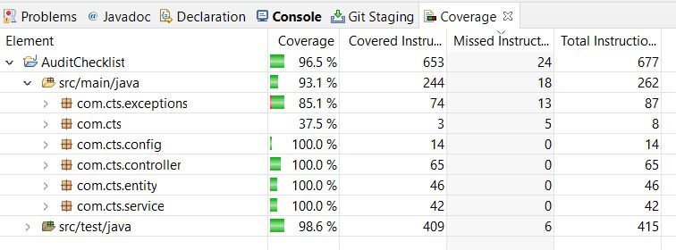
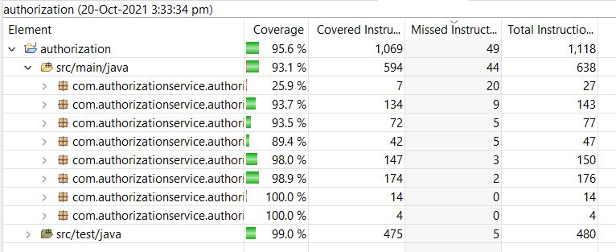
CODE COVERAGE
AuditChecklist Microservice
Authorization Microservice

Slide 10
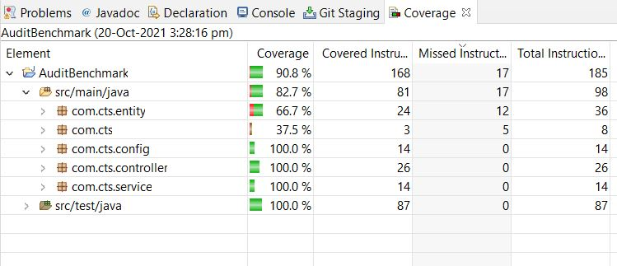
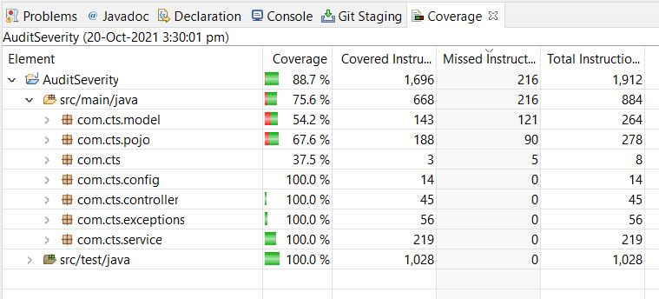
AuditBenchmark Microservice
AuditSeverity Microservice

Slide 11
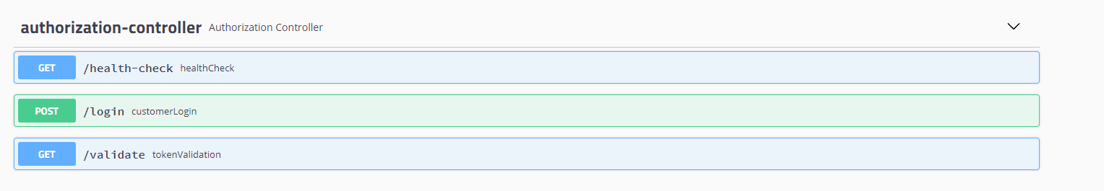
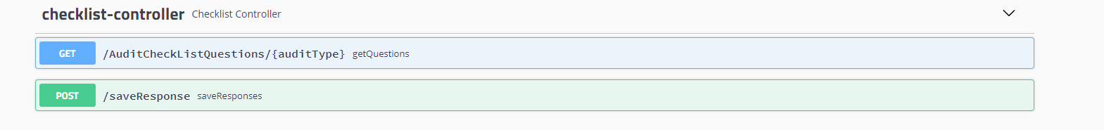
SWAGGER IMPLEMENTATION

Slide 12
SWAGGER IMPLEMENTATION CONTINUED..

Slide 13
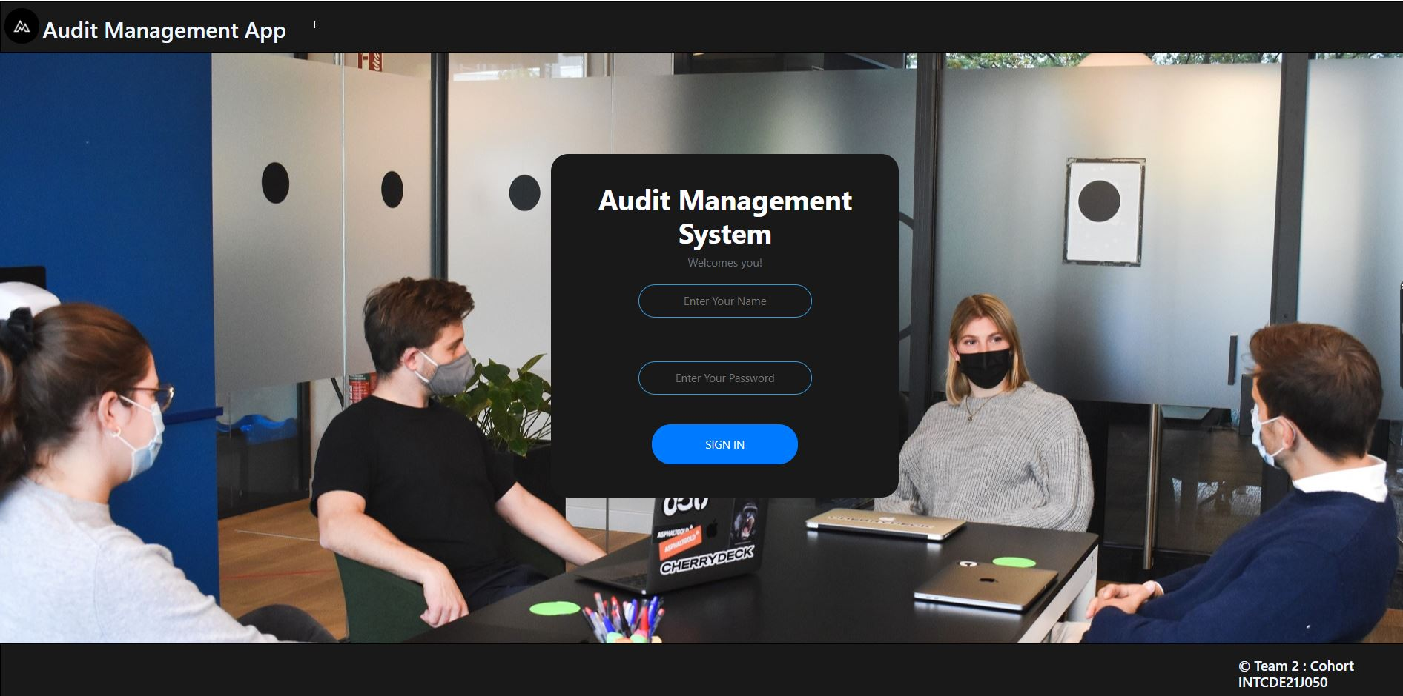
LOGIN SCREEN

Slide 14
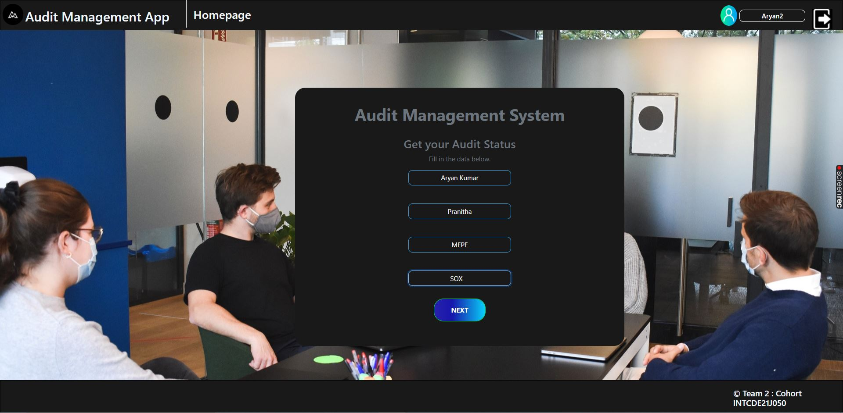
AUDIT DETAILS

Slide 15
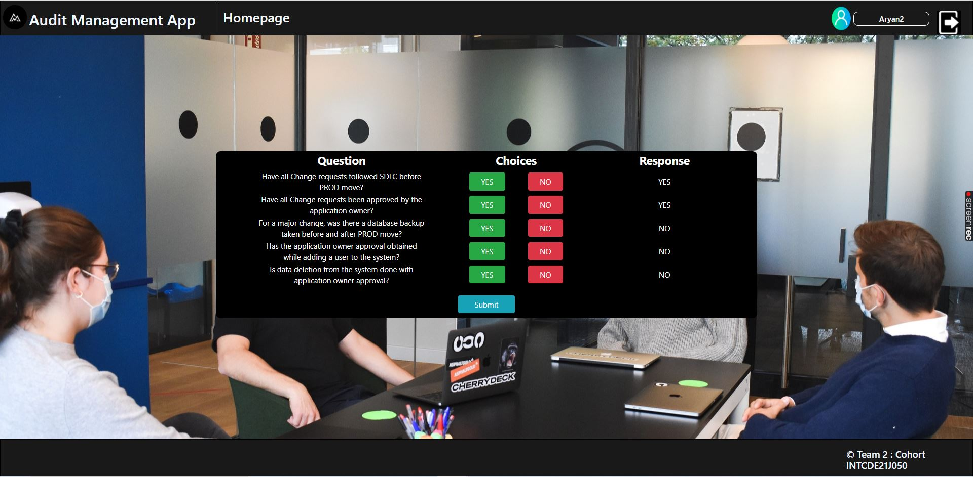
AUDIT QUESTIONS

Slide 16
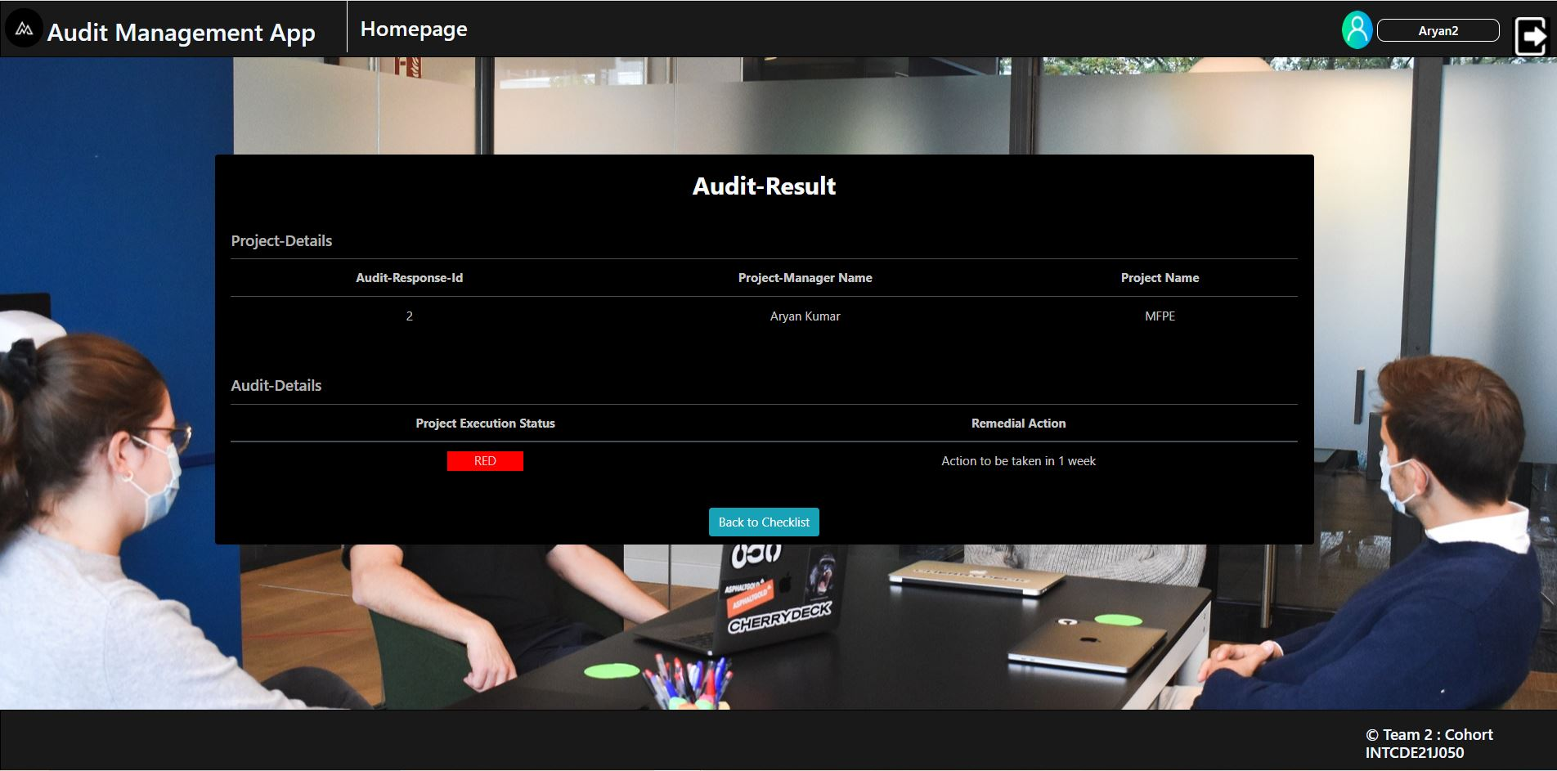
RESULT

Slide 17
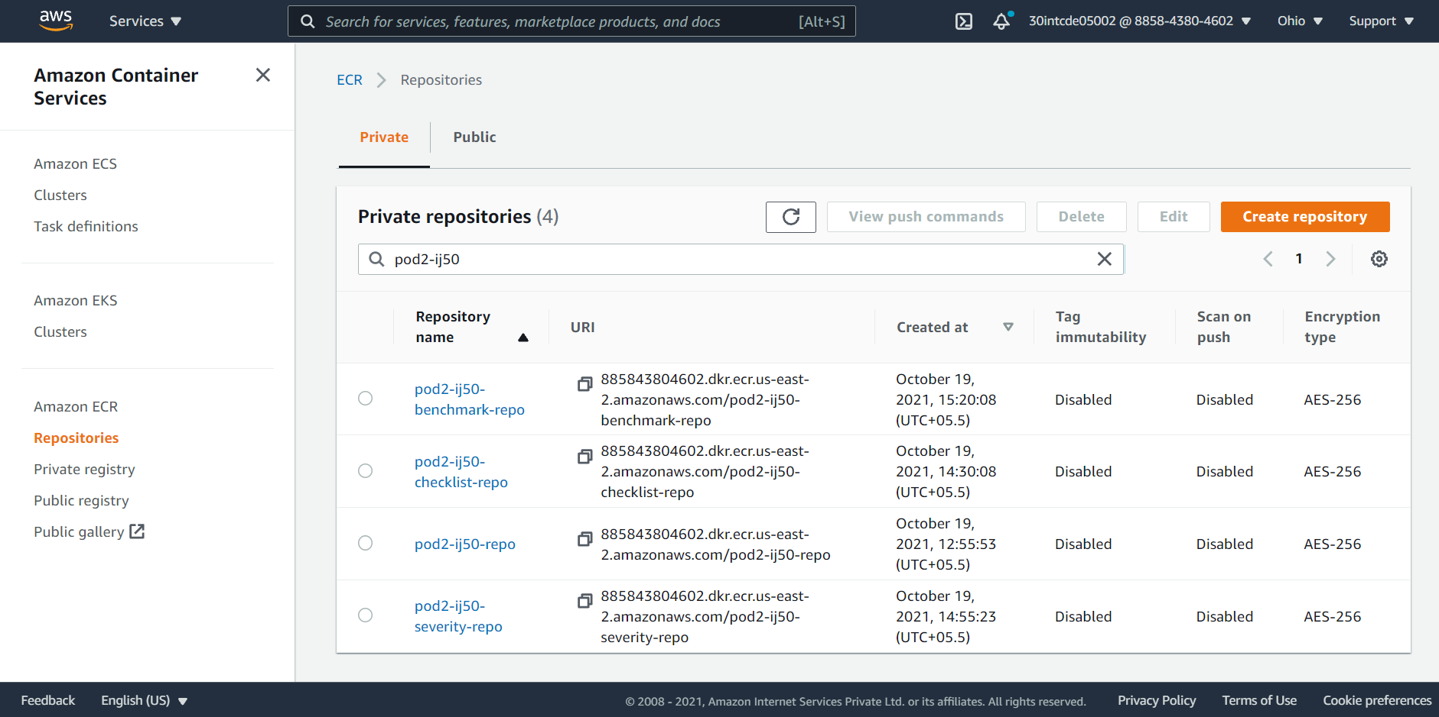
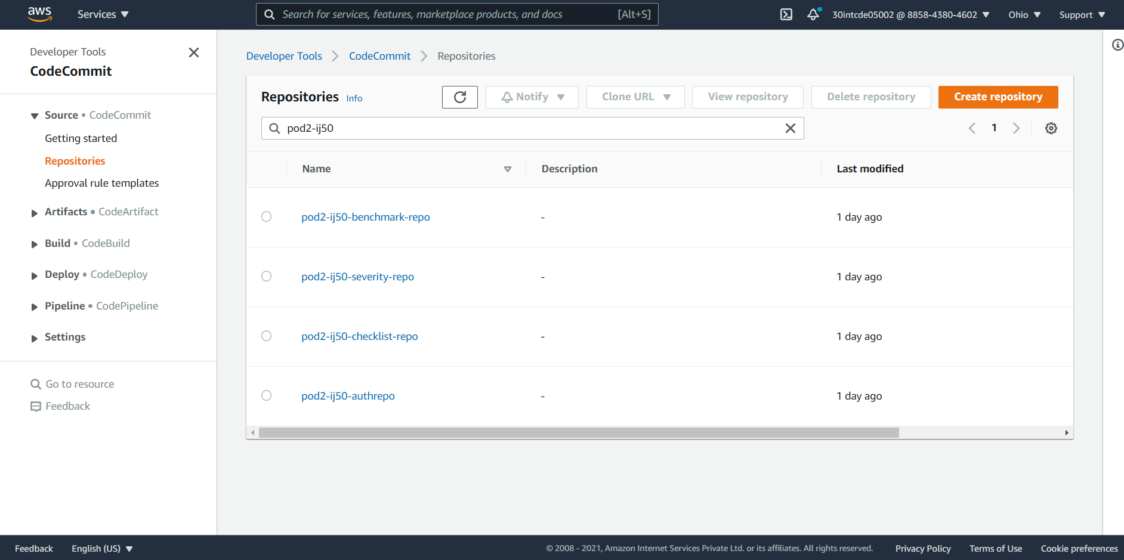
DEPLOYMENT IN AWS-> (USING CI/CD PIPELINE)
CODE COMMIT
ECR REPOSITORIES

Slide 18
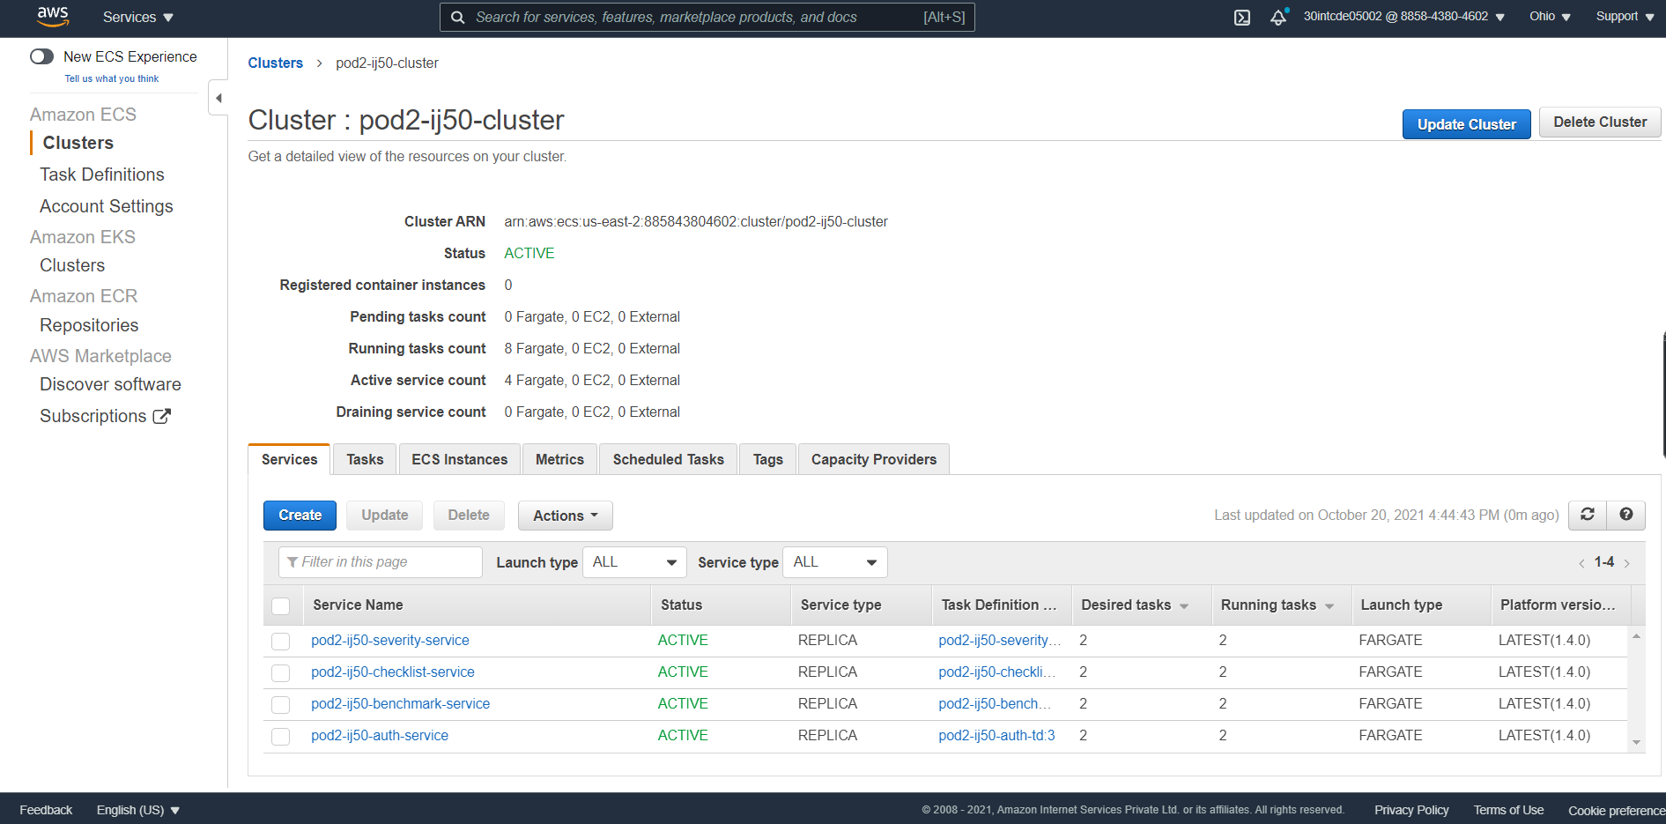
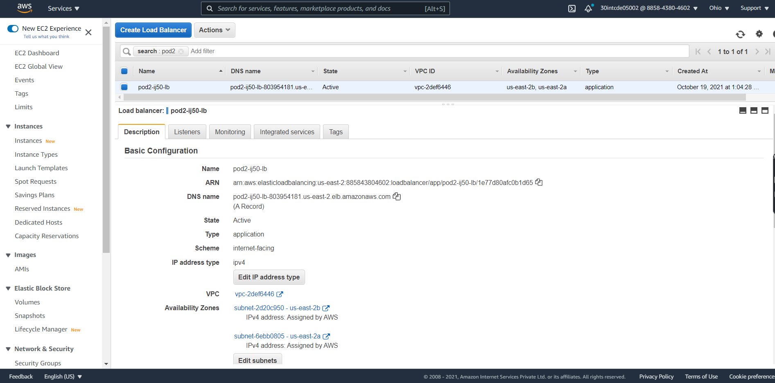
ECS CLUSTER & SERVICES
LOAD BALANCER

Slide 19
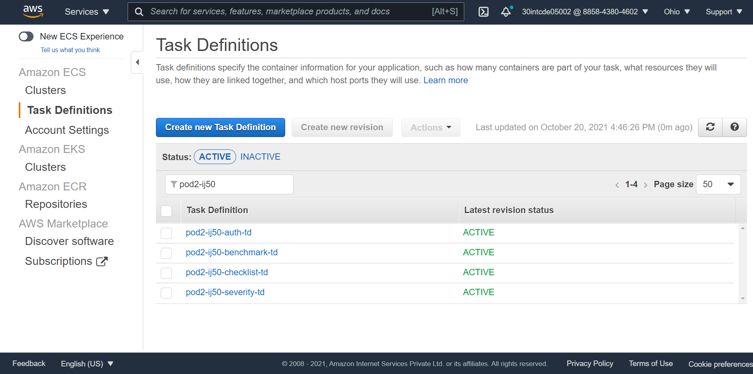
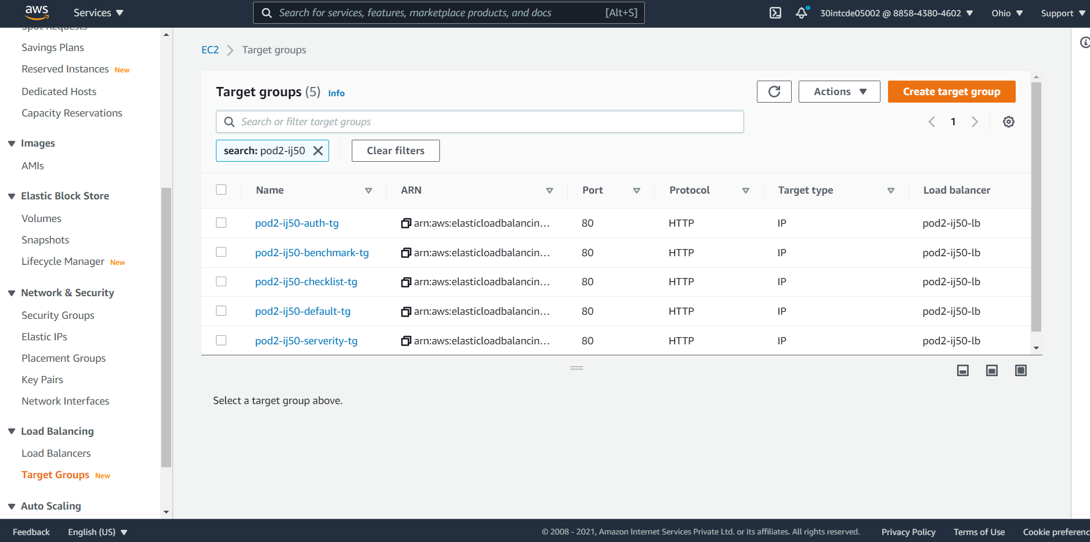
TARGET GROUPS
TASK DEFINITIONS

Slide 20
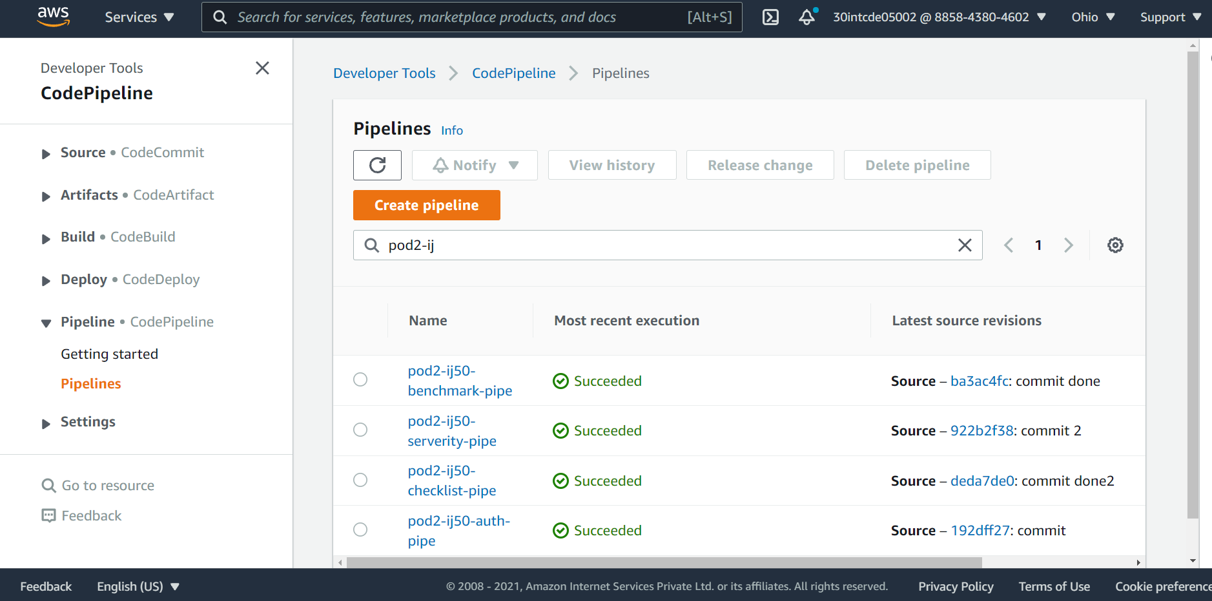
PIPELINES

Slide 21
OVERCOMING THE HURDLES
Overcoming CORS-Cross-Origin Resource Sharing error
Implementing hot keys in angular app
Designing Audit severity microservice…

Slide 22
FUTURE ENHANCEMENTS
A section can be provided where the last entered audit type details and responses can be displayed.
A profile section can provided where user can see his credentials and can update them if required from the portal itself.

Slide 23
THANK YOU!

