Slide 1
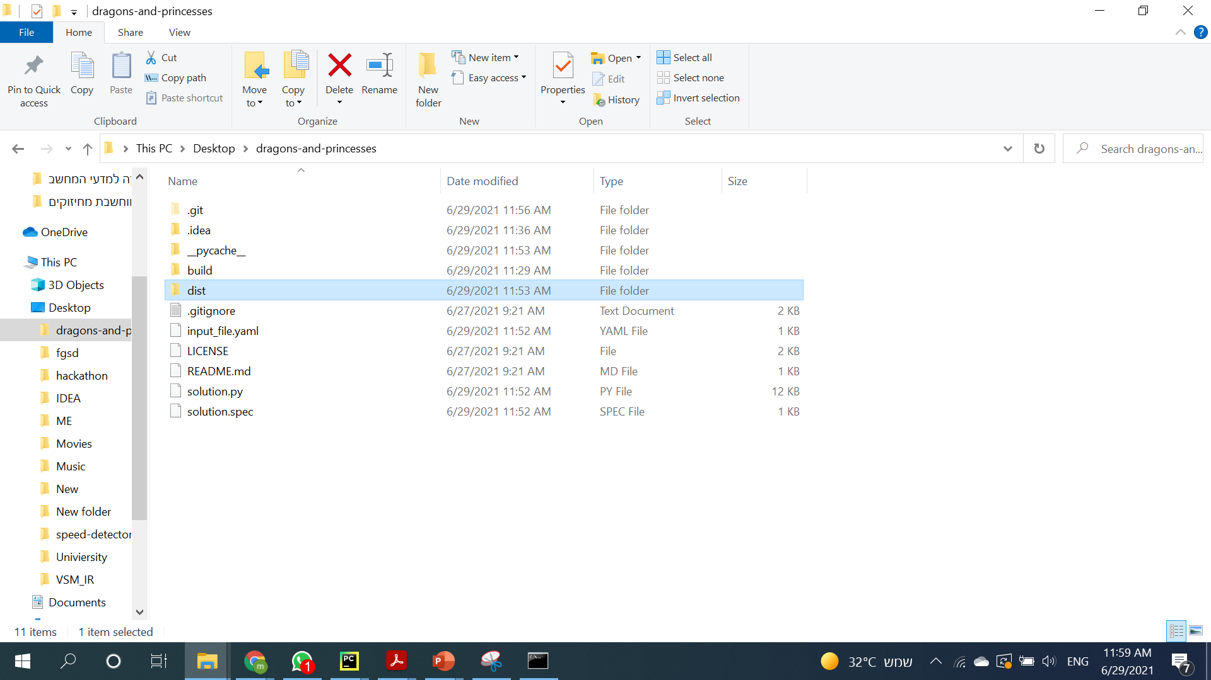
Go to dist folder in the main project folder

Slide 2
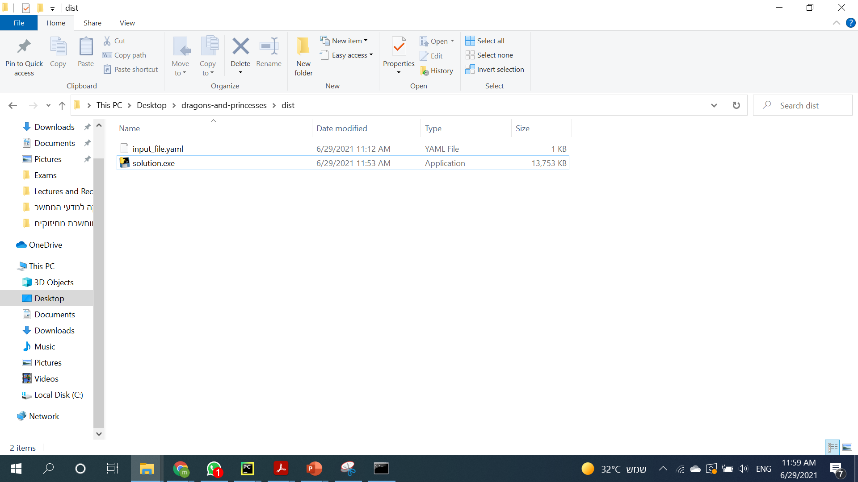
Double click on solution.exe

Slide 3
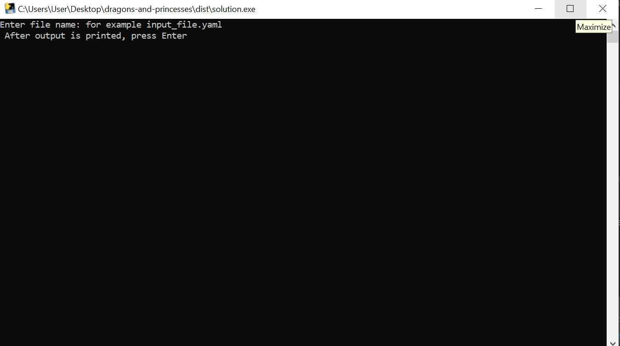
The exe was made using pyinstaller
Insert file name and location

Slide 4
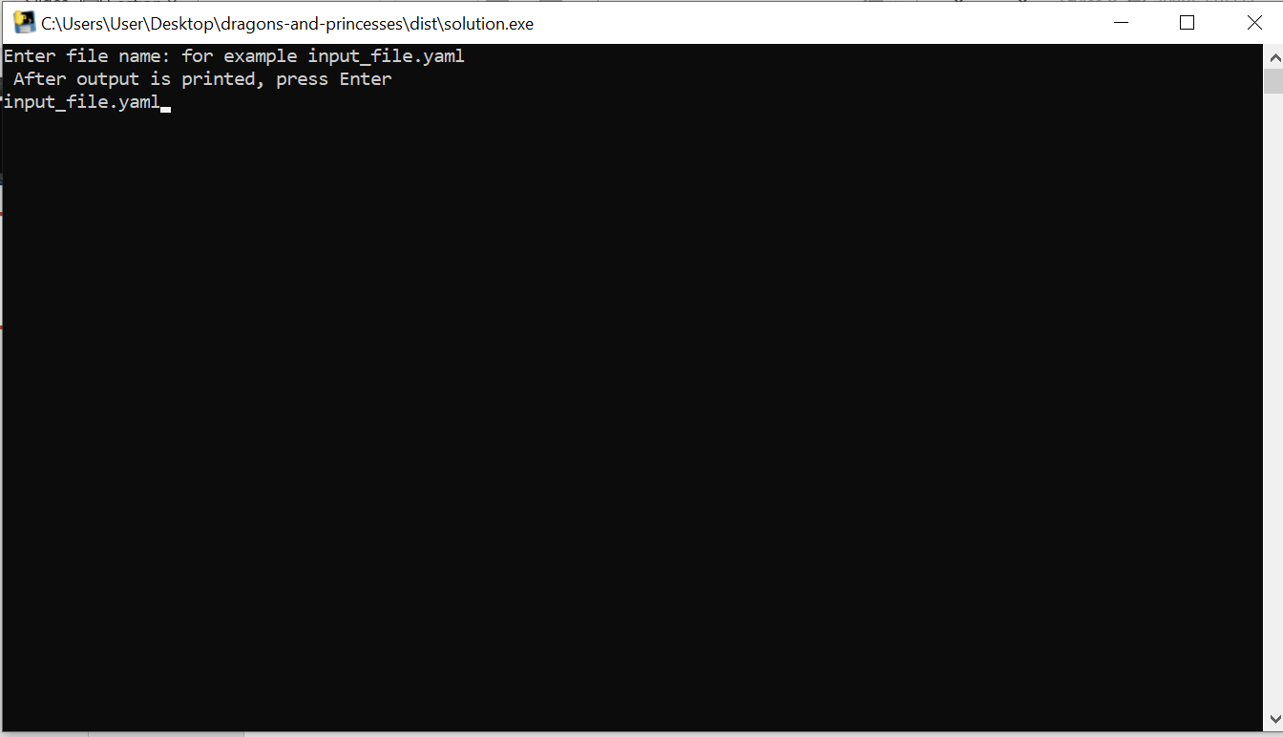
Press Enter

Slide 5
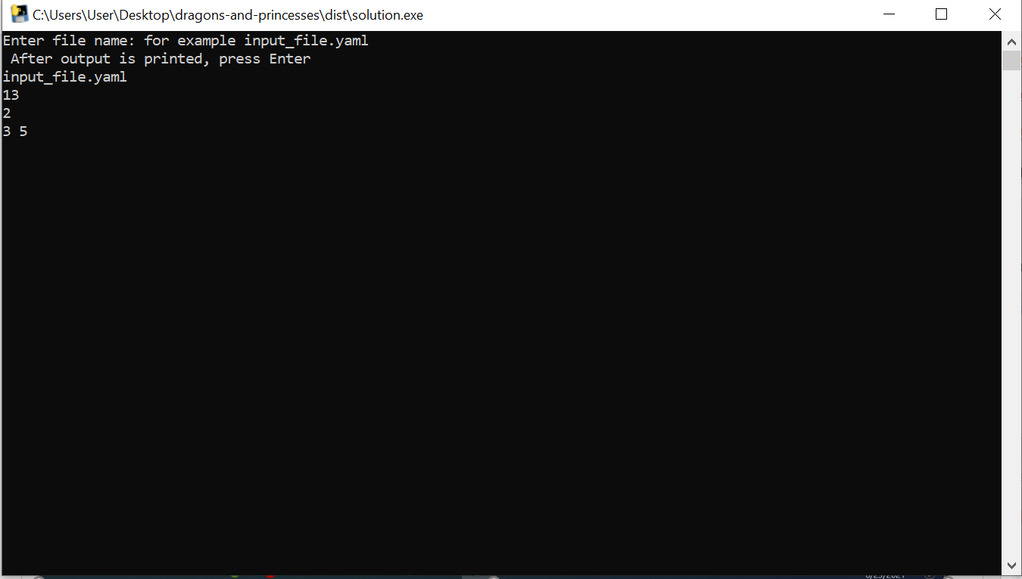
Press Enter again

