Slide 1
Dancing on the head
of a ping!
Notes:
Ian got the wrong screen.... lol!

Slide 2
Dancing on the head
of a ping!

Slide 3
Dancing on the head
of a ping!
There and back again:
An echo reply time!

Slide 4


Ian “idn” Norton
Shadowcat Systems
Notes:
Ian Norton of Shadowcat Systems
Lancaster
Northwest England PM
Giving this tutorial for the last three years
I'm hoping not to under or overrun

Slide 5
Building a SaaS
Monitoring platform
Using OpenNMS!

Slide 6
What are we adding?
Layers
Integration
Simplified UI
Notes:
For the audience here, we're not adding much, but you guys are not our target audience!
Automate as much as possible, make safe assumptions to try and reduce input and hide the complexity of what's happening from the user.

Slide 7
OpenNMS hosting
2 x 2GB Bytemark BigV instances
Debian 6 (Wheezy)
Ansible
PostgreSQL
OpenNMS 16.0.3
Notes:
Tom Bloor spoke about our Ansible configuration work earlier in the day which will hopefully be available online after the conference. Keep an eye on the twitter account or look at Tom's github repo.

Slide 8
Ansible
Tom's github repos:
http://github.com/TBSliver/OUCE-2015-Ansible-Config
http://github.com/TBSliver/OUCE-2015-Config-Files

Slide 9
Ansible summary?
OpenNMS instance build?
Notes:
How long does it take you to build an OpenNMS instance to production?

Slide 10
Ansible summary?
OpenNMS instance build?
To live in 15 minutes

Slide 11
Why two instances?
ShadowNMS front end & discovery
Dedicated monitoring host

Slide 12
Let's talk front end!

Slide 13
Simplification of terms
Device = OpenNMS node
Benchmark = OpenNMS service

Slide 14
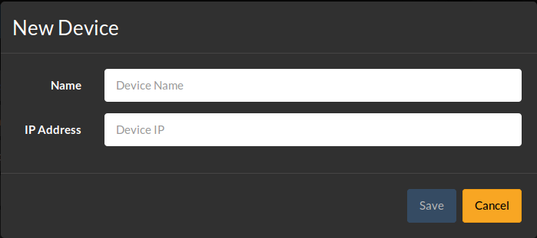
Adding a device

Slide 15
Discovery
Service discovery
Notes:
By far the best and most comprehensive service discovery. SNMP functionality blows everything else out of the water

Slide 16
Discovery
Set device 'needs discovery' flag
PRIS (PRovisioning Integration)
Notes:
In the database, mark the device as needing discovery.
PRIS generates a configuration from these nodes
Watch events on discovery node

Slide 17
PRIS?
Take a data source:
  Database
  Spreadsheet (shudder)
  CSV file
Generate provisioning requisition
  Including categories
Notes:
Markus is talking about PRIS tomorrow at 14:00, if you don't know what it is you need to attend that talk! It's all kinds of awesome!

Slide 18
Discovery
Watch for 'Completed' event
ReST API:
Create benchmark records
  ShadowNMS database
/rest/events?limit=0&eventUei=uei.opennms.org/internal/provisiond/nodeScanCompleted
Notes:
In the database, mark the device as needing discovery.
PRIS generates a configuration from these nodes
Watch events on discovery node

Slide 19
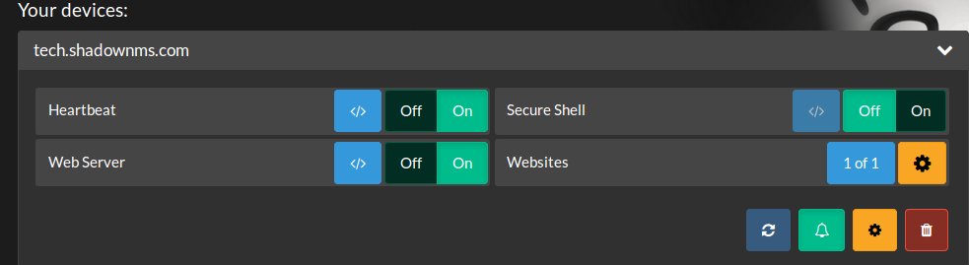
Discovered benchmarks
Allow user to enable / disable

Slide 20
Pushing that live?
More PRIS!

Slide 21
Pushing that live?
More PRIS!
Seriously, Markus, 14:00 tomorrow
Learn awesome things

Slide 22
Pushing that live?
More PRIS!
Seriously, Markus, 14:00 tomorrow
Learn awesome things
And then sync them.....

Slide 23
Getting status
Collect node ID from monitor
Add to ShadowNMS database
Retrieve outages via ReST
/rest/outages?limit=0

Slide 24
Just our organisation?
Set admin asset information
Filter on this

Slide 25
Getting status
Retrieve outages via ReST
/rest/outages?limit=0&query=this_.nodeid%20IN%20%28SELECT%20nodeid%20FROM%20assets%20WHERE%20admin%3D%27organisation_id%3A%20Cthulu%27%29%20AND%20this_.ifRegainedService%20IS%20NULL

Slide 26
Getting status
Retrieve outages via ReST
For org id Cthulu...
/rest/outages?limit=0&query=this_.nodeid%20IN%20%28SELECT%20nodeid%20FROM%20assets%20WHERE%20admin%3D%27organisation_id%3A%20Cthulu%27%29%20AND%20this_.ifRegainedService%20IS%20NULL

Slide 27
Getting status
Retrieve outages via ReST
For org id Cthulu...
/rest/outages?limit=0&query=this_.nodeid%20IN%20%28SELECT%20nodeid%20FROM%20assets%20WHERE%20admin%3D%27organisation_id%3A%20Cthulu%27%29%20AND%20this_.ifRegainedService%20IS%20NULL

Slide 28
Lose your first
SAN point....

Slide 29
Lose your first
SAN point....
It's not the last...

Slide 30
Stick around for the next talk
Seth is talking about:
Enhanced ReST searches

Slide 31
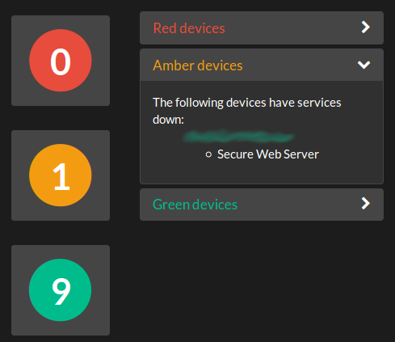
Status

Slide 32
So what tech is this?
Perl!
Catalyst web framework
Angular JS & Bootstrap
JSON API end points
PostgreSQL

Slide 33
Clients
PostgreSQL
(OpenNMS)
PostgreSQL
(OpenNMS)
OpenNMS
OpenNMS
Angular JS
Bootstrap
Catalyst
framework
PostgreSQL
(ShadowNMS)
PRIS
Scripting

Slide 34
What services?
ICMP
HTTP / HTTPS
ICMP
SSH
SMTP
IMAP
POP3
DNS
NTP
Notes:
At th`e moment this list is fairly limited.

Slide 35
You gained 100 XP!

Slide 36
You gained 100 XP!
Ding!

Slide 37


Slide 38

Moggles!

Slide 39
Moggles!
Because failure is
Always an option

Slide 40
PRIS in Production
We pull from PRIS every 5 mins
Each time we get events:
uei.opennms.org/internal/importer/importStarted
uei.opennms.org/nodes/nodeUpdated
uei.opennms.org/internal/provisiond/nodeScanCompleted
uei.opennms.org/internal/importer/importSuccessful

Slide 41
PRIS in Production
288 x 4 x 300 = 345,600
Events per 24 hours
2.4M events per week

Slide 42
PRIS in Production
Events hit ~5M records
OpenNMS got a bit slow....

Slide 43
PRIS in Production
Switched these to donotpersist:
About 8 hours to delete records
Much wailing
uei.opennms.org/internal/importer/importStarted
uei.opennms.org/nodes/nodeUpdated
uei.opennms.org/internal/provisiond/nodeScanCompleted

Slide 44
Website monitoring
We want to monitor by name!
We don't care about IP
HTTP 1.1 vhosts

Slide 45
Website monitoring
We want to monitor by name!
We don't care about IP
HTTP 1.1 vhosts
OpenNMS cares about IP

Slide 46
Website monitoring
Page Sequence Monitor
Thanks to Markus & JeffG

Slide 47
Website monitoring
<service name="WEBSITEHTTP" interval="300000" user-defined="true" status="on">
<parameter key="sequence-retry" value="2"/>
<parameter key="timeout" value="8000"/>
<parameter key="rrd-repository" value="/var/lib/opennms/rrd/response" />
<parameter key="rrd-base-name" value="websitehttp" />
<parameter key="ds-name" value="websitehttp" />
<parameter key="page-sequence">
<page-sequence>
<page method="GET"
http-version="1.1"
virtual-host="${nodelabel}"
scheme="http"
host="${nodelabel}"
disable-ssl-verification="true"
port="80"
path="/"
response-range="100-399" />
</page-sequence>
</parameter>
</service>

Slide 48
Website monitoring
<service name="WEBSITEHTTP" interval="300000" user-defined="true" status="on">
<parameter key="sequence-retry" value="2"/>
<parameter key="timeout" value="8000"/>
<parameter key="rrd-repository" value="/var/lib/opennms/rrd/response" />
<parameter key="rrd-base-name" value="websitehttp" />
<parameter key="ds-name" value="websitehttp" />
<parameter key="page-sequence">
<page-sequence>
<page method="GET"
http-version="1.1"
virtual-host="${nodelabel}"
scheme="http"
host="${nodelabel}"
disable-ssl-verification="true"
port="80"
path="/"
response-range="100-399" />
</page-sequence>
</parameter>
</service>
Magic here!

Slide 49
Website monitoring
But OpenNMS still cares about IP
It doesn't need it!

Slide 50
Website monitoring
But OpenNMS still cares about IP
It doesn't need it!
Let's fake it.....

Slide 51
Website monitoring
But OpenNMS still cares about IP
It doesn't need it!
Let's fake it.....
IPv6 loopback addresses!

Slide 52
Website monitoring
Use fe80::
And the id..
With a PostgreSQL function...
'fe80::' || to_hex(id)

Slide 53
Pretty Graphs!
Never underestimate a boss who wants pretty graphs.....

Slide 54
HE KNOWS WHO HE IS.....

Slide 55
Graphs using N3 Chart
Based on D3JS
VERY pretty graphs
Pull data from ReST API!

Slide 56
Pretty graphs
We're using IPv6 node addresses

Slide 57
Pretty graphs
We're using IPv6 node addresses
But the ReST API is broken
No data out for any IPv6 :(
NMS-7189

Slide 58
Pretty graphs
We're using IPv6 node addresses
But the ReST API is broken
No data out for any IPv6 :(
NMS-7189
Fixed in 16.0.4 (hopefully)

Slide 59
Pretty graphs
Micro service for RRD data export
JSON API
ReST interface to rrdtool

Slide 60
Pretty graphs
Micro service for RRD data export
JSON API
ReST interface to rrdtool
Short term fix but long term gain

Slide 61
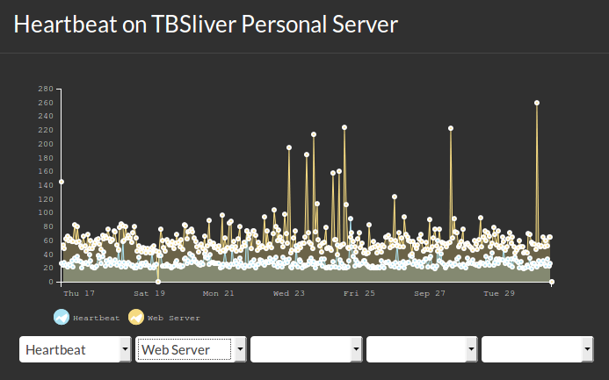

Slide 62
Notifications!
Notes:
Email, IRC, twitter, XMPP or whatever else we want.

Slide 63
Notifications by email
Based on user record
Notes:
We don't want to have to configure users for every person that OpenNMS should notify for an organisation.

Slide 64
Notifications by email
Based on user record
Can't set target address?
Notes:
We don't want to have to configure users for every person that OpenNMS should notify for an organisation.

Slide 65
Notifications by email
Based on user record
Can't set target address?
Best efforts at evil failed :(

Slide 66
Notifications by http
HTTP GET or POST for event
Looks ideal!
Oddness....

Slide 67
Notification by http
Resolution of event oddness
  Timestamp is midnight of today
  Severity is that of original event
  Only as a number
Notes:
We've made this work for us, but I'm still not sure if the functionality is correct as such?
Should resolution be normal?
Timestamp is definitely wrong
Once we work this out, will have to file a bug or patch, at this point can't find which bit of code is the issue and not clear on what the behaviour should be.

Slide 68
Provisioning
Nodes removed, aren't
Can be removed via ReST API

Slide 69
The Future
But you didn't use feature X!
What about cool thing Y?!

Slide 70
The Future
Website profiling using PhantomJS
SNMP
Distributed monitoring
Minion!
More cool things from OpenNMS

Slide 71
Questions?

Slide 72
Questions?
Stunned silence is also fine...

Slide 73


Slide 74
What is best in OpenNMS?

Slide 75
What is best in OpenNMS?
THE COMMUNITY!

Slide 76
Special thanks to
JeffG
Markus Neumann
Ben (RangerRick)
Keith Spragg (spraggle)
OpenNMS Group
#opennms on freenode!

Slide 77
Thanks to you!
Don't forget to fill in the conference survey!

