Slide 1
Discussion 4 RISC-V
yangchao@shanghaitech.edu.cn

Slide 2
Agenda
1.RISC-V Calling Convention
2.Big Endian vs. Little Endian
3.Jump
4.Label and Assembler Directives
5.Enviroment calls
6.Exam examples

Slide 3
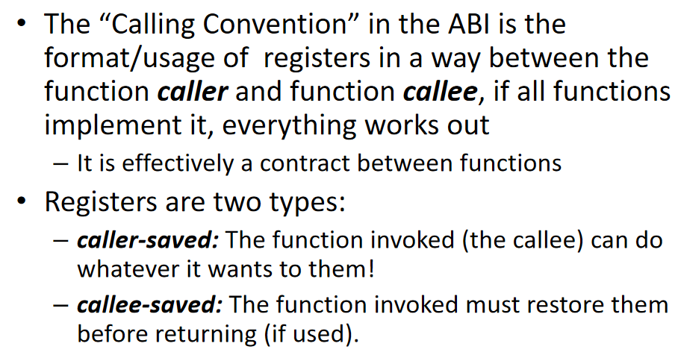
RISC-V Calling Convention

Slide 4
◦ Values saved by the caller before jumping to a function using jal
◦ ra: Return address, used in function call.
◦ a0-a1: Function argument and return values, also argument of environment call.
◦ a2-a7: Function argument, used to pass parameters in function call.
◦ t0-t6: Temporaries, cannot trust them after function call.
◦ Values restored by the callee before returning from a function using jalr
◦ sp: Stack pointer. We subtract from sp to create more space and add to free space. The stack is mainly used to save (and later restore) the value of registers that may be overwritten.
◦ s0-s11: Saved registers, should not change after function call.

Slide 5
Caller & Callee
• Caller invoke callee
• Caller should save Caller-Saved registers (to memory) before the call.
• Callee should save Callee-Saved registers at the beginning of its execution and restore them before return.
Steps of function call :
1. Caller put parameters into registers a0-a7.
2. Caller put next line’s address into ra and jump to the function label. (using jal)
3. Callee pushes s0-s11, sp onto stack.
4. Callee execution.
5. Callee extract value from stack.
6. Callee jump to ra’s address.

Slide 6
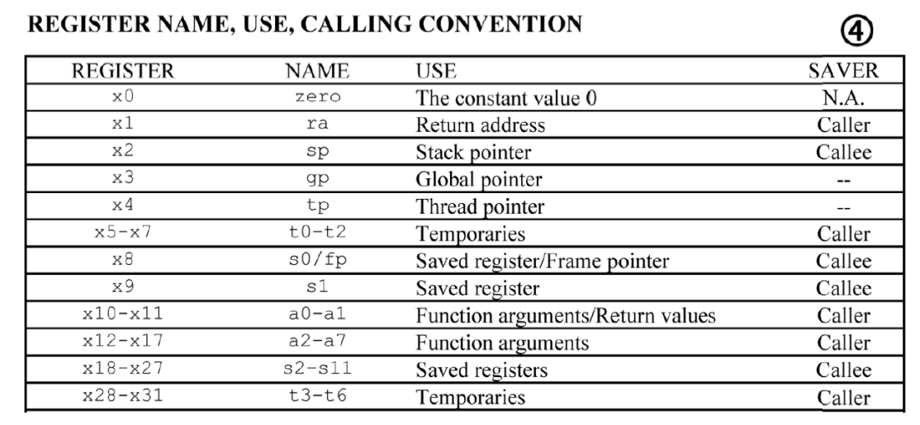

Slide 7
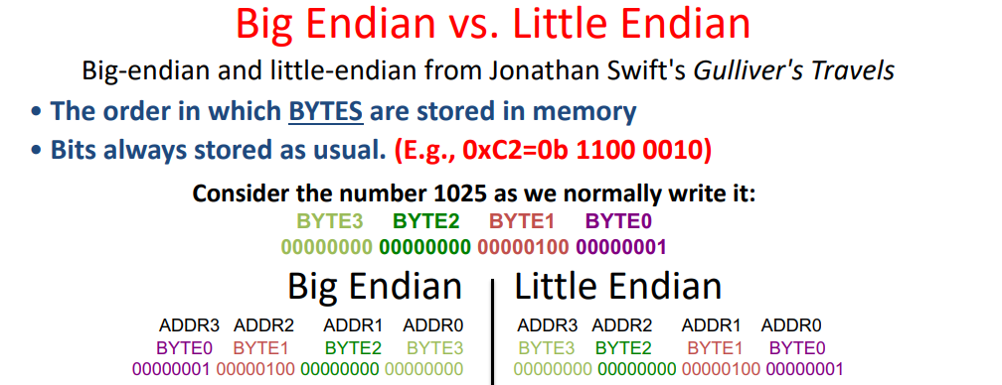
Big Endian vs. Little Endian

Slide 8
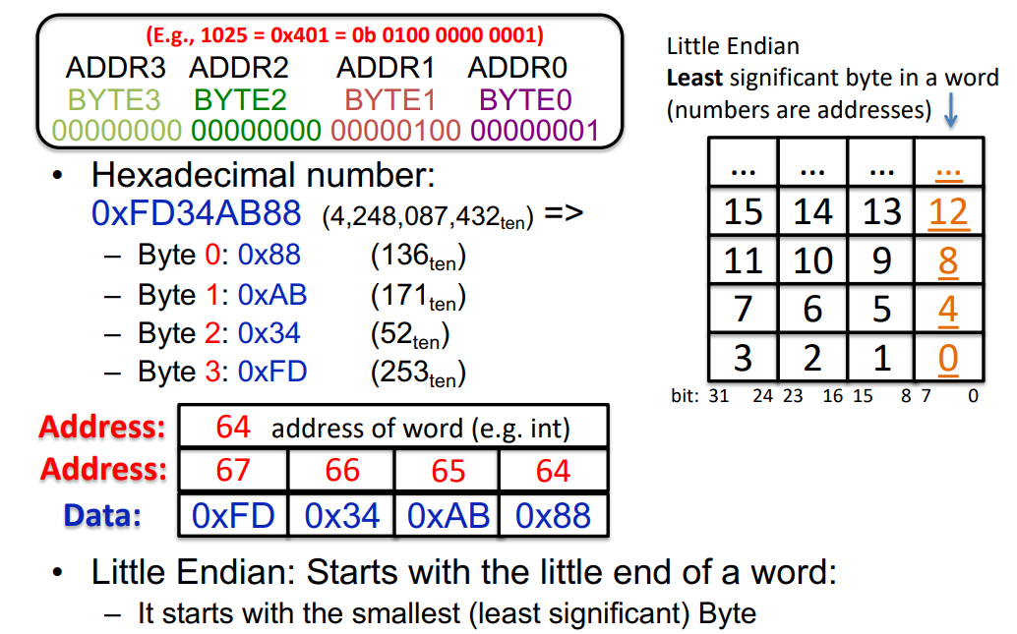

Slide 9
Jump
● j指令操作为PC-relative Jump，它将PC 设置为 PC + offset，它实际上为pseudo-insturction， 它使用的JAL接口，但将rd设置为x0（即忽略返回地址）。
● jr指令虽然也用于转移，但它是I类型，它并不是 PC-relative Jump，它将PC 设置为 rs + offset，因为它提供的是一个寄存器，由于寄存器中存储的就是32位的数据，所以指令无需进行指令那样的取位操作，它实际上也是pseudo-insturction， 它使用的JALR接口，但将rd设置为x0（即忽略返回地址）。
● jal与j指令的唯一区别是在跳转之前，将下一条指令的PC地址赋值给$ra寄存器，j是一种无条件跳转的指令，而jal则是以比较明显的方法声明子程序调用的结构。
● j/jr与jal/jalr关系类似，左右两边都分别代表使用立即数或寄存器，同样地，jalr也是I类型的指令。

Slide 10
Generally,
when the main function calls other functions, use jal ra,function
when some function return, use jr ra
when in a loop, iterate by jal x0,loop
jr rs == jalr x0,rs
j offset == jal x0,offset
jal offset == jal ra,offset

Slide 11
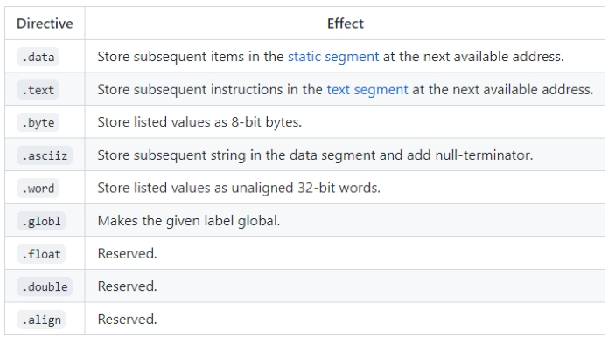
Label and Assembler Directives
Label : Hold the address of data or instructions.
(Will be placed by the actual address during assembly or link.)
Some directives :

Slide 12
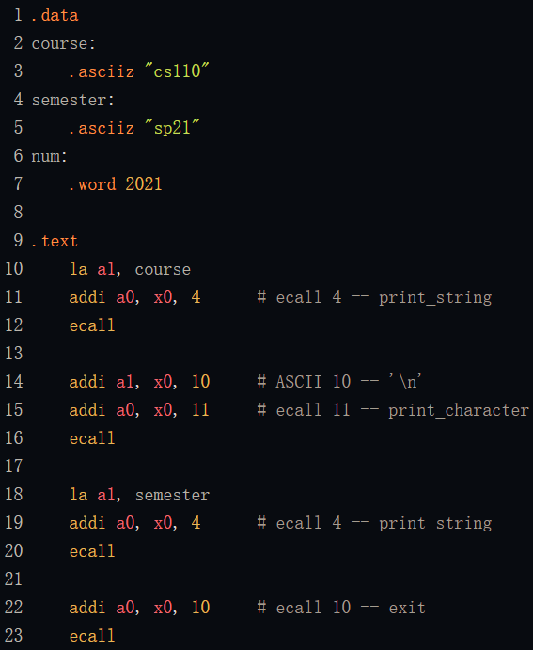

Output :

Slide 13
Thank you for attending the discussion!
Wish you good luck doing homework/projects/exams!

