Slide 2
Network Architecture
Anchor-boxes locations (x,y)
240 x 135 x 2
Two 1x1-conv-layers;
channels: 2→4→4
Location features
240 x 135 x 4
Object vs. background classification:
Conv 1x1 + Sigmoid
Detection scores
240 x 135 x 9
Image
1920 x 1080 x 3
Feature-map extractor:
15 first layers of
pre-trained Resnet34
Feature-map
240 x 135 x 128
Conv 3x3 + Relu
Feature-map
240 x 135 x 128
Bounding-box regression:
Conv 1x1
Bounding-boxes
240 x 135 x (9x4)

Slide 3
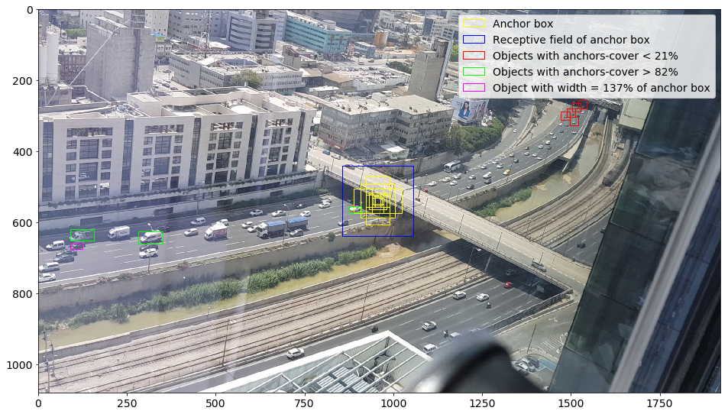
Anchor Boxes and Receptive Fields

Slide 4
From network output to predicted boxes
Detection scores
240 x 135 x 9
Threshold
Bounding-boxes
N x 4
Bounding-boxes
240 x 135 x (9x4)
Road-boundaries constraints
NMS:
Remove highly-intersecting boxes

