Slide 1


RepReady
Live Call Coach for B2B Sales
Ido Avraham
B.Sc Computer Science | Ariel University

Slide 2

Project Overview
Always know your next move.
⚠️ THE PROBLEM
🎯 USERS
🤖 THE SOLUTION
• One mistake on a call → deal lost
• Long time to prepare — digging through Confluence, CRM, docs
• Reps freeze on pricing & compliance
Sales reps
• Prep before calls, coach live on the phone
Managers / team leads
• Call-update emails
• Web AI coach — approved KB only
• PREP — prospect, objections, product facts
• LIVE — 4 bullets + Next move
• Tools: calendar · company search ·email
⚡ One question replaces long hours of digging
🗣️ Reps keep talking — don't freeze
📎 Grounded answers with citations
📝 Missing knowledge auto-logged

Slide 3
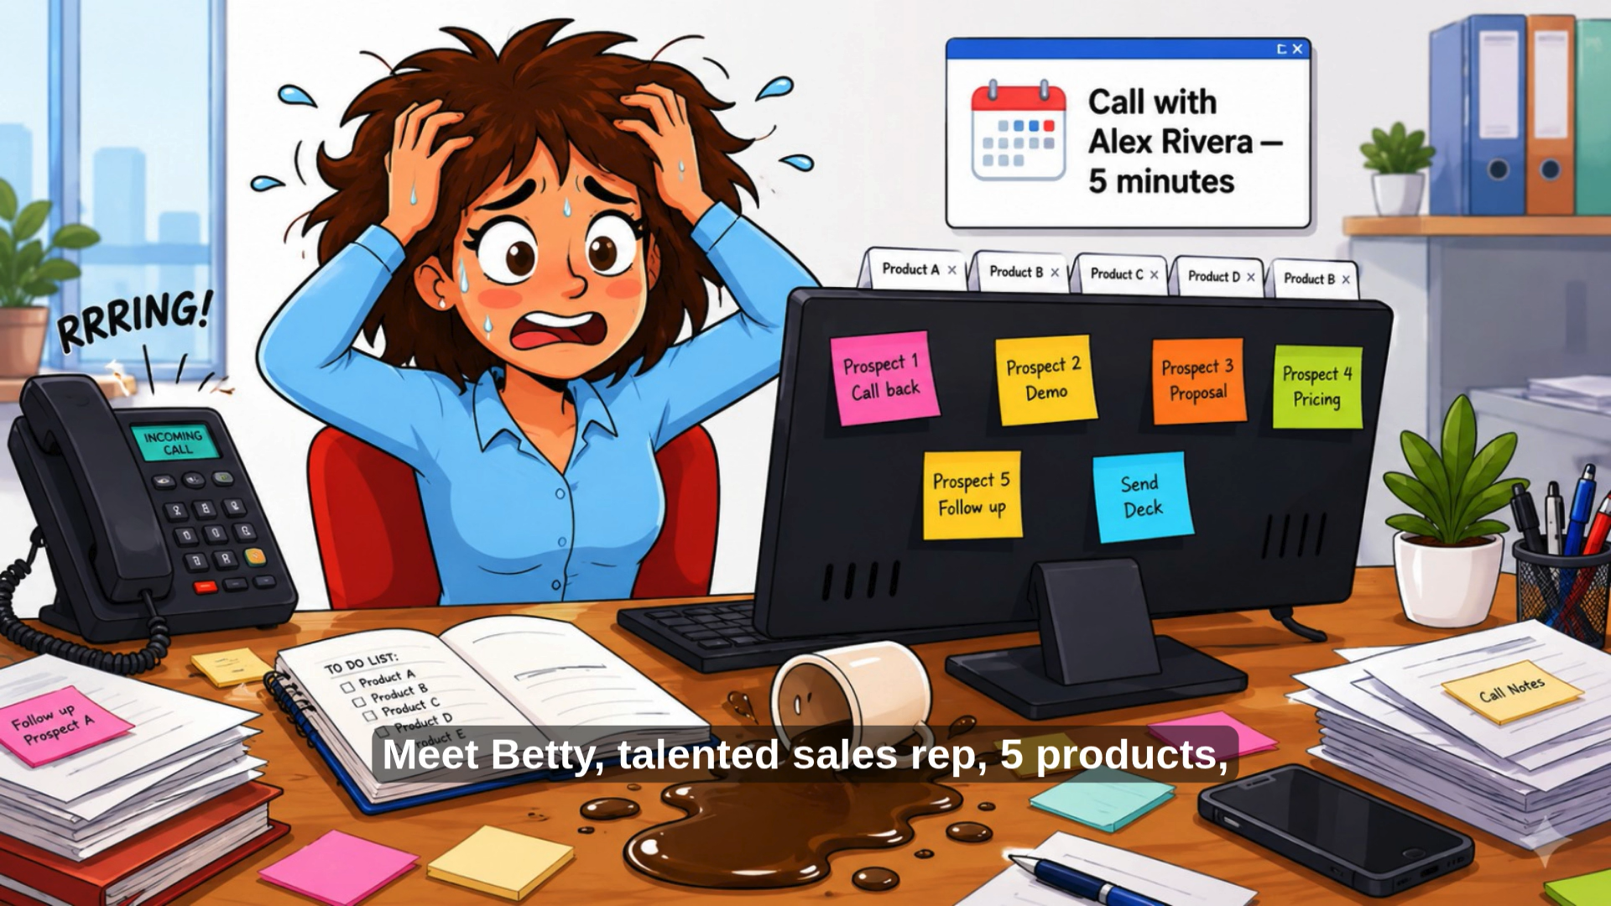

Slide 4

Technologies Used
Tech stack powering RepReady
🐍 PYTHON
🌐 FLASK
📚 RAG
⚡ MCP / TOOLS
Core backend — Flask server, Bedrock client, routing logic
Web UI + POST /chat endpoint dashboard
AWS Bedrock KB — S3 docs products + customer notes
Lambda action groups — calendar, company search, email
🐳 DOCKER
🔀 GIT / GITHUB
🧠 AMAZON BEDROCK
Containerized deployment on EC2 via Docker Hub
Source control for app, prompts, KB content, config
Agent orchestration , KB

Slide 5

System Architecture
End-to-end request flow
🖥️ BROWSER
⚙️ FLASK
🧠 BEDROCK AGENT
📚 KB / TOOLS
💬 RESPONSE
Sales rep types
question + context
Routing tags
InvokeAgent
Orchestration LLM
KB or Tool decision
S3 docs
Streamed bullets
Prep or Live format
📡 HOW IT WORKS
📚 WHERE RAG IS USED
🔧 TOOLS (LAMBDA)
• Rep sends question + mode + product + prospect
• Flask embeds routing tags in inputText
• Bedrock Agent decides: KB lookup or tool call
• Response generated
• Person prep → Customer Notes from KB only
• Product questions → docs filtered by metadata
• No web search for person data — KB is truth
• Metadata JSON sidecars scope retrieval
• get_todays_calls → Google Calendar
• get_company_context → Tavily Search API
• send_call_update_email → Resend API
• Agent decides when to invoke each tool

Slide 6

Live Demo
http://50.17.43.22
1. OPEN APP
6. TOOL — CALENDAR
Navigate to public URL, show landing page
Prep/Live toggle + product pill + prospect sidebar
Ask today's calls → Google Calendar events
Verify against calendar tab
2. CREATE PROSPECT CHAT
7. TOOL — EMAIL
New chat → Alex Rivera, CloudScale
Show suggested question chips
Send call update → Resend API
Verify email arrives in Gmail
3. RAG — PERSON PREP
8. LIVE MODE
Ask about Alex → grounded bullets from Customer Notes
KB only, no web search for person data
Toggle Live → paste objection
4 urgent bullets + Next move
4. RAG — PRODUCT PREP
9. RESPONSE QUALITY
Ask about objections → KB product docs + prospect notes
Filtered by active product metadata
Bullet-formatted, prospect-specific, cited sources
Prep = calm notes, Live = urgent coaching
5. TOOL — COMPANY SEARCH
Ask about CloudScale → Tavily background
Contrast: person = KB, company = Tavily

Slide 7

Challenges & Next Steps
What we learned and where we go from here
✅ WHAT WORKS
⚠️ CHALLENGES
🚀 NEXT STEPS
• RAG-grounded answers
• Prep + Live modes
• Live tools verified
• KB vs tool routing
• Prep/Live format rules
• Orchestration latency
• Authentication
• Voice-to-text
• Manager dashboard
RepReady is live, grounded, and ready to scale.

