Slide 1
UBR3 Co-Immunoprecipitation Mass Spectrometry
Interactome analysis: enriched interactors, functional enrichment, network, and RING-dependence
Samples (3 biological replicates each): 293T = negative control · WT = UBR3 wild-type · UBR3 = RING-domain mutant

Slide 2
Experimental design & analysis workflow
Experiment
• Co-IP of UBR3 wild-type (WT), a UBR3 RING-domain mutant (labelled "UBR3"), and 293T cells (control), 3 replicates each.
• Bait UBR3 is the top hit in both pulldowns (log2 fold change ≈ 17) — confirms the pulldown worked.
Mass spectrometry / quantification
• MaxQuant proteinGroups with label-free quantification (LFQ); 2,332 protein groups; no contaminants or reverse hits present.
• Peptide/protein FDR filtered to 1% (standard MaxQuant).
Interactor definition
• A protein is a specific interactor if enriched over the 293T control: adjusted P < 0.05 and log2 fold change ≥ 1 (2-fold).
• UBR3-WT: 50 interactors · RING mutant: 38 interactors · union: 82 (6 shared).
Downstream analyses
• Functional enrichment (GO, DAVID/Enrichr) · STRING protein network · WT-vs-RING differential · abundance heatmaps · N-degron · sample QC.

Slide 3
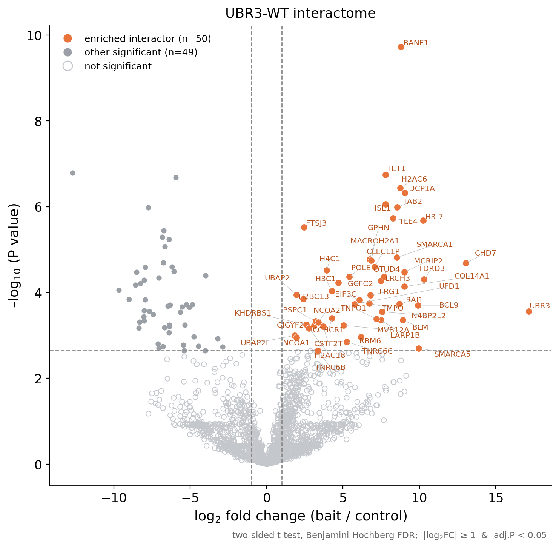
UBR3-WT interactome — volcano plot
Method
• Each protein: LFQ intensity in the UBR3-WT pulldown vs 293T control (n = 3 per group), log2-transformed.
• x = log2 fold change (bait/control); y = −log10(P value). Right side = enriched in the pulldown.
• Orange = 50 enriched interactors (labelled). Filled grey = other significant; open grey = not significant.
Statistics
• Two-sided Student’s t-test per protein.
• Multiple testing corrected with the Benjamini-Hochberg FDR (adjusted P).
• Significance thresholds (dashed lines): adjusted P < 0.05 AND |log2 FC| ≥ 1.
• Same test and thresholds as the reference paper (Welch/Student t-test + BH-FDR).

Slide 4
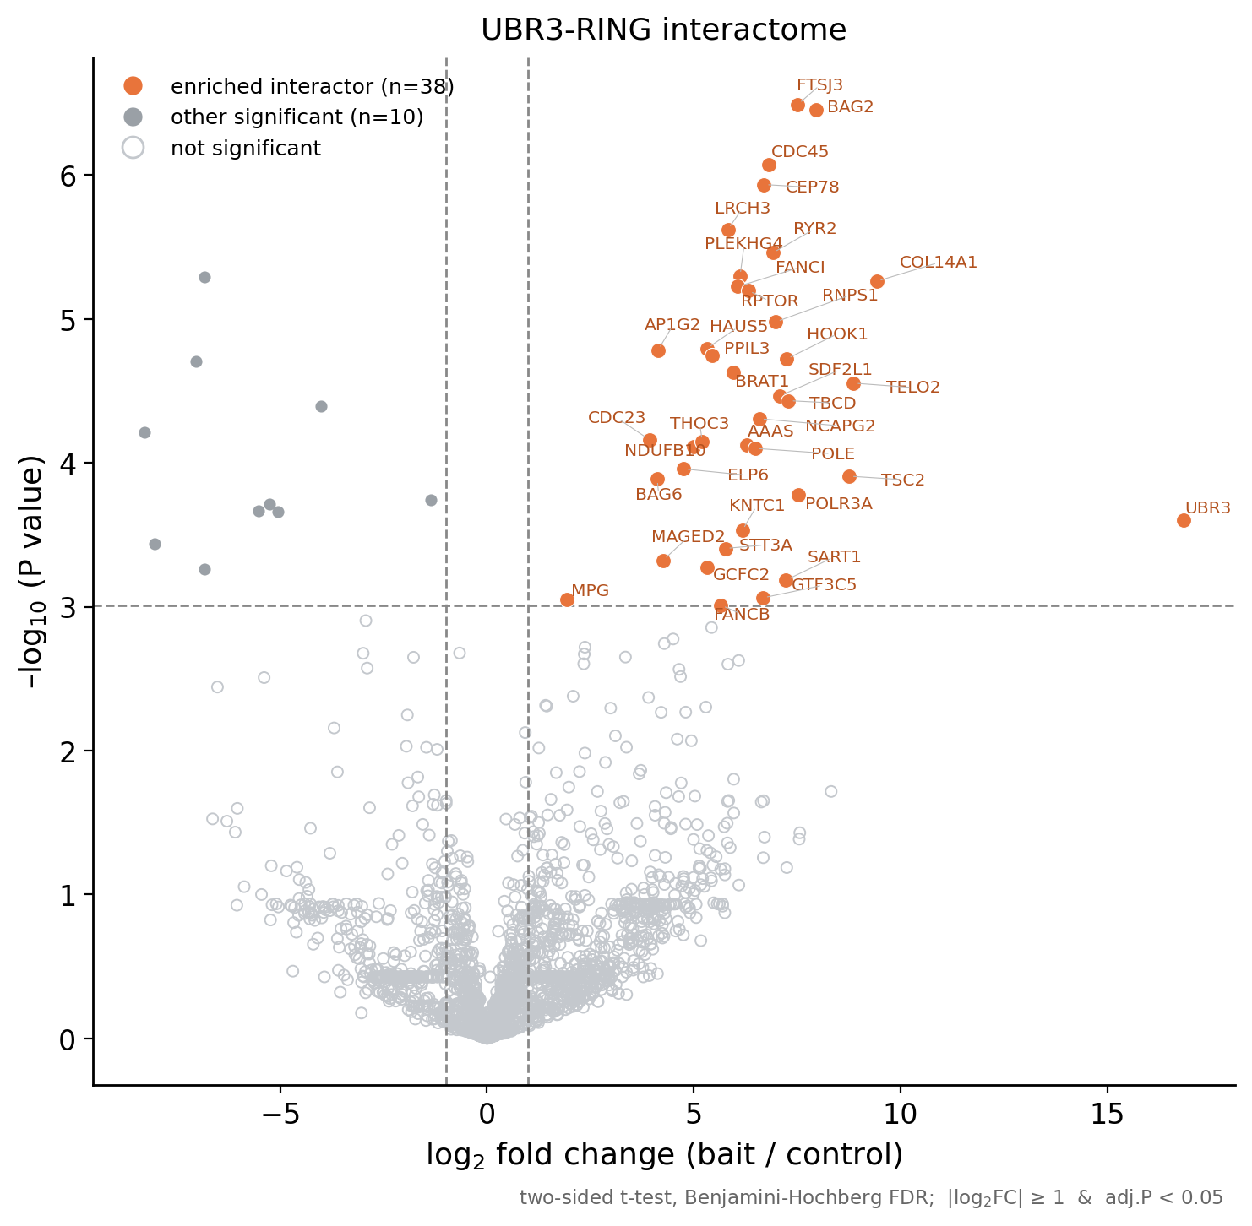
UBR3-RING mutant interactome — volcano plot
Method
• LFQ intensity in the RING-mutant pulldown vs 293T control (n = 3 per group), log2-transformed.
• Orange = 38 enriched interactors; grey as in the WT volcano.
Statistics
• Two-sided t-test with Benjamini-Hochberg FDR.
• Significant interactor: adjusted P < 0.05 AND |log2 FC| ≥ 1.
• Fewer interactors than WT, consistent with reduced binding by the catalytically-impaired mutant.

Slide 5
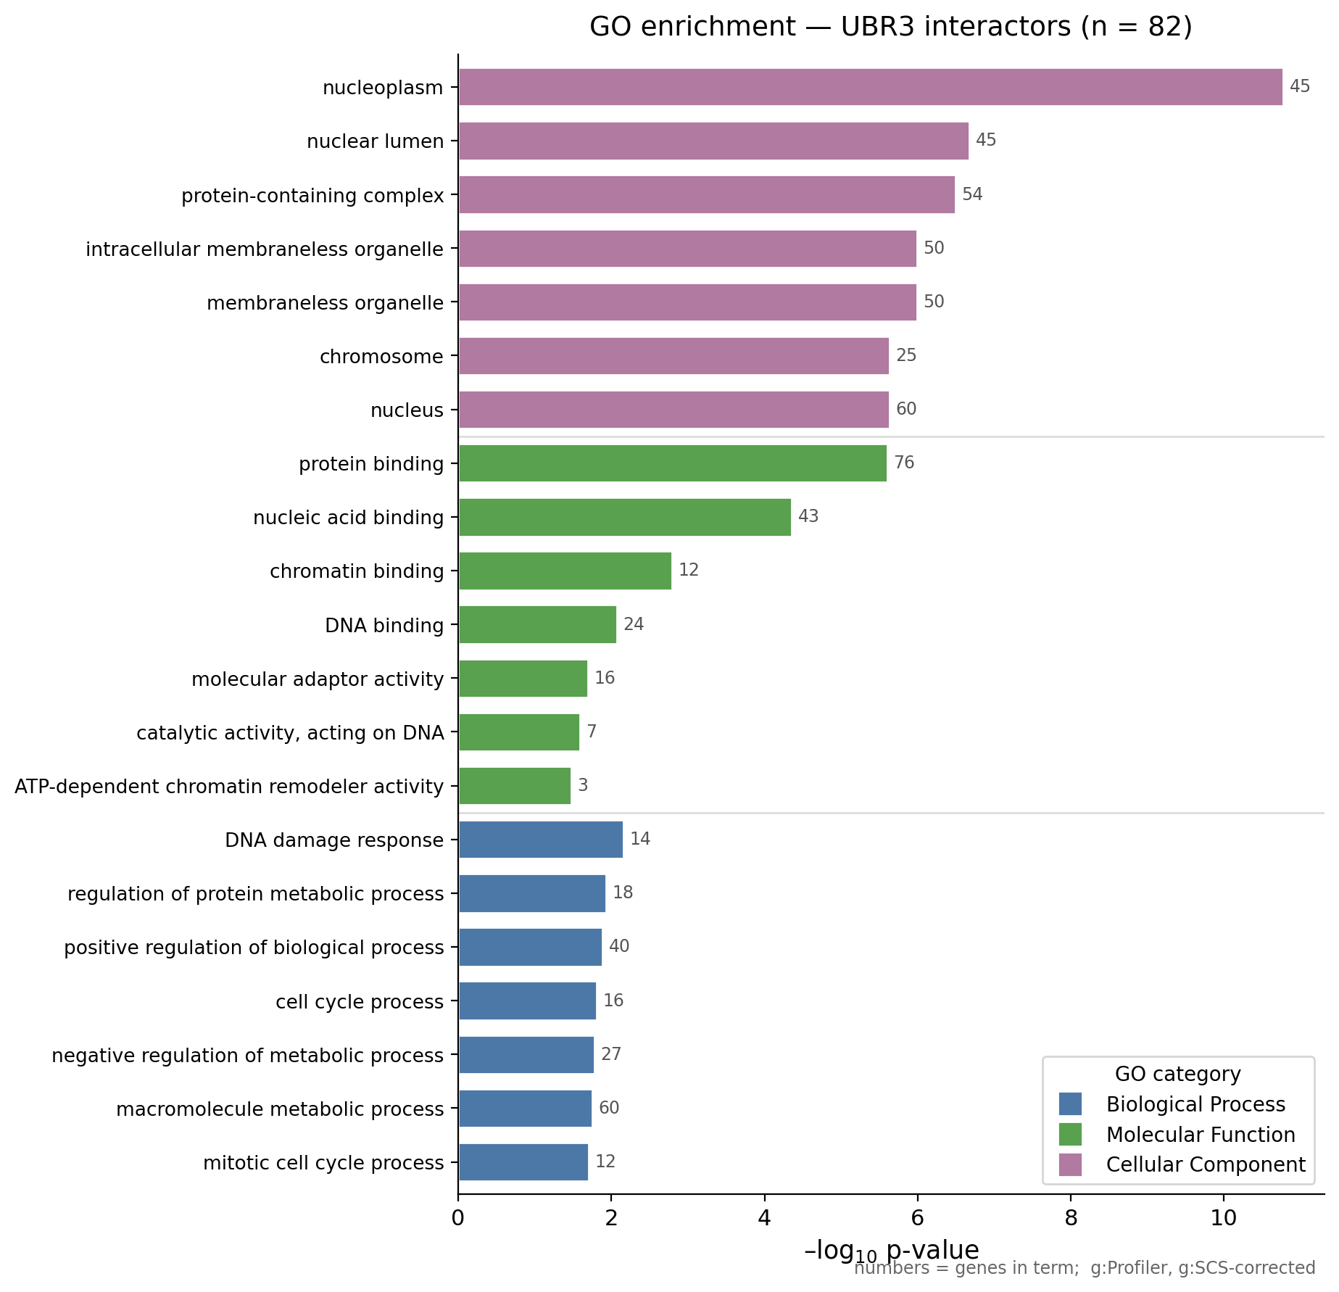
GO enrichment of the interactors
Method
• Gene Ontology over-representation of the 82 union interactor genes.
• Terms grouped by category: Biological Process, Molecular Function, Cellular Component (top 7 each).
• Bar length = −log10(P value); numbers at bars = interactor genes in the term.
Statistics
• Tool: g:Profiler (g:GOSt), organism Homo sapiens, whole-genome background.
• Multiple-testing correction: g:SCS method (threshold 0.05) — g:Profiler’s tailored analogue of FDR.
• Enrichment test = one-sided over-representation (hypergeometric).
Interpretation
• Nuclear / chromatin, DNA & nucleic-acid binding, DNA-damage response, cell cycle/mitotic.

Slide 6
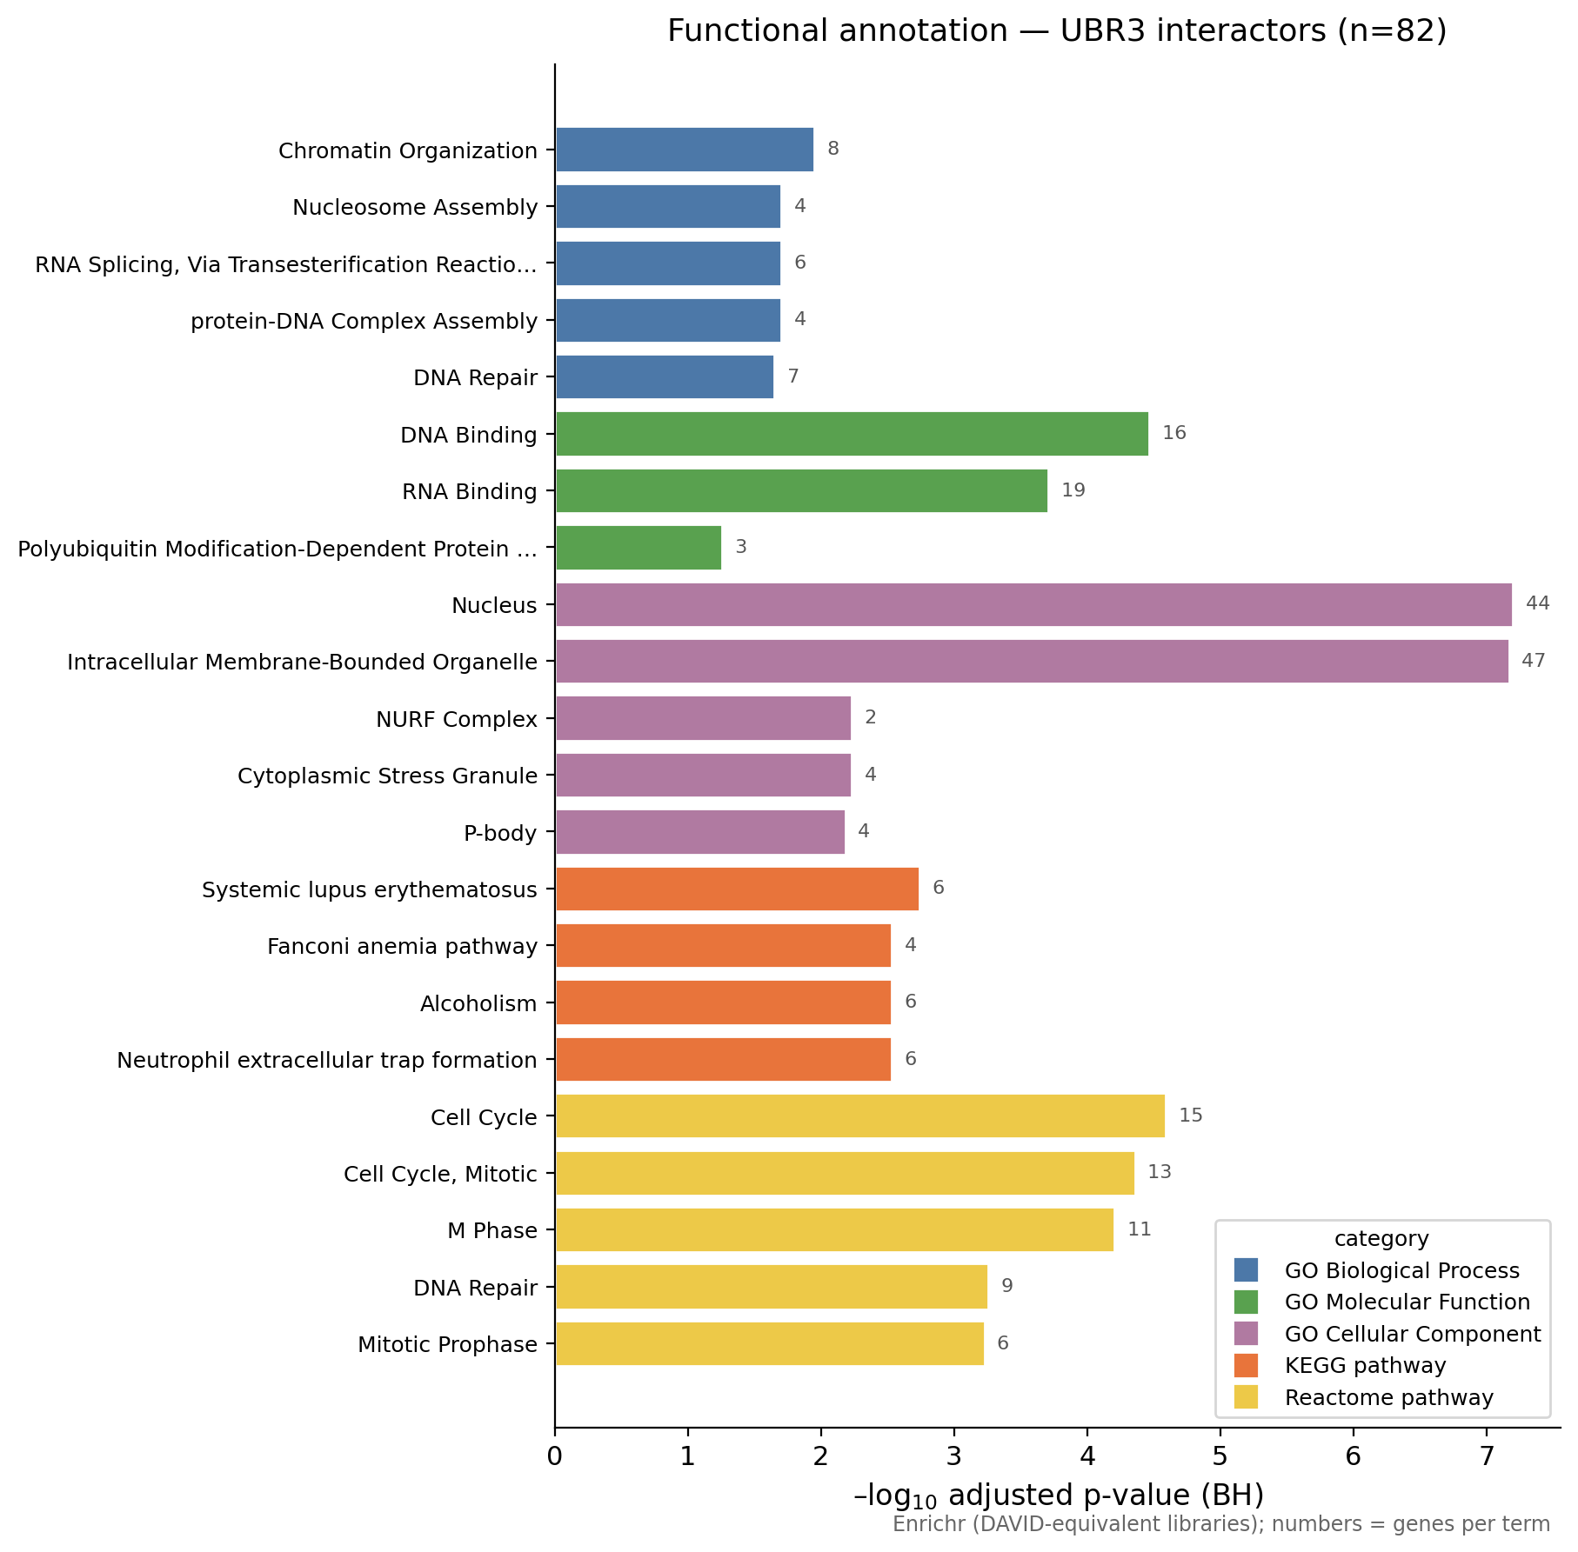
Functional annotation (DAVID-style)
Method
• Functional annotation of the 82 interactors across GO BP/MF/CC, KEGG and Reactome.
• Bars = −log10(adjusted P); coloured by source database; numbers = genes per term.
Statistics
• Enrichment test: Fisher’s exact test (over-representation).
• Correction: Benjamini-Hochberg adjusted p ≤ 0.10.
• Run with Enrichr, which queries the same GO/KEGG/Reactome libraries DAVID uses.
Note on DAVID
• The DAVID web API requires a registered email; ready-to-paste gene lists + steps are in the workbook (DAVID_howto).

Slide 7
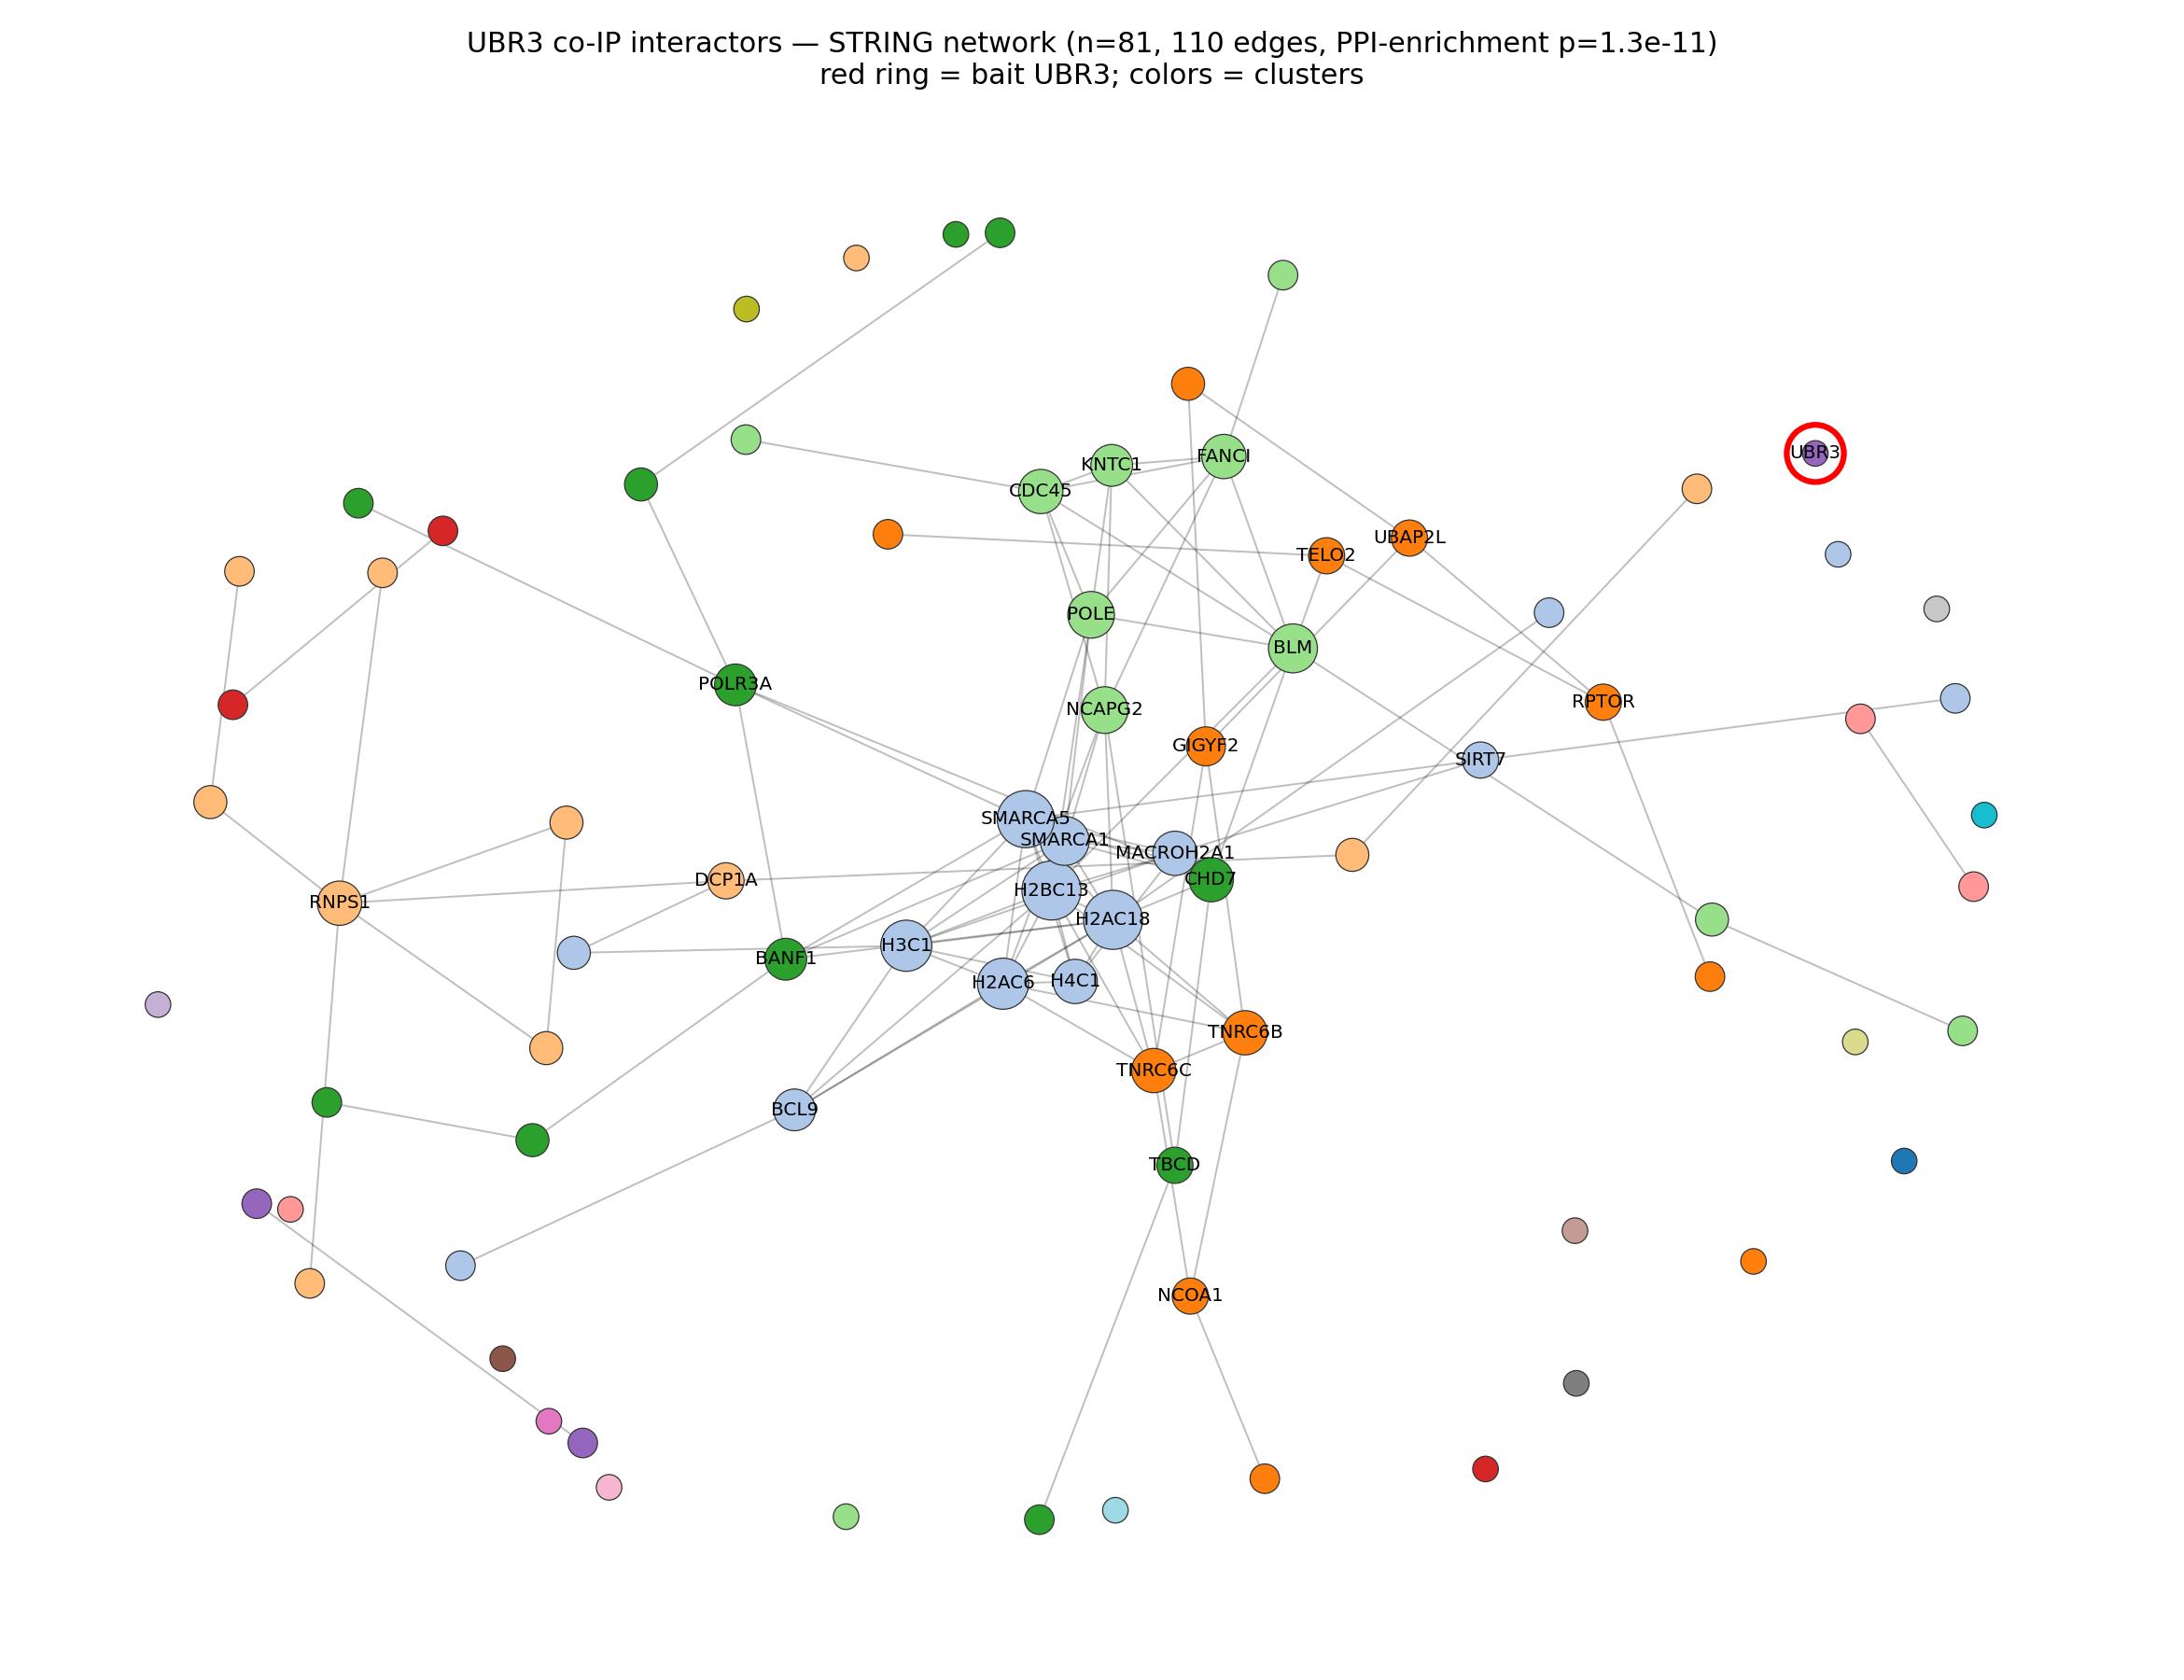
STRING protein-protein interaction network
Method
• The 82 interactors mapped to STRING (Homo sapiens); edges = interactions at confidence ≥ 0.4.
• Node colour = functional module (greedy-modularity clustering); node size = number of connections.
• Red ring = bait UBR3.
Statistics
• PPI-enrichment test (STRING): observed 110 edges vs 54 expected for a random protein set of equal size.
• PPI-enrichment p = 1.3 × 10⁻¹¹ → the interactors are far more interconnected than random (a real complex, not noise).
• UBR3 has no prior STRING edges → the interactors are largely novel.
Modules
• Histone/chromatin hub · DNA-repair/replication · mRNA-silencing (TNRC6B/C, GIGYF2).

Slide 8
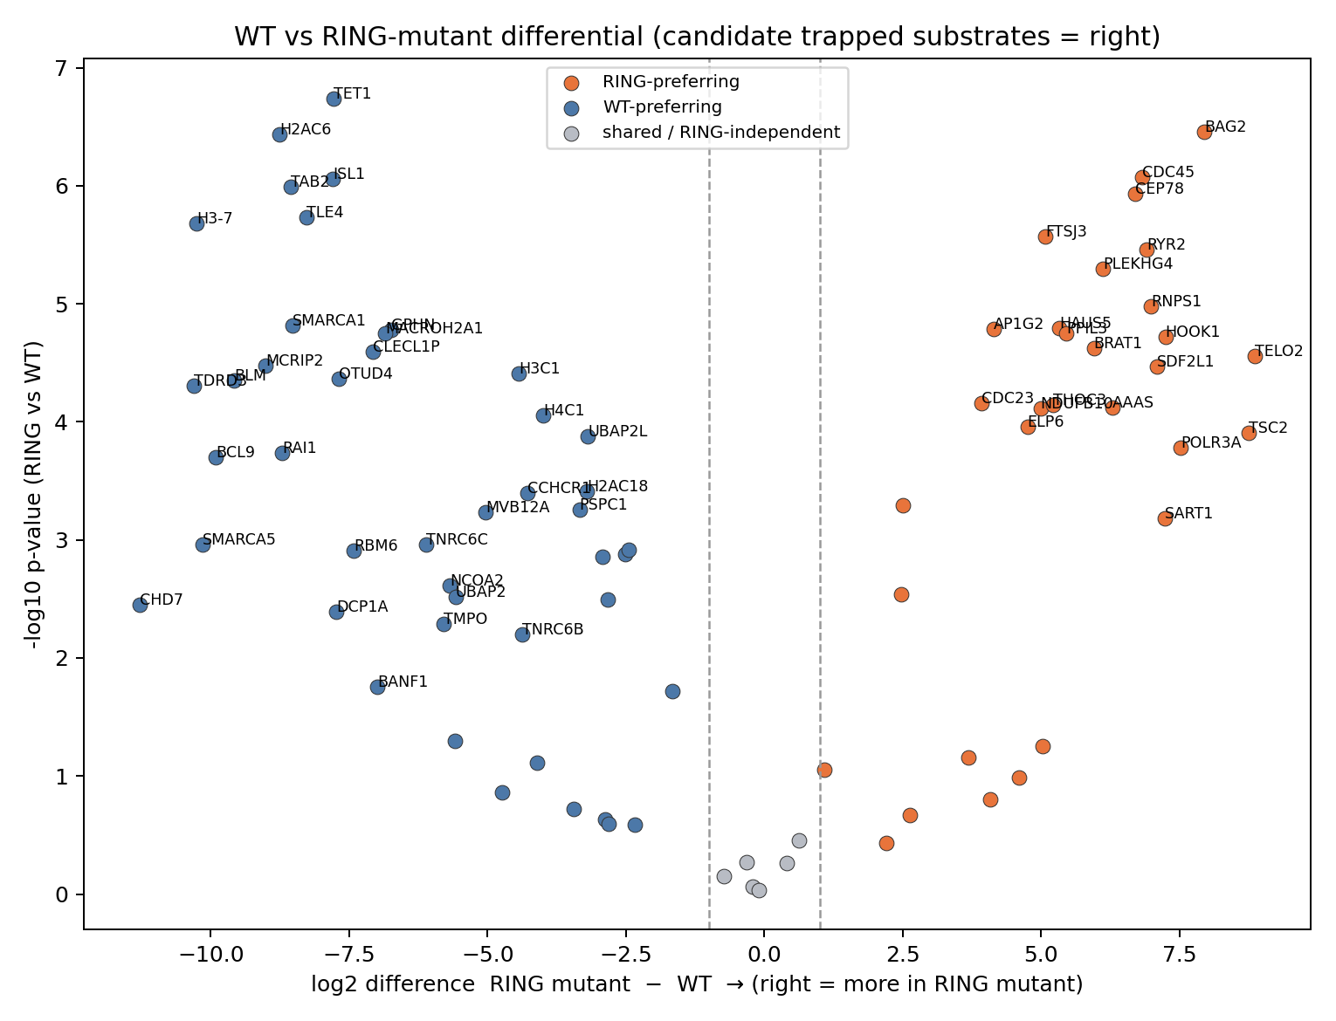
WT vs RING mutant — differential (substrate trapping)
Method
• Direct comparison of interactor abundance in the RING mutant vs WT pulldown, to test RING-dependence.
• Right (positive) = higher in the RING mutant → candidate trapped substrates (accumulate when the ligase is catalytically dead).
• Left (negative) = higher in WT → RING-dependent binding (reduced in the mutant).
Statistics
• Two-sample t-test, RING vs WT.
• Classification by log2 difference: > +1 = RING-preferring (31) · < −1 = WT-preferring (45) · else shared/RING-independent (6).
Caveat
• Differences may also reflect construct expression / pulldown efficiency — candidate substrates need orthogonal validation.

Slide 9
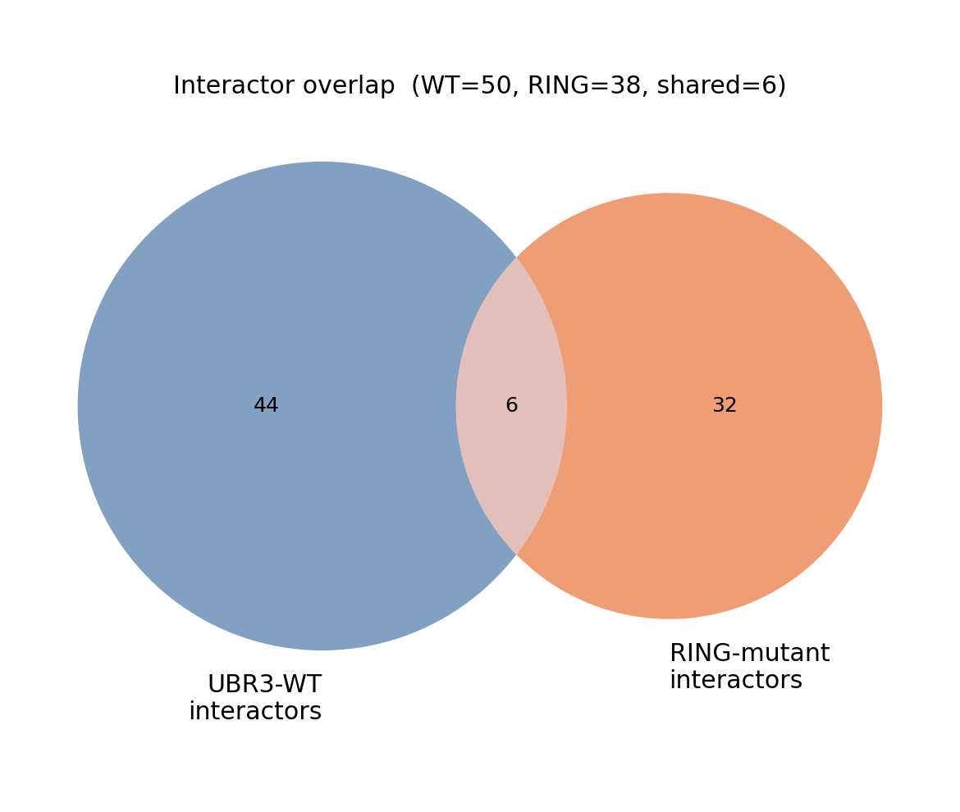
WT vs RING interactor overlap
Method
• Overlap of the significant enriched-interactor sets from the two pulldowns.
• UBR3-WT = 50 · RING mutant = 38 · shared = 6.
Statistics
• Sets defined identically (adjusted P < 0.05 & |log2 FC| ≥ 1 vs 293T).
• Limited overlap → the intact vs catalytically-dead ligase engage largely distinct partners.

Slide 10
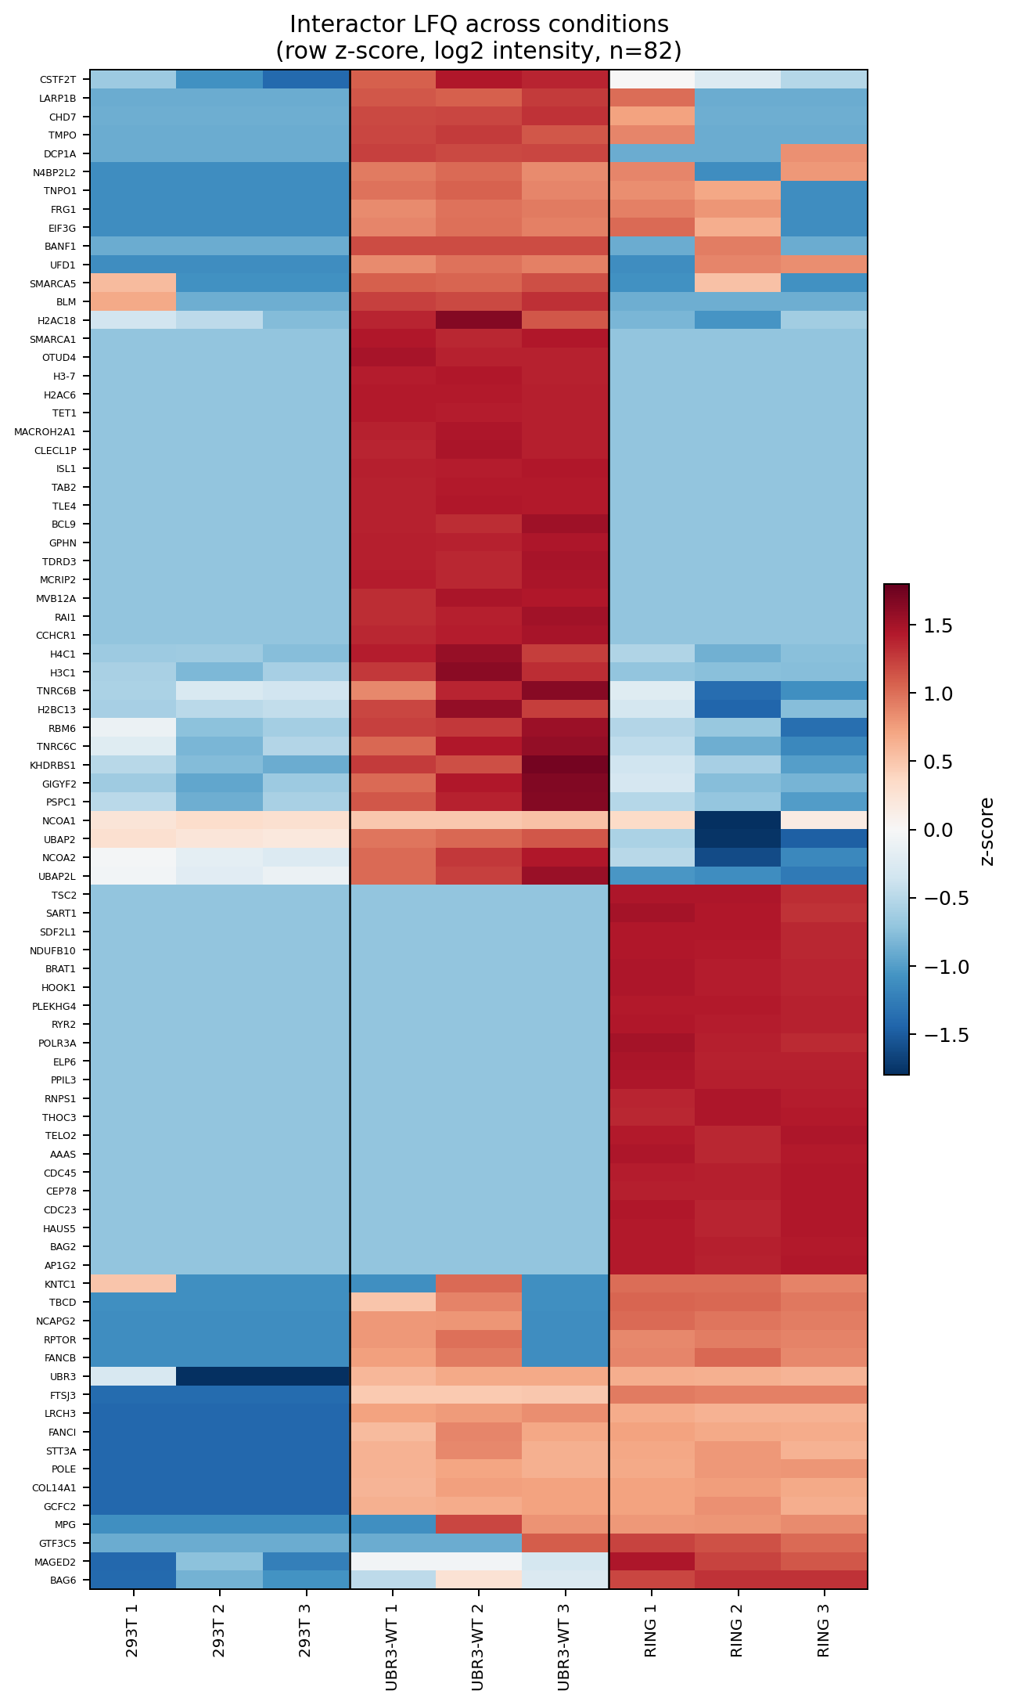
Interactor abundance heatmap (clustered)
Method
• Log2 LFQ intensity of the 82 interactors across all 9 samples (3 × 293T, WT, RING).
• Rows clustered by similarity so co-behaving proteins group together.
Statistics
• Row z-score: each protein’s values standardised (mean 0, sd 1) across samples; colour = z-score (red high, blue low).
• Clustering: Ward linkage on Euclidean distance of the z-scored rows.

Slide 11
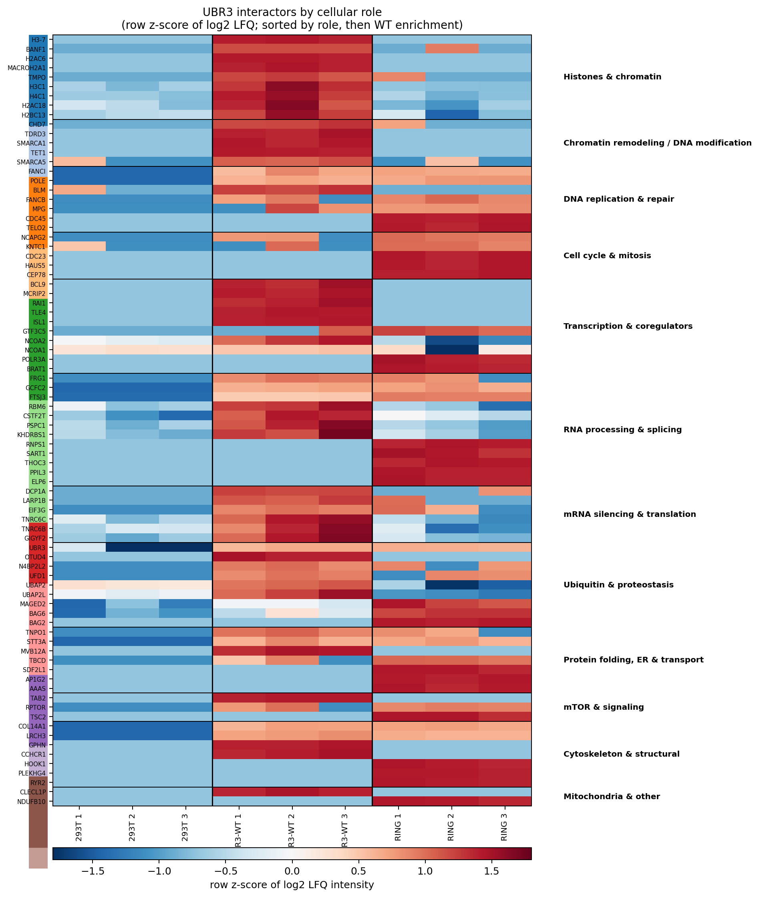
Interactor heatmap organised by cellular role
Method
• Same data, but rows grouped into 12 curated cellular-role categories (colour strip at left) instead of clustering.
• Within each role, sorted by WT enrichment.
Statistics
• Row z-score of log2 LFQ (as above).
• Roles assigned from each protein’s known function, informed by the GO/enrichment results.
Key result
• WT-preferring roles = chromatin / transcription / mRNA silencing; RING-preferring = DNA repair / cell cycle / RNA processing.

Slide 12
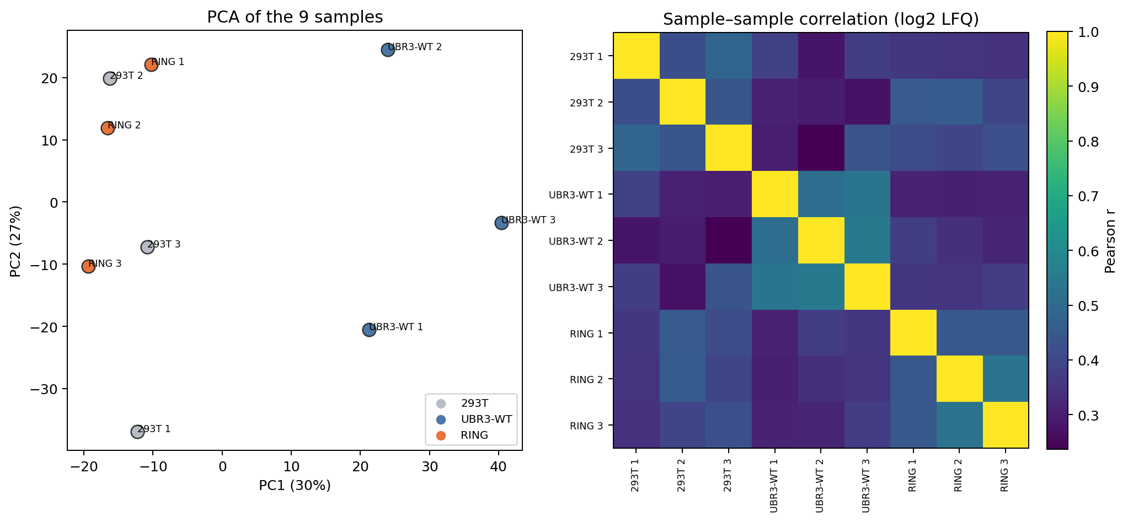
Sample quality control — PCA & correlation
Method
• Left: principal-component analysis of the 9 samples. Right: pairwise Pearson correlation of samples.
• Based on log2 LFQ of proteins detected in ≥ 6 samples.
Statistics
• PCA on standardised log2 LFQ; percentages = variance explained by PC1/PC2.
• Correlation = Pearson r between samples.
Interpretation
• Replicates group loosely by condition; UBR3-WT is the most variable, so borderline WT-only hits are noisier (the t-test already accounts for variance).

Slide 13
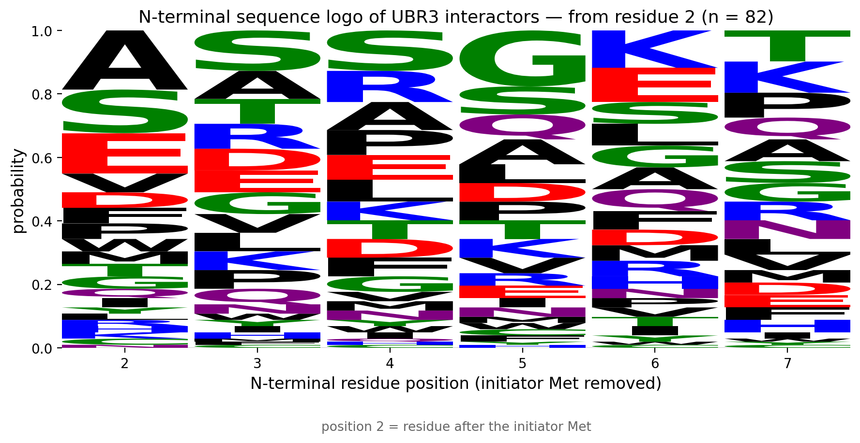
N-degron analysis — N-terminal sequence logo (from residue 2)
Method
• Sequence logo of the 6 N-terminal residues starting at position 2 (initiator Met removed) for the 82 interactors.
• Letter height = probability (relative frequency of each amino acid at that position).
• Position 2 = the residue immediately after the initiator Met.
Statistics
• No conserved motif: position 2 is a mix (A most common, then S, E, V, D…); information content < 0.5 bits at every position.
• UBR3 is a UBR-box E3 (N-recognin family) that recognises destabilising N-termini (type-1 basic R/K/H; type-2 bulky F/W/Y/L/I) — none of which dominate here.
Caveat
• Position 2 is only the true N-terminus if the initiator Met is co-translationally removed — which happens ONLY when position 2 is a small residue (A/C/G/P/S/T/V), and those are all stabilising. Bulky/charged residues at position 2 (E, D, F…) retain the Met, so they are not actually N-terminal → no genuine Arg/N-degron signal.

Slide 14
Summary
Interactors
• 50 UBR3-WT and 38 RING-mutant specific interactors (union 82); bait UBR3 top hit (QC passed).
Function (GO / DAVID / STRING)
• Coherent nuclear-chromatin & DNA-damage / cell-cycle interactome; PPI-enrichment p = 1.3e-11 (not random).
• Modules: histones/chromatin remodelling, DNA repair/replication, mRNA silencing.
RING-dependence
• 45 WT-preferring (RING-dependent binding), 31 RING-preferring (candidate trapped substrates), 6 shared.
• WT- vs RING-preferring partners map to distinct cellular roles.
Statistics used
• Interactors: two-sided t-test + Benjamini-Hochberg FDR (adj P<0.05, |log2FC|≥1).
• Enrichment: g:Profiler g:SCS (GO) and Fisher + BH (DAVID/Enrichr). Network: STRING PPI-enrichment.
• N-degron: Fisher’s exact test. n = 3 biological replicates per condition.
Caveats
• Candidate trapped substrates need orthogonal validation; UBR3-WT replicates are the most variable; DAVID run via Enrichr equivalent.

