Slide 1
MP Project — N-terminal Enrichment Analysis
155 hit peptides vs N-terminome GPS screen library
Two-background comparison:
1) vs all MP-starting peptides in the library (n = 1,263)
2) vs the full GPS library, all N-termini (n = 23,408)
Each section: enrichment heatmap, frequency heatmaps, Fisher's exact significance, sequence logo, property-grouped heatmap, per-position top movers.

Slide 2
Data sources, definitions & methods
Inputs:
• MP project peptide list — 155 user-supplied gene / transcript IDs (some with explicit |ENST suffix). Loaded from peptide_list.txt; duplicate ' 2' suffixes are stripped.
• Library — Data S3.xlsx (N-terminome GPS screen, in different genetic backgrounds). Sheets Data S3A / S3B / S3C are concatenated and deduplicated on Ensembl Transcript ID, giving 23,408 unique transcripts. 1,263 of those start with M-P. Each entry has a 24-residue N-terminal peptide sequence.
Definitions:
• 'MP peptide' = peptide whose AA sequence starts with M-P.
• Each user entry is matched to the library first by Ensembl transcript (when supplied), otherwise by gene symbol; we then take the first MP-starting peptide from the matching rows. All 155 entries match (0 unmatched).
Enrichment statistic:
• At every (amino acid, position) cell, log2( hit_freq / library_freq ), with a Laplace pseudocount of 0.5 added to raw counts before normalisation.
• Cells where both hit and library counts are exactly 0 are set to 0 (avoids pseudocount artefacts in fully empty cells).
• Significance is two-sided Fisher's exact (AA vs others, hits vs library). No multiple-testing correction.

Slide 3
Section 1 — vs MP-only library background
Background:
• 1,263 unique MP-starting peptides in the GPS library.
• This is the conservative comparison: it cancels out the library's design constraints around the M-P start and isolates the biological signal at positions 3 and beyond.
Why this matters:
• If a residue is enriched at position 4 vs MP library, it is enriched relative to OTHER MP peptides — i.e. it is a true preference within the M-P starting population.

Slide 4
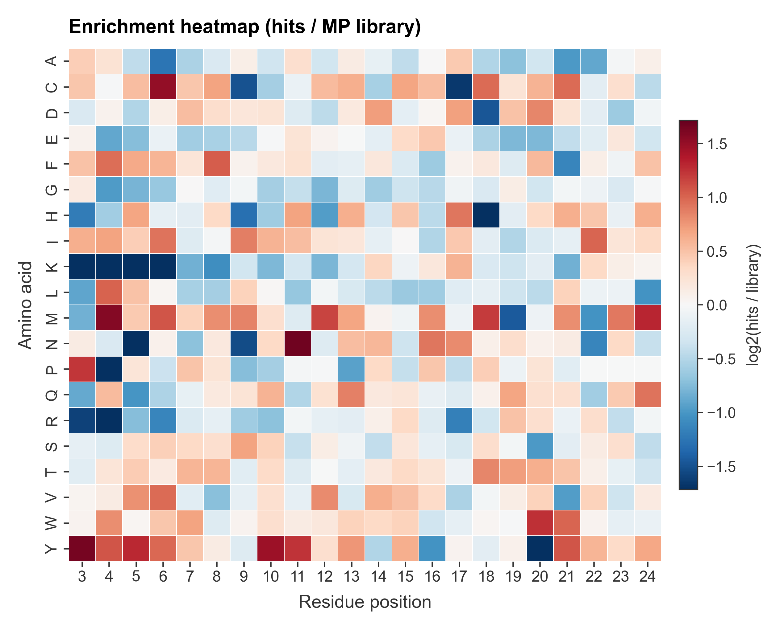
Enrichment heatmap (primary)
MP project (n=155) vs all MP peptides in the GPS library (n=1,263)
Explanation
Each cell shows log2(frequency in hits / frequency in MP library) for one amino acid (rows) at one residue position (columns).
Red = enriched in your hits, blue = depleted, white ≈ no change.
The strongest signals sit at positions 3–7: Y, M, F, W, V, C are enriched while K, R, N, P are depleted — the canonical hydrophobic / aromatic preference of an N-degron pathway after the conserved M-P start.
Methods
Counts of each amino acid at each position were computed for both the hit set and the MP library, then converted to per-position frequencies. log2 ratio reported with a Laplace pseudocount of 0.5 to avoid divide-by-zero. Cells where both groups have zero observations are forced to 0. Positions 1 (always M) and 2 (always P in MP peptides) are invariant in both groups and were excluded; positions 3–24 are shown.

Slide 5
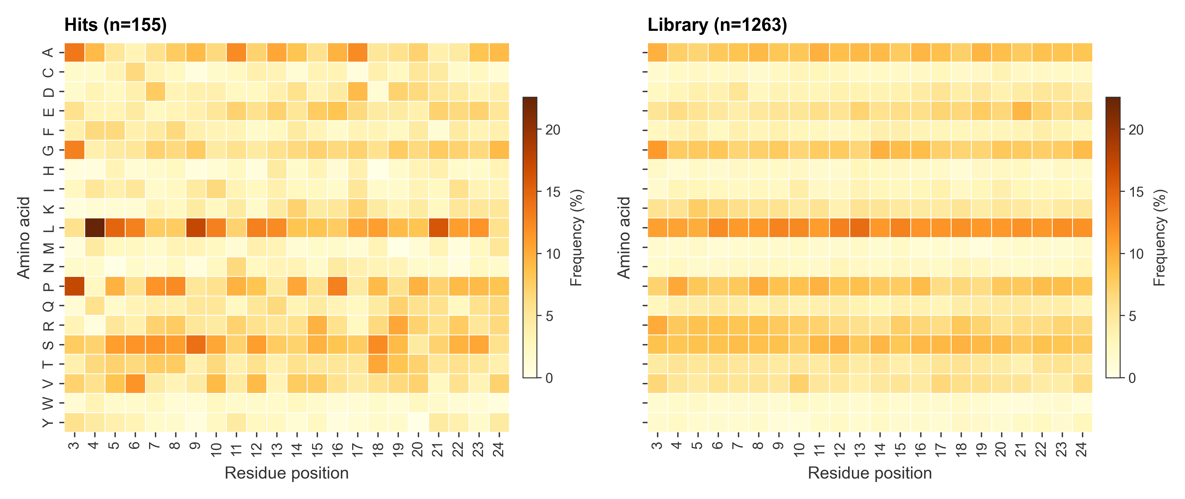
Per-position frequency heatmaps
Raw amino-acid frequencies — hits vs MP library
Explanation
Same data without the ratio — panel A is the hit set, panel B is the MP library. Both panels share the same colour scale so the darker cell is the more frequent residue at that position.
The library (B) is roughly uniform; the hits (A) show clear patches of darker colour at hydrophobic / aromatic rows and at positions 3–7, which is what produces the red areas in the enrichment heatmap.
Methods
Frequency = count of AA at position / total count at that position, expressed as a percentage. No pseudocount, no ratio — this is purely descriptive.

Slide 6
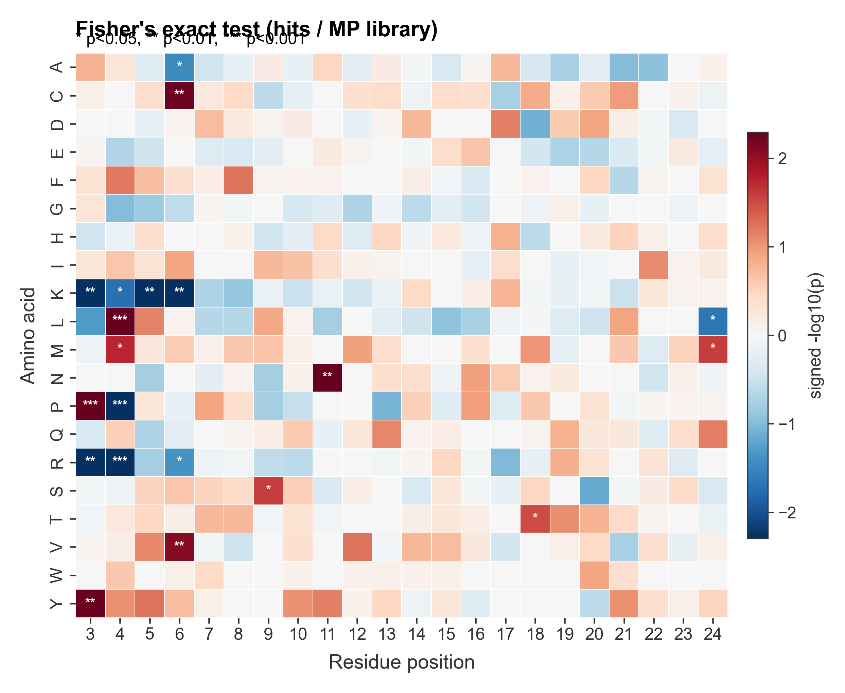
Statistical significance — Fisher's exact
Signed -log10(p) for each (AA, position) cell
Explanation
Same layout as the enrichment heatmap, but each cell is a signed -log10(p) from a 2×2 Fisher's exact test (AA-of-interest vs others, hit set vs MP library).
* = p<0.05, ** = p<0.01, *** = p<0.001 (two-sided).
The most significant signals (***) are at positions 3 and 4: P and Y enriched, K / R / L / P depleted — these are the cells you can quote with statistical confidence.
Methods
For each (AA, position) cell, a 2×2 contingency table was built (rows: hits / library, columns: this AA / all other AAs at that position). p-values come from scipy.stats.fisher_exact, two-sided. The colour is sign(observed − expected) × -log10(p). No multiple-testing correction is applied; treat single-cell p-values as descriptive.

Slide 7
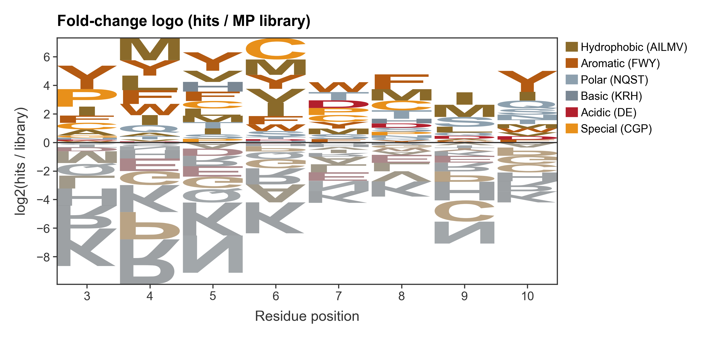
Enrichment sequence logo
Letter heights = log2(hit / library), coloured by chemistry
Explanation
A sequence logo where letter height encodes log2 enrichment directly. Letters above the baseline = enriched in hits; letters below (flipped upside-down) = depleted.
Letters are coloured by amino-acid chemistry group: green = hydrophobic, purple = aromatic, light blue = polar, dark blue = basic, red = acidic, orange = special (C, G, P).
The aromatic / hydrophobic stack at positions 3–7 above the baseline and the basic stack below are the visual summary of the substrate preference.
Methods
Built with logomaker. Letter values are the same log2 enrichment matrix used in the heatmap (with the 0/0-cell mask applied), focused on positions 3–10 for figure readability. Negative values are rendered flipped below the baseline.

Slide 8
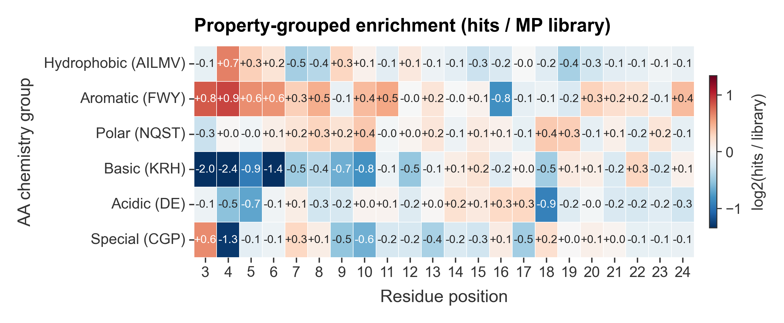
Property-grouped enrichment
Amino acids collapsed into 6 chemistry groups
Explanation
The same enrichment, summed within chemistry groups so the global trend is easier to read at a glance.
Aromatic (FWY) is enriched at positions 3–10. Basic (KRH) is depleted across positions 3–10 — strongest at position 4 (log2 ≈ −2.5). Acidic (DE) is mostly flat. Special (CGP) shows the M-P motif extension into early positions.
Methods
For each group, hit and library counts were summed across the AAs in the group at each position, then a log2 ratio was taken with the same pseudocount and total-normalisation as the AA-level heatmap. The groups are: Hydrophobic (AILMV), Aromatic (FWY), Polar (NQST), Basic (KRH), Acidic (DE), Special (CGP).

Slide 9
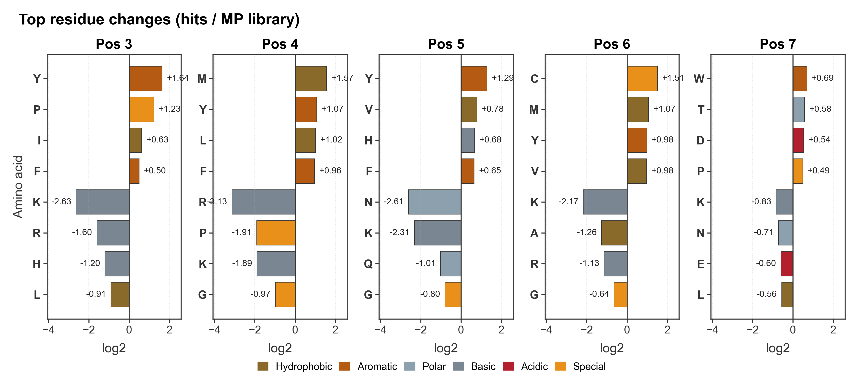
Top movers per position (3–7)
Four most enriched and four most depleted residues at each early position
Explanation
For each early residue position (3 through 7), a horizontal bar chart of the four most enriched (top, positive bars) and four most depleted (bottom, negative bars) amino acids. Bar colour = chemistry group; numeric label = log2 enrichment.
Useful as a 'pull-quote' figure: at every position 3–6 a basic residue (K or R) is the single most depleted residue, and at every position an aromatic / bulky-hydrophobic residue (Y, M, F, W, V, C) is the most enriched.
Methods
Top-4 enriched and top-4 depleted residues at each position were ranked by the same log2-enrichment score. All five panels share the same x-axis range so the bar lengths are directly comparable across positions.

Slide 10
Section 2 — vs FULL library background
Background:
• All 23,408 unique transcripts in the GPS library (every N-terminus, not just MP starts).
What this comparison answers:
• Are the position-3-and-beyond preferences seen in Section 1 a property of the MP-only sub-library, or of the hit set? Comparing the same 155 hits to the entire library isolates the biology from the M-P start design.
Display choices (kept identical to Section 1):
• Positions 3–24 are shown in every plot.
• Position 1 is invariant (always M) in both groups.
• Position 2 trivially enriches for P (every hit starts MP, only ~5.4 % of the library does); we exclude it so the biology at positions 3+ isn't obscured by the M-P design signal.

Slide 11
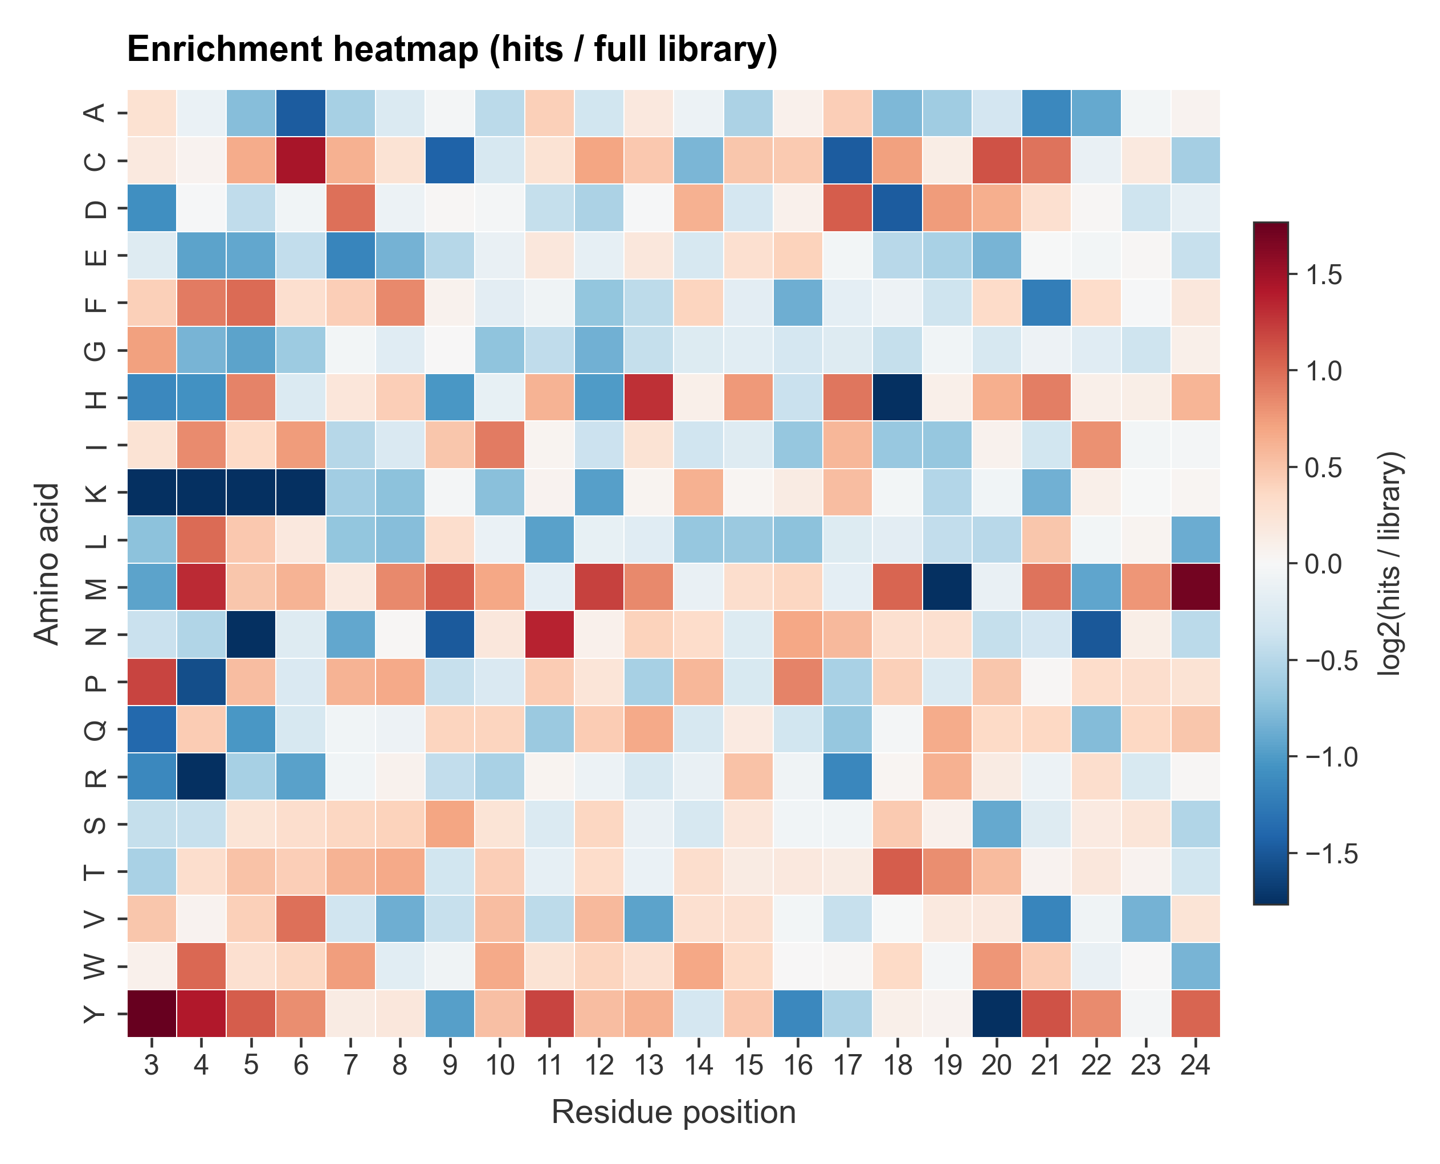
Enrichment heatmap (primary)
MP project (n=155) vs full GPS library (n=23,408)
Explanation
Same layout as the MP-vs-MP heatmap, but the background is now every N-terminus in the GPS library — not just the M-P starts.
The biological signature is preserved: aromatic / bulky-hydrophobic residues (Y, M, F, W, V, C) are enriched at positions 3–7 and basic residues (K, R) are depleted, with the strongest depletion at position 4 (R log2 ≈ −3.0).
Compared to the MP-vs-MP heatmap, the absolute log2 values are similar — confirming that the signal is biological and not an artefact of the library's M-P starting design.
Methods
Counts → frequencies → log2 ratio with 0.5 pseudocount; cells with zero counts in both groups are masked to 0. Positions 1 (invariant M) and 2 (trivially enriched for P because every hit is an MP peptide while only ~5.4 % of the library is) are excluded. Positions 3–24 are shown.

Slide 12
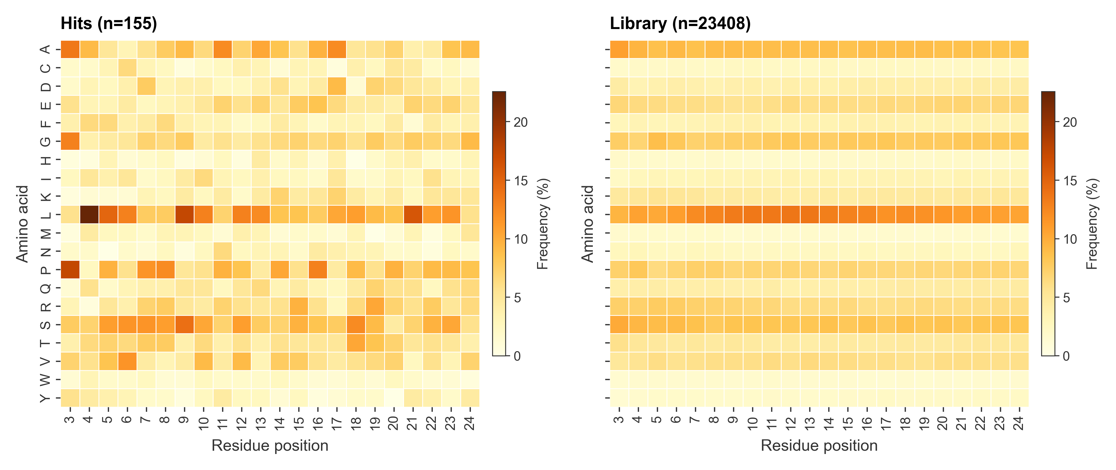
Per-position frequency heatmaps
Raw frequencies — hits vs full library
Explanation
Side-by-side raw frequencies for hits (A) and the full library (B), shared colour scale. The library panel is more uniform and slightly more intense than the MP-only library because it contains ~19× more sequences.
The hit panel still shows the aromatic / hydrophobic patches at positions 3–7 — the same signal that drives the enrichment heatmap.
Methods
Frequency = AA count divided by total count at that position, as a percentage. No pseudocount, no ratio — purely descriptive.

Slide 13
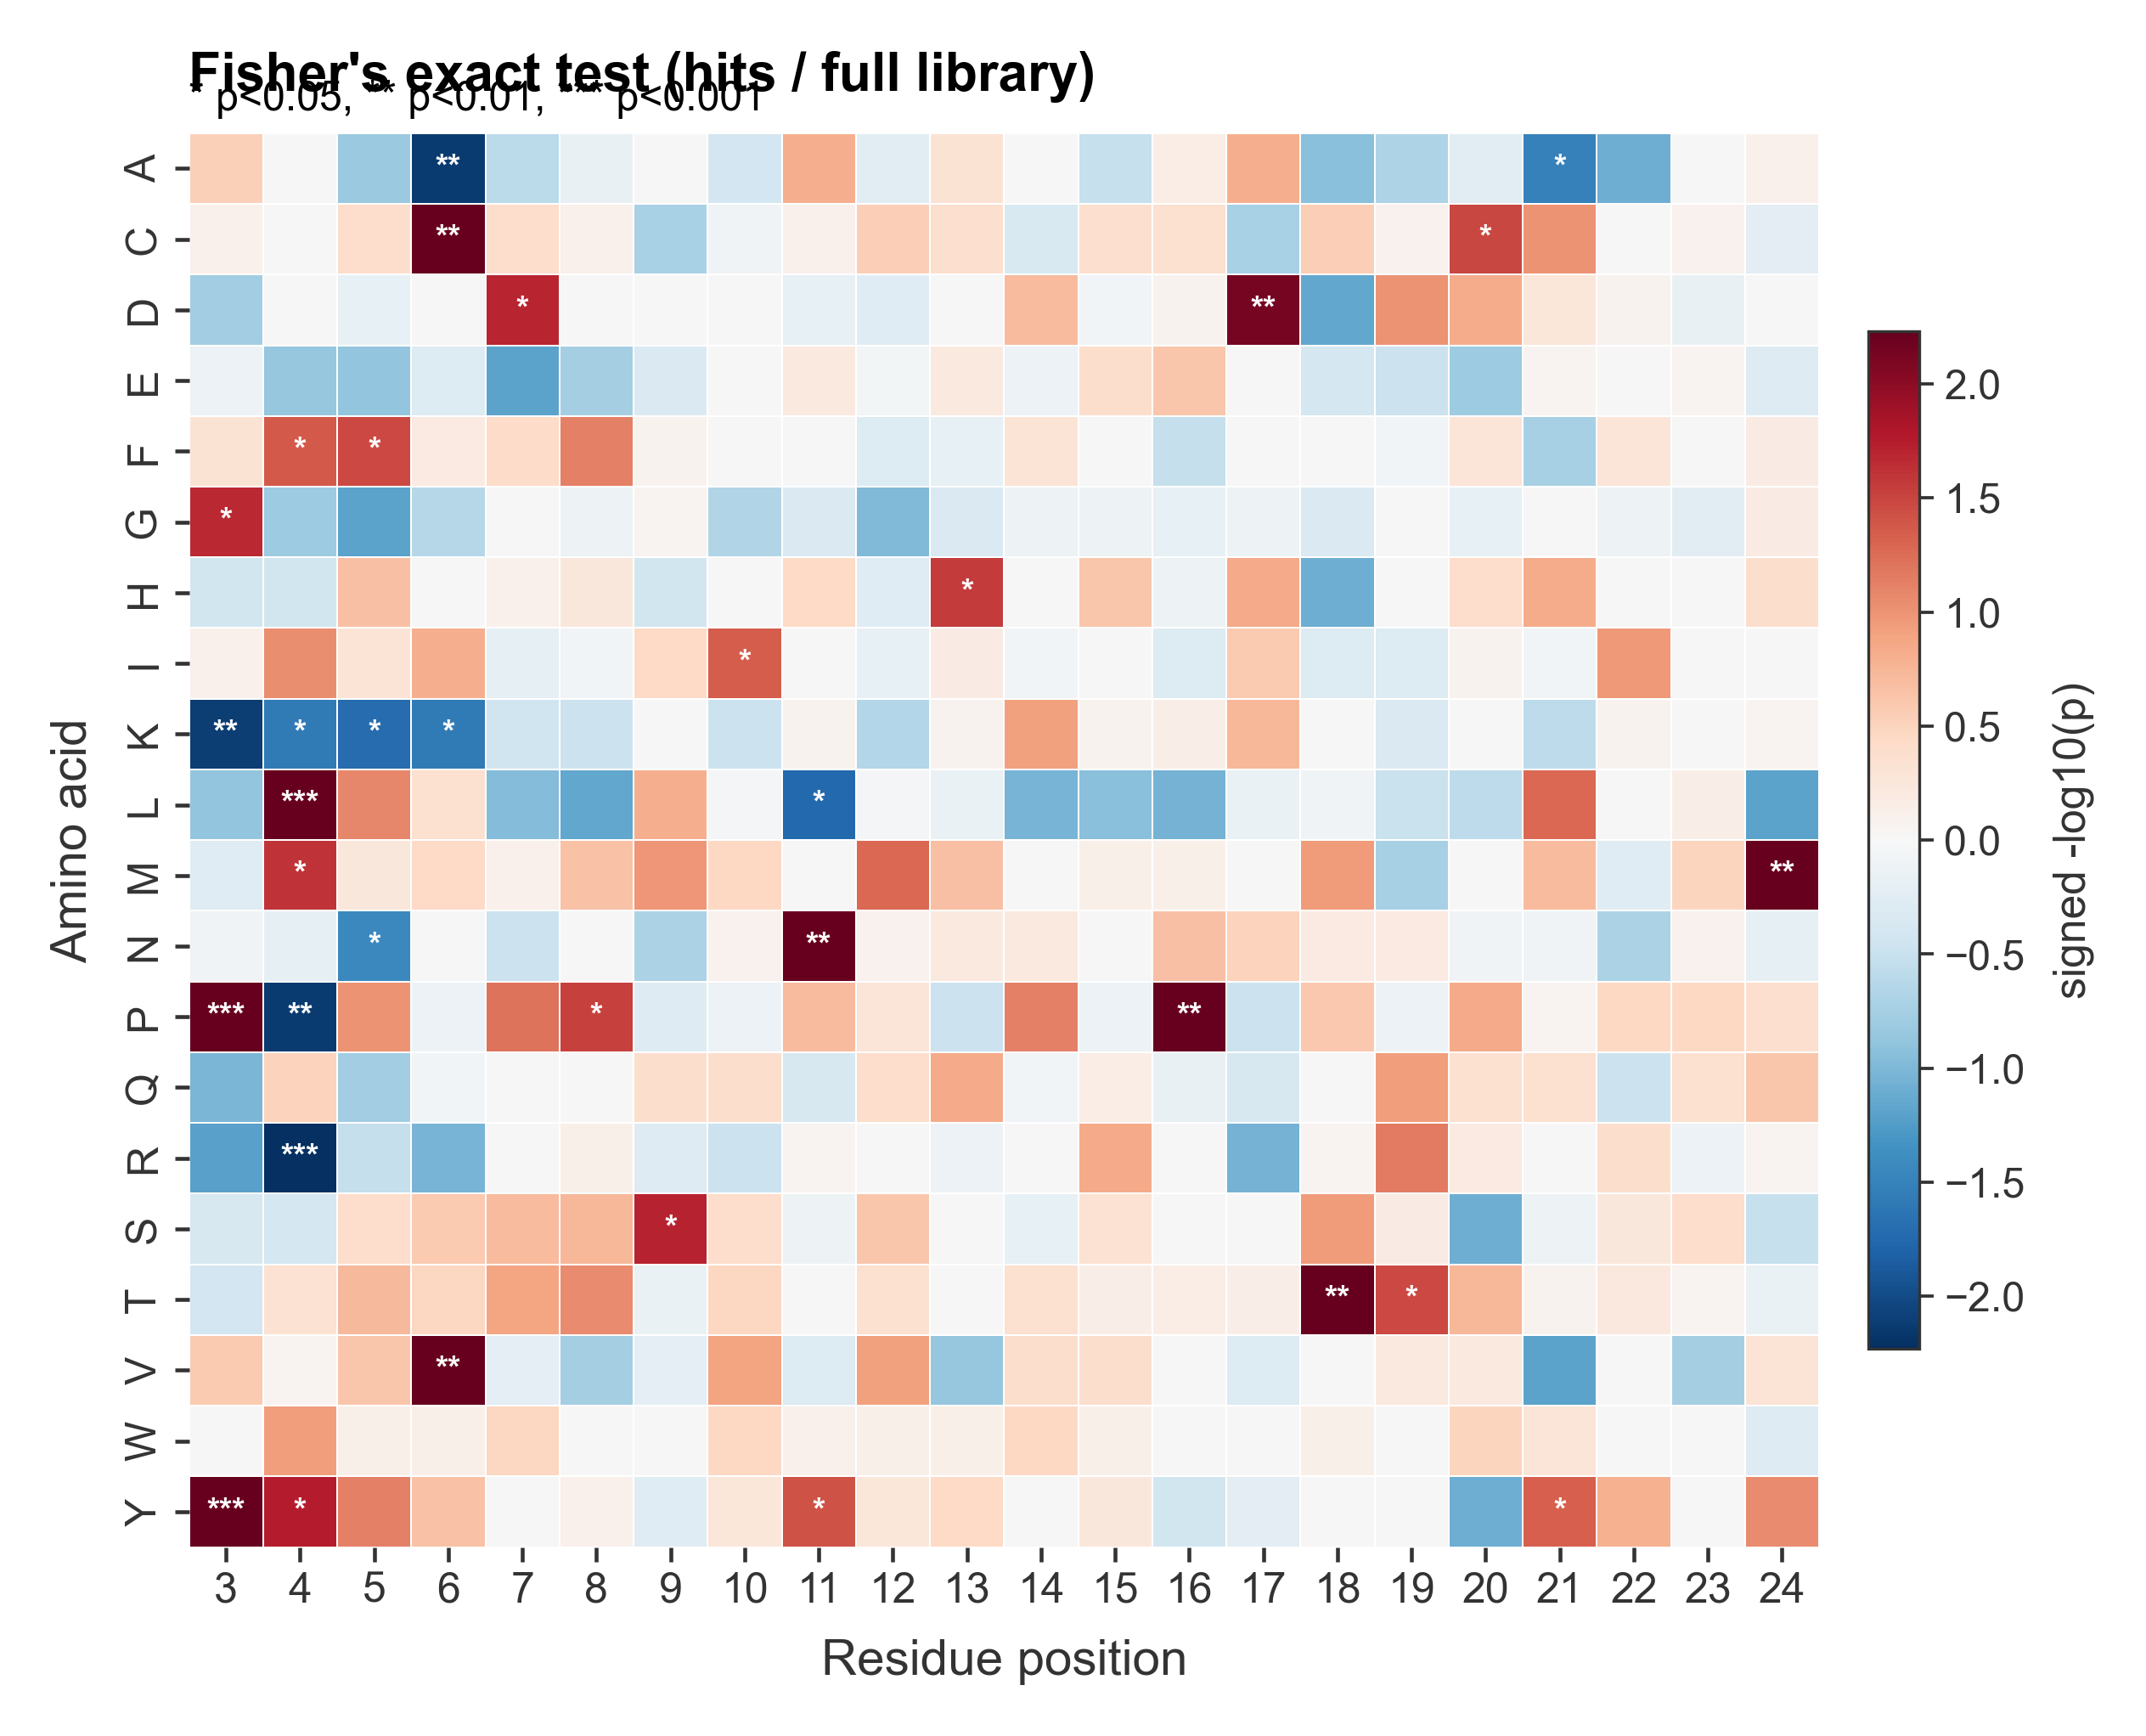
Statistical significance — Fisher's exact
Signed -log10(p), full-library background
Explanation
Same significance map as the MP-vs-MP run, but with a larger library denominator (~23 k entries), so p-values are tighter and *** labels appear in more cells.
The strongest *** signals reproduce the MP-vs-MP pattern: K, R depleted at positions 3–6; Y, P enriched at positions 3–4. Cells you can quote with statistical confidence (***) line up across both backgrounds — the biology is robust.
Methods
Two-sided Fisher's exact for each (AA, position) cell against the full library. No multiple-testing correction. Positions 3–24.

Slide 14
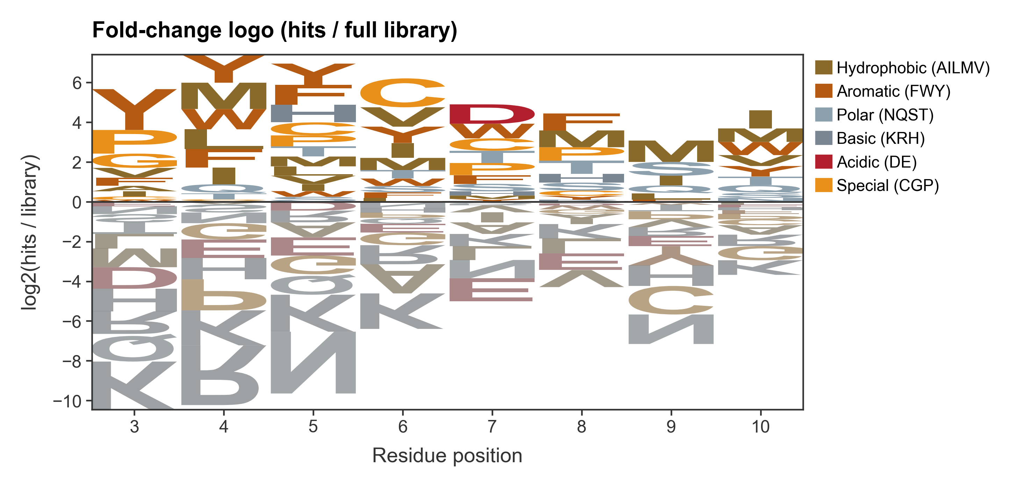
Enrichment sequence logo
Letter heights = log2(hit / full library)
Explanation
Logo of the same enrichment matrix. The aromatic / hydrophobic stack above the baseline at positions 3–7 and the basic stack below are visually similar to the MP-vs-MP logo — just slightly compressed because the larger background smoothens single-residue tails.
Methods
Same logomaker construction as the MP-vs-MP logo; positions 3–10, 0/0-cell mask applied, negative letters flipped below the baseline.

Slide 15
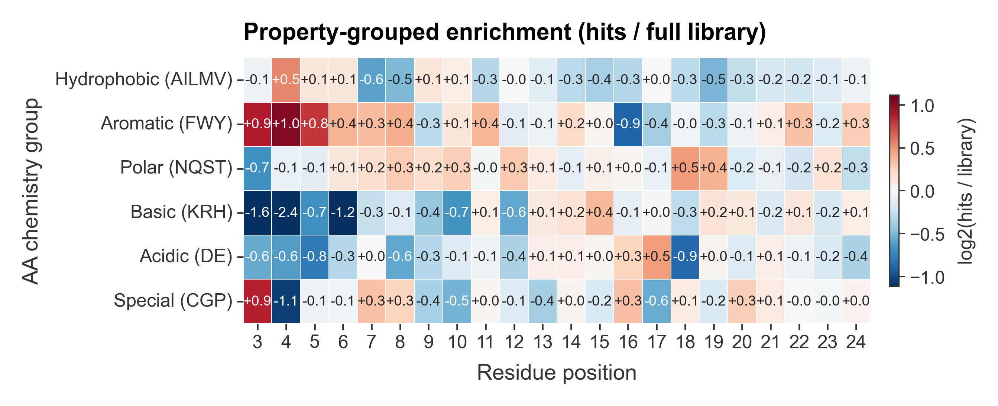
Property-grouped enrichment
Chemistry-group summary, full-library background
Explanation
Same chemistry-group summary as the MP-vs-MP run.
Position 4 still shows the strongest depletion of Basic (KRH, log2 ≈ −2.4) and Aromatic (FWY) is enriched at positions 3–10. The fact that this pattern survives a 19× larger / more diverse background confirms it's a property of the hit set, not of the MP-only library.
Methods
Same group definitions and computation as the MP-vs-MP run.

Slide 16
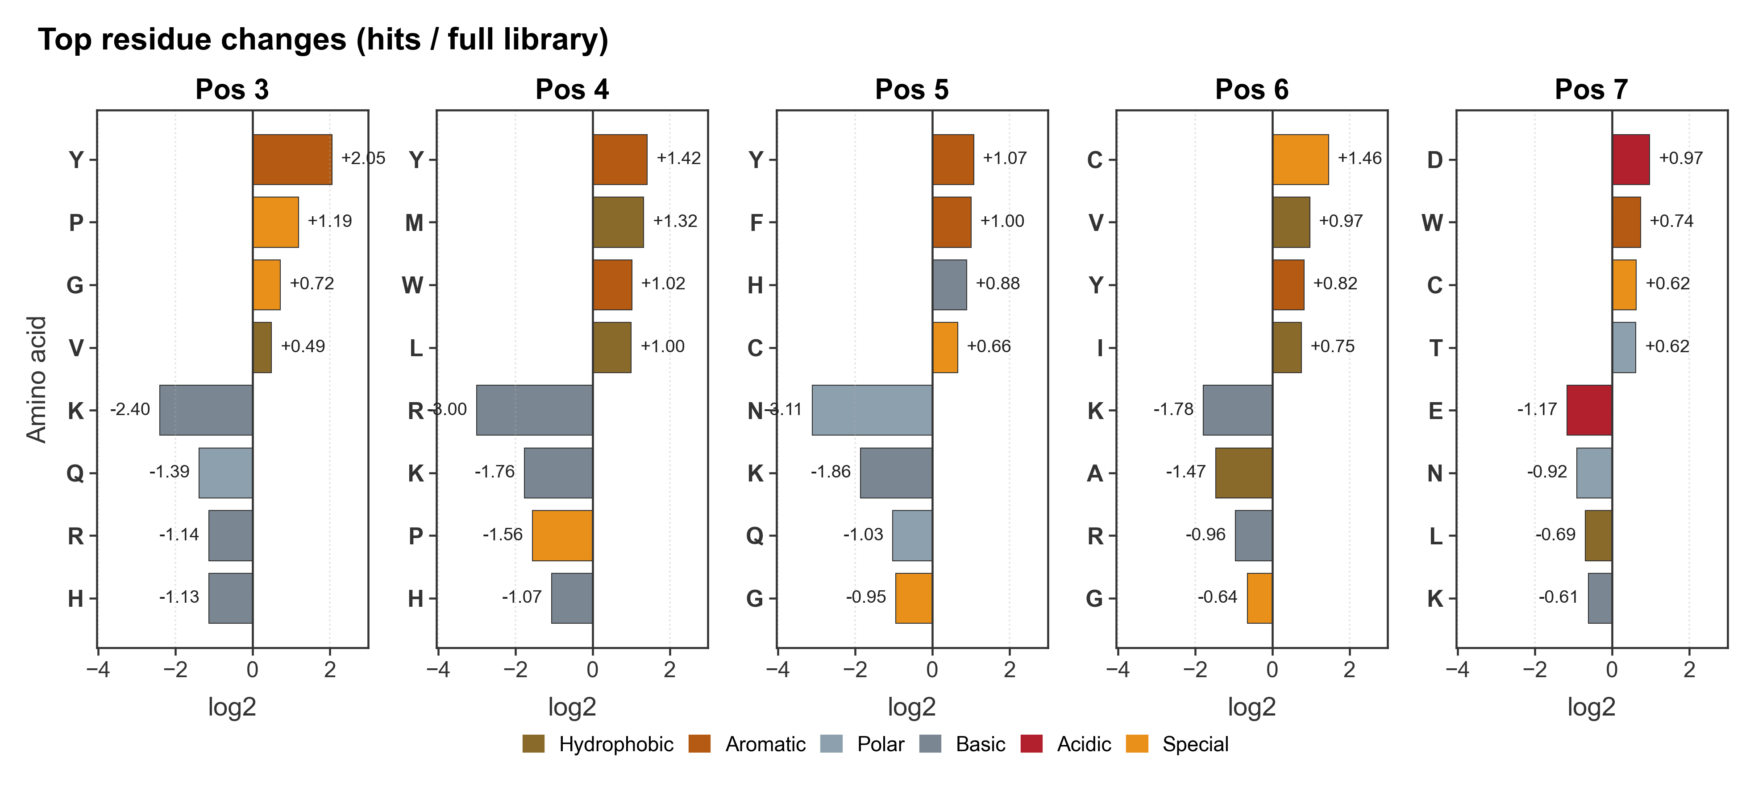
Top movers per position (3–7)
Top-4 enriched / depleted residues, full-library background
Explanation
Per-position top movers, full-library background. Comparing side by side with the MP-vs-MP panel: the same residues occupy the top and bottom slots at almost every position — Y leads positions 3–5, K and R dominate the depleted side at positions 3–6, F and M follow Y in the enriched stack at positions 4–5.
Quantitative differences exist (effects are typically a touch larger vs full library because the background is more diffuse), but the ranking is virtually identical.
Methods
Same top-4 ranking and shared x-axis as the MP-vs-MP panel; positions 3–7.

Slide 17
Summary of findings
Background-invariant biological signal (positions 3–7):
• Strong enrichment of aromatic / bulky-hydrophobic residues (Y, M, L, F, W, V, C) at the early peptide positions.
• Strong depletion of basic residues (K, R, H) and several polar / amide residues (N, Q) at the same positions.
• Largest single signals: K depleted at positions 3–6 (log2 ≈ −2 to −2.6); R depleted at position 4 (≈ −3.0 vs full library, −3.1 vs MP library).
Robustness across backgrounds:
• The same residues occupy the same enriched / depleted slots whether the hits are compared against the MP-only library (n = 1,263) or the full library (n = 23,408).
• Effect magnitudes are similar between the two backgrounds; the full-library comparison gives slightly tighter p-values thanks to the larger denominator.
Outputs delivered:
• mpProject/results/vs_MP_library/ — 6 figures + CSVs
• mpProject/results/vs_full_library/ — 6 figures + CSVs
• MP_project_results.pptx (this deck)

