Slide 1
UBR3 N-terminal Degron Screen
Statistical Reanalysis, Figures and Methods
Library: 16,514 peptides · Best hits: 54 peptides
Figures · Raw data · Methods · References

Slide 2
Contents
Each figure is on its own slide with a paper-ready caption. Methods and raw data are at the end.
▸ 1. Amino-acid enrichment heatmap — Fisher exact test (Fig 1B)
▸ 2. Top dipeptide enrichments at positions 2–3 (Fig 3)
▸ 3. Fold-change sequence logo (positions 2 and 3) (Fig 4)
▸ 4. Combined dipeptide groups PD+PE+PT and GE+GD — Mann-Whitney U
▸ 5. Combined dipeptide groups — Brunner-Munzel + Cohen's d
▸ 6. Volcano plot — moderated t-test (limma-style EB) + BH FDR (Fig 20c)
▸ 7. Methods section (paper-ready)
▸ 8. Raw data — Top Hits (PD+PE+PT and GE+GD)
▸ 9. Software, packages, references
UBR3 N-terminal screen · 2/14

Slide 3
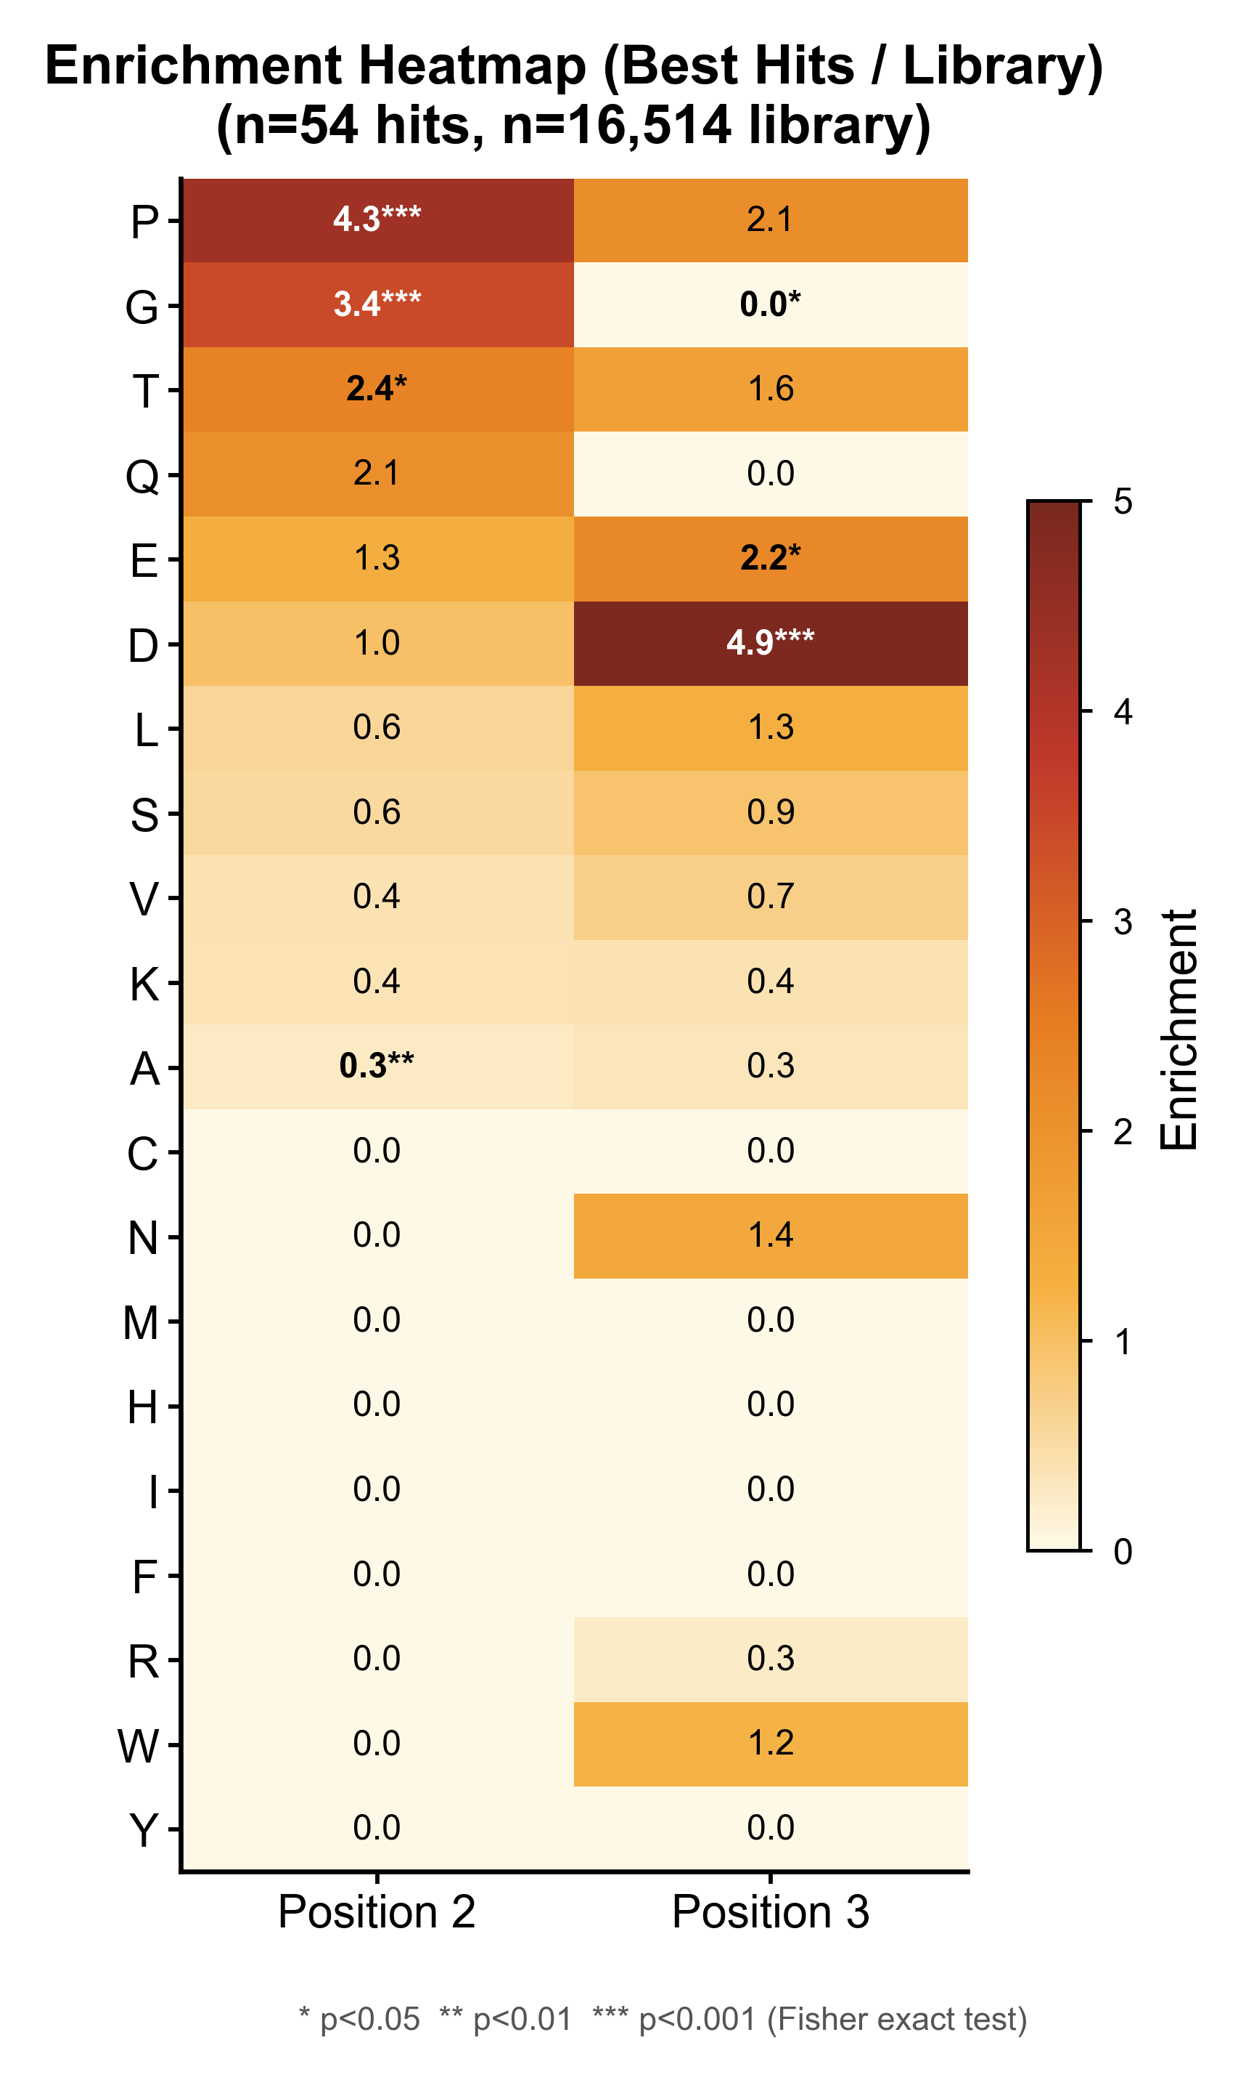
Fig 1B. Amino-acid enrichment heatmap (Positions 2 and 3)
Best hits vs. full library | Fisher exact test
Description
• Heatmap of per-residue enrichment at the two positions immediately after the N-terminal Met.
• Enrichment = frequency in best hits / frequency in library. Rows sorted by enrichment at position 2.
• P, G and T dominate position 2; D, E and N dominate position 3 — consistent with the UBR family Nt-degron recognition rules.
• Stars indicate significance from Fisher exact tests (two-sided) on 2×2 contingency tables (hit vs. non-hit × carries AA vs. does not).
Statistical method
• Test: Fisher exact (two-sided) scipy.stats.fisher_exact
• 2×2 table per amino acid × position
• n_hits = 54, n_library = 16,514
• * p<0.05 ** p<0.01 *** p<0.001
Editable vector (SVG) available in project folder

Slide 4
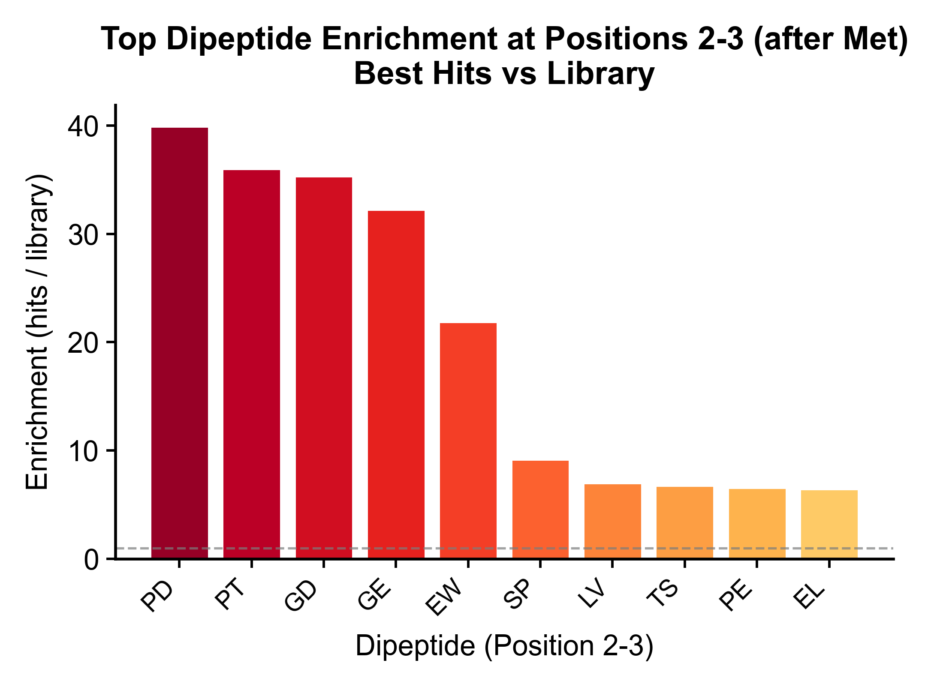
Fig 3. Top-10 dipeptide enrichments at P2-P3
Best hits vs. full library | frequency fold-change
Description
• Ranked enrichment of the 10 most frequent dipeptides at positions 2–3 in the best-hits subset (out of the top-20 observed).
• Dipeptide enrichment = f(dipeptide|hits) / f(dipeptide|library).
• PD, PT, GD and GE exceed 30× enrichment — these are the dominant P2-P3 motifs in UBR3 substrates.
• Dashed line at 1 marks the background (library) frequency.
Statistical method
• Frequency-based enrichment, no statistical test (descriptive).
• Chart truncated at dipeptide EL (rank 10).
• See Fig 1C in the project for the complete 20×20 heatmap.
Editable vector (SVG) available in project folder

Slide 5
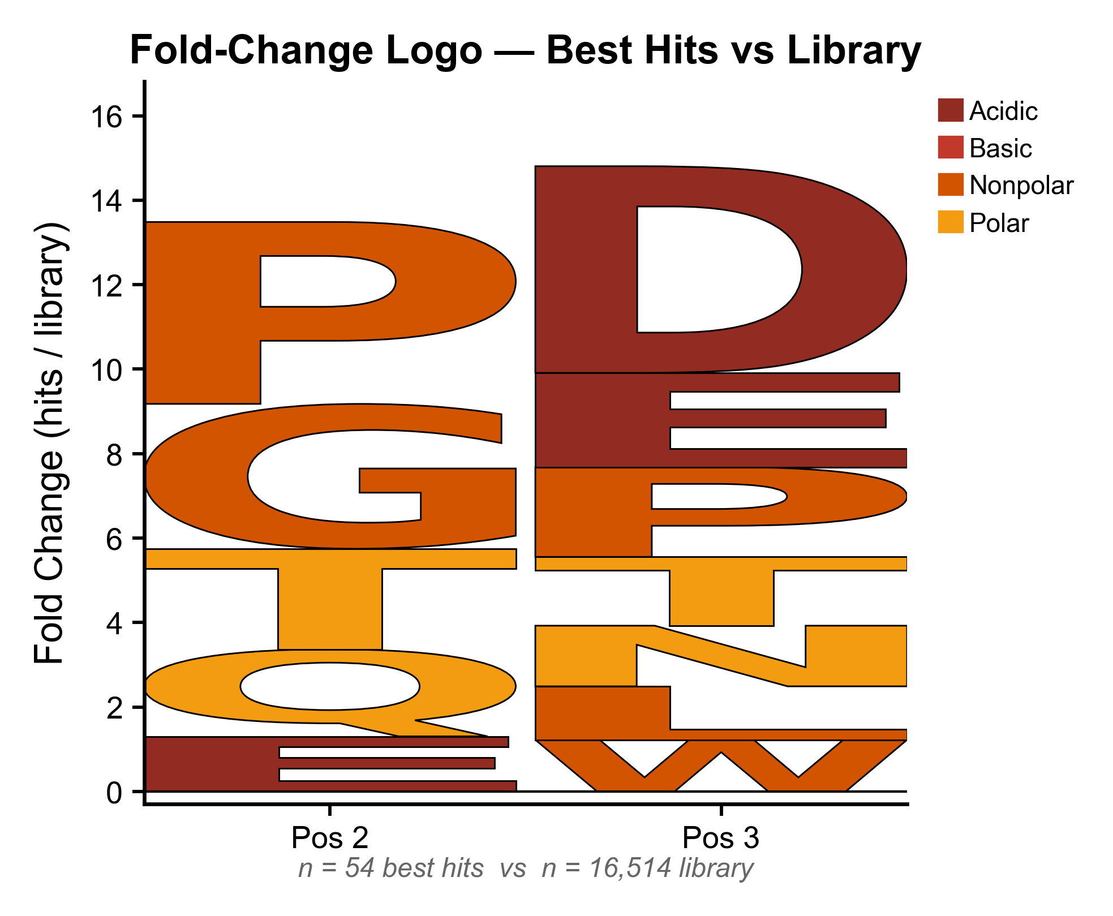
Fig 4. Fold-change sequence logo
Best hits vs. library at positions 2 and 3
Description
• Stacked logo where each letter's height equals its fold-change (enrichment) at that position; letters with FC ≤ 1 are hidden.
• Colour = biochemical category: Acidic (dark red), Basic, Nonpolar (orange) and Polar (yellow).
• Position 2 is dominated by P and G (large Nonpolar stack); position 3 is dominated by D and E (Acidic stack).
• A simultaneous P/G at P2 and D/E at P3 defines the core UBR3 motif.
Statistical method
• Built with logomaker (Python); stack_order="big_on_top".
• Matrix = per-residue enrichment (hits/library); threshold at 1.
• No statistical test — descriptive visualization of enrichment.
Editable vector (SVG) available in project folder

Slide 6
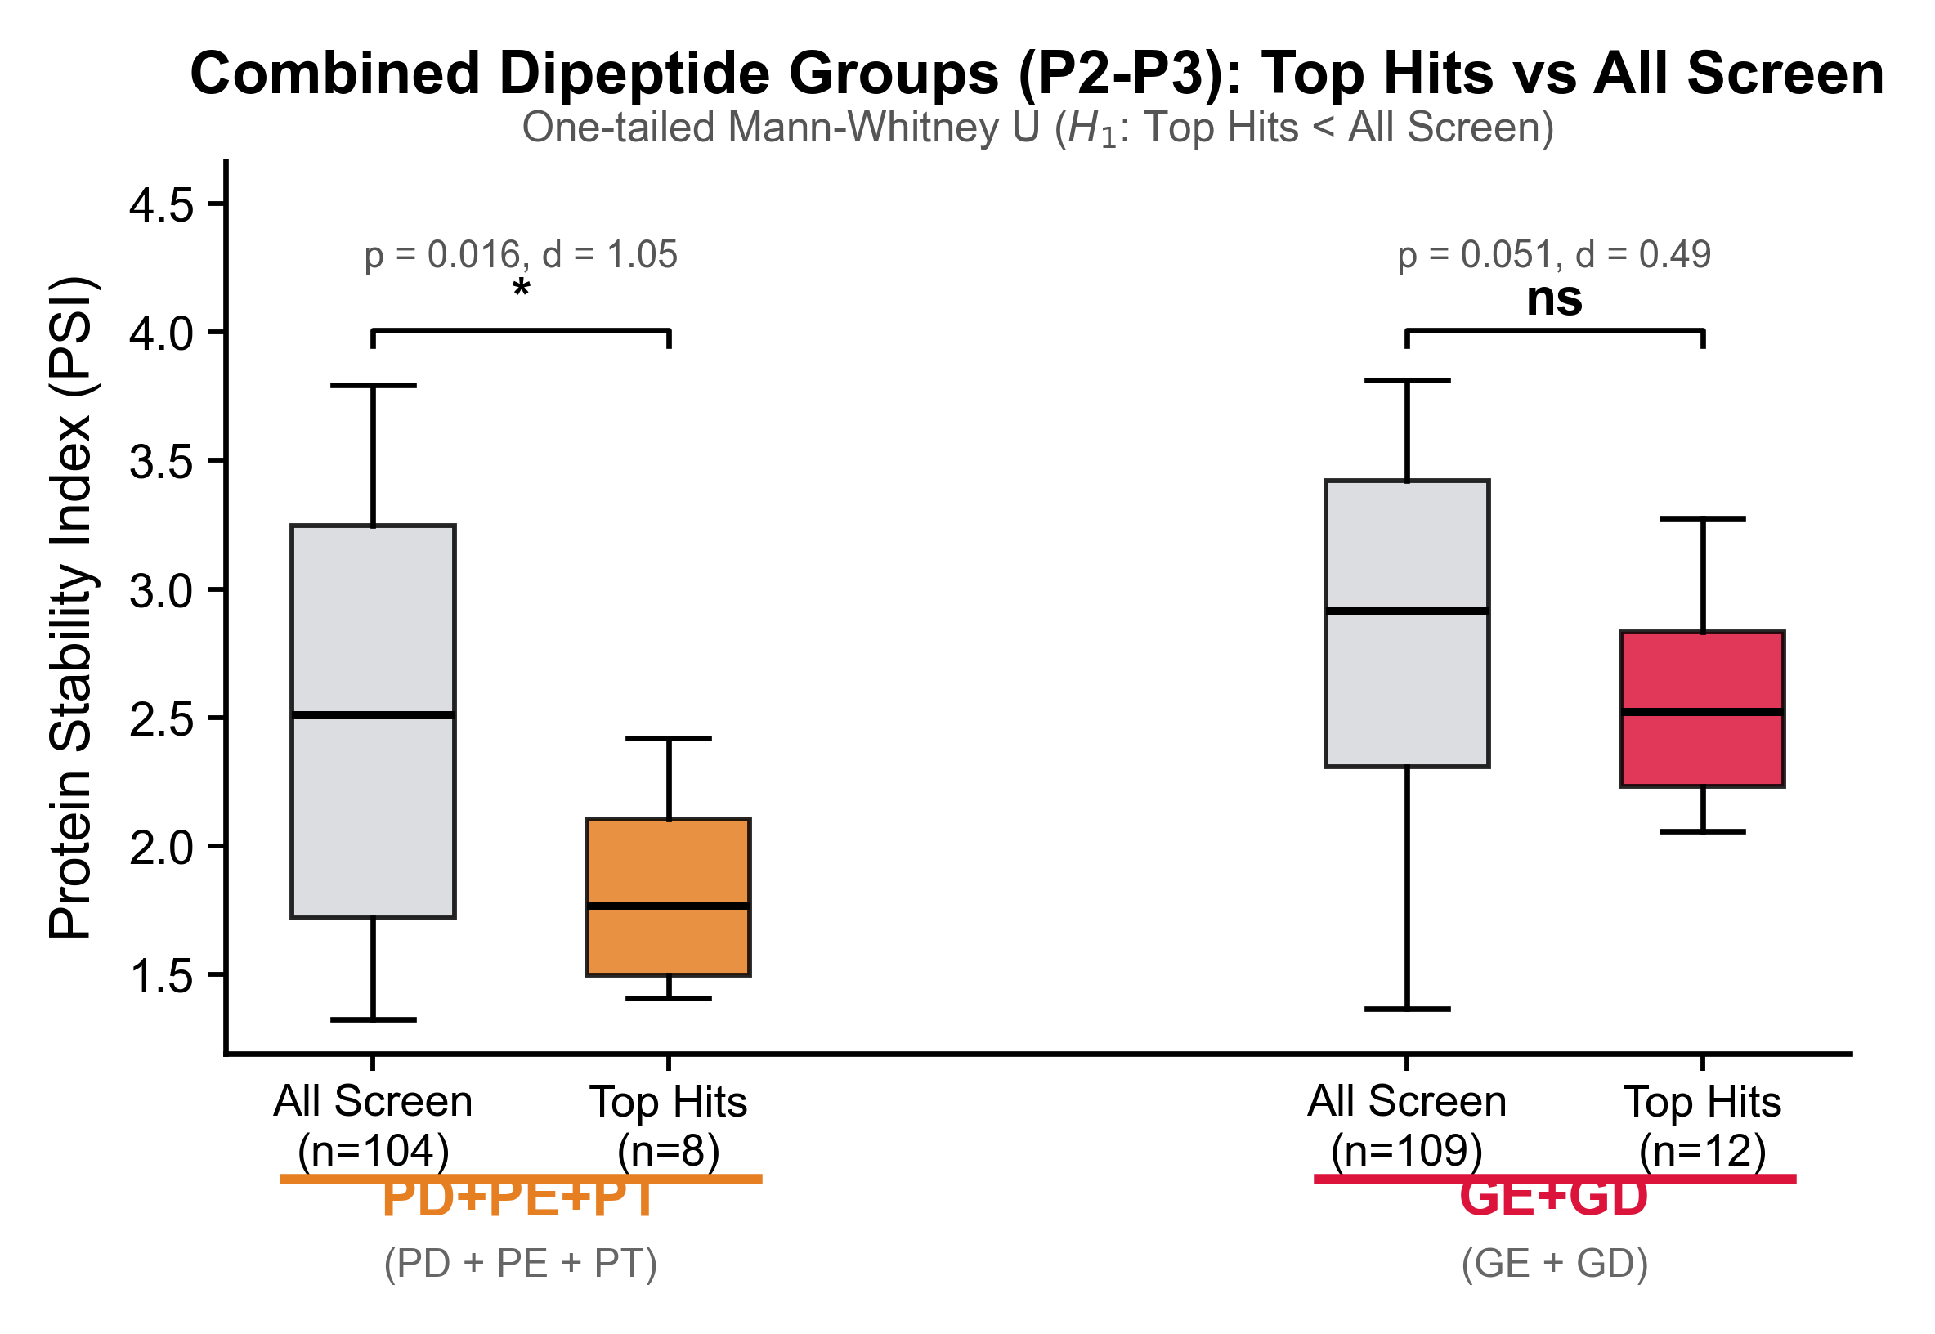
Combined dipeptide groups — Mann-Whitney U test
PD+PE+PT and GE+GD — PSI in control (AAVS) cells
Description
• PSI (Protein Stability Index in the AAVS control cell line) compared between Top Hits and the full library for two pooled motif groups.
• PD+PE+PT: n_hits = 8, n_all = 104 → p = 0.016 (*)
• GE+GD: n_hits = 12, n_all = 109 → p = 0.051 (ns, borderline)
• One-tailed test (H₁: Top Hits < All Screen) reflecting the pre-specified hypothesis that destabilizing motifs have lower PSI.
Statistical method
• Test: one-tailed Mann-Whitney U
• scipy.stats.mannwhitneyu(alternative="less")
• Rank-based; assumes similar dispersions in both groups.
• With unequal SDs + unequal N, MW is conservative here → see next slide.
Editable vector (SVG) available in project folder

Slide 7
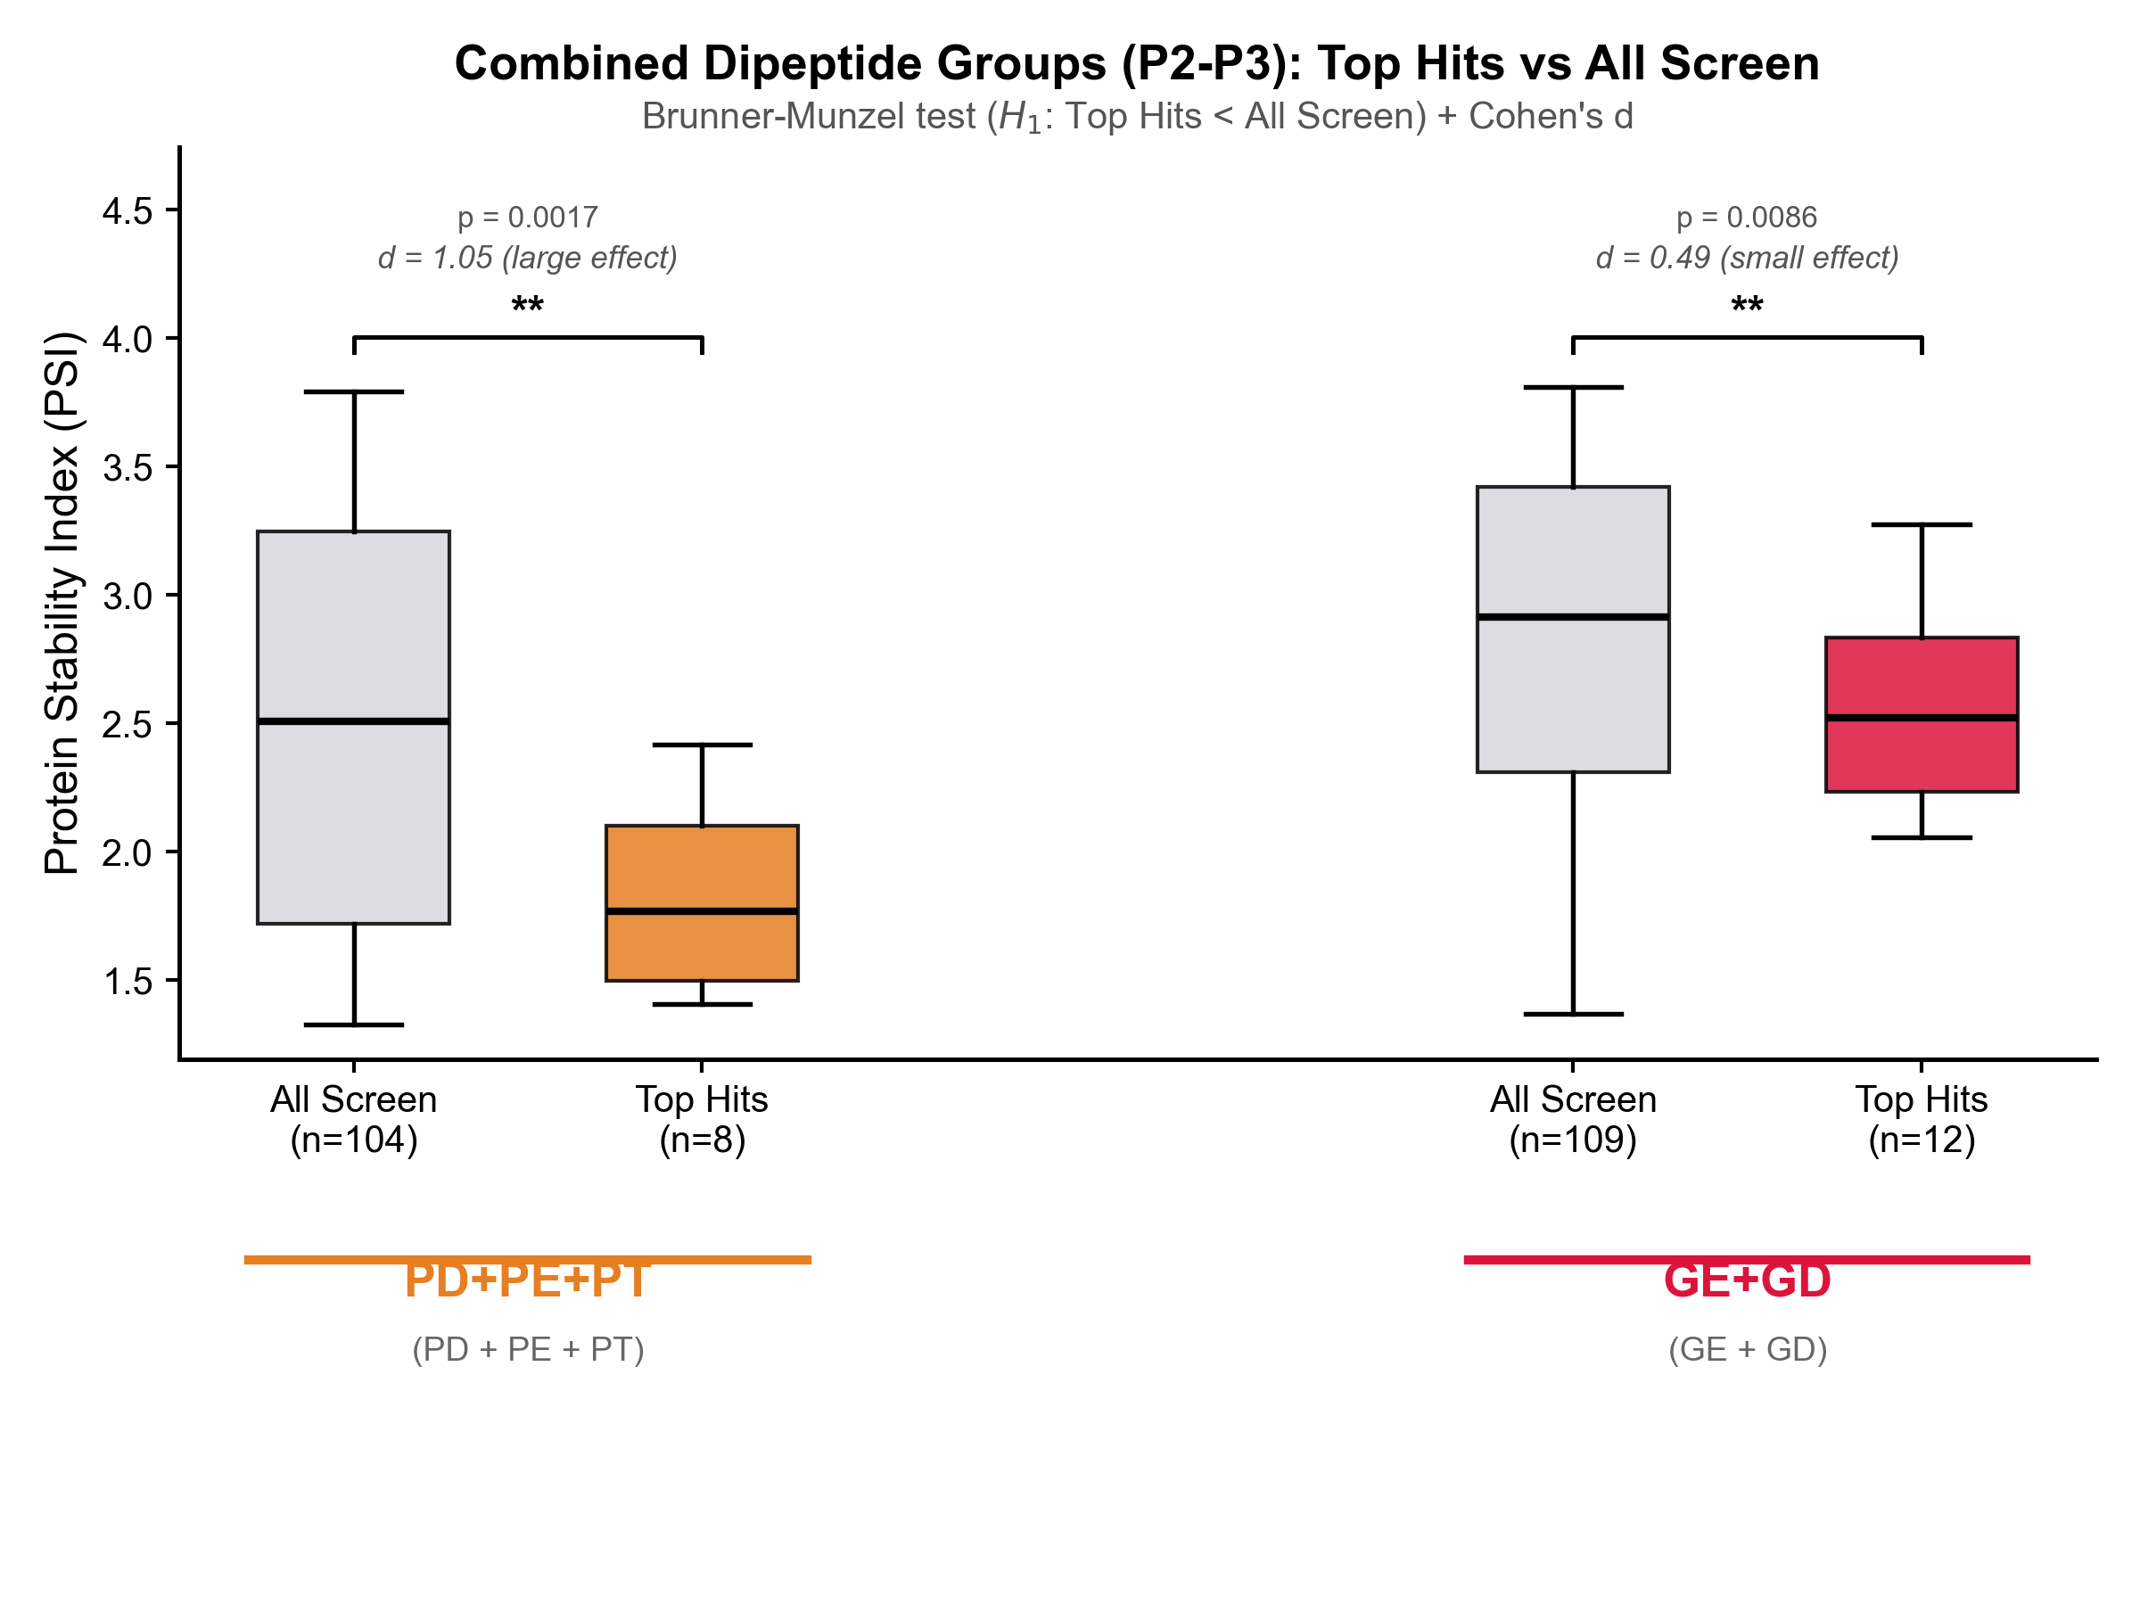
Combined dipeptide groups — Brunner-Munzel + Cohen's d
Rank-based test robust to unequal variances and unequal n
Description
• Same data as the previous slide, analysed with a test appropriate for the data structure (unequal variances, unequal sample sizes, non-normal library distribution).
• PD+PE+PT: d = 1.05 (large effect), Brunner-Munzel p = 0.0017 **
• GE+GD: d = 0.49 (small effect), Brunner-Munzel p = 0.0086 **
• Both dipeptide groups are significantly destabilized relative to the background screen.
Statistical method
• Test: one-tailed Brunner-Munzel
• scipy.stats.brunnermunzel(alternative="less")
• Cohen's d = (mean_all − mean_hits) / pooled SD.
• Rank-based, Welch-style variance adjustment — rank analogue of Welch's t-test.
• Shapiro-Wilk on All Screen: non-normal (p < 0.001) → parametric tests are not ideal.
Editable vector (SVG) available in project folder

Slide 8
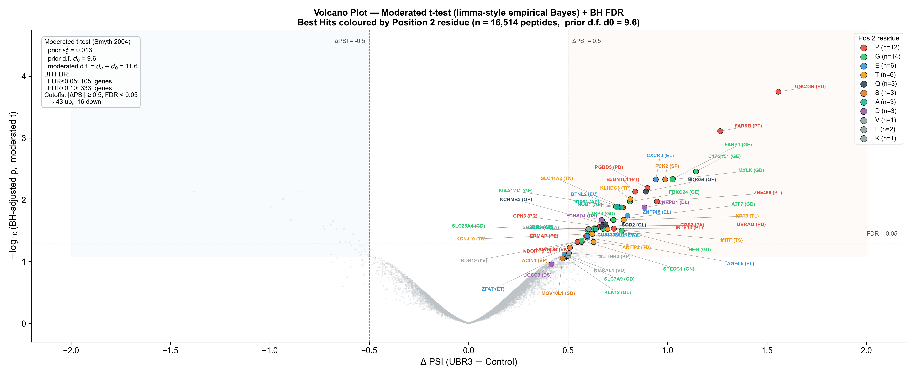
Fig 20C. Volcano plot — moderated t-test + BH FDR
limma-style empirical Bayes variance shrinkage (Smyth 2004)
Description
• ΔPSI = UBR3-cell PSI − AAVS-control PSI, per peptide (N=2 each).
• Y-axis = –log10(BH-adjusted p) from a moderated t-test — variances are shrunk toward a dataset-wide prior, raising effective d.f. from ~1–2 (Welch) to ~11.6.
• Empirical Bayes prior: s₀² = 0.013, d₀ = 9.6 (fit from all 16,514 variances).
• After |ΔPSI| ≥ 0.5 and FDR < 0.05: 43 stabilized, 16 destabilized, plus the 54 pre-labelled best hits — all visibly enriched in the upper-right quadrant.
• Dots coloured by Position-2 residue; hits labelled Gene (P2P3).
Statistical method
• Moderated t-test (Smyth 2004) implemented from scratch.
• Per-gene pooled variance s²_g (d.f. d_g = 2).
• Prior (s₀², d₀) estimated by fitting a scaled F-distribution to s²_g (trigamma-based method of moments).
• s̃²_g = (d₀·s₀² + d_g·s²_g) / (d₀ + d_g)
• t̃_g = ΔPSI / √[s̃²_g · (1/n₁ + 1/n₂)]
• p̃_g from t-distribution with (d_g + d₀) d.f., two-sided.
• Benjamini-Hochberg FDR: statsmodels.multitest, method="fdr_bh".
Editable vector (SVG) available in project folder

Slide 9
Methods — Data and statistics (paper-ready, part 1)
Verbatim text suitable for the Methods section of the paper.
Dataset. A library of 16,514 human N-terminal 24-mer peptides was screened in duplicate in HEK293-derived AAVS (control) and UBR3-expressing cells using a GFP:RFP dual-reporter stability assay. For each peptide, the Protein Stability Index (PSI) was taken as the mean log-ratio over the two replicates: PSI_ctrl = (PSI-293a + PSI-293b) / 2 and PSI_UBR3 = (PSI-UBR3a + PSI-UBR3b) / 2. The per-peptide differential was ΔPSI = PSI_UBR3 − PSI_ctrl, where a positive value indicates UBR3-dependent stabilization. A curated set of 54 top hits (sheet sub_high, column HITubr3 = TRUE) was used wherever the analysis refers to "best hits".
Enrichment analyses (Figs 1B, 3, 4). For each amino acid at each position and for each dipeptide at positions 2–3, enrichment was defined as f_hits / f_library where f is the frequency in the respective subset. Per-residue significance (Fig 1B) was assessed with a two-sided Fisher exact test on the 2×2 contingency table [hit vs non-hit] × [carries AA at position p vs does not] (scipy.stats.fisher_exact). Sequence logos (Fig 4) were built in logomaker 0.8 using the fold-change matrix with stack_order = "big_on_top"; letters with fold-change ≤ 1 were hidden.
UBR3 N-terminal screen · 9/14

Slide 10
Methods — Statistics (part 2)
Group comparisons and moderated t-test.
Comparison of combined dipeptide groups. Peptides were pooled into two groups: PD+PE+PT and GE+GD. For each group, the PSI_ctrl distribution of Top Hits was compared with the PSI_ctrl distribution of all library peptides carrying the same motif. Because the two groups in each comparison differed markedly in sample size (n_hits ≈ 8–12 vs n_library ≈ 100) and dispersion (SD_library / SD_hits ≈ 1.7), and because the library distribution was non-normal (Shapiro-Wilk p < 0.001), the reported p-values are from the Brunner-Munzel test (scipy.stats.brunnermunzel, alternative="less"), which is the rank analogue of Welch's t-test and does not assume equal variances or equal shape. Effect sizes are Cohen's d with a pooled standard deviation (ddof = 1). The one-tailed Mann-Whitney U test (scipy.stats.mannwhitneyu, alternative="less") is reported as a supplementary reference in the original boxplot figure.
Differential stability (volcano plot, Fig 20C). To improve power given the N=2 replicate design, ΔPSI was analysed with a moderated t-test using the limma-style empirical Bayes variance shrinkage of Smyth (2004). Per-peptide pooled variances s²_g were computed under the equal-variance assumption (d.f. d_g = 2). A scaled F-distribution was fitted to the 16,514 variances by the method of moments on log(s²_g), using the trigamma-inverse estimator, yielding prior hyperparameters s₀² = 0.0133 and d₀ = 9.61. Shrunk variances were computed as s̃²_g = (d₀·s₀² + d_g·s²_g) / (d₀ + d_g). The moderated t-statistic was t̃_g = ΔPSI / √[s̃²_g · (1/n₁ + 1/n₂)] and p-values were obtained from a t-distribution with d_g + d₀ ≈ 11.6 d.f. Multiple-testing correction was performed with the Benjamini-Hochberg procedure (statsmodels.stats.multitest.multipletests, method="fdr_bh"). A peptide was considered significantly regulated when |ΔPSI| ≥ 0.5 and FDR < 0.05. As an orthogonal, non-parametric cross-check, a robust z-score of ΔPSI was computed as (ΔPSI − median) / (1.4826·MAD).
UBR3 N-terminal screen · 10/14

Slide 11
Raw data — Top Hits with PD, PE or PT at P2-P3
n_hits = 8 | n_all_library = 104 | mean PSI = 1.835 vs 2.490
Gene | Dipeptide | PSI-293a | PSI-293b | PSI_AAVS
UNC13B | PD | 1.4356 | 1.5907 | 1.5132
PGBD5 | PD | 2.3598 | 2.4766 | 2.4182
UVRAG | PD | 1.5629 | 1.3280 | 1.4454
ERMAP | PE | 1.7786 | 1.8865 | 1.8326
FARSB | PT | 1.7000 | 1.7056 | 1.7028
B3GNTL1 | PT | 1.3689 | 1.4457 | 1.4073
ZNF496 | PT | 2.0584 | 1.9931 | 2.0258
INTS14 | PT | 2.4953 | 2.1736 | 2.3345
Summary statistics
· n hits = 8
· mean PSI = 1.8350
· SD PSI = 0.3931
· median = 1.7677
· Q1, Q3 = 1.496, 2.103
· vs all-library PSI (n = 104):
· mean = 2.4900
· SD = 0.7907
· mean diff = −0.655
· Cohen's d = 1.05 (large)
· Brunner-Munzel p = 0.0017
UBR3 N-terminal screen · 11/14

Slide 12
Raw data — Top Hits with GE or GD at P2-P3
n_hits = 12 | n_all_library = 109 | mean PSI = 2.562 vs 2.836
Gene | Dipeptide | PSI-293a | PSI-293b | PSI_AAVS
FARP1 | GE | 2.4875 | 2.6695 | 2.5785
C17orf51 | GE | 2.0616 | 2.0534 | 2.0575
FBXO24 | GE | 1.9973 | 2.1763 | 2.0868
FARP2 | GE | 2.4798 | 2.4433 | 2.4616
KIAA1211 | GE | 2.2567 | 2.2608 | 2.2587
LPIN1 | GE | 2.8316 | 2.7794 | 2.8055
MYLK | GD | 2.7720 | 2.5882 | 2.6801
LTBP4 | GD | 2.1862 | 2.1254 | 2.1558
SLC25A4 | GD | 2.3997 | 2.4494 | 2.4246
ATF7 | GD | 2.9843 | 2.8472 | 2.9158
SLC7A9 | GD | 3.1908 | 3.3571 | 3.2740
THEG | GD | 3.2440 | 2.8405 | 3.0423
Summary statistics
· n hits = 12
· mean PSI = 2.5618
· SD PSI = 0.3934
· median = 2.5200
· Q1, Q3 = 2.233, 2.833
· vs all-library PSI (n = 109):
· mean = 2.8364
· SD = 0.6937
· mean diff = −0.275
· Cohen's d = 0.49 (small)
· Brunner-Munzel p = 0.0086
UBR3 N-terminal screen · 12/14

Slide 13
Software and references
Python environment
Files produced by this analysis
· Python 3.13
· numpy 2.4, pandas 2.3, scipy 1.17
· matplotlib 3.10
· logomaker 0.8 (Tareen & Kinney 2019)
· statsmodels 0.14 (BH FDR correction)
· adjustText 1.3 (non-overlapping labels)
· python-docx 1.2, python-pptx 1.0, PyMuPDF 1.27
· openpyxl / xlsxwriter (Excel I/O)
· figures/fig1b_enrichment_heatmap.{png|pdf|svg}
· figures/fig3_dipeptide_enrichment_bars.{png|pdf|svg}
· figures/fig4_logo_pos2_pos3_besthits.{png|pdf|svg}
· dipeptide_analysis/Fig_Combined_only_boxplot.{png|pdf|svg}
· dipeptide_analysis/Fig_Combined_only_cohen_d.{png|pdf|svg}
· figures/fig20c_volcano_moderated_t.{png|pdf|svg}
· figures/volcano_moderated_t_results.xlsx
· dipeptide_analysis/RAW_DATA_for_verification.xlsx
· dipeptide_analysis/Statistical_reanalysis_report.docx
Key statistical references
· Smyth GK. Linear models and empirical Bayes methods for assessing differential expression in microarray experiments. Stat Appl Genet Mol Biol. 2004;3:Article 3.
· Brunner E, Munzel U. The nonparametric Behrens-Fisher problem: Asymptotic theory and a small-sample approximation. Biom J. 2000;42:17-25.
· Benjamini Y, Hochberg Y. Controlling the false discovery rate: A practical and powerful approach to multiple testing. J R Stat Soc B. 1995;57:289-300.
· Tareen A, Kinney JB. Logomaker: beautiful sequence logos in Python. Bioinformatics. 2020;36:2272-2274.
Source scripts
· ubr3enrichmentlogo/peptide_analysis.py
· ubr3paper/dipeptide_boxplot_analysis.py
· ubr3paper/volcano_moderated_t.py
· ubr3paper/build_paper_pptx.py (this deck)
UBR3 N-terminal screen · 13/14

Slide 14
End of deck
All figures, raw data, and source scripts are kept in the project repository alongside this deck.

