Slide 1
RPL22 and RPL22L1 Sequence Conservation Analysis
Cross-species alignment and paralog comparison of ribosomal protein eL22
Species panel spanning Mammalia to Cnidaria
RPL22 (eL22): 60S ribosomal protein, EBV EBER-binding, cell cycle regulation RPL22L1 (eL22-like): Paralog that compensates for RPL22 loss in cancer
Methods: Sequences from NCBI (RefSeq), aligned with Clustal Omega (EBI), analyzed with Python (Biopython, Matplotlib)

Slide 2
Overview
Key summary figures of RPL22 and RPL22L1 conservation across animal species

Slide 3
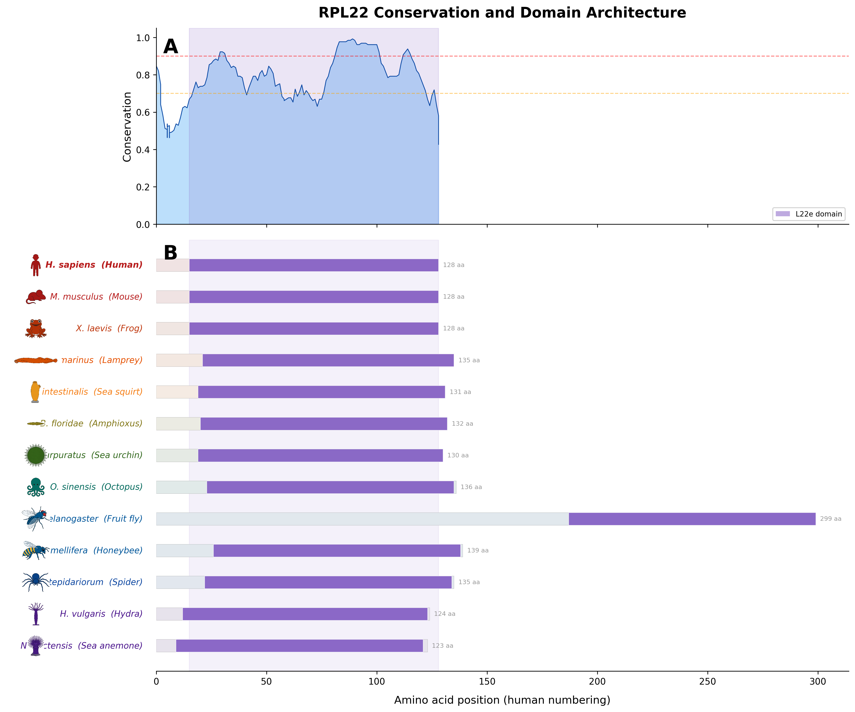
RPL22 Conservation Score and Domain Architecture
This figure combines the per-position conservation plot (Panel A) with the domain architecture across species (Panel B), sharing the same x-axis.
Panel A shows the conservation score (fraction of species sharing the most common residue) smoothed over a window. The L22e domain region is highlighted in purple. Red and orange dashed lines mark 90% and 70% conservation.
Panel B shows the full-length RPL22 protein for each species with the L22e domain colored. Because both panels share the same x-axis, conservation peaks can be traced directly to domain positions.
The high conservation throughout the L22e domain reflects its essential role in ribosome assembly and function, while the short N-terminal extension shows more variability.

Slide 4
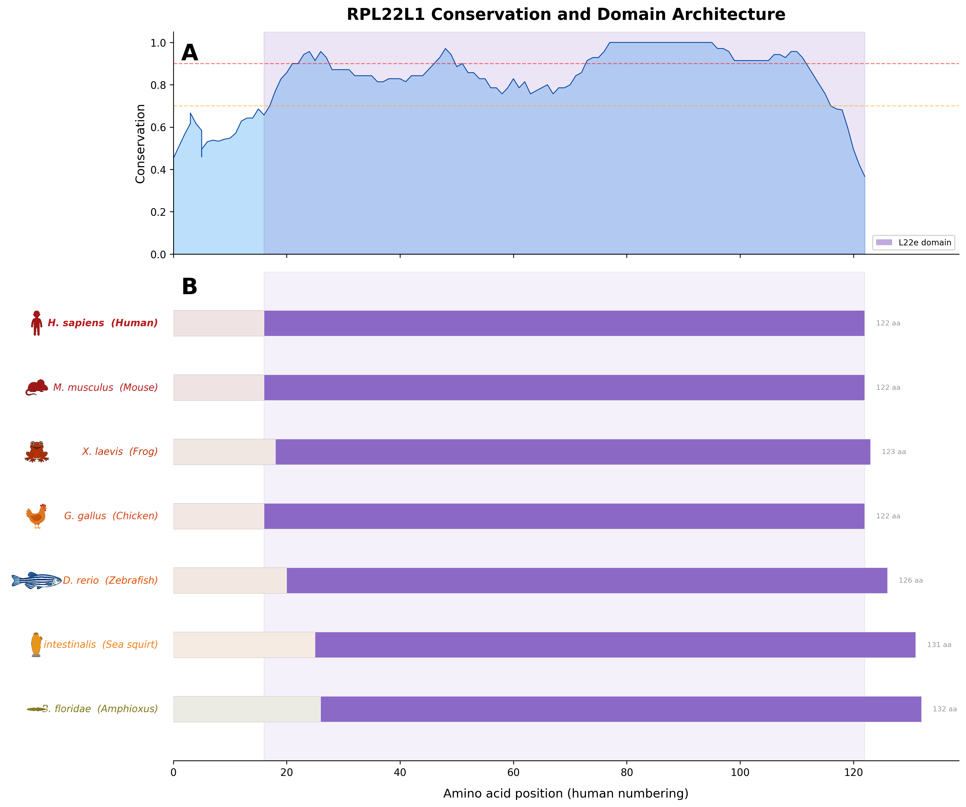
RPL22L1 Conservation Score and Domain Architecture
Combined conservation plot (Panel A) and domain architecture (Panel B) for RPL22L1, sharing the same x-axis (human residue numbering).
RPL22L1 shows a similar conservation pattern to RPL22 within the L22e domain, but with some notable differences in the N-terminal region that may relate to its distinct regulatory properties.
The L22e domain is well-conserved across all species, consistent with RPL22L1's ability to functionally substitute for RPL22 in the ribosome.

Slide 5
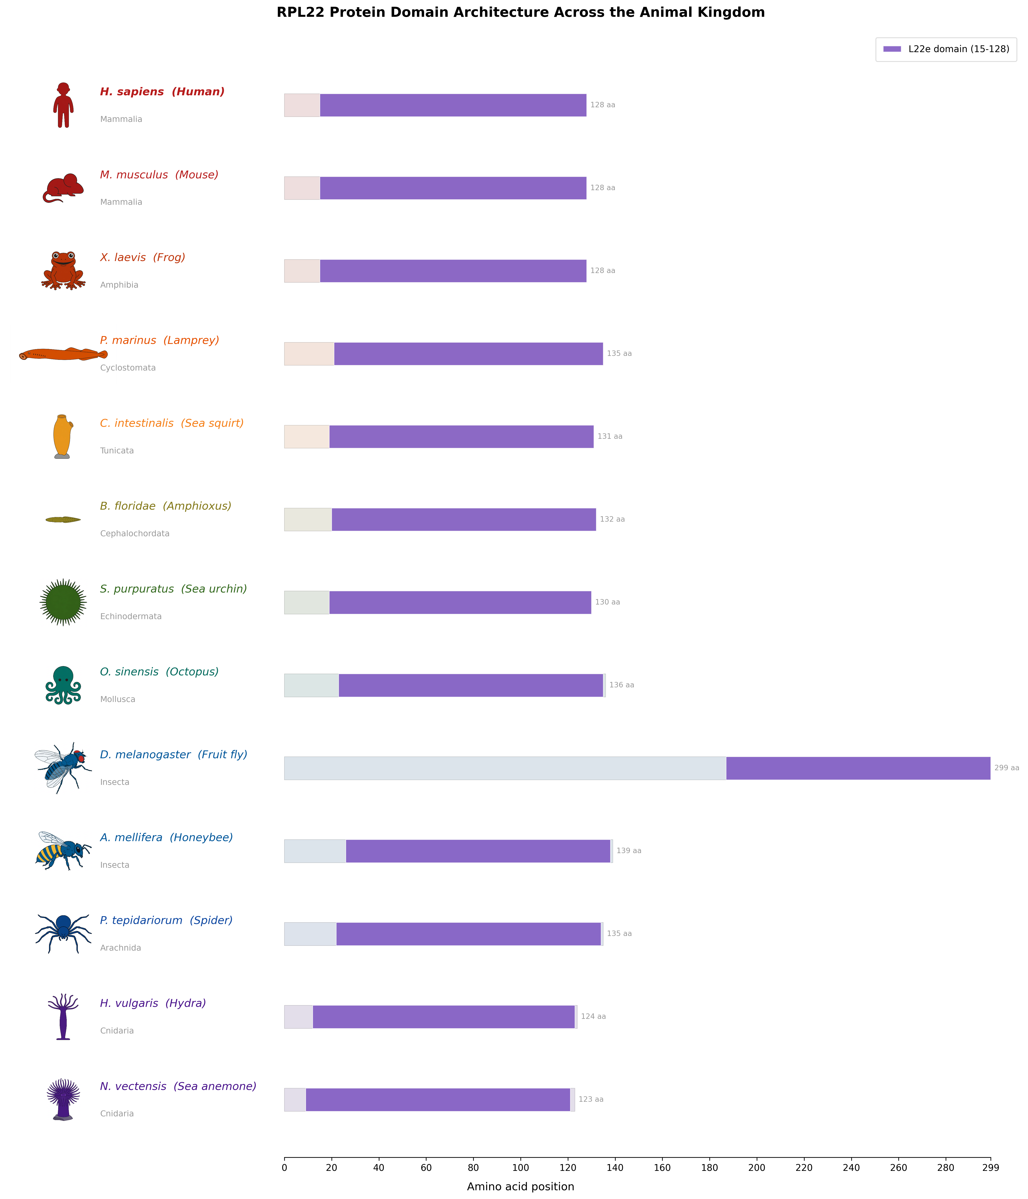
RPL22 Domain Architecture Across the Animal Kingdom
This figure displays the full-length RPL22 (eL22) ribosomal protein for each of the species analyzed, ordered from vertebrates (top) to cnidarians (bottom).
The L22e domain (purple) is the core ribosomal protein fold that mediates RNA binding and incorporation into the 60S ribosomal subunit. It spans most of the protein (approximately residues 15-128 in human).
RPL22 is a highly conserved component of the eukaryotic 60S ribosomal subunit. Beyond its ribosomal role, it binds EBV-encoded small RNAs (EBERs) and has reported roles in cell cycle regulation and hematopoiesis.
Animal icons illustrate each species, color-coded by taxonomic group. Protein lengths (in amino acids) are shown on the right.

Slide 6
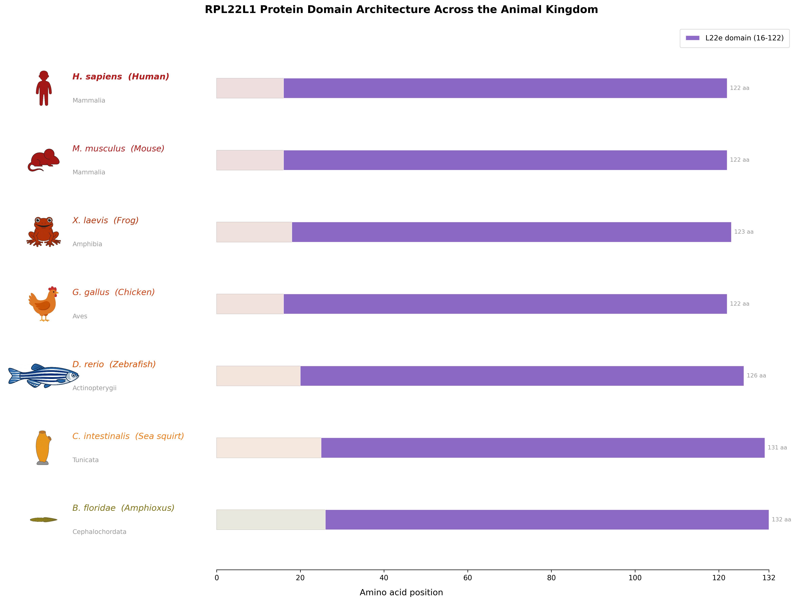
RPL22L1 Domain Architecture Across the Animal Kingdom
This figure displays the full-length RPL22L1 (eL22-like 1) protein for each species, ordered from vertebrates to cnidarians.
Like RPL22, RPL22L1 contains a single L22e domain (purple, approximately residues 16-122 in human) that constitutes nearly the entire protein.
RPL22L1 is a paralog of RPL22 that can substitute for RPL22 in the ribosome. RPL22 directly represses RPL22L1 expression by binding an internal stem-loop in the RPL22L1 mRNA, creating a regulatory feedback mechanism.
When RPL22 is lost (as frequently occurs in microsatellite-instable cancers), RPL22L1 is upregulated and incorporated into ribosomes, maintaining translational capacity.

Slide 7
RPL22 Conservation Analysis
Quantitative conservation analysis of RPL22 (eL22)

Slide 8
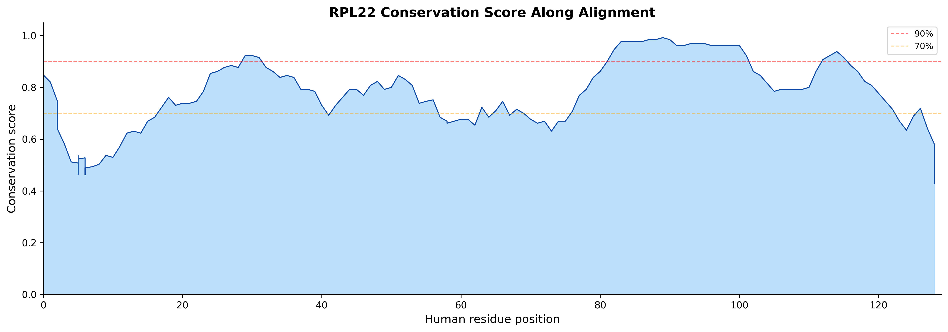
RPL22 Conservation Score Along Alignment
Per-position conservation score across the RPL22 alignment (human residue positions on x-axis).
The conservation score at each column is the fraction of species sharing the most common amino acid (ignoring gaps). A sliding window smooths the signal.
RPL22 shows high conservation throughout most of its length, with the L22e domain region showing particularly strong conservation (>90%).

Slide 9
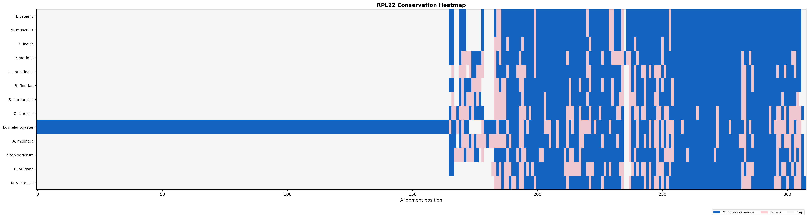
RPL22 Conservation Heatmap
Heatmap where each row is a species and each column is an alignment position. Blue indicates matching the consensus, pink indicates divergence, light gray indicates gaps.
Vertical bands of consistent blue reveal globally conserved positions.

Slide 10
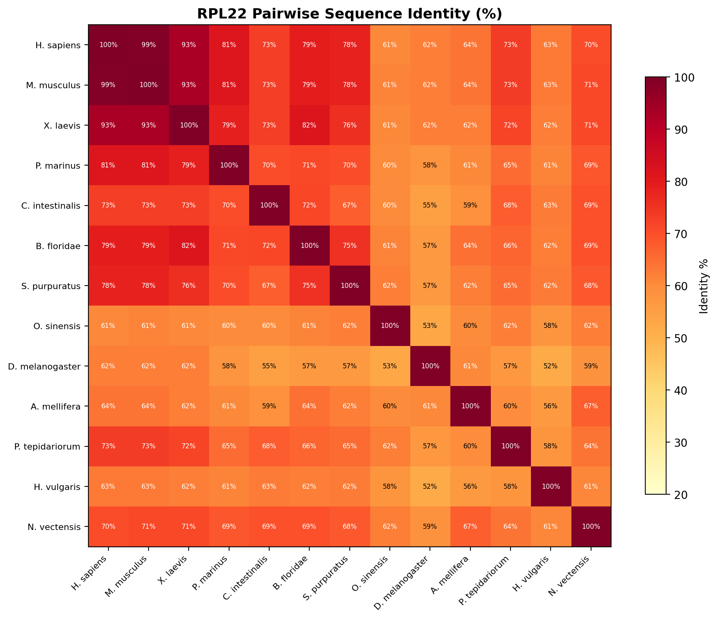
RPL22 Pairwise Sequence Identity Matrix
Percent sequence identity between every pair of species for RPL22.
Closely related species share high identity, while distant comparisons show lower but still substantial identity, reflecting the essential nature of this ribosomal protein.

Slide 11
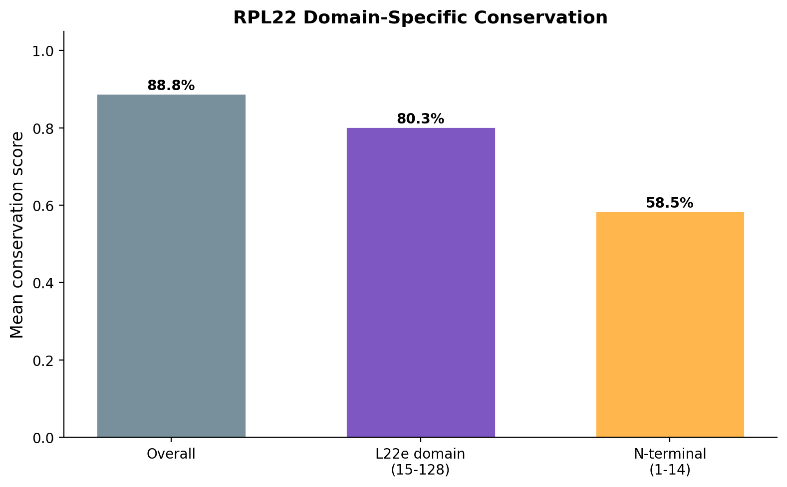
RPL22 Domain-Specific Conservation
Bar chart comparing mean conservation within the L22e domain versus the N-terminal and C-terminal extensions.
The L22e domain shows significantly higher conservation than the flanking regions, consistent with its essential role in ribosome assembly.

Slide 12
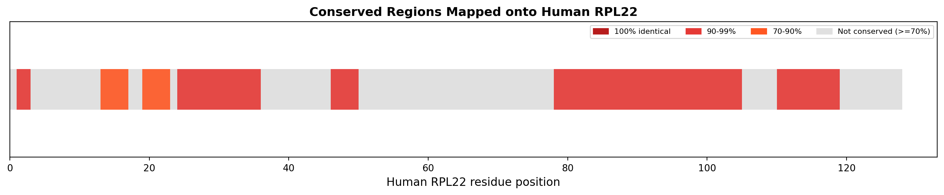
RPL22 Conserved Regions Map
Linear map showing conserved regions (>=70%) on the RPL22 protein.

Slide 13
RPL22L1 Conservation Analysis
Quantitative conservation analysis of RPL22L1 (eL22-like)

Slide 14
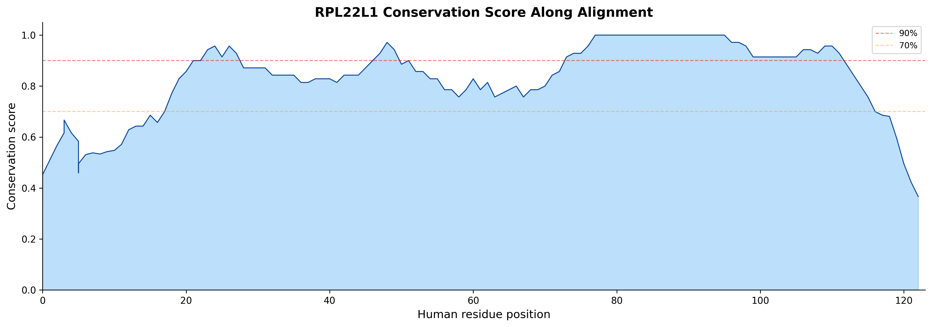
RPL22L1 Conservation Score Along Alignment
Per-position conservation score for RPL22L1.
Comparison with the RPL22 conservation plot reveals whether the two paralogs are under similar or different selective pressures at each position.

Slide 15
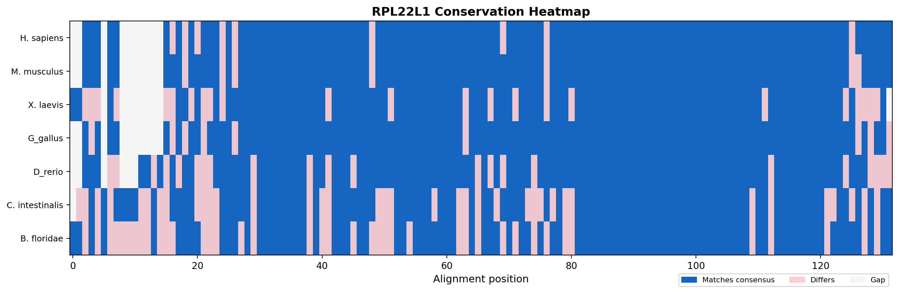
RPL22L1 Conservation Heatmap
Conservation heatmap for RPL22L1, using the same color scheme as RPL22.

Slide 16
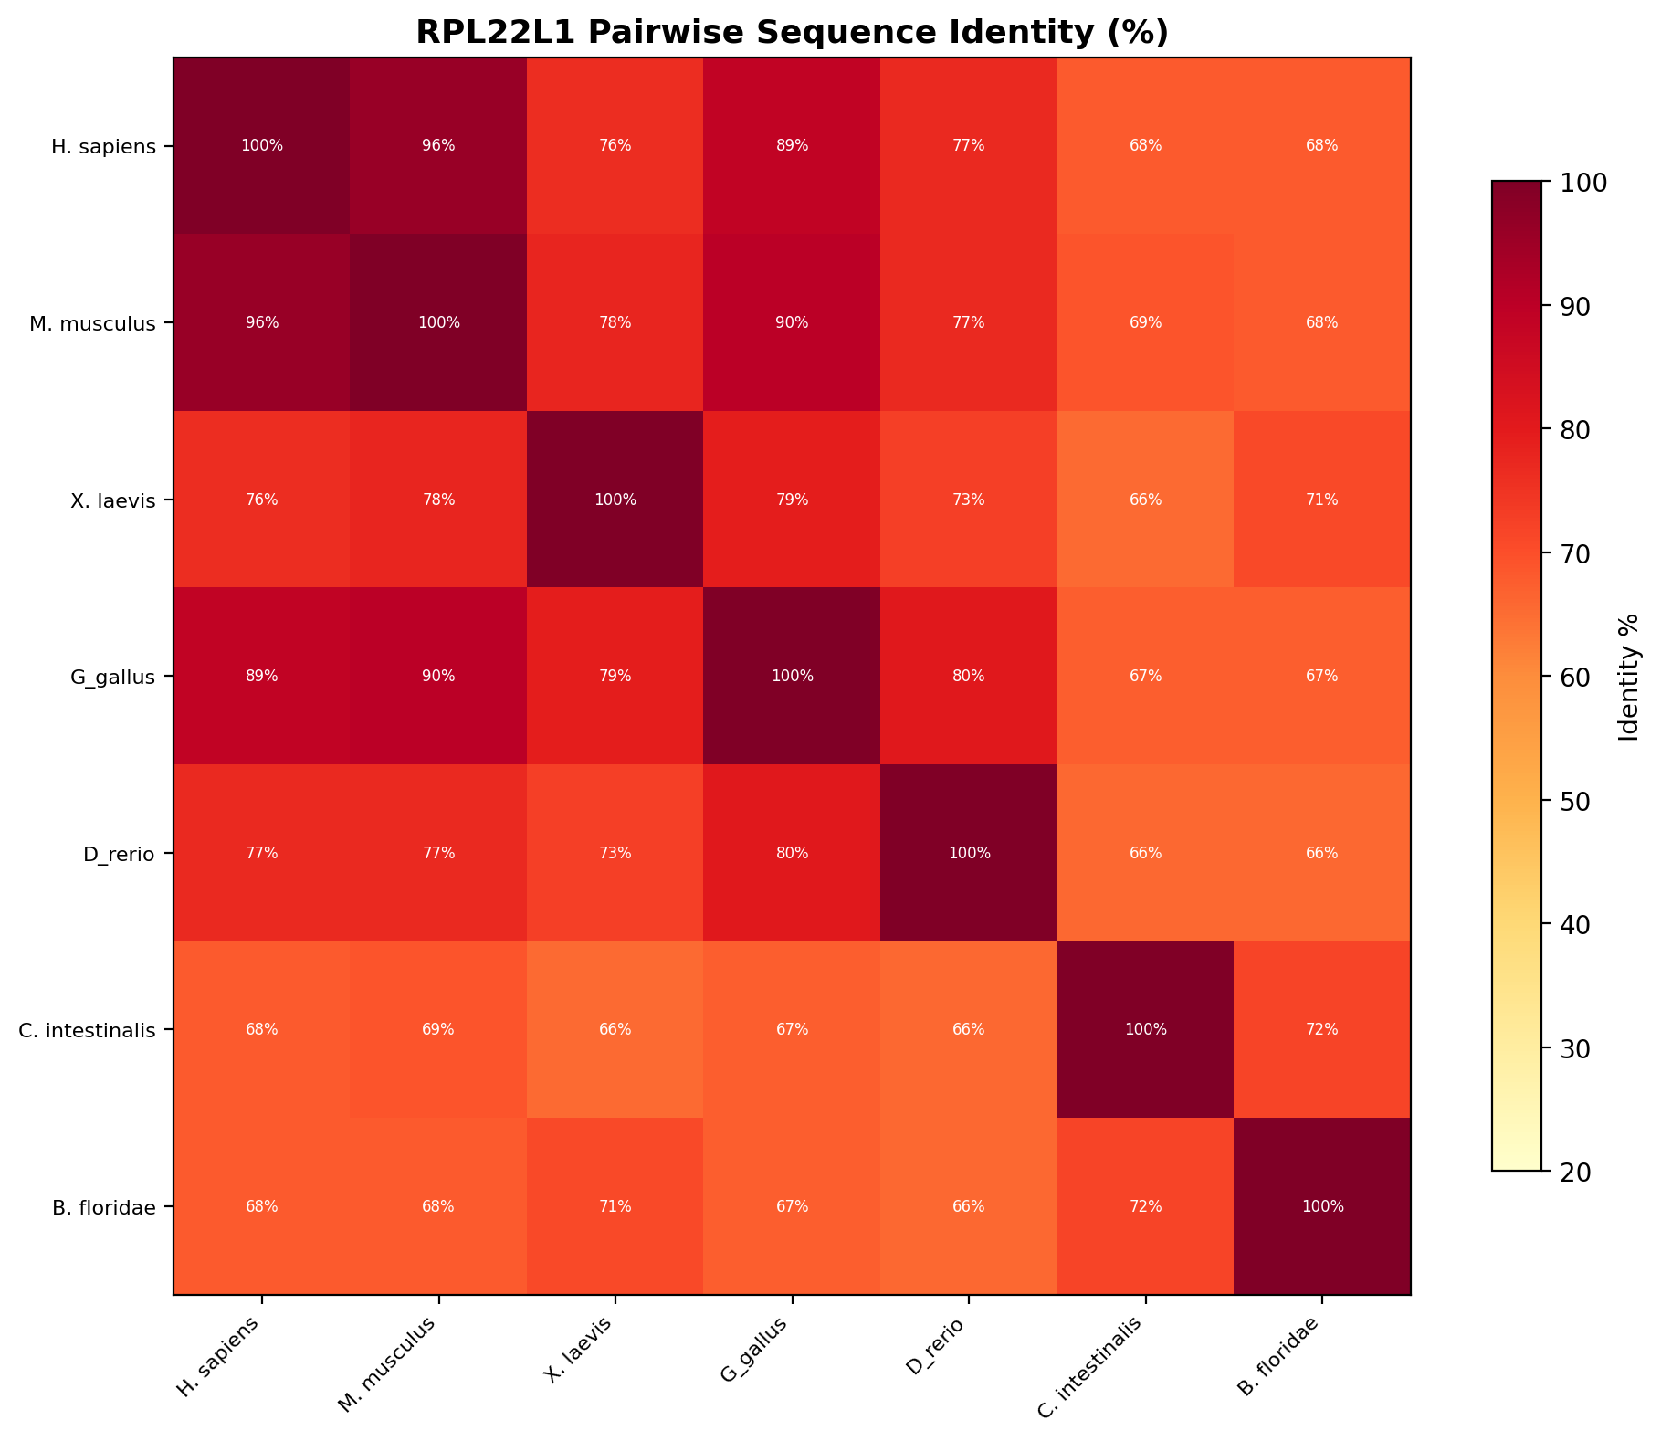
RPL22L1 Pairwise Sequence Identity Matrix
Pairwise identity matrix for RPL22L1.
Comparing these values with the RPL22 matrix reveals whether the paralog is under similar or relaxed selective constraint.

Slide 17
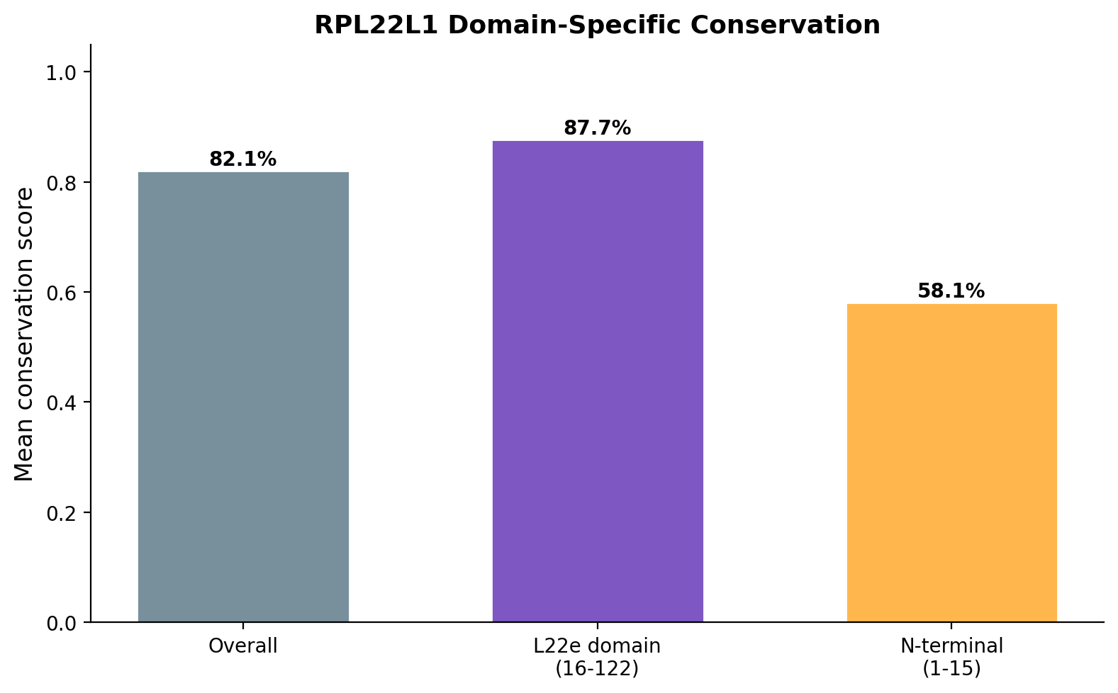
RPL22L1 Domain-Specific Conservation
Domain-specific conservation for RPL22L1.

Slide 18
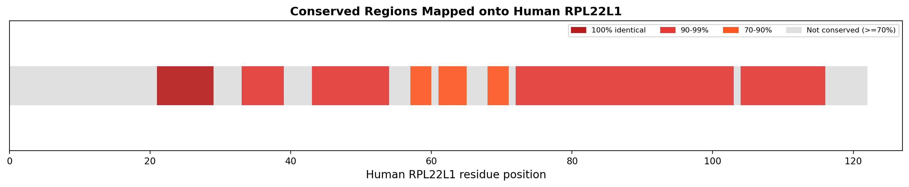
RPL22L1 Conserved Regions Map
Linear map showing conserved regions (>=70%) on the RPL22L1 protein.

Slide 19
RPL22 Publication Alignments
ClustalW-style alignments and domain architecture for RPL22

Slide 20
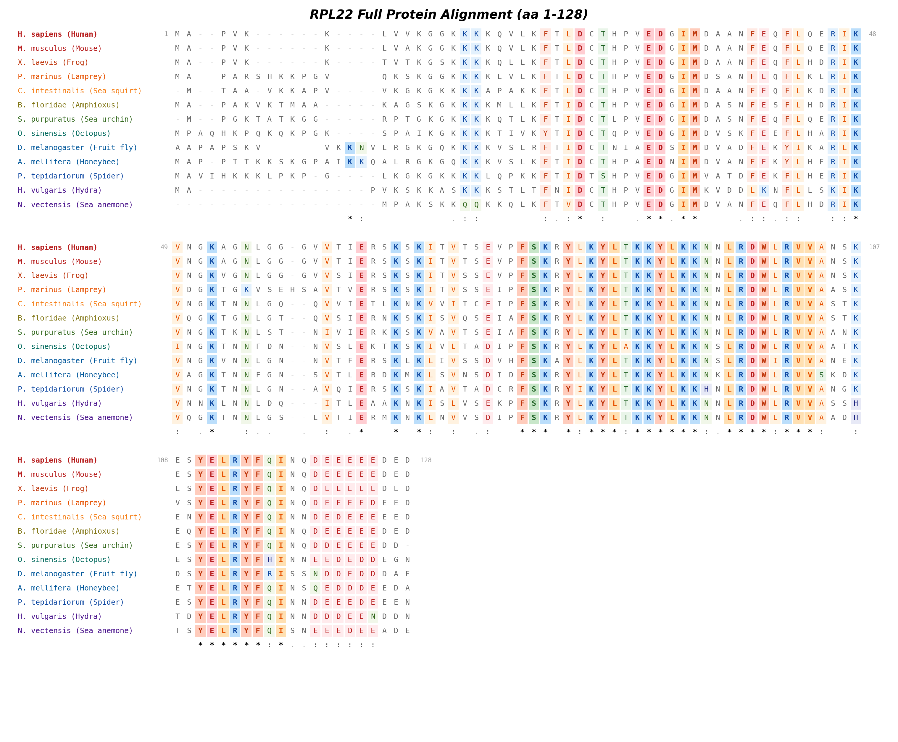
RPL22 Full Protein Alignment
ClustalW-style alignment of the complete RPL22 protein across all species.
Residues with identical amino acids across all species are highlighted with colored backgrounds grouped by biochemical property: acidic (red), basic (blue), polar (green), hydrophobic (orange), aromatic (brown), special (purple/gray).
Conservation symbols: '*' = identical in all species, ':' = strongly similar (conserved biochemical property), '.' = weakly similar.
The high density of '*' symbols throughout the alignment demonstrates that RPL22 is one of the most conserved ribosomal proteins, reflecting its essential role in the 60S subunit.

Slide 21
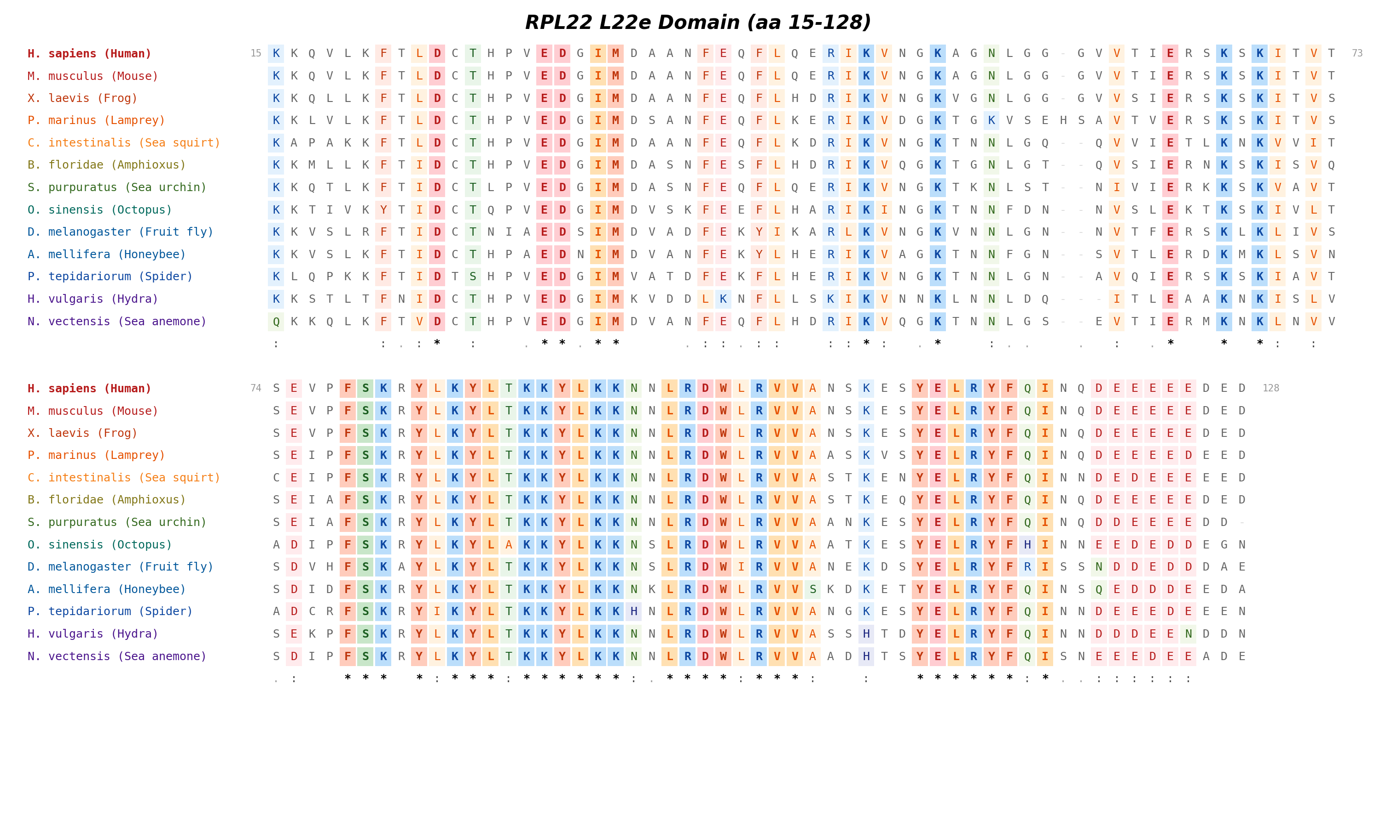
RPL22 L22e Domain Alignment
ClustalW-style alignment focused on the L22e domain of RPL22, which constitutes the core ribosomal protein fold.
The L22e domain mediates binding to 28S rRNA and is required for stable incorporation into the 60S ribosomal subunit. It adopts a characteristic alpha/beta fold conserved across eukaryotes.
The extremely high conservation within this domain reflects strong purifying selection on the ribosome-binding interface.

Slide 22
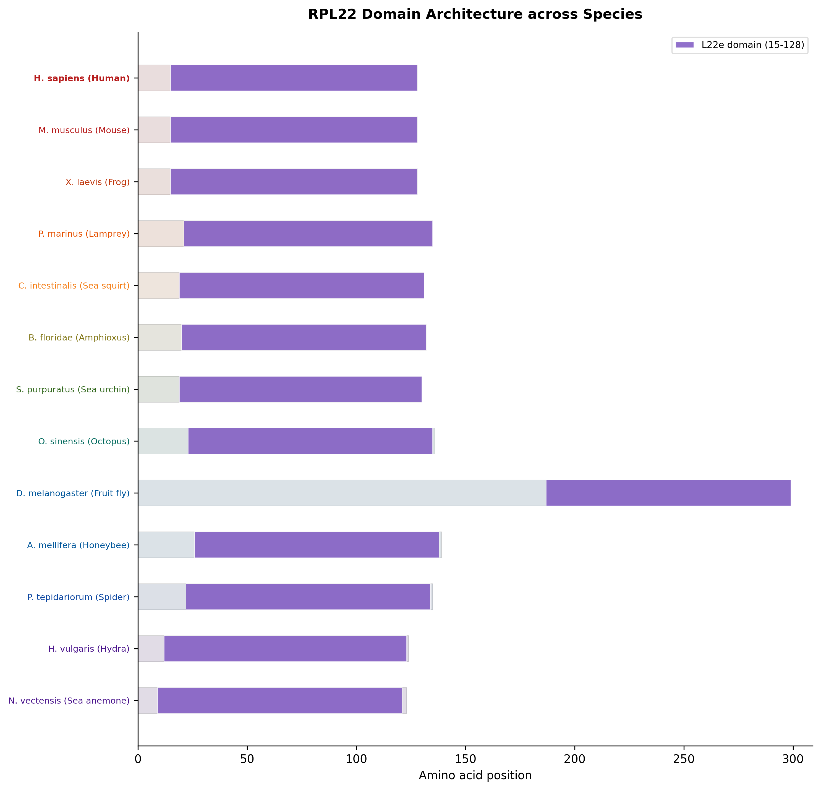
RPL22 Domain Architecture Diagram
Schematic showing the linear domain architecture of RPL22 across all species, with species names color-coded by taxonomic group.
The protein backbone (gray bar) is proportional to sequence length. The L22e domain (purple) covers most of the protein in all species.
Domain boundaries are mapped from human coordinates through the multiple sequence alignment to find corresponding positions in each ortholog.

Slide 23
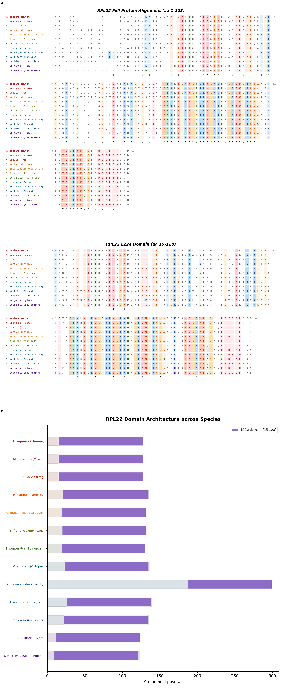
RPL22 Combined Publication Figure
Composite figure combining ClustalW-style alignments (Panel A) with the domain architecture diagram (Panel B) for RPL22.
Panel A shows the full protein and L22e domain alignments. Panel B shows domain positions across all species.

Slide 24
RPL22L1 Publication Alignments
ClustalW-style alignments and domain architecture for RPL22L1

Slide 25
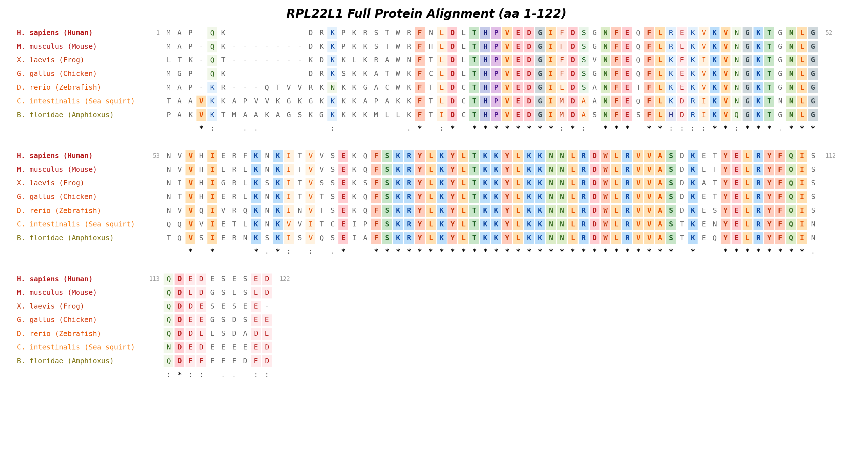
RPL22L1 Full Protein Alignment
ClustalW-style alignment of the complete RPL22L1 protein across all species.
The alignment reveals which positions are conserved across the RPL22L1 paralogs and which have diverged. Comparison with the RPL22 alignment can identify paralog-specific residues.
Conservation symbols follow the same convention: '*' = identical, ':' = strongly similar, '.' = weakly similar.

Slide 26
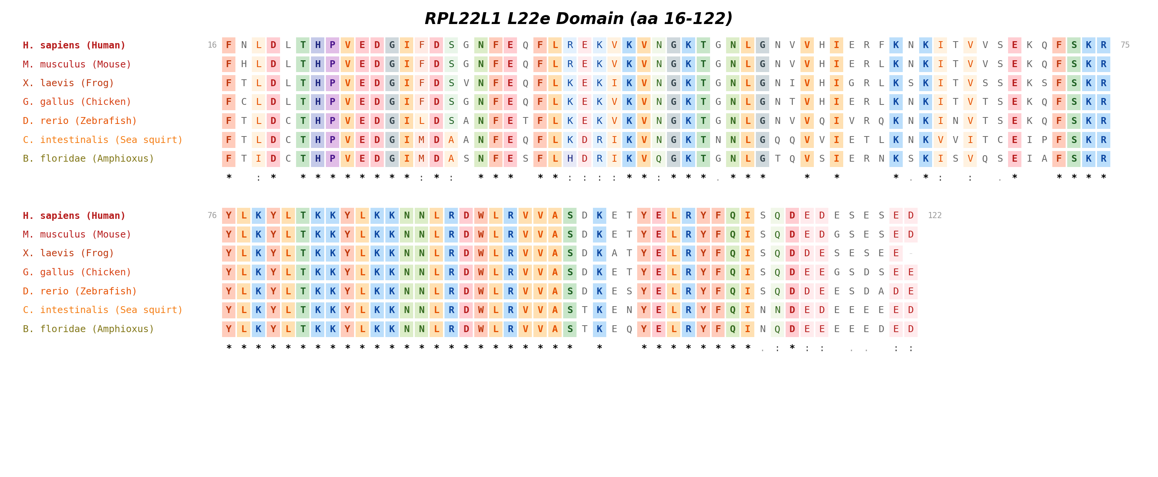
RPL22L1 L22e Domain Alignment
ClustalW-style alignment of the L22e domain in RPL22L1.
This domain enables RPL22L1 to substitute for RPL22 in the ribosome. Comparing this alignment with the RPL22 L22e domain alignment reveals which positions are conserved in both paralogs (essential for ribosome function) versus those that differ (potentially related to paralog-specific regulation).

Slide 27
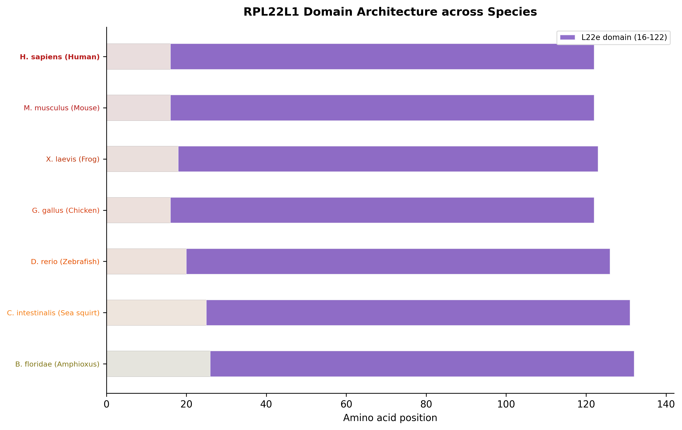
RPL22L1 Domain Architecture Diagram
Linear domain architecture of RPL22L1 across all species.
Like RPL22, the L22e domain dominates the protein architecture. The consistent domain organization across species demonstrates that the paralog duplication preserved the core ribosomal protein structure.

Slide 28
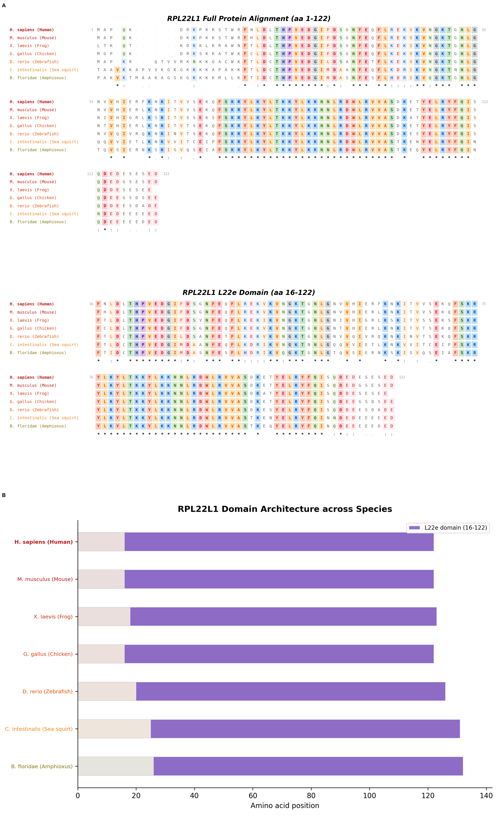
RPL22L1 Combined Publication Figure
Composite figure combining ClustalW-style alignments (Panel A) with the domain architecture diagram (Panel B) for RPL22L1.

Slide 29
RPL22 vs RPL22L1 Comparison
Direct comparison of the two ribosomal protein paralogs

Slide 30
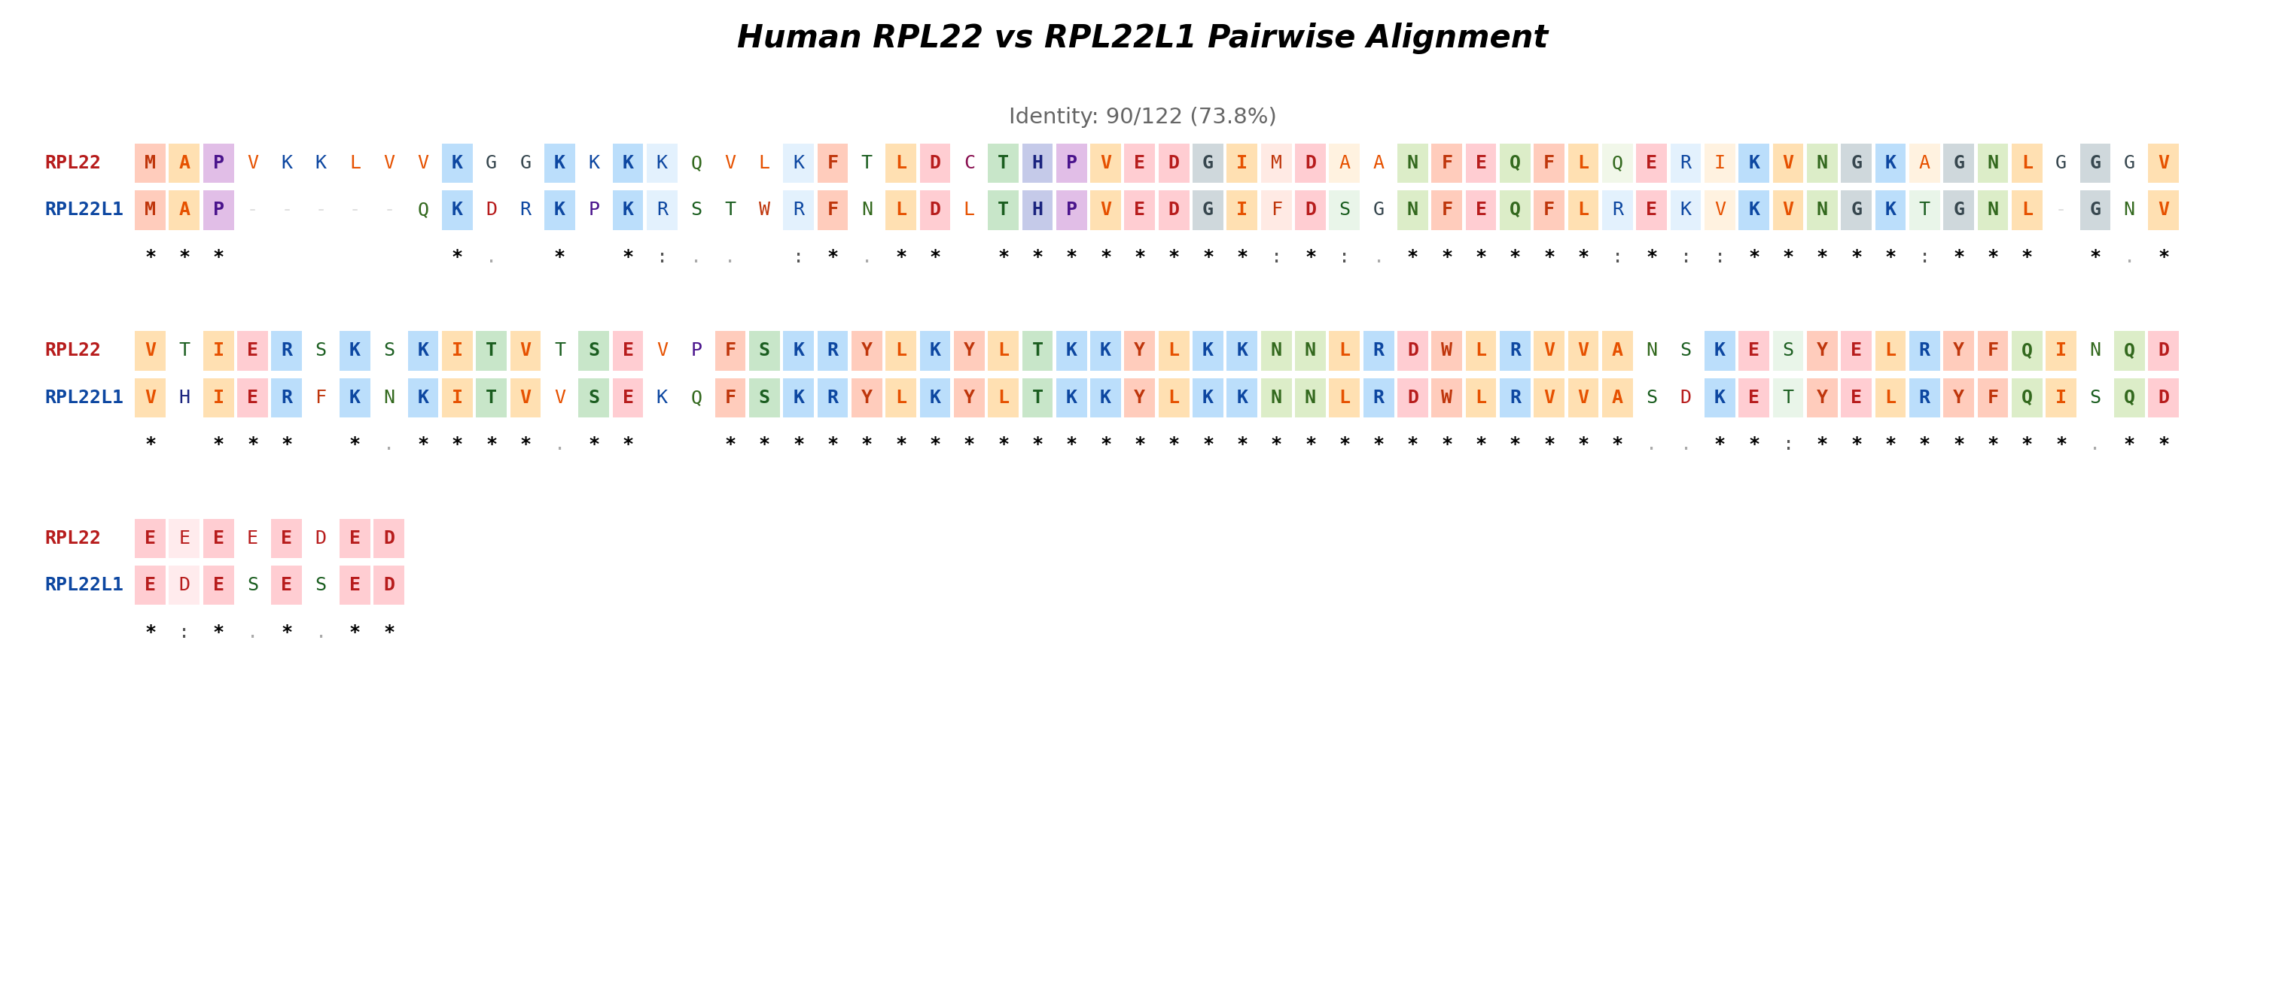
Human RPL22 vs RPL22L1 Pairwise Alignment
ClustalW-style pairwise alignment of human RPL22 and RPL22L1 protein sequences.
This alignment directly compares the two paralogs, highlighting identical positions (colored backgrounds) and divergent positions. Conservation symbols indicate the degree of similarity at each position.
Regions of high identity between the paralogs correspond to the core L22e domain fold required for ribosome incorporation. Divergent regions, particularly at the N-terminus, may contribute to paralog-specific functions or regulation.
RPL22 directly represses RPL22L1 by binding an internal stem-loop in the RPL22L1 mRNA. The protein-level differences shown here may affect ribosome composition and translational specificity.

Slide 31
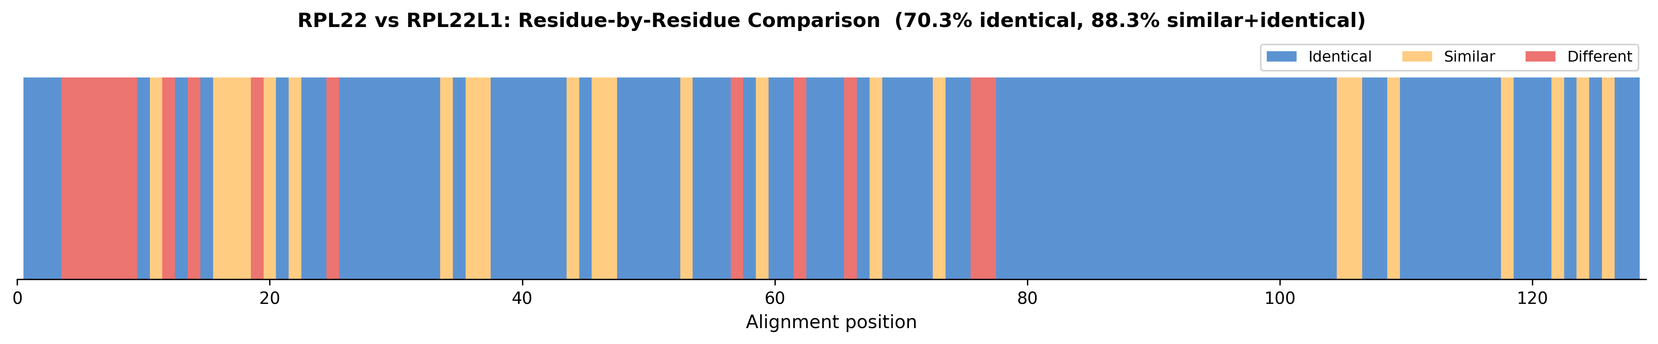
RPL22 vs RPL22L1 Residue-by-Residue Divergence Map
Visual map showing identical (blue), similar (orange), and different (red) positions between human RPL22 and RPL22L1.
This bar chart provides a quick overview of where the two paralogs have diverged. Clusters of red bars indicate regions of significant divergence that may underlie functional differences between the paralogs.
The N-terminal region typically shows more divergence, while the core L22e domain is more conserved between the paralogs.

Slide 32
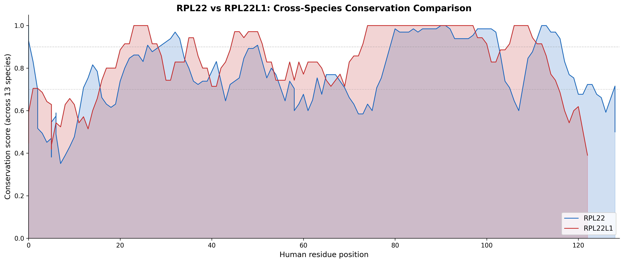
RPL22 vs RPL22L1 Cross-Species Conservation Comparison
Overlay of per-position conservation scores for RPL22 (blue) and RPL22L1 (red) across all species, plotted against human residue positions.
This comparison reveals whether the two paralogs are under similar evolutionary pressure at each position. Positions where both curves are high indicate residues essential for the shared ribosomal function.
Positions where RPL22 conservation exceeds RPL22L1 (or vice versa) may indicate paralog-specific functional constraints or relaxed selection following gene duplication.

