Slide 1
Is the UBR3 P–[D/E] motif enriched
after the 2A ribosomal skip?
Amino-acid enrichment at position 2 of 2A downstream products,
tested against three backgrounds built from 17,517 viral proteins
Foreground: Rao et al. 2025 combined 2A set · 35,573 instances → 2,693 distinct downstream contexts

Slide 2
The question
What the 2A skip produces, and what UBR3 reads
The 2A ribosomal skip
2A peptides end in a conserved …D(V/I)ExNPG↓P motif. The ribosome skips forming the peptide bond between the terminal glycine and the following proline, releasing the upstream protein and continuing translation.
The consequence: every downstream product begins with that proline. Position 1 is P, always — it is built into the mechanism.
What UBR3 recognises
UBR3 is an N-recognin E3 ligase. The motif of interest is a proline at position 1 followed by an acidic residue — aspartate (D) or glutamate (E) — at position 2.
Position 2 is therefore the only variable position, and it is contributed by the protein downstream of the skip site — not by the 2A peptide itself. That fact drives the whole analysis.
… D V E x N P G ↓ P · X …
skip happens here → P is position 1
X is position 2 — D or E = UBR3 motif
The question in one line
Does D/E turn up at position 2 more often than chance would put it there — i.e. is the 2A skip site biased toward or against creating UBR3 substrates?
2A definition and dataset: Rao et al. (2025) Cell Reports, doi:10.1016/j.celrep.2025.115822

Slide 3
Data and the three backgrounds
A percentage means nothing without stating what it is compared to
Foreground
The combined 2A set assembled earlier: Supplementary Table S2 plus the paper's repository search, merged and de-duplicated — 35,573 instances with a resolved position 2.
Databases: UniParc, UniProtKB, MGnify, IMG/VR.
Background
17,517 reviewed (Swiss-Prot) viral proteins, 7,989,533 residues. Viral, because 2A peptides are overwhelmingly of viral origin.
Three ways to ask 'what would you expect by chance?'
1 · All amino acids, all positions
How common are D and E in viral protein sequence at all? The crudest expectation.
11.1%
2 · Position 2 of viral proteins
The residue after the initiator Met. Controls for N-termini having their own composition, unlike the bulk average.
21.2%
3 · Residue after any proline
P2 sits directly after a proline, and proline constrains what follows it. The best-matched control.
11.1%
Backgrounds computed from UniProt Swiss-Prot, taxonomy 10239 (Viruses), reviewed entries only

Slide 4
First, a counting problem that decides the answer
The same number can read as 2.6% or 12.1% depending on what you count
84% of the instances come from UniParc
UniParc archives every sequence variant separately, so a single protein can appear hundreds of times. Counting raw instances counts the same downstream context over and over.
The 35,573 instances collapse to just 2,693 distinct downstream contexts — a 12.3-fold duplication.
Which unit is right?
Position 2 is a property of the protein that follows the skip site, not of the 2A peptide. So each distinct downstream context should count once. That is the unit used for every result that follows.
2.6%
counting raw instances (redundancy included)
12.1%
counting distinct downstream contexts
Why this matters
The 2.4–2.6% figure reported previously is a database-redundancy artefact, not a biological depletion. It reflects how often a handful of well-deposited 2A peptides were sequenced, not how often the motif occurs.
This corrects the earlier conclusion in 2a_combined_UBR3.
Redundancy measured on the combined instance table; see enrichment_summary.json → redundancy

Slide 5
Result
D/E at position 2, counting distinct downstream contexts (n = 2,693)
Compared with each background
12.1%
observed D/E at position 2 95% CI 10.9–13.4%
vs all amino acids, all positions
expected 11.1%
1.10×
no difference (n.s.)
vs residue after any proline
expected 11.1%
1.09×
no difference (n.s.)
vs position 2 of viral proteins
expected 21.2%
0.57×
depleted (p = 1e-30)
In one sentence
D/E follows the skip proline at essentially the rate chance predicts — there is no selection for or against the UBR3 motif at 2A skip sites. It is depleted only against viral N-termini, a background that is itself unusual.
Fisher exact test, two-sided, on 2×2 counts; exact binomial 95% CI on the observed proportion

Slide 6
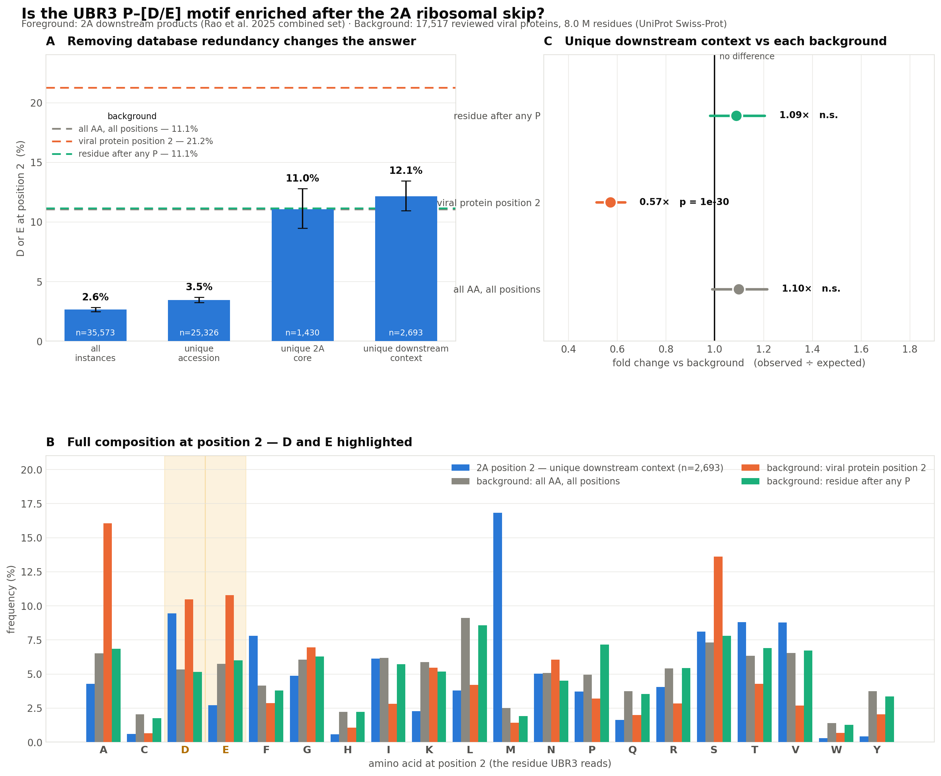
The analysis in one figure
A · Redundancy changes the answer
Each bar is the same measurement counted a different way. As duplicate database entries are collapsed, D/E rises from 2.6% to 12.1% and crosses the two matched background lines.
B · Composition at position 2
Blue is the observed 2A position 2; the three background sets sit beside it. D and E (shaded) track the grey and green backgrounds closely, and fall well below the orange viral-N-terminus background.
C · Fold change with 95% CI
Two intervals cross 1.0 — no difference from chance. Only the viral position-2 comparison is significant, at 0.57×.
Full-resolution vector version available as enrichment_figure.pdf / .svg

Slide 7
What it means
Three readings, in order of confidence
The motif occurs at chance frequency
Against the two matched backgrounds — overall amino-acid composition (11.1%) and the residue after any proline (11.1%) — the observed 12.1% is statistically indistinguishable (1.10× and 1.09×, both n.s.). Nothing about the 2A skip favours or avoids creating a UBR3 substrate.
1
The depletion vs viral N-termini is real but says less than it looks
Position 2 of viral proteins is 21.2% D/E — far above bulk composition. That is expected: Met-aminopeptidase only removes the initiator methionine when residue 2 is small, so acidic residues accumulate at position 2 of real N-termini. Comparing against it measures N-terminal biology, not 2A biology.
2
The earlier 'uncommon motif' conclusion needs revising
The previously reported 2.4% came from raw instance counts dominated by UniParc duplication. On distinct downstream contexts the figure is 12.1% — five times higher, and exactly at background. The motif is not rare; it is ordinary.
3
Met-aminopeptidase specificity: initiator Met is cleaved only when residue 2 has a small side chain (A, C, G, P, S, T, V)

Slide 8
Caveats and what would strengthen this
Limits of this analysis
• 6.8% of instances still have no resolved downstream residue — almost all MGnify (MGYP), which needs the ~270 GB MGnify FASTA dump. resolve_mgnify.py is written but has not been run.
• The background is reviewed viral proteins. The 2A set also contains host and unclassified sequences; using a viral background for all of them is a simplification. The viral-only subset gives the same answer (12.5%).
• 'Distinct downstream context' de-duplicates on the 20-aa product. Homologous proteins with slightly different downstream sequence still count separately, so some redundancy remains — this makes the estimate conservative, not inflated.
What would make it stronger
• Resolve the MGnify fraction and re-run — it is the one systematic gap.
• Test position 2 against a phylogeny-aware background rather than pooled composition, so related viruses do not count as independent observations.
• Ask the reverse question: among 2A sites that do carry P–[D/E], is anything else shared — host range, protein family, genome position?
• The 280 distinct P–[D/E] peptides already identified remain the useful output regardless of whether they are enriched: they are candidate UBR3 substrates.
Scripts: enrichment.py, plot_enrichment.py, build_pptx.py · all outputs regenerate from these

Slide 9
Methods
So the numbers can be reproduced or challenged
Foreground
combined_all_instances.csv from 2a_combined_UBR3 — the merged Table S2 + repository set. Kept instances with position 2 resolved to one of the 20 standard amino acids.
De-duplication
Each distinct 20-aa downstream product counted once (2,693 of 35,573 instances). Raw instances, unique accession and unique 2A core are also reported so the effect of the choice is visible.
Background
17,517 reviewed viral proteins from UniProt (taxonomy 10239). Three counts: every residue; residue 2 of proteins beginning with Met (17,136); and every residue immediately following a proline.
Statistics
Two-sided Fisher exact test on the 2×2 table of D/E vs other, foreground vs background; chi-square reported alongside. Exact binomial 95% CI on the observed proportion. Fold change = observed % ÷ background %.
Outputs: enrichment_results.csv · enrichment_composition.csv · enrichment_summary.json · enrichment_figure.png/pdf/svg

