Slide 1
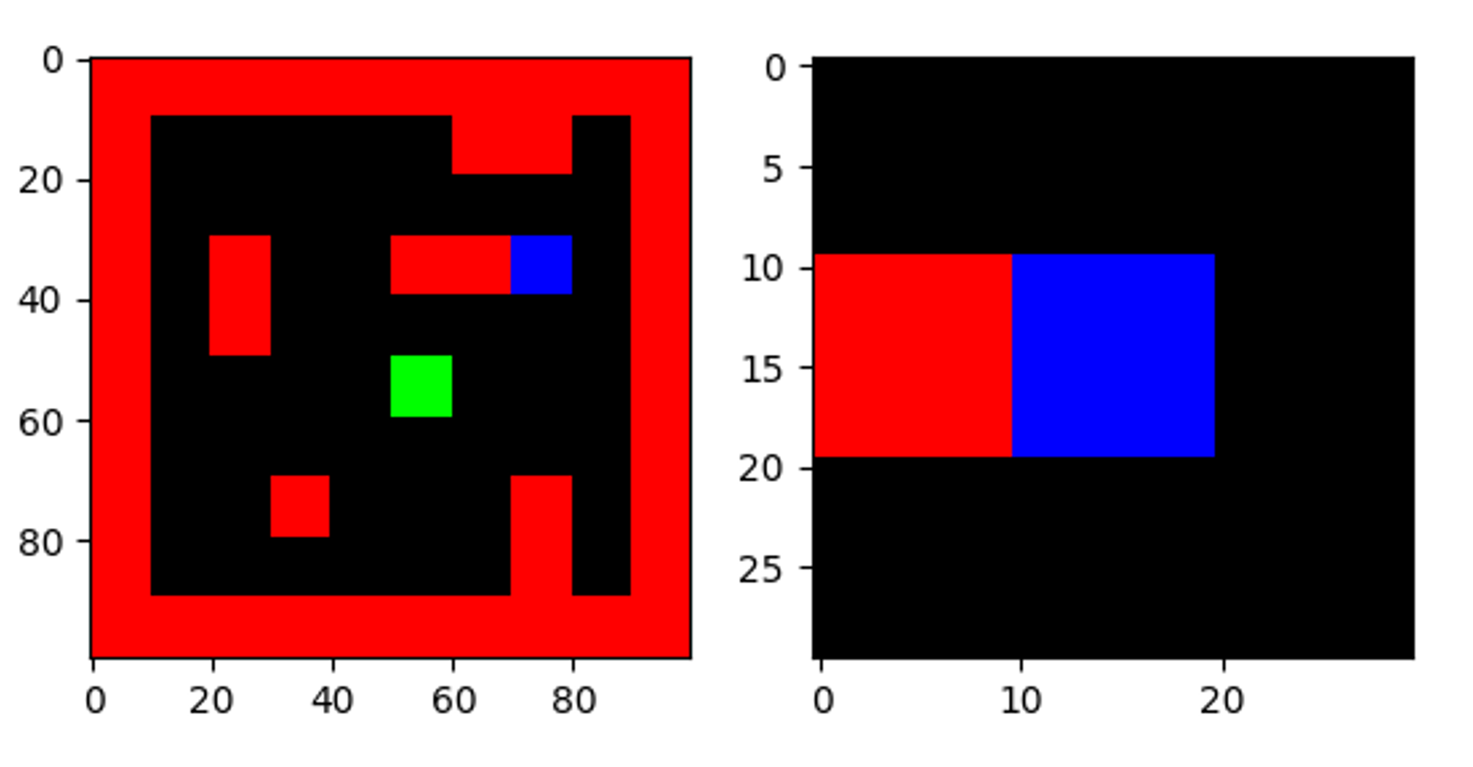
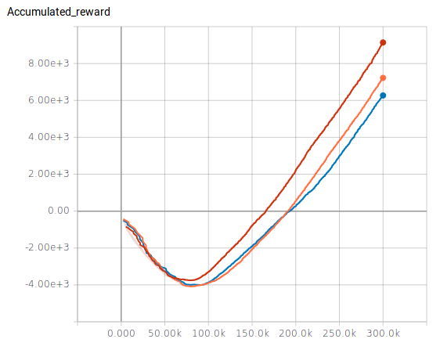
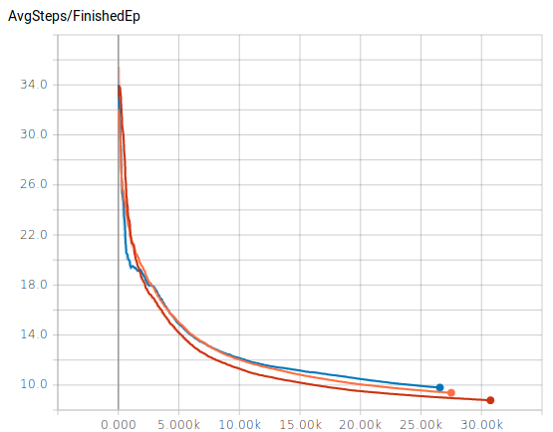
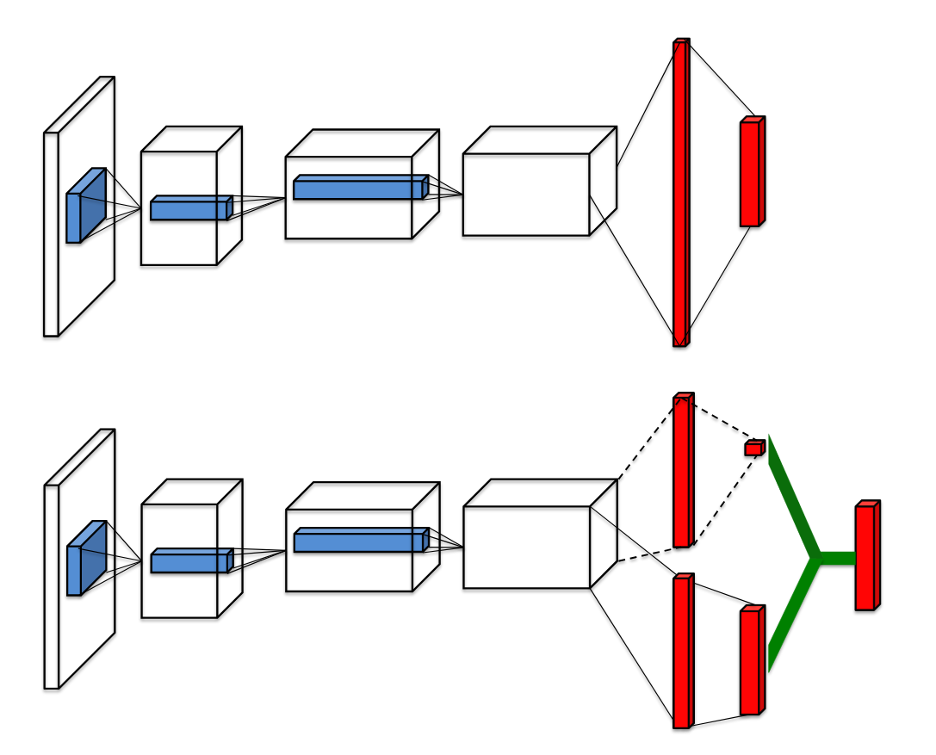
Deep Q-learning variants
Archit Basal, Ilia Dobrusin
Deep Q-learning (DQN)
Use Deep Neural Network to approximate Q-function
We implement and compare three extensions to regular Deep Q-learning
Visual Planning task: find route to goal in a grid maze map with small local view
Train for 300.000 steps with random sampling from previous experience
Target Network
Simple extensions of regular DQN
Use second (target) network to calculate target Q-values and next action (for loss calculation)
Keep target network static, only update source network weights
Synchronize source and target network periodically
Double DQN (DDQN)
Regular DQN overestimates Q-values
Similar to target network
Use source network for action prediction
Calculate target Q-value with target network
Duelling Networks
Q-values indicate how good each action is for given state
Split Q-value calculation into two:
      Value function V(s): indicates value of current state
      Advantage function A(a): Comparrison of actions compared to each other
Duelling approach: Let network compute seperate values for V and A by splitting network internally after convolution layers
Results
Training performance
Test performance
  Regular DQN, Target Network and DDQN reach the goal in 100 % of test episodes
  Dueling DQN not shown (implementation issue)
Regular DQN can overestimate Q-values, implement extensions to stabilize results
Target network keeps predicted Q-value fixed for a period of time – stabilize Q-value prediction
Double DQN decouples action selection and Q-value prediction into seperate networks which increases performance further
Colors: DQN, Target Network, DDQN
# Steps
Accumulated reward
# Steps
# Finished episodes
[1]
References:
[1] Ziyu Wang, Nando de Freitas, Marc Lanctot, Dueling Network Architectures for Deep Reinforcement Learning, in CoRR, 2015, arXiv:1511.06581v3

