Slide 1

DS Workshop
Shachar Hirshberg, Ido Calman & Ofri Kleinfeld

Slide 2

The Problem
Predict which activity (walking, sitting, etc.) is being performed using phone sensors data analysis
Working with Time-Series data: - Data is only meaningful as bulks - Raw data do not fit classic ML algorithm

Slide 3
The Dataset
Time-Series data generated by accelerometer and gyroscope smartphone sensors.
The experiment explored 6 different activities: walk downstairs, walk upstairs, walk straight, sit, stand, run
24 participants, 15 trials, ~4000 snapshots per trial, ~1.5M rows

Slide 4
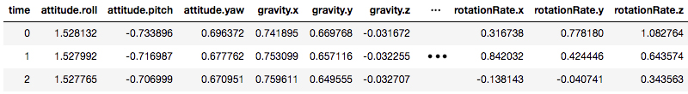
The Features
Each row is a labeled time snapshot with 12 features: acceleration, rotation, gravity, attitude (3 axes each)
Gravity - the acceleration on the phone caused by the force of gravitation
Attitude - the orientation of the phone with respect to earth

Slide 5
Feature Engineering
Need to decode “history” as features for each sample
Two approaches
Aggregate history over a sliding window
Concatenate history as a long vector
How much history to consider?

Slide 6
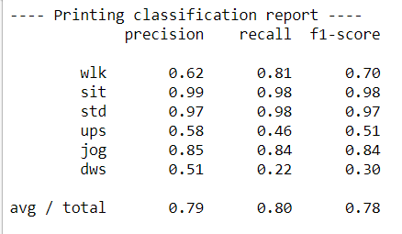
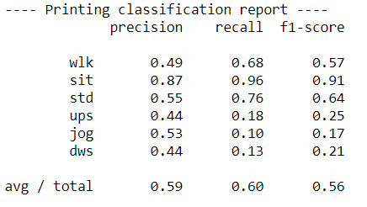
Initial Results
For each approach run a linear model and non linear model
Logistic Regression model didn’t show good results on validation set
Aggregate window
data set
History encoded
data set
Notes:
* Results refer to using 10 past examples – for both history and aggregated data sets

Slide 7
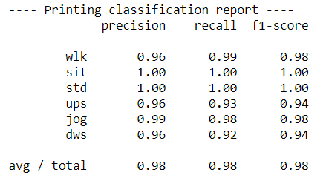
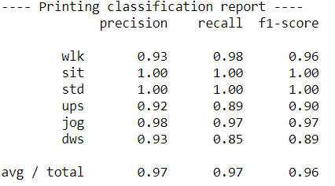
Initial Results
Random Forest classifier with showed much better result – implying the data is not linearly separable with current features
Aggregate window
data set
History encoded
data set
Notes:
Random Forest classifier uses 10 decision trees as base estimators
Results are always on the validation set

Slide 8
Window Size – Accuracy Tradeoff
Calman you can add here the graph showing the results as a function of the window size (lets say for the aggregate window data set)

Slide 9
Next Steps
Increase the performance using more tuning of hyper parameters or a change in the features
Try to use more complex sequence models (LSTM, GRU) to increase accuracy or maintain accuracy while using smaller window size
Build framework to predict user’s action on real time using one of the models

Slide 10
Thank You!
For more information: https://github.com/idocal/workshop/blob/master/MotionSenese/initial-analysis.ipynb

