Slide 1

MotionSense
Shachar Hirshberg, Ido Calman & Ofri Kleinfeld

Slide 2

Previously…

Slide 3
The Problem
Predict which activity (walking, sitting, etc.) is being performed using phone sensors data analysis
Working with Time-Series data: - Data is only meaningful as bulks - Raw data do not fit classic ML algorithm

Slide 4
The Dataset
Time-Series data generated by accelerometer and gyroscope smartphone sensors.
The experiment explored 6 different activities: walk downstairs, walk upstairs, walk straight, sit, stand, run
24 participants, 15 trials, ~4000 snapshots per trial, ~1.5M rows

Slide 5
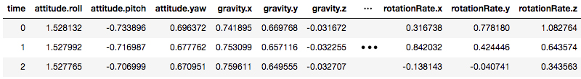
The Features
Each row is a labeled time snapshot with 12 features: acceleration, rotation, gravity, attitude (3 axes each)
Gravity - the acceleration on the phone caused by the force of gravitation
Attitude - the orientation of the phone with respect to earth

Slide 6
Today

Slide 7


Feature Engineering
Goal: Encoding time samples as meaningful features
vs
Concatenated History
Sliding Window

Slide 8
Feature Engineering
Questions:
How long should the window be?
What should the window be sliding on?
Samples
Standard deviation
Local min/max
Mean
Average

Slide 9


Initial Results
Linear vs Non-linear on both approaches
Logistic Regression did not achieve good results on validation set
Random Forest did quite well
Data is not linearly separable with current features

Slide 10
Initial Results
Logistic Regression
Class | Percision | Recall | F1-score
walk | 0.49 | 0.68 | 0.57
sit | 0.87 | 0.96 | 0.91
stand | 0.55 | 0.76 | 0.64
up-stairs | 0.44 | 0.18 | 0.25
jog | 0.53 | 0.10 | 0.17
down-stairs | 0.44 | 0.13 | 0.21
average | 0.58 | 0.60 | 0.56
Class | Percision | Recall | F1-score
walk | 0.62 | 0.81 | 0.70
sit | 0.99 | 0.98 | 0.98
stand | 0.97 | 0.98 | 0.97
up-stairs | 0.58 | 0.46 | 0.51
jog | 0.85 | 0.84 | 0.84
down-stairs | 0.51 | 0.22 | 0.30
average | 0.79 | 0.80 | 0.78

Slide 11
Initial Results
Random Forest
Class | Percision | Recall | F1-score
walk | 0.93 | 0.98 | 0.96
sit | 1.00 | 1.00 | 1.00
stand | 1.00 | 1.00 | 1.00
up-stairs | 0.92 | 0.89 | 0.90
jog | 0.98 | 0.97 | 0.97
down-stairs | 0.93 | 0.85 | 0.89
average | 0.96 | 0.97 | 0.96
Class | Percision | Recall | F1-score
walk | 0.96 | 0.99 | 0.98
sit | 1.00 | 1.00 | 1.00
stand | 1.00 | 1.00 | 1.00
up-stairs | 0.96 | 0.93 | 0.94
jog | 0.99 | 0.98 | 0.98
down-stairs | 0.96 | 0.92 | 0.94
average | 0.98 | 0.98 | 0.98

Slide 12
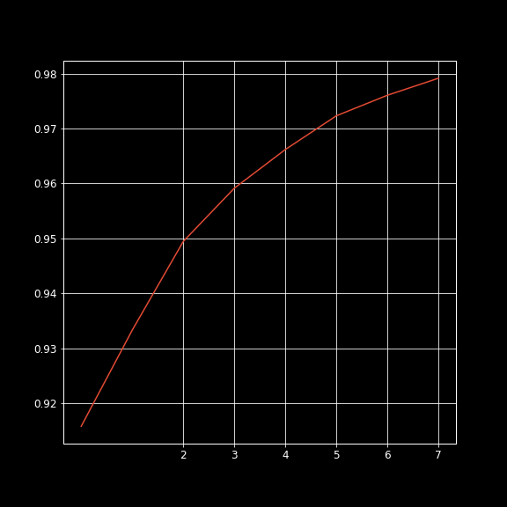
Window Size Effect
Random Forest
accuracy
window size

Slide 13
Next Steps
Increase the accuracy by adding/changing features and fine tuning of the model’s hyper parameters
Predict using less samples.
Check more complex sequence models (LSTM, GRU) as a means to increase/maintain the accuracy while using a smaller window size
Develop a mobile application which will predict the user’s action on real time using our models

Slide 14
Thank You!
For more information: https://github.com/idocal/workshop/blob/master/MotionSenese/initial-analysis.ipynb

