Slide 1

DS Workshop
Shachar Hirshberg, Ido Calman & Ofri Kleinfeld
Notes:
אפשר לסדר את הרקע כדי שיהיה כמו שצריך גם בווינדוס, אם אתה רוצה אתה יכול לשלוח לי את התמונה ואבדוק אצלי

Slide 2

The Problem
Predict which activity (walking, sitting, etc.) is being performed using phone sensors data analysis
Working with Time-Series data: - Data is only meaningful as bulks - Raw data do not fit classic ML algorithm

Slide 3
The Dataset
Time-Series data generated by accelerometer and gyroscope smartphone sensors.
The experiment explored 6 different activities: walk downstairs, walk upstairs, walk straight, sit, stand, run
24 participants, 15 trials, ~4000 snapshots per trial, ~1.5M rows

Slide 4
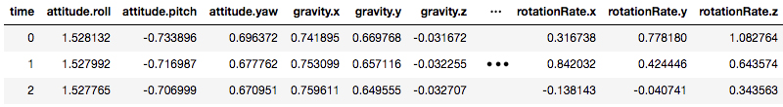
The Original Features
Each row is a labeled time snapshot with 12 features: acceleration, rotation, gravity, attitude (3 axes each)
Gravity - the acceleration on the phone caused by the force of gravitation
Attitude - the orientation of the phone with respect to earth

Slide 5
Feature Engineering
The goal – encoding time history as meaningful features.
Two approaches:
Concatenating history as a long vector
Aggregating samples in a sliding window
Notes:
Tradeoff for attitude 1:
Less samples but has more meaning(?)
Hard to work with in ML models
Tradeoff for attitude 2:
Less accurate
Easier to work with in ML models

Slide 6
Feature Engineering
Questions we encountered:
How long should the window be?
What should be actually sliding on? Samples? STD? Local min/max? Global min/max? Mean? Avg?
We chose to start with Mean and STD.
Notes:
Tradeoff for attitude 1:
Less samples but has more meaning
Hard to work with in ML models
Tradeoff for attitude 2:
Less accurate
Easier to work with in ML models

Slide 7
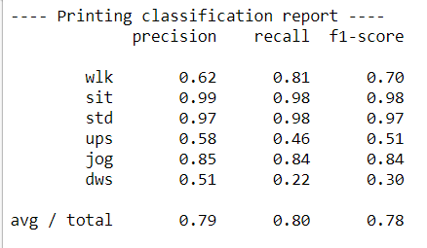
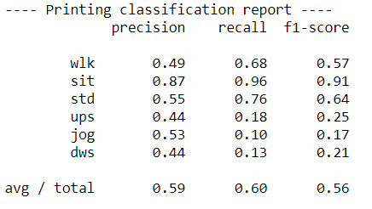
Initial Results
We ran a linear model and non linear model for each approach (vector/sliding window)
Logistic Regression did not achieve good results on the validation set
Aggregate window
data set
History encoded
data set
Notes:
Results refer to using 10 past examples == 1 second, for both history and aggregated data sets
***** נראה לי כדאי לסמן את העמודה של התוצאה בריבוע אדום או משהו שיבלוט

Slide 8
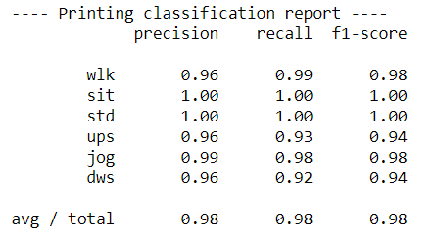
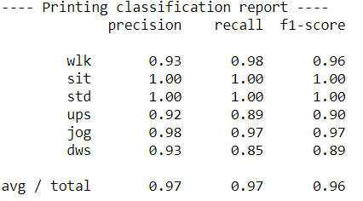
Initial Results
Random Forest classifier got much better results – implying the data is not linearly separable with current features
Aggregate window
data set
History encoded
data set
Notes:
Random Forest classifier uses 10 decision trees as base estimators
Results are always on the validation set

Slide 9
Window Size – Accuracy Tradeoff
Calman you can add here the graph showing the results as a function of the window size (lets say for the aggregate window data set)

Slide 10
Next Steps
Increasing the accuracy by adding/changing features and fine tuning of the model’s hyper parameters
We want to be able to predict using less samples.
Checking more complex sequence models (LSTM, GRU) as a means to increase/maintain the accuracy while using a smaller window size.
Building a mobile application which will predict the user’s action on real time using our models

Slide 11
Thank You!

