Slide 1

DS Workshop
Shachar Hirshberg, Ido Calman & Ofri Kleinfeld

Slide 2

The Problem
Predict which activity (walking, sitting, etc.) is being performed using phone sensors data analysis
Working with Time-Series data: - Raw data do not fit classic ML algorithm - Data is only meaningful as bulks

Slide 3
The Dataset
Time-Series data generated by accelerometer and gyroscope smartphone sensors.
The experiment explored 6 different activities: walk downstairs, walk upstairs, walk straight, sit, stand, run
24 participants, 15 trials, ~4000 snapshots per trial, ~1.5M rows

Slide 4
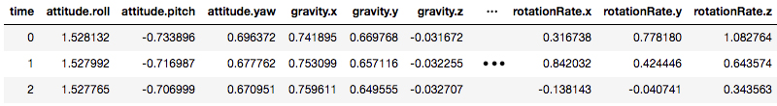
The Features
Each row is a labeled time snapshot with 12 features: attitude, gravity, acceleration, rotation (3 axes each)
Gravity - the acceleration on the phone caused by the force of gravitation
Attitude - the orientation of the phone with respect to earth

Slide 5
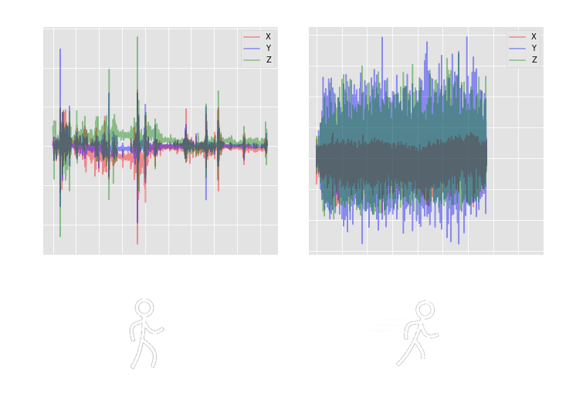
Initial Analysis
Visually identify how certain features correspond with the labeled activity
Acceleration over Time

Slide 6
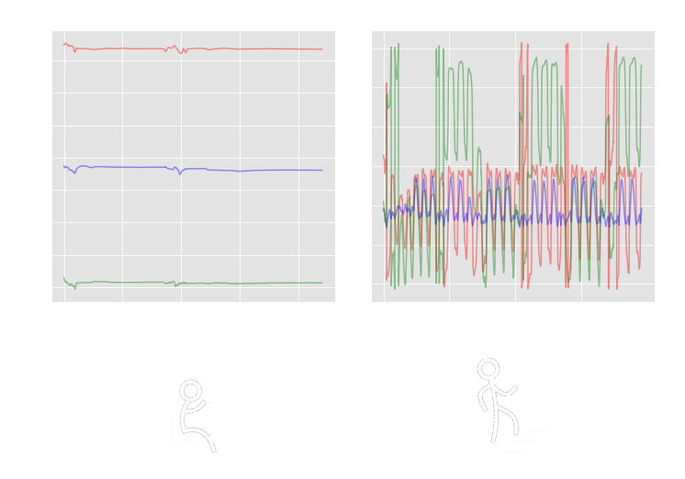
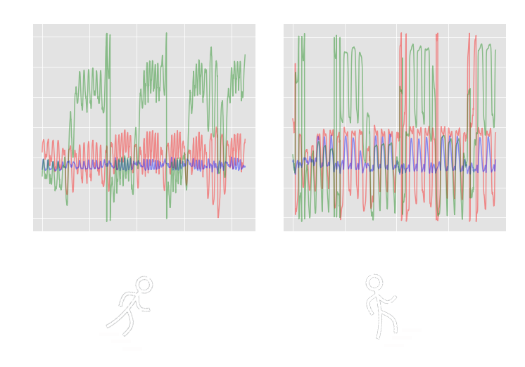
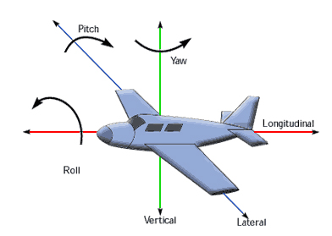
Initial Analysis - cont.
Attitude over Time

Slide 7
Thank You!
For more information: https://github.com/idocal/workshop/blob/master/MotionSenese/initial-analysis.ipynb

