Slide 1
Welcome to ASP.NET: MVC

Slide 2
Here’s what we’ll cover…
What is ASP.NET MVC and why should I care?
When would I ever use it in an application?
ASP.NET: Web Forms vs. MVC
Code Demo
Conclusion

Slide 3
Why would I want to use it?
Makes code management a breeze
Easy to read/debug
Organized structure
Reuse
Follows software development principles
Separation of concerns
Loose coupling
DRY (Don’t Repeat Yourself)

Slide 4
Just tell me what it is!
Model
View
Controller

Slide 5
Model-View-Controller
Model – Contains the business logic/rules
View – The presentation; usually an HTML file
Controller – Interface between Model & View

Slide 6

MVC Flow of Execution

Slide 7
If only it were that easy!
Let’s take a closer look at
the three components of an
MVC application in the .NET framework

Slide 8
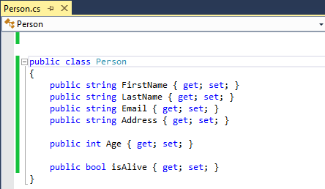
Example Model: Person

Slide 9
Model – What’s in it
Think of it as a class
Contains different kinds of logic:
Business Logic = How objects behave and relate
Validation Logic = Valid values for objects
Data Logic = How objects are persisted
Session Logic = Tracking user state
Source: http://blogs.msdn.com/b/aspnetue/archive/2010/09/17/second_2d00_post.aspx

Slide 10
View
Essentially an HTML file
Can be .html, .aspx, .vbhtml, .cshtml
Commonly used is Razor syntax (.cshtml)
Includes what are known as Helper methods
@Html.Label()
@Html.TextBox()
Uses @ sign rather than <% %> tags

Slide 11
View (cont.)
Can be strongly-typed to a model
Very useful for web forms
Allows use of strongly-typed Helper methods
@Html.TextBoxFor(x => x.FirstName)
LINQ (Language INtegrated Query) expression
Where “x” is an alias for the model (Person in this example)

Slide 12
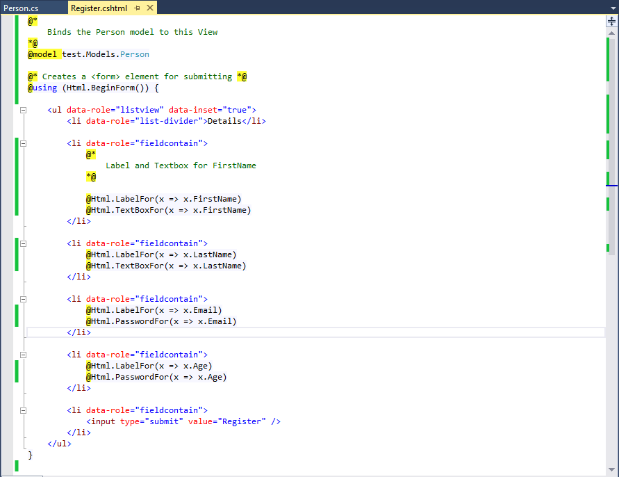
Example View: Register (using Razor syntax)

Slide 13
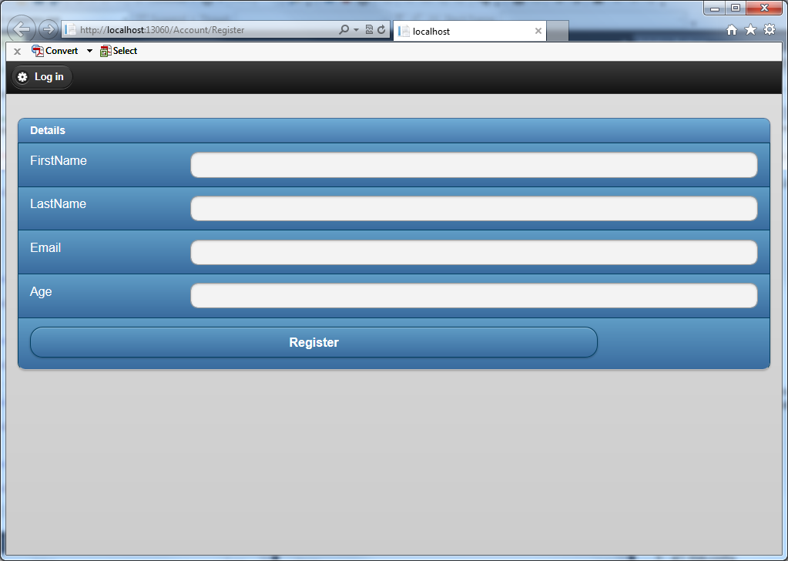
Register View in IE

Slide 14
Controller
Here’s where things get difficult…
Most complex – where bulk of the work goes
First to be hit on page request
Creates any necessary class/model instances
Possibly sent to corresponding View
Usually returns an ActionResult object
Sends HTML to browser
Let’s look at the Register() method in the AccountController…

Slide 15
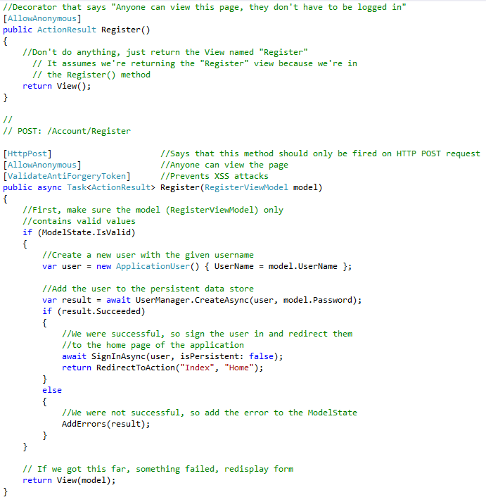

Slide 16
Brief MVC Background
“Software design pattern for implementing user interfaces.”
“…adopted as an architecture for World Wide Web applications in all major programming languages.”
Introduced in 1970’s, but was not recognized as a general concept until 1988.
Microsoft released ASP.NET MVC 1.0 framework in April 2009
Source: http://en.wikipedia.org/wiki/Model%E2%80%93view%E2%80%93controller

Slide 17
ASP.NET Fight Night: Web Forms vs. MVC
Different project architectures
Web Forms is very flexible; developer’s choice
MVC adheres to a more strict structure
Controllers must be in the “Controllers” folder, models must be in the “Models” folder, etc.
MVC has no Page object, no Page life cycle
Nothing like Page_Load or Page_Init
Unlike Web Forms, which goes through multiple stages when a page is requested

Slide 18
Web Forms vs. MVC (cont.)
MVC has no server controls or ViewState
No event handlers (i.e. Button1_Click)
Removing ViewState increases performance
No Postback
Web Forms caters to VB/WinForm programmers
Rapid Application Development (RAD)
Abstracts out the WWW’s stateless nature
Makes migrating to web development easier

Slide 19
Conclusion
Why care about ASP.NET MVC?
Becoming increasingly popular
Helps with aligning to development principles
Reduces “spaghetti code”
When to use it?
Probably not for everything; takes up space
Fast turnaround is not a priority
When it feels comfortable to use (familiarity)

Slide 20
Concluding Remarks
ASP.NET MVC is not in competition with Web Forms. Both will coexist for many years (in my opinion).
A matter of personal preference which one to use
It’s all just a different approach to solving a similar problem

