Slide 1

Gender gap in tech
through data
Idoia Martí Aluja
Data Science Lead @Allwomen
22nd January 2022

Slide 2



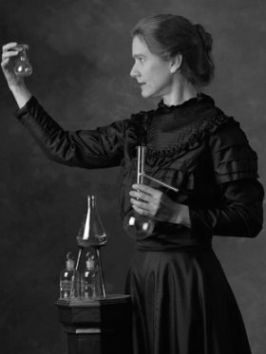
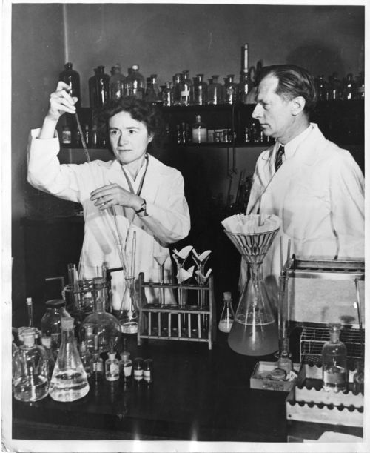
Idoia Martí Aluja
Data Science Lead at AllWomen
Instructor of the DS/DA courses
Marie Curie
Rosalind Franklin
Non-conventional chemist

Slide 3
Talking in numbers
only 1 in 4 students in STEM courses are women
only 1 in 5 tech workers worldwide are women
Notes:
Teaching point

Slide 4

THE GREATEST POTENTIAL
THAT WE HAVE LEFT
UNTAPPED
IS WOMEN
Notes:
The greatest talent potencial we have untapped is women

Slide 5
ALLWOMEN seeks to break those numbers
by helping women building a rewarding career in technology
Data Analytics
Data Science
UX/UI
UX writing
Product Management
Web Development
Notes:
VALUE PROP

Slide 6
About AW
empowering women through technology
30K+
female community members
10K+
attendees
to our tech events
300+
professional women upskilled in tech
80%
student employment success rate
Notes:
VALUE PROP

Slide 7


Gender gap,
myth or reality?

Slide 8
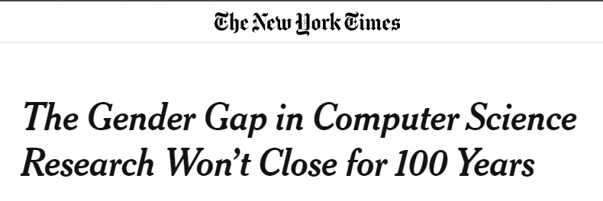
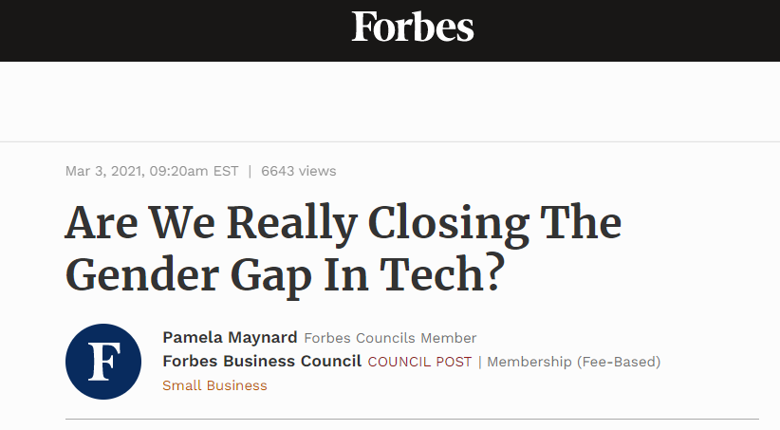
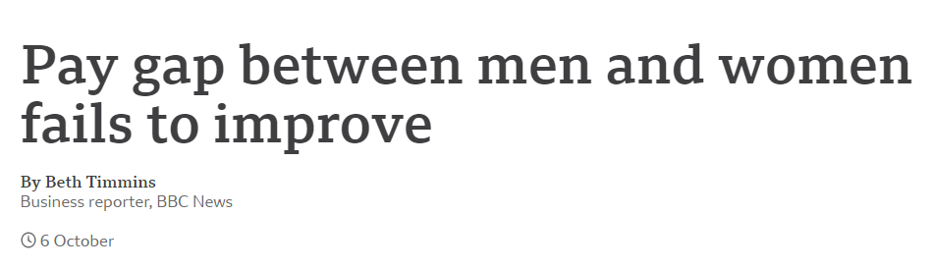
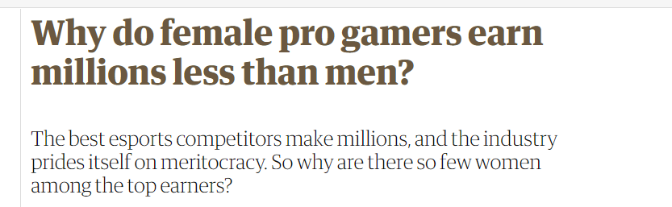


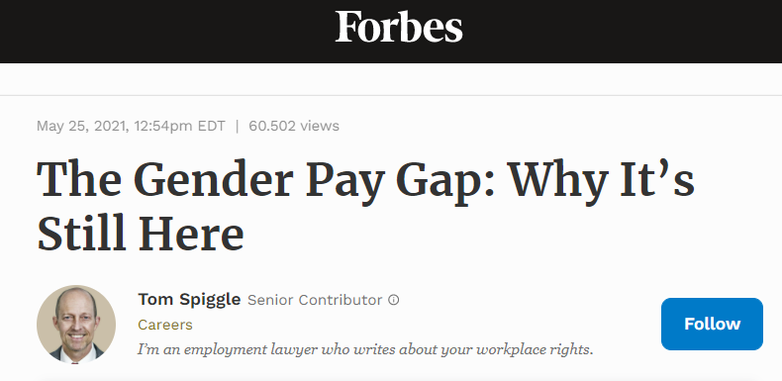

Slide 9
Let’s try to answer those questions with
REAL DATA
& Python
Notes:
The greatest talent potencial we have untapped is women

