Slide 1
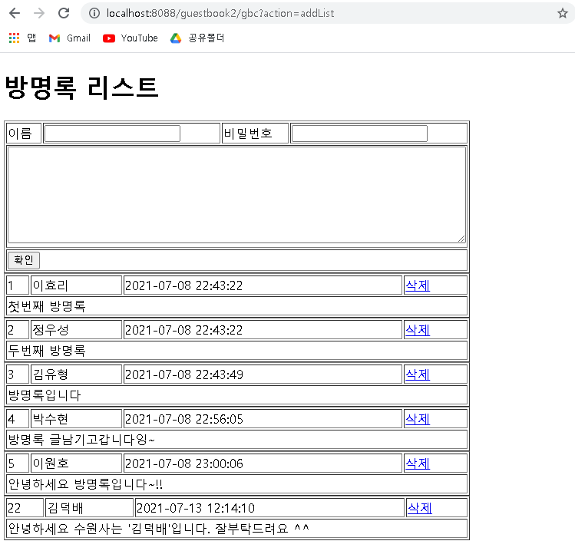
guestbook2 개요 및 분석
01
분석-리스트(addList)
Rqeust(요청)
Tomcat
Request header
파라미터: action=addList
Request body
guestbook2
contoller(servlet)객체
http://localhost:8088/guestbook2/gbc?action=addList
guestDao 객체
addList일때
guestList
getGuestList()
rquest
response
*포워드
addList.jsp
객체
Response(응답)
Response header
Response body
(html)
DB

Slide 2
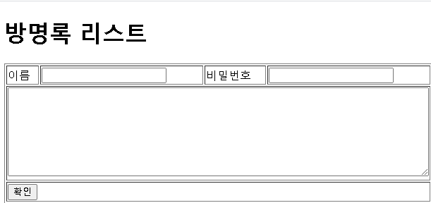
guestbook2 개요 및 분석
01
분석-등록(post 방식)
action=add&name=김윤형&password=1234&content=방명록입니다
http://localhost:8088/guestbook2/gbc
Rqeust(요청)
Tomcat
guestbook2
Request header
Request body
(파라미터)
Contoller(servlet)
객체
guestDao 객체
rquest
add일때
guestInsert(guestVo)
response
Response(응답)
Response header
Response body
(리다이렉트코드)
DB
http://localhost:8088/guestbook2/gbc?action=addList

Slide 3
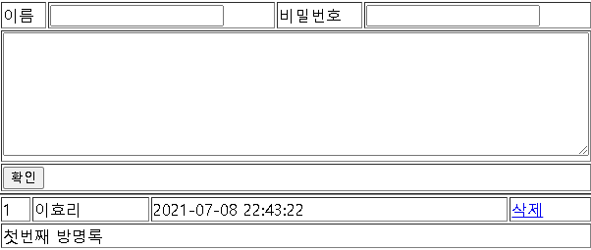
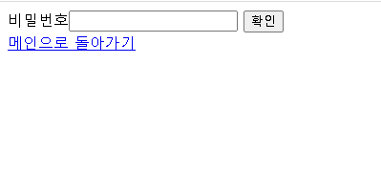
guestbook2 개요 및 분석
01
분석-삭제폼
Tomcat
Rqeust(요청)
guestbook2
Request header
Request body
Contoller(servlet)
객체
guestDao 객체
http://localhost:8088/guestbook2/gbc?action=dform&no=1
dform일때
rquest
dform
response
포워드
deleteForm.jsp
객체
Response(응답)
Response header
Response body
(html)
DB

Slide 4
guestbook2 개요 및 분석
01
분석-삭제(post 방식)
action=delete&no=1& password=1234
http://localhost:8088/guestbook2/gbc
Rqeust(요청)
Tomcat
guestbook2
Request header
Request body
(파라미터)
Contoller(servlet)
객체
guestDao 객체
rquest
delete일때
guestDelete(guestVo)
response
Response(응답)
Response header
Response body
(리다이렉트코드)
DB
http://localhost:8088/guestbook2/gbc?action=addList

