Slide 1
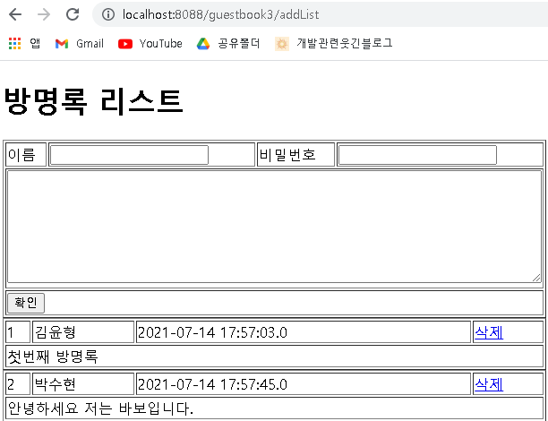
Guestbook3 분석
01
Handler Mapping
“guestbook3/addList” get post -> GuestController.addList()
분석-리스트(addList)
Tomcat
http://localhost:8088/guestbook3/addList
Guestbook3
web.xml
spring-servlet.xml
guestDao 객체
request
Handler Mapping
/addList
GuestController
getGuestList()
2
1
Front Controller
DispatcherServlet
3
Controller
4
ModelAndView
6
5
Model
response
View
View Resolver
gList
7
View
Return “/WEB-INF/views/addList.jsp”
DB

Slide 2
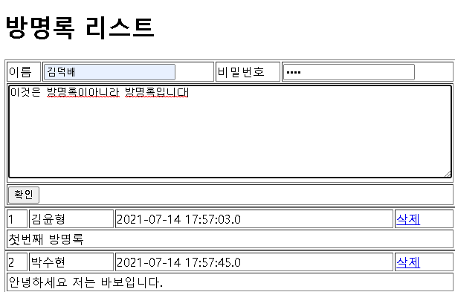
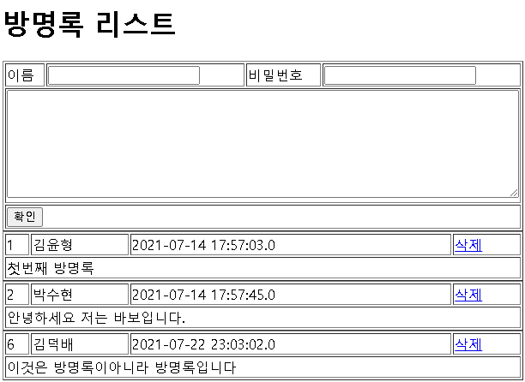
01
Guestbook3 분석
Handler Mapping
“guestbook3/addList” get post -> GuestController.addList()
“guestbook3/add” get post -> GuestController.add()
분석-방명록 추가(add)
http://localhost:8088/guestbook3/add?name=****&password=****&content=****
Tomcat
Guestbook3
web.xml
spring-servlet.xml
guestDao 객체
request
Handler Mapping
/add
GuestController
guestInsert(guestVo)
파라미터
Name
Password
content
2
1
Front Controller
DispatcherServlet
3
Controller
4
ModelAndView
6
5
ModelAttribute
response
View Resolver
GuestVo
Name
Password
content
리다이렉트
7
View
View
Return “redirect:/addList”
DB

Slide 3
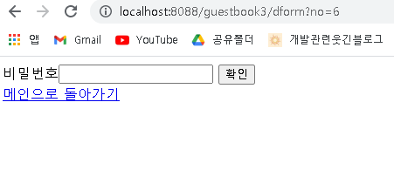
01
Guestbook3 분석
Handler Mapping
“guestbook3/addList” get post -> GuestController.addList()
“guestbook3/add” get post -> GuestController.add()
“guestbook3/dform” get post -> GuestController.deleteForm()
분석-삭제폼(dform)
http://localhost:8088/guestbook3/dform?no=6
Tomcat
Guestbook3
web.xml
spring-servlet.xml
Handler Mapping
request
/addList
GuestController
No=6
2
1
Front Controller
DispatcherServlet
3
Controller
4
ModelAndView
6
5
Model
addAttribute
response
View
View Resolver
no
7
View
Return “/WEB-INF/views/deleteForm.jsp”

Slide 4
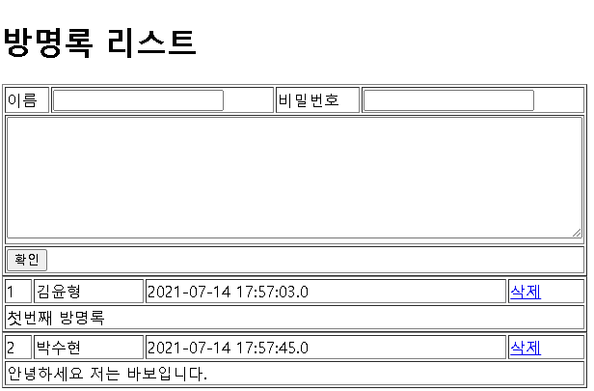
01
Guestbook3 분석
Handler Mapping
“guestbook3/addList” get post -> GuestController.addList()
“guestbook3/add” get post -> GuestController.add()
“guestbook3/dform” get post -> GuestController.deleteForm()
“guestbook3/delete” get post -> GuestController.delete()
분석-방명록 삭제(delete)
http://localhost:8088/guestbook3/delete?password=1234&no=6
Tomcat
Guestbook3
web.xml
spring-servlet.xml
guestDao 객체
request
Handler Mapping
/add
GuestController
guestIDelete(no, password)
파라미터
No
Password
2
1
Front Controller
DispatcherServlet
3
Controller
4
ModelAndView
6
5
response
View
View Resolver
리다이렉트
7
View
Return “redirect:/addList”
DB

