Slide 1
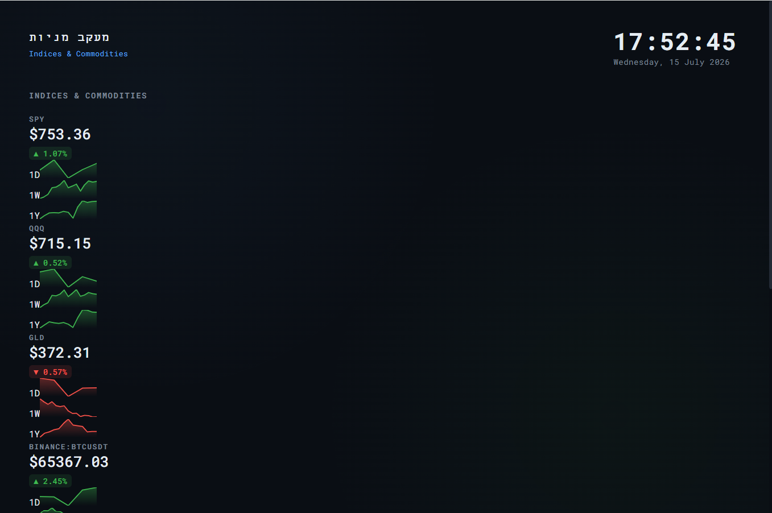

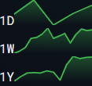

2.93%
210.33$
NVDA
0.22%
1.31%
2.93%

