Slide 1
Introduction to Akka.Net
Dormenco Ion

Slide 2
Contents
What is an actor model?
What is Akka.NET?
What is an Actor
Use cases
Demo
Q&A

Slide 3
What is Akka.NET?
A set of open-source libraries for designing scalable, resilient systems that span processor cores and networks.
Akka allows you to focus on meeting business needs instead of writing low-level code to provide reliable behavior, fault tolerance, and high performance.
Multi-threaded behavior without the use of low-level concurrency constructs like atomics or locks. You do not even need to think about memory visibility issues.
Transparent remote communication between systems and their components. You do not need to write or maintain difficult networking code.
A clustered, high-availability architecture that is elastic, scales in or out, on demand.

Slide 4
What is an actor model?
The actor model originated in 1973 and was proposed by Carl Hewitt.
The actor model in computer science is a mathematical model of concurrent computation that treats "actors" as the universal primitives of concurrent computation.
The basic characteristic of actors is that they model the world as stateful entities communicating with each other by explicit message passing.

Slide 5
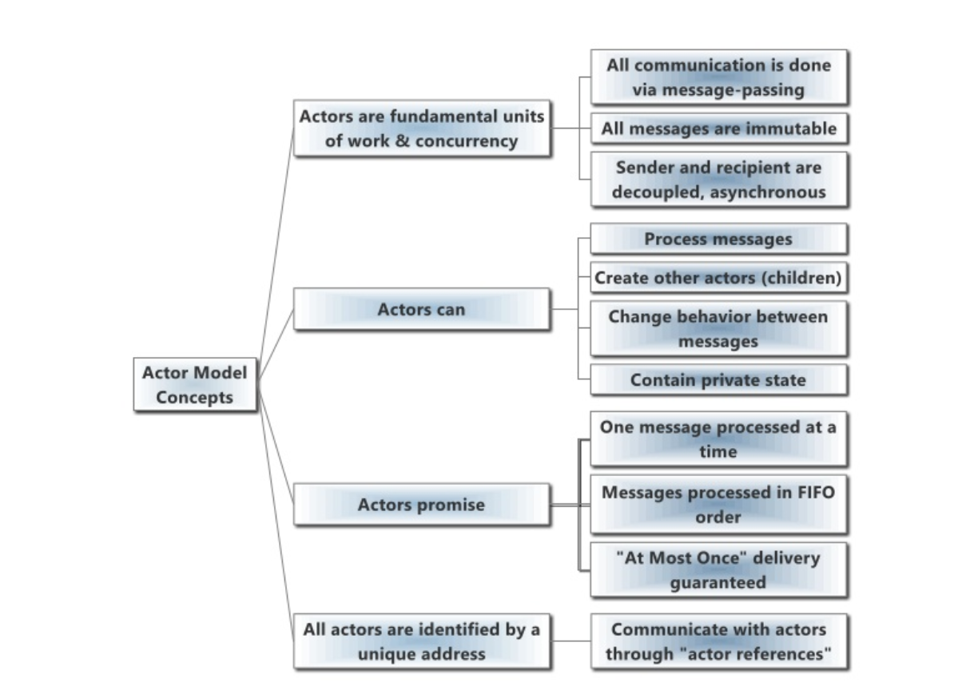
What is an actor?

Slide 6
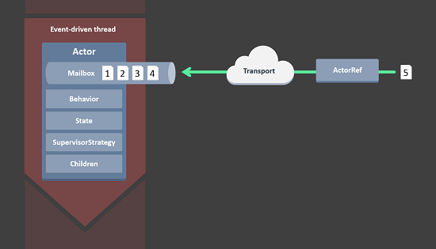
What is an actor?

Slide 7
What is an actor?
Actor Reference - actors are represented to the outside using actor references, which are objects that can be passed around freely and without restriction.
State – actor objects will typically contain some variables which reflect possible states the actor may be in.
Actors each have their own light-weight thread, which is completely shielded from the rest of the system
Behavior - every time a message is processed, it is matched against the current behavior of the actor. Behavior means a function which defines the actions to be taken in reaction to the message at that point in time

Slide 8
What is an actor?
Mailbox- each actor has exactly one mailbox to which all senders enqueue their messages
Child Actors - each actor is potentially a supervisor: if it creates children for delegating sub-tasks, it will automatically supervise them. The list of children is maintained within the actor's context and the actor has access to it.
Supervisor Strategy –strategy for handling faults of its children fault handling is then done transparently by Akka.

Slide 9
Use cases
Transaction processing (Online Gaming, Finance/Banking, Trading, Statistics, Betting, Social Media, Telecom)
Service backend (any industry, any app)
Concurrency/parallelism (any app)
Batch processing (any industry)
Gaming and Betting (MOM, online gaming, betting)

Slide 10
Demo
*Fingers crossed

