Slide 1

2015 The Air Battle
JavaScript game
Team “Hotaru"
Васил Коларов - vassilpk
Генчо Разсилев – gencho85
Георги Серев - lockheed
Ивайло Христов – Ivaylo1987
Иван Дойчинов - ivand
Милан Друмев – milan.drumev

Slide 2

Game Logo

Slide 3
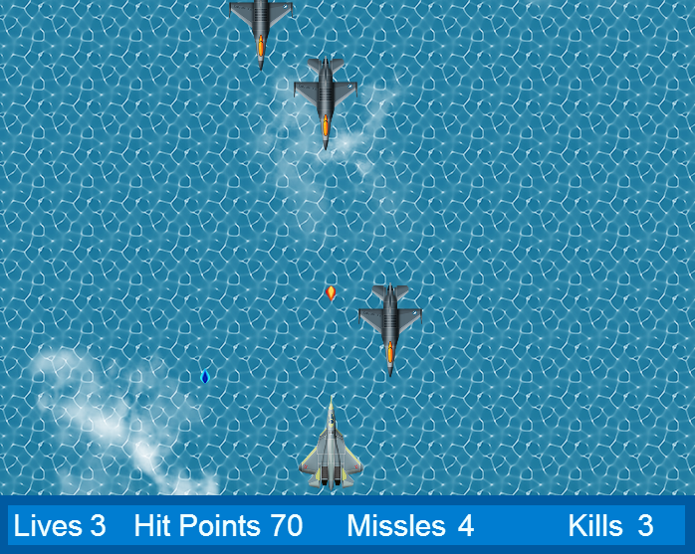
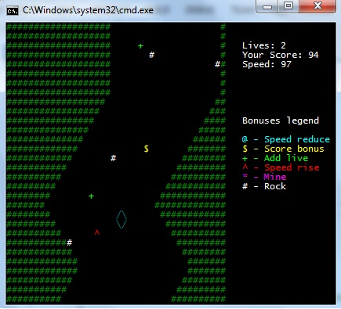
Gameplay

Slide 4
Game Overview
General
Moving background objects
Collision detection for all the objects except background ones
Generation of background objects and enemy’s aircrafts
Option for pausing the game
Player’s character
Different kinds of aircrafts depending on the level
Option for the aircraft to move in all directions
Different kinds of shooting manners depending on the level
Current score
Current lives
Damage levels

Slide 5
Game Overview
Non player character
Different kinds of aircrafts
Navigation by artificial intelligence
Shooting controlled by artificial intelligence
Damage levels
Design Characteristics
HTML 5 Canvas
SVG
Animations
DOM Manipulation
JavaScript OOP
Class Diagram

Slide 6
?
?
?
?
?
?
?
?
?
Questions?
?
?
?
?
?
?
?
?
?
?

Slide 7
Thank you!

