Slide 1

Project A 044167 Offloading TCP/IP to Smart-NIC Using VPP Host Stack
MIDWAY Presentation
Students: Ido Yehezkel & Uri kirstein
Supervisor: Haggai Eran

Slide 2
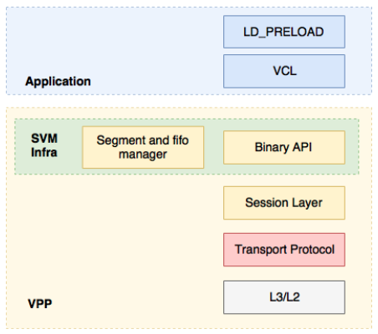
Introduction - Vector Packet Processing
VPP's host stack is a user space implementation of a number of transport, session and application layer protocols that leverages VPP's existing protocol stack. It roughly consists of four major components:
Session Layer that accepts pluggable transport protocols
Shared memory mechanisms for pushing data between VPP and applications
Transport protocol implementations (e.g. TCP, SCTP, UDP)
Comms Library (VCL) and LD_PRELOAD Library

Slide 3
Main Goal and Motivation
Main Goal:
Offloading packet processing job ,TCP/IP, from host CPU to smart NIC.
Motivation:
Adapt heterogenic system concepts – using accelerators.
Freeing a CPU core from networking tasks to other jobs.
Increase CPU utilization for user.
Might increase performance.

Slide 4
How To Do That ?
Take advantage of an existing implementation of TCP stack in user space (VPP project) – avoiding memory copy and context switch overhead to kernel.
Using Mellanox BlueField™ smart NIC for housing VPP process.
Integrate Remote direct memory access (RDMA) between client (VCL) and packet processing tasks (VPP) – replacing existing shared memory protocol.

Slide 5
Project - Timeline
Understating existing shared memory protocol between packet processing – VPP and the client – VCL.
Learning about RDMA technology:
How it works.
API.
How it is integrated in Mellanox smart NIC, BlueField™.
Design and develop a new data transfer protocol between VPP and VCL via RDMA.
Implementing the protocol – write code.
Testing and benchmarks.

Slide 6
Methodology
Weekly meeting with all participating personnel - supervisor and students.
Students (us) dedicate a whole workday for the project every week.
Open against Git Hub repository.
Asking related questions about the project in VPP mailing list.

Slide 7



Framework
Open source project VPP
C and C++ programming languages.
Linux.
Mellanox BlueField™ smart NIC – RDMA.

Slide 8
Progress So Far
Installing and get basic knowledge about open source project VPP.
Starting to understand existing shared memory protocol:
VCL and VPP communicate using Linux Sockets.
VPP process is in charge to allocate the shared memory region.
Shared memory is allocated using the system call “shm_open”.
Tracing data transfer.

Slide 9
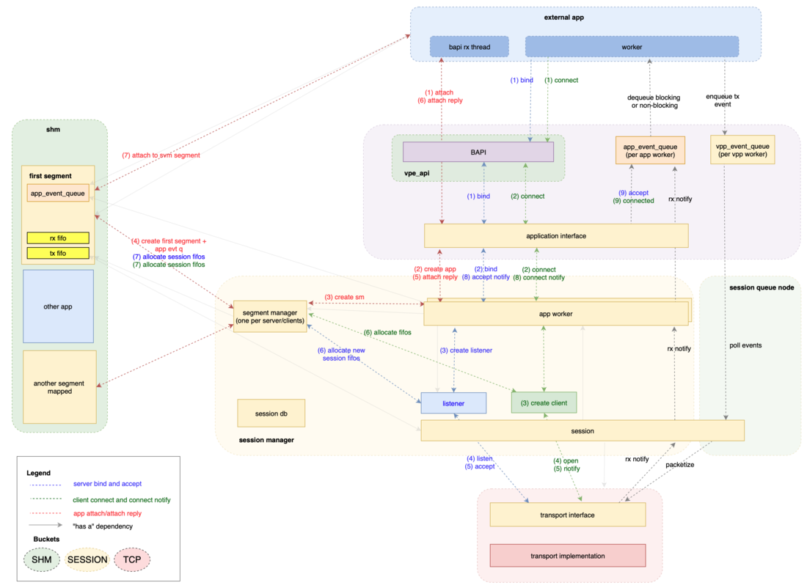

Slide 10
Next Immediate Steps
Finish to understanding existing shared memory protocol
Learn about RDMA.
Design new protocol using RDMA.

Slide 11
References
https://fd.io/
https://wiki.fd.io/view/VPP
http://www.mellanox.com/page/products_dyn?product_family=256&mtag=soc_overview

