Slide 1
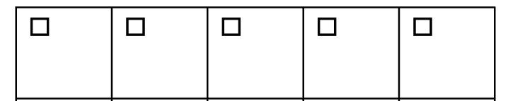
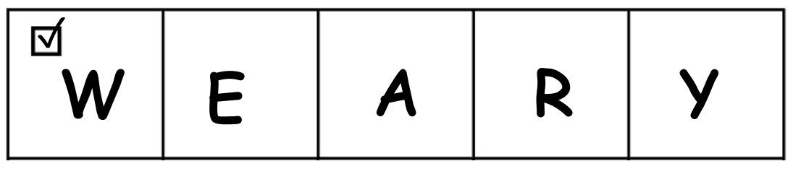
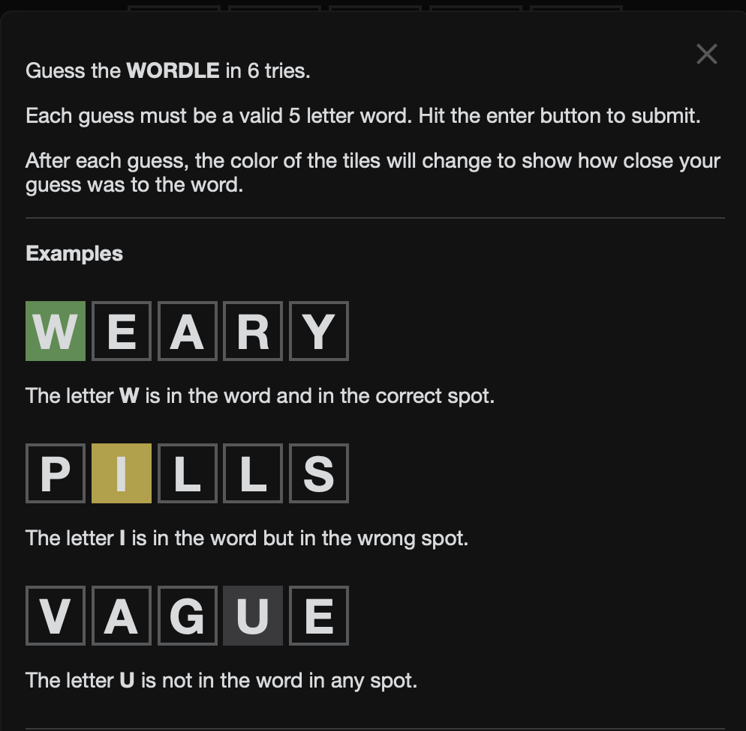
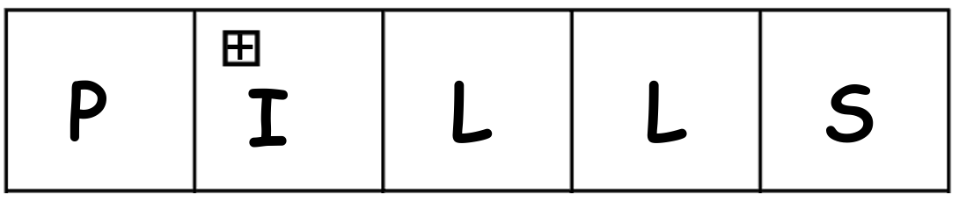
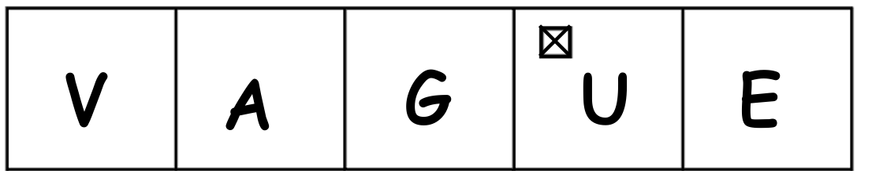
paper
WORDLE
✓
W
E
A
R
Y
Player 1
Write down a valid 5 letter WORDLE.
Player 2
Guess the WORDLE in 6 tries.
Player 1
After each try of Player 2, mark each letter with
✓, + or ✕, to
show how close their guess was to the word.
☐ | ☐ | ☐ | ☐ | ☐
☐ | ☐ | ☐ | ☐ | ☐
☐ | ☐ | ☐ | ☐ | ☐
☐ | ☐ | ☐ | ☐ | ☐
☐ | ☐ | ☐ | ☐ | ☐
☐ | ☐ | ☐ | ☐ | ☐
Examples
WEARY
The letter W is in the word and in the correct spot.
PILLS
The letter I is in the word but in the wrong spot.
VAGUE
The letter U is not in the word in any spot.
+
P
I
L
L
S
✕
V
A
G
U
E
fold up
paper
WORDLE
fold down
paper
WORDLE
fold up
WORDLE
Notes:
1

Slide 2
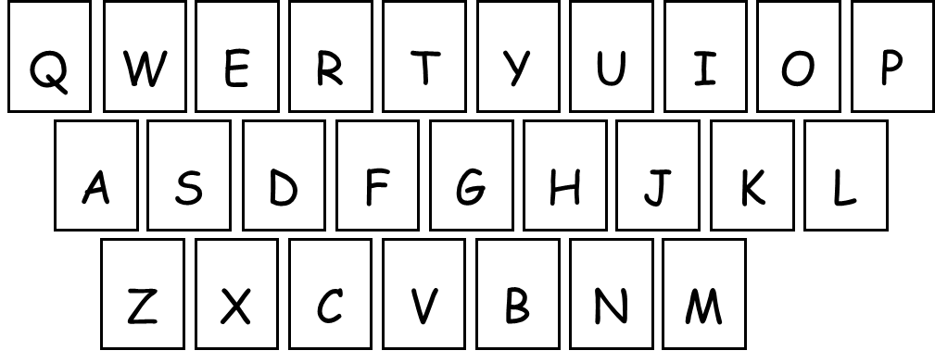
paper
WORDLE
☐ | ☐ | ☐ | ☐ | ☐
☐ | ☐ | ☐ | ☐ | ☐
☐ | ☐ | ☐ | ☐ | ☐
☐ | ☐ | ☐ | ☐ | ☐
☐ | ☐ | ☐ | ☐ | ☐
☐ | ☐ | ☐ | ☐ | ☐
Examples
WEARY
The letter W is in the word and in the correct spot.
PILLS
The letter I is in the word but in the wrong spot.
VAGUE
The letter U is not in the word in any spot.
✓
W
E
A
R
Y
Player 1
Write down a valid 5 letter WORDLE.
Player 2
Guess the WORDLE in 6 tries.
Player 1
After each try of Player 2, mark each letter with
✓, + or ✕, to
show how close their guess was to the WORDLE.
+
P
I
L
L
S
✕
V
A
G
U
E
fold up
paper
WORDLE
fold down
paper
WORDLE
fold up
WORDLE
Notes:
2

Slide 3
paper
WORDLE
☐ | ☐ | ☐ | ☐ | ☐
☐ | ☐ | ☐ | ☐ | ☐
☐ | ☐ | ☐ | ☐ | ☐
☐ | ☐ | ☐ | ☐ | ☐
☐ | ☐ | ☐ | ☐ | ☐
☐ | ☐ | ☐ | ☐ | ☐
Examples
WEARY
The letter W is in the word and in the correct spot.
PILLS
The letter I is in the word but in the wrong spot.
VAGUE
The letter U is not in the word in any spot.
✓
W
E
A
R
Y
Player 1
Write down a valid 5 letter WORDLE.
Player 2
Guess the WORDLE in 6 tries.
Player 1
After each try of Player 2, mark each letter with
✓, + or ✕, to
show how close their guess was to the WORDLE.
+
P
I
L
L
S
✕
V
A
G
U
E
fold up
paper
WORDLE
fold down
paper
WORDLE
fold up
WORDLE
Notes:
3

Slide 4


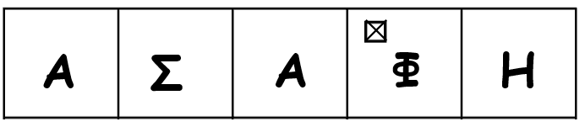
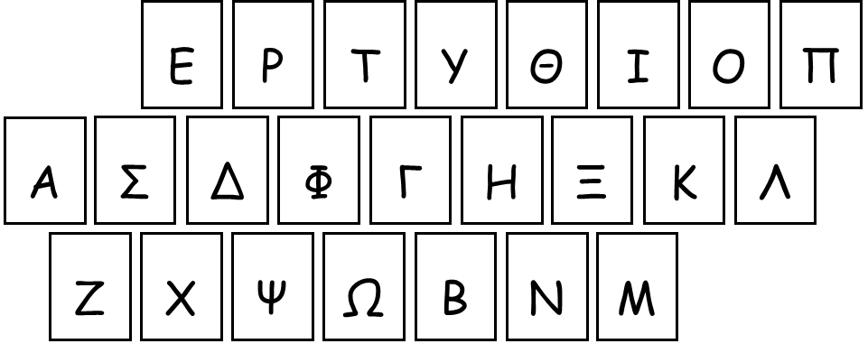
WORDLE
στο χαρτί
☐ | ☐ | ☐ | ☐ | ☐
☐ | ☐ | ☐ | ☐ | ☐
☐ | ☐ | ☐ | ☐ | ☐
☐ | ☐ | ☐ | ☐ | ☐
☐ | ☐ | ☐ | ☐ | ☐
☐ | ☐ | ☐ | ☐ | ☐
Παραδείγματα
WEARY
Το γράμμα Υ είναι στη λέξη, στη σωστή θέση.
PILLS
Το γράμμα Α είναι στη λέξη, αλλά σε λάθος θέση.
VAGUE
Το γράμμα Φ δεν είναι πουθενά στη λέξη.
✓
Υ
Π
Ν
Ο
Σ
Παίχτης 1
Γράψε ένα έγκυρο WORDLE με 5 γράμματα.
Παίχτης 2
Μάντεψε το WORDLE σε 6 προσπάθειες.
Παίχτης 1
Μετά από κάθε προσπάθεια του Παίχτη 1, σημείωσε κάθε γράμμα με
✓, + ή ✕, για να δείξεις πόσο κοντά ήταν στο WORDLE.
+
Χ
Α
Π
Ι
Α
✕
Α
Σ
Α
Φ
Η
fold up
WORDLE
στο χαρτί
fold down
WORDLE
στο χαρτί
fold up
WORDLE
Notes:
4

Slide 5
Q
W
E
R
T
Y
U
I
O
P
A
S
D
F
G
H
J
K
L
Z
X
C
V
B
N
M
E
P
T
Y
Θ
I
O
Π
A
Σ
Δ
Φ
Γ
H
Ξ
K
Λ
Z
X
Ψ
Ω
B
N
M
Notes:
5

