Slide 1
Detailed Overview of HEVC/H.265

Slide 2
High Level Syntax

Slide 3
HEVC Encoder
Ref
+
Residual
T & Q
CABAC
Bit-Stream
Ref
Ref
Motion
Est.
-
Input Video
MVs
Motion
Comp.
Inter
Intra/Inter
Decision
Reference samples
MVs/Intra modes
Mode
Intra
Pred.
Intra
Intra
Est.
Quantized
residuals
Ref.
+
Ref
SAO
Deblk.
Reconstructed
Q⁻¹& T⁻¹
Ref
Ref
+
DPB
SAO Params
Est.
Filter Control
SAO params
Notes:
In addition to AVC/H.264, SAO and SAO Params Estimation added.
SAO Params Est. can be executed right after deblocking or right after the reconstruction
as shown in the figure.
HEVC similarity with AVC/H.264 allows quick upgrading of existing AVC/H.264 solutions
to HEVC ones.

Slide 4
Bitstream Structure
VPS
SPS
PPS
Slice Header
Slice Data
* * * *
Picture #1
Slice Header
Slice Data
Slice Header
Slice Data
* * * *
Picture #k

Slide 5
High-Level Syntax ( Sequence, Picture level )
Sequence‐level: VPS, SPS and PPS
  VPS – specify multi-layer structure
  SPS – specify a single layer:
  Profile, tier, level
  Picture Size
  Max/Min CTU size, CU depth
  Max/Min TU size, TU depth
  …..
  PPS – specify a single layer, on/off tools:
  Sign Data Hiding
  Transform Skip
  Weighted Prediction
  Tiles, WPP
  …

Slide 6
Picture Syntax – Slice Header
Reference Frames – the list of reference pictures in DPB is explicitly signaled in slice header (unlike to AVC/H.264 where MMCO or sliding window mode is used). Not mentioned pictures are marked as unused for reference and should be removed from DPB respectively.
Notice that explicit signaling of the reference pictures enhances error resilience. Indeed, if a decoder detects that one of the reference pictures (mentioned in the list) is not exist in DPB then this picture got lost.
Deblocking Parameters

Slide 7
Picture Syntax (2)
Coding Tree Block (CTB):
Picture is partitioned into square coding tree blocks (CTBs). The size N of the CTBs is chosen by the encoder (16x16, 32x32, 64x64). Luma CTB covers a square picture area of N ×N samples and the corresponding chroma CTBs cover each (N/2) × (N/2) samples (in 4:2:0 format).
Coding Tree Units (CTU):
The luma CTB and the two chroma CTBs, together with the associated syntax, form a
coding tree unit (CTU). The CTU is the basic processing unit similar to MB in prior standards.
Coding Block (CB):
Each CTB can be further partitioned into multiple coding blocks (CBs). The size of the CB can range from the same size as the CTB to a minimum size (8×8).
Coding Unit (CU)
The luma CB and the chroma CBs, together with the associated syntax, form a coding unit (CU). Each CU can be either Intra or Inter predicted.

Slide 8
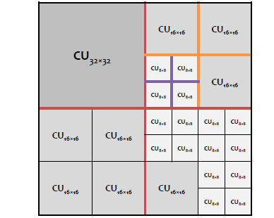
CTU Syntax
64x64 CTU

Slide 9
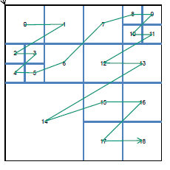
CTU Syntax (2)
All CUs in a CTU are encoded (traversed) in Z–Scan order:
64x64 CTU

Slide 10
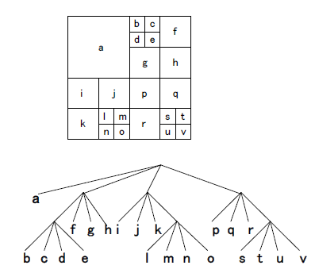
CTU Syntax (3)
Formally CTU specifies quad-tree traversed in ‘inorder’.
Note: unlike to prior standards where MB header is followed by data, in HEVC ‘headers are dispersed’:
CTU Header
CU Hdr
CU Data
* * * *
CU Hdr
CU Data
CTU

Slide 11
CU Syntax (1)
Prediction Block (PB):
Each CB is partitioned in 1, 2 or 4 prediction blocks (PBs).
Prediction Unit (PU):
The luma PB and the chroma PBs, together with the associated syntax, form a prediction unit (PU).
Intra:
2Nx2N NxN (only if CB size is smallest CB size, i.e. CU = SCU)
Inter:
2Nx2N NxN 2NxN Nx2N
Sub-partitions (e.g. NxN) are allowed if CU = SCU

Slide 12




CU Syntax (2)
Inter Assymetric Partitions (conditioned by amp_enabled_flag in SPS):
nLx2N
nRx2N
2NxnU
2NxnD
Why assymetric partitions are beneficial:
2NxnU
2NxnD
nLx2N
nRx2N

Slide 13
CU Syntax (3)
Notes:
The smallest luma PB size is 4 × 8 or 8 × 4 samples (where 4x8 and 8x4 are permitted only for uni-directional predictions, no bi-prediction < 8x8 allowed).
Chroma PBs mimic corresponding luma partition with the scaling factor 1/2 for 4:2:0.
Assymetric splitting is also applied to chroma CBs.

Slide 14
CU Syntax (4)
Transform Block (TB) :
Each luma CB can be quadtree partitioned into one, four or larger number of TBs.
The number of transform levels is controlled by max_transform_hierarchy_depth_inter
and max_transform_hierarchy_depth_intra.
Example.
CB divided into two TB levels (the block #1 is split into four blocks):
0
1,0
1,1
1,2
1,3
2
3
0
2
3
1,0
1,1
1,2
1,3

Slide 15
CU Syntax (5)
Notes
Unlike to H.264/AVC where TB ≤ PB, prediction and transform partitioning are independent, i.e. TB can contain several PBs and vice versa.
Reported by some experts that prediction discontinuities on PB boundaries within TB are smoothed by transform and quantization. If PB and TB boundaries coincide then the discontinuities are observed increased.

Slide 16
Restrictions/Constraints
HEVC disallows 16x16 CTBs for level 5 and above (4K TV).
Motivation:
16x16 CTBs add overheads for decoders to target 4K TV:
    Up to 10% increase in worst-case decode time
    Add storage for SAO params.
Maximal CTU size shall be less than or equal to 4 * RawCtuBits / 3.
The variable RawCtuBits is derived as
RawCtuBits=CtbSizeY * CtbSizeY * BitDepth_{Y} +2 * ( CtbWidthC * CtbHeightC ) * BitDepth_{C}
Illustration:
Let’s take CtbSizeY=16 (as in AVC/H.264). Then RawCtuBits = 16*16*8+2*8*8*8 = 3072
and maximal CTB bit-size is 4*3072/3 = 4096 bits respectively.
Notice that in AVC/H.264 the maximal MB bit-size is 3200 bits.

Slide 17
Inter Prediction/ Motion Compensation

Slide 18
Luma Motion Compensation Details (1)
Fractional interpolation for luma samples uses 8-tap filter for both half-pels and quarter-pels (although some positions actually reduced to 7-tap filter).
Notice that in AVC/H.264 the motion compensation is executed in two serial stages:
6-tap filter for half-pels
bilinear filter for quarter-pels
So, AVC/H.264 gives the same complexity as HEVC 8-tap filter but two-stage latency (HEVC motion compensation filter can be executed in one stage).
In the following slides we illustrate as positions a_{0,0} through r_{0,0} are specified.
A
-
1,
-
1
A
0,
-
1
a
0,
-
1
b
0,
-
1
c
0,
-
1
A
1,
-
1
A
2,
-
1
A
-
1,0
A
0,0
a
b
c
A
A
0,0
0,0
0,0
1,0
2,0
d
-
1,0
d
0,0
e
0,0
f
0,0
g
0,0
d
1,0
d
2,0
h
-
1,0
h
0,0
i
0,0
j
0,0
k
0,0
h
1,0
h
2,0
n
-
1,0
n
0,0
p
0,0
q
0,0
r
0,0
n
1,0
n
2,0
A
-
1,1
A
0,1
a
0,1
b
0,1
c
0,1
A
1,1
A
2,1
A
-
1,2
A
0,2
a
0,2
b
0,2
c
0,2
A
1,2
A
2,2

Slide 19
Luma Motion Compensation Details (2)
Quarter-pels a_{0,0}, c_{0,0}, d_{0,0}, n_{0,0} and half-pels b_{0,0}, h_{0,0} are derived from nearest integer positions.
The quarter-pels a_{0,0}, c_{0,0}, d_{0,0}, n_{0,0} are derived by the 7-tap filter and the half-pels b_{0,0}, h_{0,0} by 8-tap filter.
a_{0,0} , b_{0,0} and c_{0,0} are computed by horizontal filtering, while d_{0,0} , h_{0,0} and n_{0,0} by vertical filtering.
A
-
1,
-
1
A
0,
-
1
a
0,
-
1
b
0,
-
1
c
0,
-
1
A
1,
-
1
A
2,
-
1
A
-
1,0
A
0,0
a
0,0
b
0,0
c
0,0
A
1,0
A
2,0
d
-
1,0
d
0,0
e
0,0
f
0,0
g
0,0
d
1,0
d
2,0
h
-
1,0
h
0,0
i
0,0
j
0,0
k
0,0
h
1,0
h
2,0
n
-
1,0
n
0,0
p
0,0
q
0,0
r
0,0
n
1,0
n
2,0
A
-
1,1
A
0,1
a
0,1
b
0,1
c
0,1
A
1,1
A
2,1
A
-
1,2
A
0,2
a
0,2
b
0,2
c
0,2
A
1,2
A
2,2

Slide 20
Luma Motion Compensation Details (3)
Half-pel j_{0,0} is derived by applying the 8-tap filter vertically to nearest half-pels: b_{0,−3} , b_{0,−2} , b_{0,−1} , b_{0,0} , b_{0,1} , b_{0,2} , b_{0,3} , b_{0,4} . Notice that j_{0,0} can be determined only after b_{0,0} has been computed (see the previous slide).
Quarter-pels e_{0,0} and p_{0,0} are derived by applying the 7-tap filter vertically to nearest quarter-pels. Notice that e_{0,0} and p_{0,0} can be determined only after a_{0,0} has been computed (see the previous slide).
A
-
1,
-
1
A
0,
-
1
a
0,
-
1
b
0,
-
1
c
0,
-
1
A
1,
-
1
A
2,
-
1
A
-
1,0
A
0,0
a
0,0
b
0,0
c
0,0
A
1,0
A
2,0
d
-
1,0
d
0,0
e
0,0
f
0,0
g
0,0
d
1,0
d
2,0
h
-
1,0
h
0,0
i
0,0
j₀₀
k
0,0
h
1,0
h
2,0
n
-
1,0
n
0,0
p
0,0
q
0,0
r
0,0
n
1,0
n
2,0
A
-
1,1
A
0,1
a
0,1
b
0,1
c
0,1
A
1,1
A
2,1
A
-
1,2
A
0,2
a
0,2
b
0,2
c
0,2
A
1,2
A
2,2

Slide 21
Luma Motion Compensation Details (4)
Quarter-pel i_{0,0} is derived by applying the 8-tap filter vertically to nearest quarter-pels: a_{0,−3}, a_{0,−2}, a_{0,−1}, a_{0,0}, a_{0,1}, a_{0,2}, a_{0,3}, a_{0,4}
Quarter-pel k_{0,0} is derived by applying the 8-tap filter vertically to nearest quarter-pels: c_{0,−3}, c_{0,−2}, c_{0,−1}, c_{0,0}, c_{0,1}, c_{0,2}, c_{0,3}, c_{0,4}
A
-
1,
-
1
A
0,
-
1
a
0,
-
1
b
0,
-
1
c
0,
-
1
A
1,
-
1
A
2,
-
1
A
-
1,0
A
0,0
a
0,0
b
0,0
c
0,0
A
1,0
A
2,0
d
-
1,0
d
0,0
e
0,0
f
0,0
g
0,0
d
1,0
d
2,0
h
-
1,0
h
0,0
i
0,0
j
0,0
k
0,0
h
1,0
h
2,0
n
-
1,0
n
0,0
p
0,0
q
0,0
r
0,0
n
1,0
n
2,0
A
-
1,1
A
0,1
a
0,1
b
0,1
c
0,1
A
1,1
A
2,1
A
-
1,2
A
0,2
a
0,2
b
0,2
c
0,2
A
1,2
A
2,2

Slide 22
Luma Motion Compensation Details (5)
Quarter-pels f_{0,0} , g_{0,0} , q_{0,0} , r_{0,0} are derived by applying the 7-tap filter vertically to the nearest quarter-pels.
A
-
1,
-
1
A
0,
-
1
a
0,
-
1
b
0,
-
1
c
0,
-
1
A
1,
-
1
A
2,
-
1
A
-
1,0
A
0,0
a
0,0
b
0,0
c
0,0
A
1,0
A
2,0
d
-
1,0
d
0,0
e
0,0
f
0,0
g
0,0
d
1,0
d
2,0
h
-
1,0
h
0,0
i
0,0
j
0,0
k
0,0
h
1,0
h
2,0
n
-
1,0
n
0,0
p
0,0
q
0,0
r
0,0
n
1,0
n
2,0
A
-
1,1
A
0,1
a
0,1
b
0,1
c
0,1
A
1,1
A
2,1
A
-
1,2
A
0,2
a
0,2
b
0,2
c
0,2
A
1,2
A
2,2

Slide 23
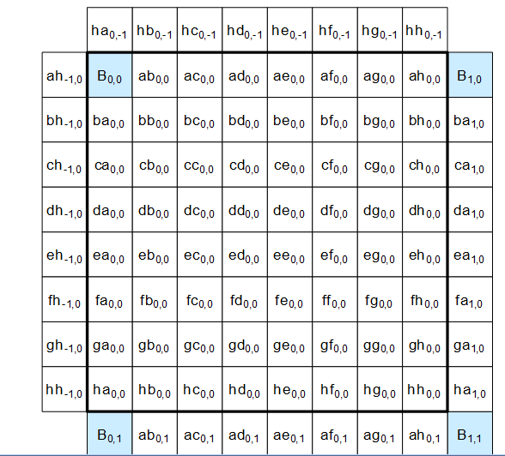
Chroma Motion Compensation
The fractional interpolation for the chroma is similar to the luma
except that the 4-tap filter is applied instead of 8-taps in luma and accuracy is 1/8-pel.

Slide 24
Notes/Conclusions
Luma interpolation can be performed in two serial stages: half-pel and quarter-pel.
For motion compensation of NxM block it’s required to load (N+7)x(M+7) reference block (3 left/above, 4 right and below).
8 tap filter coefficients: { -1, 4, -11, 40, 40, -11, 4, -1 }
7-tap filter coefficients: { -1, 4, -10, 58, 17, -5, 1 }, non-symmetric.
8-tap MC interpolation filter expands DR of intermediate results to 22 bits:
½-pel interpolation expands DR for 8-bits input to 16 bits.
The next ¼-pel interpolation expands DR to 22 bits.

Slide 25
Dynamic Range Estimation
Worst case for 1/2-pel filter :
b_{0,0} = −A_{−3,0} + 4*A_{−2,0} − 11*A_{−1,0} + 40*A_{0,0} + 40*A_{1,0} − 11*A_{2,0} + 4*A_{3,0} − A_{4,0}
Maximal value of b_{0,0} is 88*255 = 22440, the minimal value is -24*255 = -6120. The same limits are also correct for h_{0,0} .
Worst case for 1/4-pel filter:
a_{0,0} = −A_{−3,0} + 4*A_{−2,0} − 10*A_{−1,0} + 58*A_{0,0} + 17*A_{1,0} − 5*A_{2,0} + A_{3,0}
Maximal value of a_{0,0} is 80*255 = 20400, the minimal value is -16*255 = -4080. The same limits are also correct for c_{0,0}, d_{0,0,} n_{0,0} .
-4080 ≤ a_{0,0}, c_{0,0}, d_{0,0,} n_{0,0} ≤ 20400
-6120 ≤ b_{0,0}, h_{0,0} ≤ 22440
So, the values of a_{0,0}, c_{0,0}, d_{0,0,} n_{0,0} , b_{0,0}, h_{0,0} are within 16 bits.

Slide 26
Dynamic Range Estimation (2)
Second step of interpolation (when neighboring half-pel and quarter-pel samples are uses):
e_{0,0} = ( −a_{0,−3} + 4*a_{0,−2} − 10*a_{0,−1} + 58*a_{0,0} + 17*a_{0,1} − 5*a_{0,2} + a_{0,3} ) >> 6
Taking into account that a_{0,k} is in the range [-4080 .. 20400] the expression in the parenthesis gives the following limits:
-80*4080= - 326400 ≤ −a_{0,−3} + 4*a_{0,−2} − 10*a_{0,−1} + 58*a_{0,0} + 17*a_{0,1} − 5*a_{0,2} + a_{0,3} ≤ 80*20400=1632000
So, the dynamic range increased to 22 bits (incl. sign bit).
After shifting by 6 the dynamic range reduced to 16 bits: -5100 ≤ e_{0,0} ≤ 25500
j_{0,0} = ( −b_{0,−3} + 4*b_{0,−2} − 11*b_{0,−1} + 40*b_{0,0} + 40*b_{0,1} − 11*b_{0,2} + 4*b_{0,3} − b_{0,4} ) >> 6
Taking into account that b_{0,k} is in the range [-6120 .. 22440] the expression in the parenthesis gives the following limits:
-88*6120 = - 538560 ≤
−b_{0,−3} + 4*b_{0,−2} − 11*b_{0,−1} + 40*b_{0,0} + 40*b_{0,1} − 11*b_{0,2} + 4*b_{0,3} − b_{0,4}
≤ 88*22440=1974720
As in the case with e_{0,0} the dynamic range in calculation of j_{0,0} is increased to 22 bits. After
the shift by 6, the dynamic range is reduced to 16 bits.

Slide 27
Intra Prediction

Slide 28
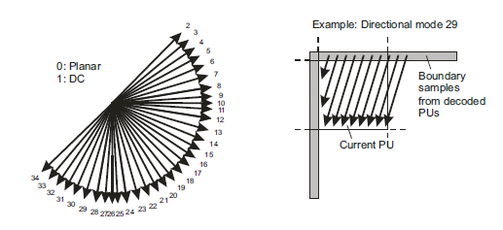
Overview
33 angular predictions for both luma and chroma. Two non-directional
predictions (DC, Planar).
PB sizes from 4×4 up to 64×64.
Like in AVC/H.264 Luma intra prediction mode is coded predictivly and chroma intra mode is derived from the luma one.

Slide 29
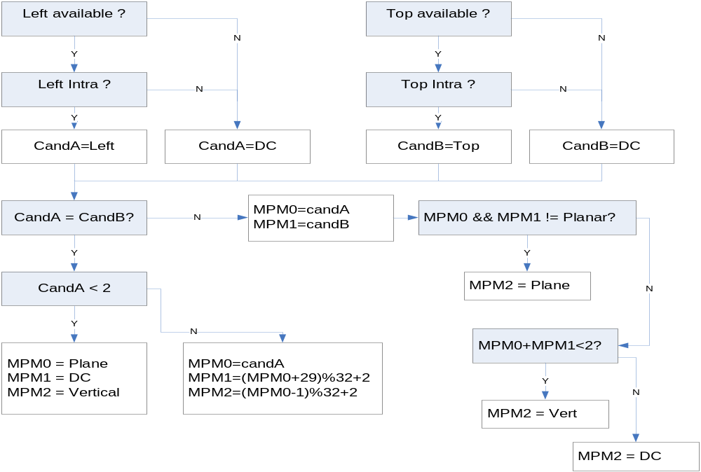
Coding & Derivation Luma Intra Prediction Mode (1)
Unlike to AVC/H.264 three “most probable modes”: MPM0, MPM1 and MPM2 are considered. The following figure reveals the logic for derivation of MPMs:

Slide 30
Coding & Derivation Luma Intra Prediction Mode (2)
Encoder side:
If the current luma intra prediction mode is one of three MPMs, prev_intra_luma_pred_flag set to 1 and the MPM index (mpm_idx) is signaled.
Otherwise, the index of the current luma intra prediction mode excluding
the three MPMs is transmitted to the decoder by using a 5-bit fixed length
code (rem_intra_luma_pred_mode).

Slide 31
Coding & Derivation Luma Intra Prediction Mode (3)
Decoder side:
Upon derivation of MPMs, collect them in candModeList[3]= [MPM0, MPM1, MPM2]. The following code outlines how luma intra mode is derived:
If prev_intra_pred_flag = true then
IntraPredMode = CandList [mpm_idx]
Else
{ sort CandList in ascending order }
if candModeList[0] is greater than candModeList[1], swap two values.
if candModeList[0] is greater than candModeList[2], swap two values.
if candModeList[1] is greater than candModeList[2], swap two values.
Read 5 bits to rem_intra_luma_pred_mode
IntraPredMode = rem_intra_luma_pred_mode
if IntraPredMode >= candList[ 0 ] IntraPredMode ++
if IntraPredMode >= candList[ 1 ] IntraPredMode ++
if IntraPredMode >= candList[ 2 ] IntraPredMode ++
EndElse

Slide 32
Coding & Derivation Chroma Intra Prediction Mode
Unlike AVC/H.264, chroma intra prediction mode is derived from luma and from the syntax element intra_chroma_pred_mode ( signaled each PB ) according to the following table:
intra_chroma_pred_mode | Luma IntraPredMode
 | 0 | 26 | 10 | 1 | X ( 0 <= X <= 34 )
0 | 34 | 0 | 0 | 0 | 0
1 | 26 | 34 | 26 | 26 | 26
2 | 10 | 10 | 34 | 10 | 10
3 | 1 | 1 | 1 | 34 | 1
4 | 0 | 26 | 10 | 1 | X

Slide 33
Implementation Angular Intra Prediction (1)
At most 4N+1 neighbor pixels are required (in contrast to H.264/AVC, below-left samples are exploited in HEVC).
Top CTU
Top-left CTU
16x16
8x8
8x8
Top-left predictor
Top predict.
Top-right predictors
Left CTU
16x16
Current PB
8x8
Left predictors
Current CTU
Below Left predictors

Slide 34
Implementation Angular Intra Prediction (2)
To improve the intra prediction accuracy, the projected reference sample location is computed with 1/32 sample accuracy, bi-linear interpolation is used.
In angular mode predicted sample PredSample(x,y) is derived as follow:
predSample[ x ][ y ] = ( ( 32 – iFact )*ref[ x+iIdx+1 ] + iFact*ref[ x+iIdx+2] + 16 ) >> 5
predSample[ x ][ y ] = ( ( 32 – iFact )*ref[ y+iIdx+1 ] + iFact*ref[ y+iIdx+2] + 16 ) >> 5
The parameter iIdx and iFact denote the index and the multiplication factor determined by the intra prediction mode (can be extracted via LUTs).
The weighting factor iFact remains constant across predicted row or column that facilitates SIMD implementations of angular intra predictions.

Slide 35
Planar Mode
In AVC/H.264, the plane intra mode requires two multiplications per sample
predL[ x, y ] = Clip1Y( ( a + b * ( x − 7 ) + c * ( y − 7 ) + 16 ) >> 5 )
plus overhead calculation per 16x16 block in determination of the parameters ‘a’,’b’ and ‘c’.
Totally the plane mode takes at most three multiplications per sample.
In HEVC, intra planar mode requires four multiplications per sample:
predSamples[ x ][ y ] = ( ( nT − 1 − x ) * p[ −1 ][ y ] + ( x + 1 ) * p[ nT ][ −1 ] +
( nT − 1 − y ) * p[ x ][ −1 ] + ( y + 1 ) * p[ −1 ][ nT ] + nT ) >> ( Log2( nT ) + 1 )
So, HEVC planar mode is more complex than in AVC/H.264.

Slide 36
Motion Vector Prediction

Slide 37
Overview
Effective motion data prediction techniques have been adopted in HEVC in order to reduce motion data portion in the stream.
Unlike other standards (e.g. AVC/H.264), the HEVC adopted competitive motion vector prediction for both regular and merge (HEVC replacement of AVC/H.264 skip/direct) modes, i.e. several predictor candidates are competing for the prediction and the right candidate is signaled in the stream.
Unlike AVC/H.264, in regular (advanced motion vector prediction or in AMVP in jargon of HEVC) MV prediction the co-located temporal MV is considered if one of spatial candidates is non-available or redundant.
In merge mode (HEVC replacement of AVC/H.264 skip/direct), the set of merge candidates can include a temporal candidate (if one or more spatial candidates are non-available or redundant).
Including of temporal MV prediction in both regular and merge modes improves error resilience. On the other hand an additional storage of co-located MVs of reference frames is required.
Spatial and temporal MVP candidates can be derived independently and in parallel

Slide 38
Merge Mode: Removal of Same Motion Candidates (Prunning)
In earlier versions of HEVC, a candidate removed if any of previous candidate has the same motion. When NumMergeCands=5 the detection of all redundant candidates requires 10 comparisons per PU.
In latest HEVC to reduce complexity of merge list generation, only 5 comparisons are executed (instead of 5) for detection of duplication and the temporal candidate is excluded from comparisons (for the sake of parallelism).
Note:
Due to limiting of comparisons and exempting the temporal candidate from prunning process, redundant candidates can appear in the merge list.
B2
B1
B0
comparison
A1
A0

Slide 39
Merge Mode: Additional Candidates
If merge list is not full (i.e. #candidates<NumMergeCands) then additional “virtual” candidates appended.

Slide 40
Merge Mode: List Construction in Encoding
Derive candidate list
(spatial & temporal )
Prunning Process
remove duplicates (restricted)
If merge list full?
No
Add “virtual” candidates
Yes
Select candidate
for encoding

Slide 41
Merge Mode: List Construction in Decoding
Derive candidate list
(spatial & temporal )
CABAC
Prunning Process
remove duplicates (restricted)
Decode merge_idx
If merge_idx< current list size?
index
No
Add “virtual” candidates
Yes
Use candidate pointed by merge_idx
for decoding

Slide 42
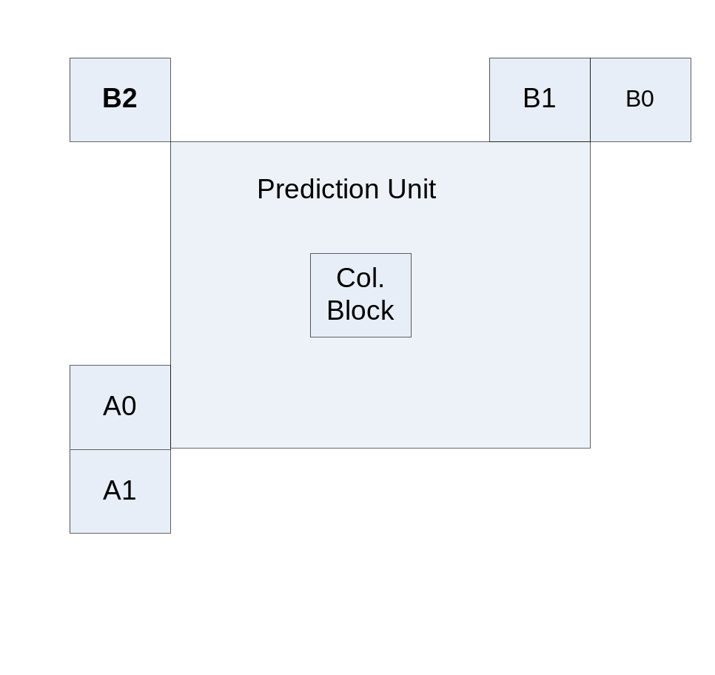
Advanced Motion Vector Prediction (AMVP)
Motion vector is predicted from five spatial neighbors: B0, B1, B2, A0, A1 (see the figure below) and one co-located temporal MV. Only two motion candidates are chosen among six neighbors and the selected predictor is explicitly signaled (mvp_lx_flag).

Slide 43
Advanced Motion Vector Prediction (AMVP) – cont.
The first motion candidate (left candidate) is chosen from {A0, A1}
The second motion candidate (top candidate) is chosen from {B0, B1, B2}
If both candidates are available and have the same motion data, one is excluded
If one of the above candidates is not available then the temporal MV is used unless the temporal prediction mode disabled
If the number of available candidates is less than 2, zero MV is added

Slide 44
Transform

Slide 45
Overview
The standard supports 32x32, 16x16, 8x8 and 4x4 DCT-like transforms and 4x4 DST-like transform. Notice that DST-like 4x4 transform is allowed only for intra mode.
Each transform is specified by 8-bits signed digital transform matrix T. To perform all transform operations it’s required 32-bits precision.
The inverse transform can be executed as follows:
  Z = X’ T, where X is the input matrix of quantized coefficients (16-bits per coefficient, for more detailed analysis refer to JCTVC-L0332)
  Scaling and clipping of Z to guarantee that the output values are within 16-bits.
  Y = Z’ T
Notice that in encoder architecture the step (c) can be “coupled” with quantization: once first row of Y completed the quantization of the first row is started.

Slide 46
Transform Implementation
Notice AVC/H.264 where transform coefficients are dyadic in 4x4 case and near dyadic (i.e. from the form 2^n, 2^n-1, 2^n+1) in 8x8 case and hence AVC/H.264 transform can be multiplication-free.
In HEVC transform operations are not multiplication-free. Indeed, let the multiplication takes 3 cycles, shift or addition – 1 cycle . Therefore if all coeffs are near dyadic we can use only shifts and additions, otherwise we need a multiplier (because the alternative of shifts and adds hurts performance).
As well as in AVC/H.264 the transforms in HEVC are separable and can be performed as sequence of two 1D transforms (vertical and horizontal):
  for (i=0, i<N, i++ )
  {
  1D Transform on column ‘i’ // vertical
  }
  Scaling (right shift by 7) & Saturation
  for (j=0, j<N, j++ )
  {
  1D Transform on row ‘j’ // horizontal
  }

Slide 47
Comments
As well as in previous standards HEVC DCT works well on flat areas, but fails on areas with noise, contours and other peculiarities of the signal.
HEVC DCT is efficient for big size of blocks but it looses efficiency on smaller blocks.
Beginning from 16x16 transforms visual artifacts are noticeable. The more the transform size the more artifacts are observable. Deblocking can reduce artifacts on TB boundaries, while artifacts inside a TB can be reduced only by SAO. Therefore it’s recommended to apply SAO when large transform sizes (32x32) are used.

Slide 48
Transform Implementation (2)

Slide 49
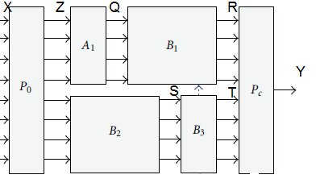
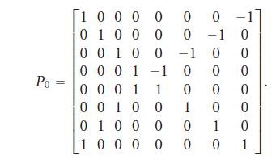
HW Aspects of Implementation – 1D 8x8 case
P₀ – “butterfly” block (free of multiplications), Z = P₀ X
P_{c} – permutation matrix

Slide 50
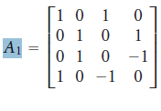
HW Aspects of Transform – 1D 8x8 case (2)
A₁ – “butterfly” block (no multiplications), Q = A₁ * Z{1..4}
B₁ , B₂ – 4x4 matrices (multiplication by these matrices can be implemented in fast form)

Slide 51
4x4 DST (Discrete Sine Transform)
4x4 DST is applied only for Intra prediction.
The 4x4 DST matrix from HEVC spec:
  29 55 74 84
  74 74 0 −74
  84 −29 −74 55
  55 −84 74 −29
Motivation:
Intra prediction is based on the top and left neighbors. Prediction accuracy is more for the pixels located near to top/left neighbors than those away from it. In other words, residual of pixels which are away from the top/left neighbor usually be larger then pixels near to neighbors. Therefore DST transform is more suitable to code such kind of residuals, since DST basis function start with low and increase further which is different from conventional DCT basis function.
Reported 4x4 DST provides some performance gain, about 1%, against DCT. For bigger sizes the gain is negligible.
As well as DCT, DST can be implemented using "fast" form

Slide 52
Performance Result
According to JCTVC-G757:
  For 8x8 transform required 2.47 cycles per sample
  For 16x16 transform required 3.35 cycles per sample
  For 32x32 transform required 4.59 cycles per sample
  The above results are obtained on x86 and ARM with SIMD operations (MMX/SSE on x86, and NEON on ARM).
  4.59 cycles per sample for 32x32 can be a bottleneck on some platforms.

Slide 53
Entropy Coding

Slide 54
Overview
HEVC specifies only one entropy coding method CABAC, comparing to two CABAC and CAVLC as in H.264/AVC.
HEVC CABAC encoding involves three main functions:
  Binarization - maps the syntax elements to binary symbols (bins).
  Context modeling - estimates the probability of the bins
  Arithmetic coding - compresses the bins to bits based on the estimated probability

Slide 55
Memory Requirements
In AVC/H.264 context of some syntax elements (e.g. mvd) depends on top and left values. This dependence on top values requires line buffers, may be issue for 4K resolutions.
In HEVC the dependence from top values in selection of context is almost removed.
For example, unlike to AVC/H.264, in HEVC ‘mvd’ is coded without the need of knowing neighboring ‘mvd’ values.

Slide 56
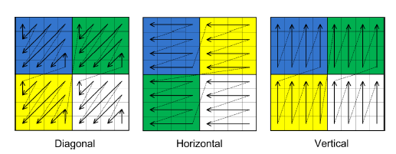
Residual Coding: Overview
Each Transform Block (TB) is divided into 4x4 sub-blocks (coefficient groups).
Processing starts with the last significant coefficient and proceeds to the DC coefficient in the reverse scanning order.
Coefficient groups are processed sequentially in the reverse order (from bottom-right to top-left) as illustrated in the following figure:
Coefficient groups for 8x8 TB, for different scans

Slide 57
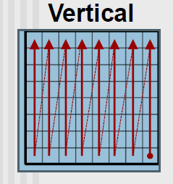
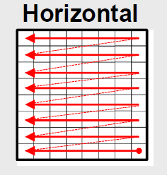
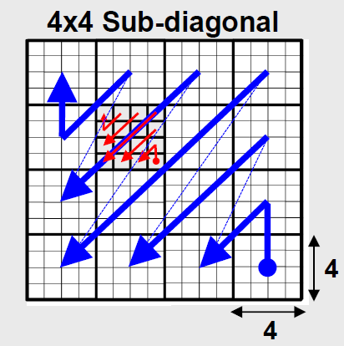
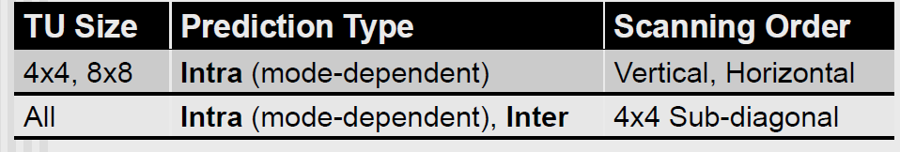
Residual Coding: Scanning Order
Note: Experiments show that including horizontal and vertical scans for large TBs offers little compression efficiency, so vertical and horizontal scans are limited to 4x4 and 8x8 sizes.

Slide 58
Residual Coding: Multi-Level Significance
Unlike to AVC/H.264, three level significance is used, intermediate level is added to exploit transform block sparsity:
Level0: coded_block_flag is signaled for each TB (transform block) to specify the significance of the entire TB.
Level1: (intermediate level): if coded_block_flag =1 then each TB divided into 4x4 coefficient groups (CG) where the significance of the entire CG is signaled (by coded_sub_block_flag).
  The coded_sub_block_flag syntax elements are signaled in reverse order (from
  bottom-right towards top-left) according to selected scan.
  The coded_sub_block_flag is not signaled for the last CG (i.e. the CG which contains the last level). Motivation: a decoder can infer significance since the last level is present.
  The coded_sub_block_flag is not signaled for the group including the DC position

Slide 59
Residual Coding: Multi-Level Significance (cont.)
Level2: If coded_sub_block_flag=1 then significant_coeff_flag are signaled to specify the significance of individual coefficients.
The significant_coeff_flag are signaled in the reverse order (from bottom-right towards top-left) according to selected scan.
Notes:
The coded_sub_block_flag of CG containing of DC coefficient (i.e. (0,0) position) is not coded and inferred to 1.
Motivation – to improve coding efficiency, since the probability of this CG to be totally zero is low.
If current CG contains last coefficient in a TB then the coded_sub_block_flag is not coded and inferred to 1.

Slide 60
Residual Coding: Multi-Level Significance (Example)
16x16 TU with 4x4 coefficient groups:
---------------------------------------------------------
| 5 2 0 1 | 1 0 0 0 | 1 1 1 0 | 0 0 0 0 |
| 5 0 2 1 | 2 0 1 1 | 0 2 1 0 | 0 0 0 0 |
| 0 1 0 0 | 1 0 1 1 | 0 1 1 1 | 0 0 0 0 |
| 0 0 0 1 | 1 1 1 1 | 0 0 1 0 | 0 0 0 0 |
---------------------------------------------------------
| 1 1 0 0 | 1 0 1 0 | 0 1 0 1 | 0 0 0 0 |
| 2 1 0 1 | 0 0 1 0 | 1 0 0 1 | 0 0 0 0 |
| 0 0 1 0 | 0 0 1 0 | 1 0 0 0 | 0 0 0 0 |
| 1 0 0 1 | 1 0 1 0 | 0 0 0 0 | 0 0 0 0 |
---------------------------------------------------------
| 0 1 1 1 | 0 1 0 1 | 1 1 1 0 | 0 1 0 0 |
| 0 0 1 0 | 0 1 1 1 | 0 0 0 1 | 0 0 0 0 |
| 1 0 0 1 | 0 0 0 0 | 1 1 0 0 | 1 0 0 0 |
| 0 0 1 0 | 0 0 0 0 | 1 1 0 0 | 0 0 0 0 |
---------------------------------------------------------
| 0 0 0 0 | 0 0 0 0 | 0 0 0 0 | 0 0 0 0 |
| 0 0 0 0 | 0 0 0 0 | 0 0 0 0 | 0 0 0 0 |
| 0 0 0 0 | 0 0 0 0 | 0 0 0 0 | 0 0 0 0 |
| 0 0 0 0 | 0 0 0 0 | 0 0 0 0 | 0 0 0 0 |
---------------------------------------------------------
Last coeff
For this CG coded_sub_block_flag is not coded

Slide 61
Residual Coding: Levels
At the start of residual block, coordinates of last significant coefficient are signaled (last_significant_coeff_x, last_significant_coeff_y)
Coding starts backward from last significant coefficient toward (0,0).
The coding process of each CG generally consists of five separate loops (passes), which provides some benefits for parallelization :
  significant_coeff_flag loop
  coeff_abs_level_greater1_flag loop
  coeff_abs_level_greater2_flag (at most one flag is coded)
  coeff_sign_flag loop
  coeff_abs_level_remaining loop
Hint for parallelization:
Grouping of syntax elements of same type enables parallel processing.
For example, while coeff_abs_level_greater1_flag are proceeding, the significance map
contexts for the next CG can be pre-calculated.

Slide 62
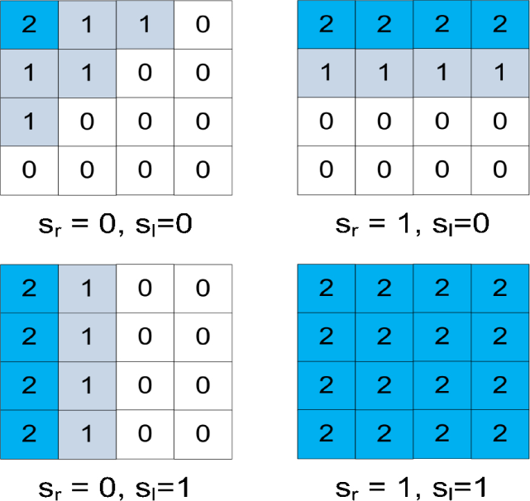
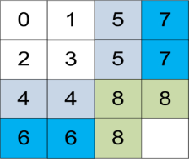
Residual Coding: significant_coeff_flag
significant_coeff_flag - indicates whether the transform coefficient is non-zero.
  1 bin – regular coding, 3 context models.
  Context model derivation for 8x8 and higher TBs - context depends on the significant_coeff_group_flag of the neighboring right CG and lower (sl) CGs and on the coefficient position in the current CG. Motivation: to avoid data dependencies within a CG and to benefit parallezation with negligible coding loss if contexts depend on significance of immediately preceeding coefficints (around 0.1% as reported in JCTVC-I0296).
  Here sr denotes significant_coeff_group_flag of the right CG and sl denotes
  significant_coeff_group_flag of the lower CG.
  Context model derivation for 4x4 TB is completely position based:
Coding direction
Current
CG
Right
CG
Bottom
CG
Not coded
inferred

Slide 63
Residual Coding: significant_coeff_flag (cont.)
Notes:
significant_coeff_flag is not coded and inferred to 1 when the last significant coefficient points at it.
significant_coeff_flag is not coded and inferred to 1 when coded_sub_block_flag is true and all the other coefficients are zero (i.e. all coefficients are zero except the (0,0), specified by inferSbDcSigCoeffFlag).
In case of 4x4 TB the significant_coeff_flag is not coded. The significant_coeff_flag is inferred to 1 if the last significant coefficient points at it, otherwise inferred to 0.

Slide 64
Residual Coding: coeff_abs_level_greater1_flag
coeff_abs_level_greater1_flag - indicates (if signaled) whether the transform coefficient has absolute value > 1.
  1 bin – regular coding, 24 context models.
Only first eight coeff_abs_level_greater1_flags in a CG are coded, the rest is inferred to 0. Motivation – to reduce regularly (context) coded bins, especially at the high bit-rate, and improve CABAC throughput. Indeed, at most 8 coeff_abs_level_greater1_flags are coded in one CG instead of 16.
There are 4 context model sets for luma ( denoted as 0, 1, 2 and 3) and 2 for chroma (denoted as 4 and 5), the number of context models in each set is 4.
The derivation of context mode consists of two steps: the inference of context set and the derivation of the model inside the selected set, the following table reveals the context set derivation:
 | Luma | Chroma
# coeff_abs_level_greater1_flags in previous CG | 0 >0 | 0 >0
CG with DC CG without DC | 0 1 2 3 | 4 5 4 5

Slide 65
Residual Coding: coeff_abs_level_greater1_flag (cont.)
    Context model derivation within the selected context set – depending on the number of trailing ones and the number of coefficient levels larger than 1 in the current CG:
  If coeff_abs_level_greater1_flag is the first in the current CG then the context model equals to 1.
  Else If the revious coefficient in current CG is more than 1 (i.e. the previous coeff_abs_level_greater1_flag=1) then the context model equal to 0.
  Else If the number of trailing ones is 1 (i.e. the previous coeff_abs_level_greater1_flag=0 and the pre-previous coeff_abs_level_greater1_flag=1 or not exist) then the model is 2
  Else (if trailing ones is 2 or more) then the model is 3.

Slide 66
Residual Coding: coeff_abs_level_greater2_flag
coeff_abs_level_greater2_flag - indicates (if signaled) whether the transform coefficient has absolute value > 2. Unlike coeff_abs_level_greater1_flag, this flag is signaled once.
  1 bin – regular coding, 6 context models.
If all coeff_abs_level_greater1_flag are 0, the coeff_abs_level_greater2_flag is not signaled and inferred to 0.
Context model derivation:
Notice that the derivation of context model for coeff_abs_level_greater2_flag is identical to the derivation of context set of coeff_abs_level_greater1_flag.
 | Luma | Chroma
# coeff_abs_level_greater1_flags in previous CG | 0 >0 | 0 >0
CG with DC CG without DC | 0 1 2 3 | 4 5 4 5

Slide 67
Residual Coding: coeff_sign_flag
coeff_sign_flag : substantial proportion in compressed stream 15-20%.
coeff_sign_flags are bypass coded
Sign Data Hiding (SDH): optional mode, for each CG the sign of the last nonzero coefficient (in the reverse scan) is omitted. Instead, the sign is embedded in the parity of the sum of the levels, if the sum is even then the hidden sign is “+”, otherwise “ – “.
  Encoder can be required to modify coefficients to embed the sign (potentially quantization noise can be increased).
  If the distance in scan order between the first and the last nonzero coefficient is less than 4 then SDH is not used. Notice that the fixed value 4 was experimentally chosen (see JCTVC-I0156). Probably that value can be a bad choice on some streams.
  If only one nonzero coefficient is present in CG, then SDH is not activated.
When SDH is beneficial?
When the percentage of sign bits is substantial (it is expected to happen when the bit-rate is low).
Disadvantages of SDH:
  More complexity and Increase of quantization noise (potentially)

Slide 68
Residual Coding: example implementation of SDH in encoder
If the parity does not match the omitted sign, the encoder has to change the value of one of the nonzero coefficients in the current CG.
Low complexity implementation (details can be found in JCTVC-H0481):
If #nonzero coeffs > 1 and
distance (in scan) between the first and the last nozero coefficient >= 4
{
For each nonzero and non-last (in reverse scan) quantized coefficient qCoef Do
{
Calculate delta = abs(qCoef) * q_scale – tCoef
where tCoef is transformed coefficient (prior to quantization).
}
If there is nonzero ‘delta’ values, find the minima minNzDelta among abs( delta )
{
If minNzDelta >0
adjust qCoef = qCoef +1
Else [minNzDelta <0]
adjust qCoef = qCoef -1
}
Else [ all ‘delta’ values are zero ]
Take most high frequence coeff and adjust it.
}

Slide 69
Residual Coding: coeff_abs_level_remaining
coeff_abs_level_remaining – remaining absolute value of the coefficient level. All bins are bypass coded (to increase throughput).
The total level is derived as:
Level = 1 + coeff_abs_level_greater1_flag+ coeff_abs_level_greater2_flag+ coeff_abs_level_remaining
Binarization - HEVC employs adaptive Golomb–Rice coding for small values and switches to Exp-Golomb code for larger values.
  The Golomb-Rice parameter cRiceParam depends on previous levels.
  The transition point to Exp-Golomb is when the unary code length equals 4.
  The maximal codeword for coeff_abs_level_remaining is kept within 32 bits.

Slide 70
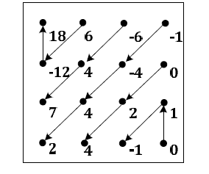
Residual Coding - Example
Scan_pos | 15 | 14 | 13 | 12 | 11 | 10 | 9 | 8 | 7 | 6 | 5 | 4 | 3 | 2 | 1 | 0
Coefficients | 0 | 1 | -1 | 0 | 2 | 4 | -1 | -4 | 4 | 2 | -6 | 4 | 7 | 6 | -12 | 18
significantFlag | 0 | 1 | 1 | 0 | 1 | 1 | 1 | 1 | 1 | 1 | 1 | 1 | 1 | 1 | 1 | 1
gr1Flag |  | 0 | 0 |  | 1 | 1 | 0 | 1 | 1 | 1 | not coded
gr2Flag |  |  |  |  | 0 | not coded
signFlag |  | 0 | 1 |  | 0 | 0 | 1 | 1 | 0 | 0 | 1 | 0 | 0 | 0 | 1 | 0
levelRem |  |  |  |  |  | 2 |  | 2 | 2 | 0 | 5 | 3 | 6 | 5 | 11 | 17

Slide 71
Residual Coding - Notes
On SW decoder: the processing of residuals take ~8% of the computation for 4K video.
It is a challenge to speedup or parallelize the residual coding loop by SW
  There are multiple branches within the loops.
  There are data dependency among adjacent data.
  The loop counts in the four loops can be different (challenge for loop unrolling)
  For coeff_abs_level_remaining the binarization type depends on the previous coefficient level.

Slide 72
Deblocking

Slide 73
Overview
The deblocking filter is applied to all samples adjacent to PB or TB boundaries,
with the following exceptions:
  picture boundaries
  slice boundaries (if deblocking is explicitly disabled in sequence level)
  tile boundaries (if deblocking is explicitly disabled in sequence level)
Granularity is 8x8 grid or higher (unlike AVC/H.264 where granularity is 4x4)
32
8X8
8X8
16x16
Deblocked
Non-deblocked
8X8
32
16X16
16X16

Slide 74
Deblocking Algorithm
For each edge of 8x8 grid determine the filter strength (Bs)
According to the filter strength and the average quantization parameter (QP) determine two thresholds: t_{C} and β
3. According to the values of edge pixels and t_{C} , β modify (if needed) the pixels

Slide 75
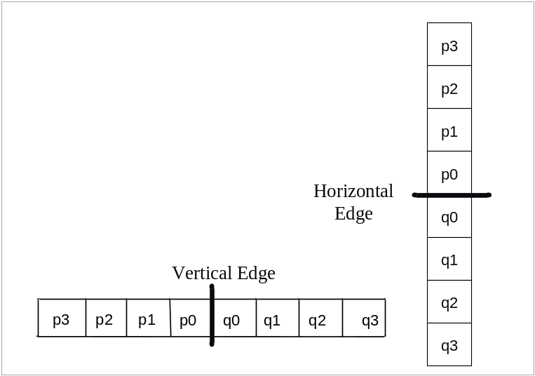
Top Line Buffer
For deblocking top reference storage is necessary:
4 luma top lines
2 chroma top lines
p₀ .. p₂ luma pixels are modifiable while p₀ .. p₃ are taken into consideration
p₀ chroma is modifiable, while p₀ , p₁ are taken into consideration
Page <number>

Slide 76
Determination of Filter Strength
The strength of the deblocking filter is represented by three values:
  0 - no deblocking
  1 - weak
  2 – strong
Notice that in AVC/H.264 there are five strengths and more complicated derivation of boundary strengths.
P and Q are two adjacent TB or PB blocks then the filter strength Bs is specified as:
If one of the blocks (P or Q) is intra
Bs = 2
Else if P and Q belong to different TBs and P or Q has at least one non-zero
transform coefficient then
Bs = 1
Else if the reference pictures of P and Q are not equal then
Bs = 1
Else if P and Q has difference number of MVs then
Bs = 1
Else if the difference between x or y motion vector component of
P and Q is equal or greater than one integer sample then
Bs = 1
Else
Bs = 0

Slide 77
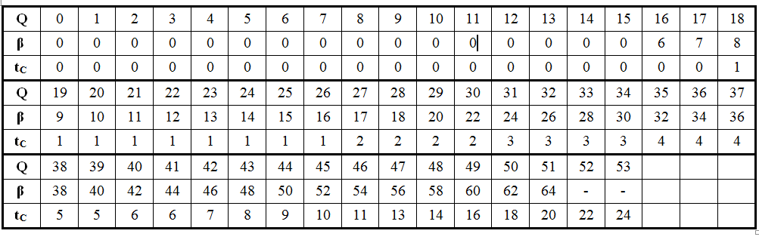
Determination thresholds t_{C} and β
Thresholds t_{C} and β are derived by the following table:
Where Q = [ (QP_{Q} + QP_{P} +1)>>1 + (beta_offset_div2<<1) ]

Slide 78
Vertical Edge Filtering (1) – derivation ‘d’
on/off decision for all 4 lines/columns based on two lines/columns:
p_{3,0} p_{2,0} p_{1,0} p_{0,0}
q_{0,0} q_{1,0} q_{2,0} q_{3,0}
p_{3,1} p_{2,1} p_{1,1} p_{0,1}
q_{0,1} q_{1,1} q_{2,1} q_{3,1}
p_{3,2} p_{2,2} p_{1,2} p_{0,2}
q_{0,2} q_{1,2} q_{2,2} q_{3,2}
p_{3,3} p_{2,3} p_{1,3} p_{0,3}
q_{0,3} q_{1,3} q_{2,3} q_{3,3}
Derivation of ‘d’:
dp0 = Abs( p_{2,0} − 2*p_{1,0} + p_{0,0} )
dp3 = Abs( p_{2,3} − 2*p_{1,3} + p_{0,3} )
dq0 = Abs( q_{2,0} − 2*q_{1,0} + q_{0,0} )
dq3 = Abs( q_{2,3} − 2*q_{1,3} + q_{0,3} )
dpq0 = dp0 + dq0
dpq3 = dp3 + dq3
dp = dp0 + dp3
dq = dq0 + dq3
d = dpq0 + dpq3
Notice that lines #1 and #2 don’t participate in calculation of ‘d’

Slide 79
Vertical Edge Filtering (2) – derivation dSam0 and dSam1
dSam0 = 0
dSam3 = 0
If ( (dpq0 ≤( β >> 2 )) And
((Abs( p_{3,0} − p_{0,0} ) + Abs( q_{0,0} − q_{3,0} ) < ( β >> 3 )) And
(Abs( p_{0,0} − q_{0,0} ) < ( 5*t_{C} + 1 ) >> 1) ) Then
{
dSam0 =1
}
If ( (dpq3 ≤( β >> 2 )) And
((Abs( p_{3,3} − p_{0,3} ) + Abs( q_{0,3} − q_{3,3} ) < ( β >> 3 )) And
(Abs( p_{0,3} − q_{0,3} ) < ( 5*t_{C} + 1 ) >> 1) ) Then
{
dSam3 =1
}

Slide 80
Vertical Edge Filtering (3) – derivation dE, dEp and dEq
dE= 0, takes values 0,1,2
dEp = 0, takes values 0,1
dEq = 0, takes values 0,1
If d < β Then
dE = 1
if dSam0 = 1 and dSam3 = 1 then
dE = 2 // strong filter, modify p0 .. p2, q0 .. q2
If dp <( β + ( β >> 1 ) ) >> 3 then
dEp = 1
If dq <( β + ( β >> 1 ) ) >> 3 then
dEq = 1
EndIf

Slide 81
Vertical Edge Filtering (4) – core
If dE = 2 // strong filtering, p0 .. p2, q0 .. q2 are modied
{
for each k=0..3
{
p_{0,k}′ = Clip3( p_{0,k}−2*t_{C}, p_{0,k}+2*t_{C}, ( p_{2,k} + 2*p_{1,k} + 2*p_{0,k} + 2*q_{0,k} + q_{1,k} + 4 ) >> 3 )
p_{1,k}′ = Clip3( p_{1,k}−2*t_{C}, p_{1,k}+2*t_{C}, ( p_{2,k} + p_{1,k} + p_{0,k} + q_{0,k} + 2 ) >> 2 )
p_{2,k}′ = Clip3( p_{2,k}−2*t_{C}, p_{2,k}+2*t_{C}, ( 2*p_{3,k} + 3*p_{2,k} + p_{1,k} + p_{0,k} + q_{0,k} + 4 ) >> 3 )
q_{0,k}′ = Clip3( q_{0,k}−2*t_{C}, q_{0,k}+2*t_{C}, ( p_{1,k} + 2*p_{0,k} + 2*q_{0,k} + 2*q_{1,k} + q_{2,k} + 4 ) >> 3 )
q_{1,k}′ = Clip3( q_{1,k}−2*t_{C}, q_{1,k}+2*t_{C}, ( p_{0,k} + q_{0,k} + q_{1,k} + q_{2,k} + 2 ) >> 2 )
q_{2,k}′= Clip3( q_{2,k}−2*t_{C}, q_{2,k}+2*t_{C}, ( p_{0,k} + q_{0,k} + q_{1,k} + 3*q_{2,k} + 2*q_{3,k} + 4 ) >> 3 )
}
}

Slide 82
Vertical Edge Filtering (5) – core
Else if dE = 1 // weak filtering, p0,p1 and q0,q1 are modified
{
for each k=0..3
{
Δ = ( 9 * ( q_{0,k} − p_{0,k} ) − 3 * ( q_{1,k} − p_{1,k} ) + 8 ) >> 4
if (Abs(Δ) < t_{C}*10)
{
Δ = Clip3( −t_{C}, t_{C}, Δ )
p_{0,k}′ = Clip1_{Y}( p_{0,k} + Δ )
q_{0,k}′ = Clip1_{Y}( q_{0,k} − Δ )
}
if dEp = 1 // modify p1
{
Δp = Clip3( −(t_{C} >> 1), t_{C} >> 1, ( ( ( p_{2,k} + p_{0,k} + 1 ) >> 1 ) − p_{1,k} + Δ ) >>1 )
p_{1,k}′ = Clip1_{Y}( p_{1,k} + Δp )
}
if dEq = 1 // modify q1
{
Δq = Clip3( −(t_{C} >> 1), t_{C} >> 1, ( ( ( q_{2,k} + q_{0,k} + 1 ) >> 1 ) − q_{1,k} + Δ ) >>1 )
q_{1,k}′ = Clip1_{Y}( q_{1,k} + Δq )
}
}
}

Slide 83
Sample Adaptive Offset (SAO)
Page <number>

Slide 84
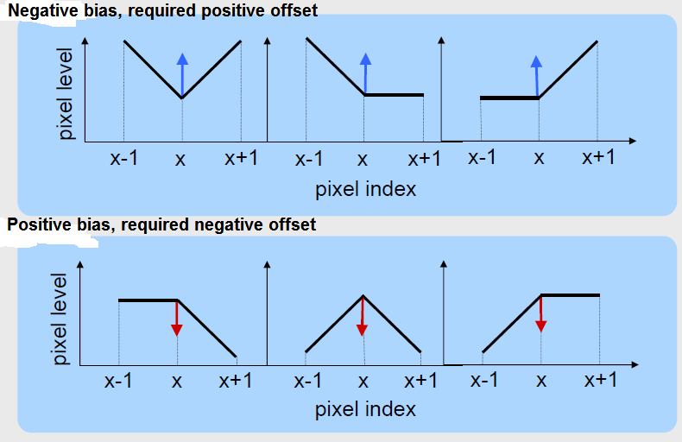
Background
Idea: Quantization makes reconstructed and original blocks differ. The quantization error is not uniformly distributed among pixels. There is a bias in distortion around edges which can be eliminated/reduced.

Slide 85
Background (cont.)
In addition to bias in quantization distortion around edges, systematic errors related to specific ranges of pixel values can also occur.
Both types of the above systematic errors (or biases) are corrected in SAO.

Slide 86
Overview
SAO is the second “post-processing” tool (after deblocking) accepted in HEVC/H.265.
SAO is applied after deblocking. For efficient HW implementation SAO can be coupled with deblocking in MB-loop.
SAO can be optionally turned off or applied only on luma samples or only on chroma samples (regulated by slice_sao_luma_flag and slice_sao_chroma_flag ).
SAO parameters can be either explicitly signalled in CTU header or inherited from left or above CTUs.
As well as deblocking SAO is adaptively applied on pixels. Unlike to deblocking SAO is adaptively applied to all pixels.
There are two types of SAO:
  Edge Type - offset depends on edge mode (signaled by SaoTypeIdx = 2)
  Band Type - offset depends on the sample amplitude (SaoTypeIdx = 1)
Note: chroma CTBs share the same SaoTypeIdx.

Slide 87
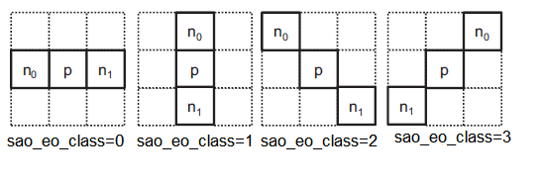
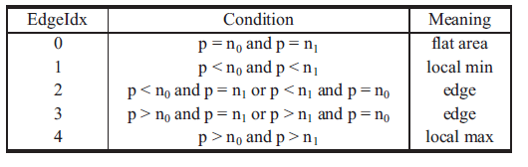
Edge Type SAO
In case of Edge type, the edge is searched across one of following directions ( the direction is signaled by sao_eo_class parameter, once per CTU):
Notes: Sample labeled “p” indicates a current sample. Two samples labeled “n0” and “n1” specify two neighboring samples along the chosen direction.
The edge detection is applied to each sample. According to the results the sample is classified into five categories (EdgeIdx) :

Slide 88
Edge Type SAO (cont.)
According to EdgeIdx the corresponding sample offset (signaled by sao_offset_abs and sao_offset_sign) is added to the current sample.
Up to 12 edge offsets (4 luma, 4 Cb chroma and 4 Cr chroma) are signaled per CTU. To reduce the bit overhead there is a particular merge mode (signaled by sao_merge_up_flag and sao_merge_left_flag flag) which enables a direct inheritance of SAO parameters from top or left CTU.
Reported that SAO reduces ring and mosquitos artifacts and improve subjective quality for low compression ratio video.

Slide 89

Band Type SAO
The pixel range from 0..255 is uniformly split into 32 bands and the sample values belonging to four consecutive bands are modified by adding the
values denoted as band offsets.
Band offsets are signaled in CTU header.
Experiments reveal that Band Type SAO is beneficial in noisy sequences or in sequences with large gradients (e.g. PeopleOnStreet which is abundant in black-white switches).

Slide 90
SAO Design Points
For SAO left and top lines of pixels need to keep in a memory.
Pipeline chain:
a) QTR → Deblock+ SAO decisions → SAO
b) QTR + SAO decisions → Deblock → SAO
According to the schema (a), during the deblocking process, statistical information is processed and the decision on SAO parameters is made. Due to the fact that SAO parameters are determined in Deblock stage we can’t apply CABAC in parallel to Deblocking.
The schema (b) enables to “parallel” Deblock and CABAC with negligible coding efficiency loss.

Slide 91
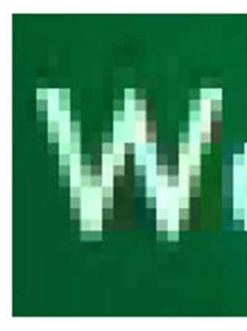
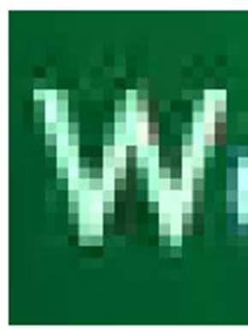
SAO Impact on Quality
SAO is enabled (QP = 32 ) SAO is disabled (QP = 32 )

Slide 92
Paralleling Tools

Slide 93
Overview
  HEVC adopted three in-built parallel processing tools:
  Slices
  Tiles
  Wavefronts (WPP)

Slide 94
Slices
As in H.264/AVC, slices are groups of CTUs in scan order, separated by start code.
There are two types of slices:
  Dependent
  Non dependent (normal).
Independent Slice
Slice #0
Slice #1
Dependent Slice
Slice #2
Slice #3
Slice #3
Slice #4
Independent Slice

Slide 95
Slices - Dependent Slices
Dependencies of dependent slice include the following:
  Slice Header Dependency: Short slice header is used where the missing elements are copied from the preceding normal slice.
  Context Models Dependency: CABAC context models are not initialized to defaults at the beginning of a dependent slice.
  Spatial Prediction Dependency: No breaking intra and motion vector prediction.

Slide 96
Slices - Dependent Slices
Restriction:
Each dependent slice must be preceded by a non-dependent slice. The picture always starts with a normal slice, followed by zero or more dependent slices.
Rationale for using of dependent slices:
Allow data associated with a particular wavefront thread or tile to be carried in a separate NAL unit, and thus make that data available to a system for fragmented packetization with lower latency than if it were all coded together in one slice.

Slide 97
Slices: Pros and Cons
Pros: Slices are effective for:
  Network packetization (MTU size matching)
  Low-delay applications. Indeed, to start transmission of the encoded data earlier, a current slice may be already transmitted, while encoding the next slice in the picture.
  Parallel processing (slice are self-contained, excepting deblocking) but decoder has to perform some preprocessing to identify entry points.
  Fast resynchronization in case of bitstream errors or packet loss.

Slide 98
Slices: Pros and Cons
Cons:
  Penalty on rate distortion performance is incurred due to the breaking
of dependencies at slice boundaries
  Overhead is added since each slice is preceded by the slice header.

Slide 99
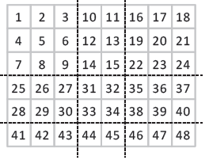
Tiles
Tiles are rectangular groups of CTUs.
Tiles are transmitted in raster scan
order, and the CTUs inside each tile
are also processed in raster scan order.
All dependencies are broken at tile boundaries.
The entropy coding engine is reset at the start of each tile and flushed at the end of the tile.
Only the deblocking filter can be optionally applied across tiles, in order to reduce visual artifacts.

Slide 100
Tiles (cont.)
At the end of each tile CABAC is flushed and consequently the tile ends at byte boundary.
The tile entry points (actually offsets) are signaled at the start of picture in order to enable to a decoder to process tiles in parallel.
Due to high area/perimeter ratio square tiles are more beneficial than
rectangular ones (since the perimeter represents the boundaries where the
dependencies are broken).

Slide 101
Tiles: Pros & Cons
Pros:
Friendly to multi-core implementations, can be built by simply replicating the single core designs.
Composition of a picture (4K TV) from multiple rectangular sources which are encoded independently. With slices we can compose only horizontal stripes.
Cons:
Pre-defined tile structure makes MTU size matching challenging.
Breaking intra and motion vector prediction across tile boundaries deteriorates coding efficiency.

Slide 102
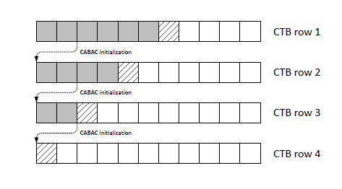
Wavefronts (WPP)
Picture is divided into rows of CTUs.
The first row is processed in an ordinary way.
The second row can be delayed until two first CTUs of the first row completed.
The third row can be processed after two first CTUs of the second row have been made, etc.

Slide 103
Wavefronts (WPP)
The context models of the entropy coder in each row are inferred from those in the
preceding row with a small fixed processing lag. Actually the context models are inherited from the second CTU of the previous row.
CABAC is flushed after the last CTU of each row, making each row to end at byte boundary.
No breaking of dependencies across rows of CTUs.

Slide 104
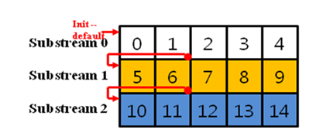
Wavefronts (Cont.)
CABAC is flushed at the end of each CTU row in order to make each row to end at byte boundary and to facilitate parallel processing.
CABAC is reset at the end of each CTU row in order to enable parallel processing.

Slide 105
Wavefronts (Cont.)
At the start of each CTU row CABAC contexts are inherited from the above row (after the second CTU of the above row finished, in order to minimize training penalty). In other words cabac context derivation crosses row boundaries. It requires some synchronization among cores.
Entry points of each CTU row are explicitly signaled in picture/slice header.

Slide 106
Wavefronts (WPP) Pros & Cons
Pros:
Good for architectures with shared cache, e.g. overlapping of search areas:
Unlike tiles intra and motion
vector prediction across
CTU rows enabled.
Cons:
MTU size matching challenging with wavefronts.
Frequent cross-core data communication, inter-processor synchronization for WPP is complex.

Slide 107
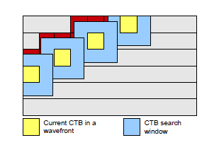
Wavefronts (WPP) Pros & Cons
Pros:
Good for architectures with shared cache, e.g. overlapping of search areas:
Unlike tiles intra and motion
vector prediction across
CTU rows enabled.
Search area of core #(n-1)
Currently processed
already processed
Core #(n-1)
Core #n
Search area of core #n

Slide 108
Notes
Wavefront parallel encoding is reported to give BD-rate degradation around 1.0% compared to a non-parallel mode.
Bitrate savings from 1% to 2.5% are observed at same QP for Wavefront against Tiles (each row is encompassed by single tile).
Wavefronts and Tiles can’t co-exist in single frame.

Slide 109
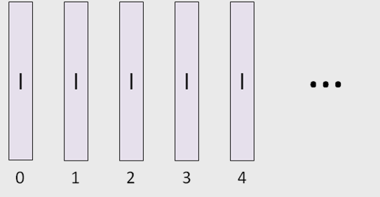
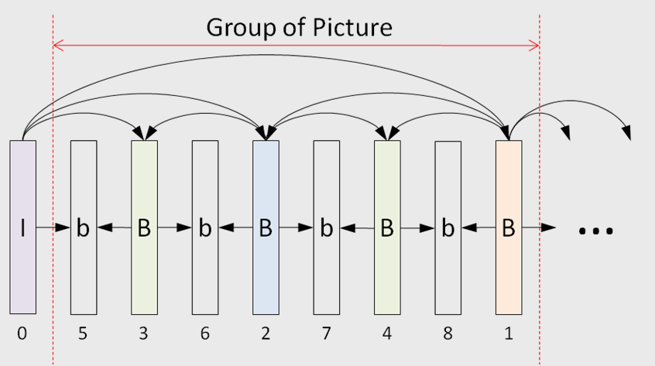
Appendix: HM Test Configuration
All Intra
  Main configuration - encoder_intra_main.cfg
  High efficiency (10 bits per pixel) - encoder_intra_he10.cfg
Random Access
Main configuration - encoder_randomaccess_main.cfg
High efficiency (10 bits per pixel) - encoder_randomaccess_he10.cfg

Slide 110
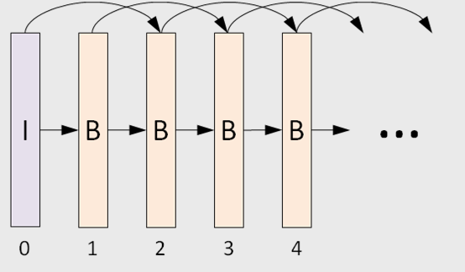
HM Test Configuration (cont.)
Low Delay (DPB buffer contains two or more reference frames, each inter frame can utilize bi-prediction from previous references):
  Main configuration - encoder_lowdelay_main.cfg
  High efficiency (10 bits per pixel) - encoder_lowdelay_he10.cfg
Low Delay (DPB buffer contains single reference frame) : I P P P P …
  Main configuration - encoder_lowdelay_P_main.cfg
  High efficiency (10 bits per pixel) - encoder_lowdelay_P_he10.cfg

