Slide 1

File System in C++

Slide 2
Introduction
A file system is crucial for organizing, storing, and managing data in a structured manner on a computer. This project simulates a basic file system in C++, offering functionalities such as file and directory creation, deletion, reading, and writing. It provides a command-driven interface for users to interact with the file system, facilitating practical understanding and management of data operations. The following sections outline the project's features, installation steps, usage examples, testing procedures, and known issues.

Slide 3
Features
Create File: Allows the user to create a new file in the current directory.
Delete File: Allows the user to delete an existing file.
Read File: Allows the user to read and display the content of a file.
Write File: Allows the user to write content to a file.
Create Directory: Allows the user to create a new directory.
Delete Directory: Allows the user to delete an existing directory.

Slide 4
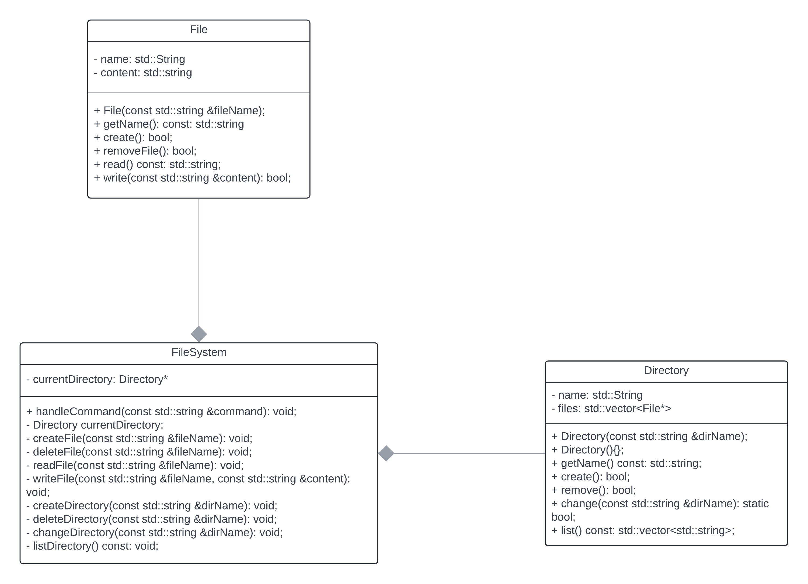
UML Class Diagram

Slide 5
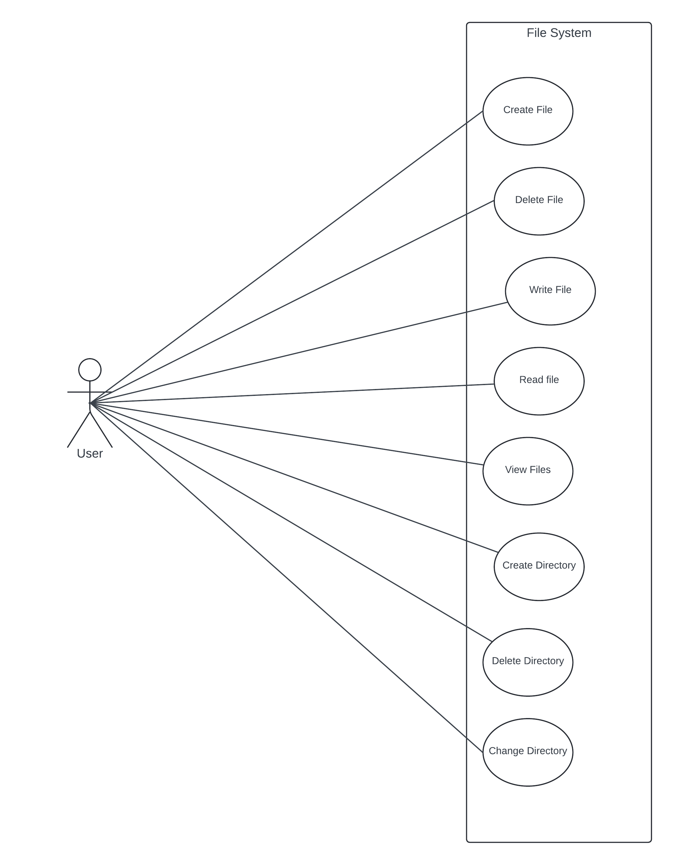
UML Use Case Diagram

Slide 6
Code Files
File.h
File.cpp
Directory.h
Directory.cpp
FileSystem.h
FileSystem.cpp
Main.cpp
test.cpp

Slide 7
Testing
Catch2 was used as the testing framework to write and run test cases for the file management system.
Catch.hpp file contains library code for Catch2 downloaded from official Catch2 GitHub Repository.

Slide 8
Test Cases
Create File
Description: Test if a file is created successfully.
Command: create_file testfile.txt
Delete File
Description: Test if a file is deleted successfully.
Command: delete_file testfile.txt
Read File
Description: Test if a file's content can be read successfully.
Commands: create_file testfile.txt, write_file testfile.txt "Hello, world!", read_file testfile.txt
Write to File
Description: Test if content can be written to a file successfully.
Commands: create_file testfile.txt, write_file testfile.txt "Hello, world!“

Slide 9
Test Cases – Cont
Create Directory
Description: Test if a directory is created successfully.
Command: create_directory testdir
Delete Directory
Description: Test if a directory is deleted successfully.
Commands: create_directory testdir, delete_directory testdir

Slide 10
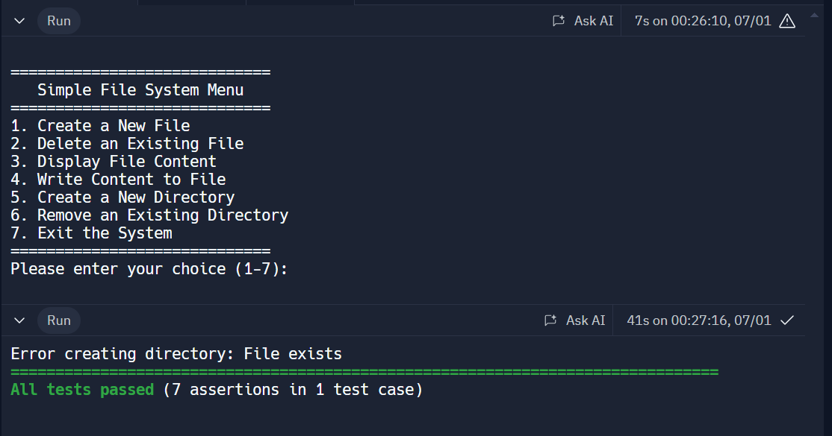
Output

Slide 11
Conclusion
Our file system project successfully implements essential file and directory management operations through a user-friendly command-driven interface. It features comprehensive functionalities for creating, deleting, reading, and writing files and directories, all encapsulated in a modular design that facilitates maintenance and scalability. Extensive unit testing with the Catch2 framework ensures reliability and correctness.

