Slide 1
WELCOME TO THE
LOCAL FOOD CHAMPIONS
STYLE GUIDE
LOCAL FOOD
LFC
Great brands build strong bonds with their audience by being consistent. They are instantly recognizable and immediately stand for something. They speak a common language, despite the fact that they may be speaking to very different people from very different places.
CHAMPIONS

Slide 2
CONTENTS
01 About
02 Brand Architecture
03 Official Logo
04 Logo Color Variations
05 Logo usage
06Typography
08 Text Heirarchy
09 Color
10 Iconography
11 Social Media Sharing
11 Brand Visual
12Glossary
LFC

Slide 3

Brand guidelines
01 About
OUR VISION
Local Food Champions' vision
is to reignite the smallholder
farmer. stabilizing local
economies through the
localized food supply, educa-
tion and collaboration. LOCAL
FOOD CHAMPIONS PROVIDE
CUSTOM INDOOR FARMING
SOLUTIONS TO SATISFY ALL
YOUR INDOOR GROWING
NEEDS AND BUDGET
THIS IS FARMING FOR EVERYONE
jason@lfcfarms.com
www.lfcfarms.com

Slide 4
Brand guidelines
02 Brand Architecture
The purpose of a design system is to enable velocity and consistency. It allows product teams to quickly createsolutions and maintain consistency across a wide range of communications. Establishing a brand visual language supports goodcommunication and narrative. It creates inspiration, consistency and artifacts for public consumption
The LOCAL FOOD CHAMPION icon is the primary graphic element that identifies our brand.
LOCAL FOOD
LFC
CHAMPIONS
Logotype
Icon
Icon as a secondary identifier is used in instances when logotype of LOCAL FOOD CHAMPIONS is not included on web pages or any medium
LFC

Slide 5
Brand guidelines
03 Official Logo
Our logo plays a key role in making our brand recognizable and memorable, it is required to appear on all marketing and communication pieces.
LOCAL FOOD
LFC
CHAMPIONS
Minimum Size
LFC
The smallest the logo should be represented is 0.75” high.
LFC

Slide 6
Brand guidelines
04 Logo Color Variations
LOCAL FOOD
LOCAL FOOD
LOCAL FOOD
LOCAL FOOD
LFc
LFc
LFc
LFc
CHAMPIONS
CHAMPIONS
CHAMPIONS
CHAMPIONS
LFC

Slide 7
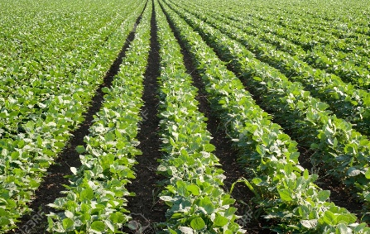
Brand guidelines
05 Logo usage
LFC
LFC
English Newspaper:
Collection of all
English Newspaper
and Online News Agenc
published from Bangladesh.
Daily star, bdnews24.com,
New age, Independent,
Bangladesh observer,
Daily sun
published from Bangladesh.
Daily star, bdnews24.com,
New age, Independent,
Bangladesh observer,
Daily sun
LFC
LFC
Idris ali
Daffodil
International
University
LOCAL FOOD
LFC
Letterhead example
Photography example
Business card example
CHAMPIONS
LFC
LFC
English Newspaper:
Collection of all
English Newspaper
and Online News Agenc
published from Bangladesh.
Daily star, bdnews24.com,
New age, Independent,
Bangladesh observer,
Daily sun
published from Bangladesh.
Daily star, bdnews24.com,
New age, Independent,
Bangladesh observer,
Daily sun
LFC
LFC
Please allow adequate
spacing at all times.
Idris ali
Daffodil
International
University
LFC

Slide 8















Brand guidelines
9 Iconography
Iconography is a unified visual language that can be understood by people from different locations and cultures. Consistency, readability, and scalability are the core parameters of any design system. Consiste ncy influences a general trustworthiness of a product, readability These illustrations are to be used to emphasize points in brochures, pamphlets and any other print or digital marketing.
LFC

Slide 9

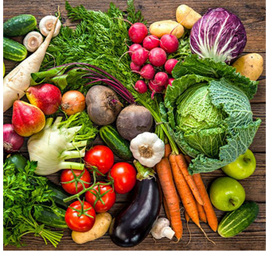
Brand guideline
11 Brand Visual
LOCAl FOOD
LFC
CHAMPIONS

Slide 10
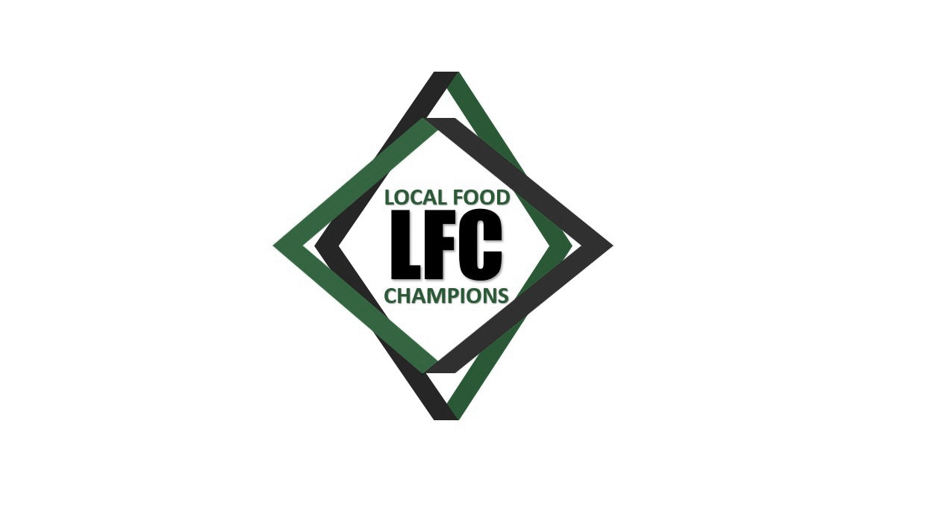
Brand guidelines
12 Glossary
RGB
CMYK
(Red, Green, Blue) color mode is for anything that is computer-based design. This includes websites, apps, banner ad and any other design created for electronic use
(Cyan, Magenta, Yellow, Black) color mode is used for print design. This includes logos, business cards, stationary, illustration, packaging and any other designs used for print.
Vector images are made up of points, lines, and curves that can be infinitely scaled without any loss in image quality
Raster
Lossless
Lossy
Raster images are made up of a set grid of dots called pixels, where each pixel is assigned a color value. Unlike a vector image, raster images are resolution dependent. When you change the size of a raster image, you shrink or stretch the pixels themselves, which can result in a significant loss of clarity and produce very blurry images.
Lossless image formats capture all of the data of your original file. Nothing from the original file, photo, or piece of art is lost—hence the term “lossless.” The file may still be compressed, but all lossless formats will be able to reconstruct your image to its original state.
Lossy image formats approximate what your original image looks like. For example, a lossy image might reduce the amount of colors in your image or analyze the image for any unnecessary data. These clever technical tricks will typically reduce the file size, though they may reduce the quality of your image

Slide 11

Vector images are made up of points,
lines, and curves that can be
infinitely scaled without
any loss in image quality

