Slide 1
PHASE 1
WIRESHARK
Wireshark tool is being used to detect anomalies as complained by the soCraTech technology. The Wireshark tools will be used to detect DNS, HTTP C2 beaconing and to detect SSH brute force attack.

Slide 2
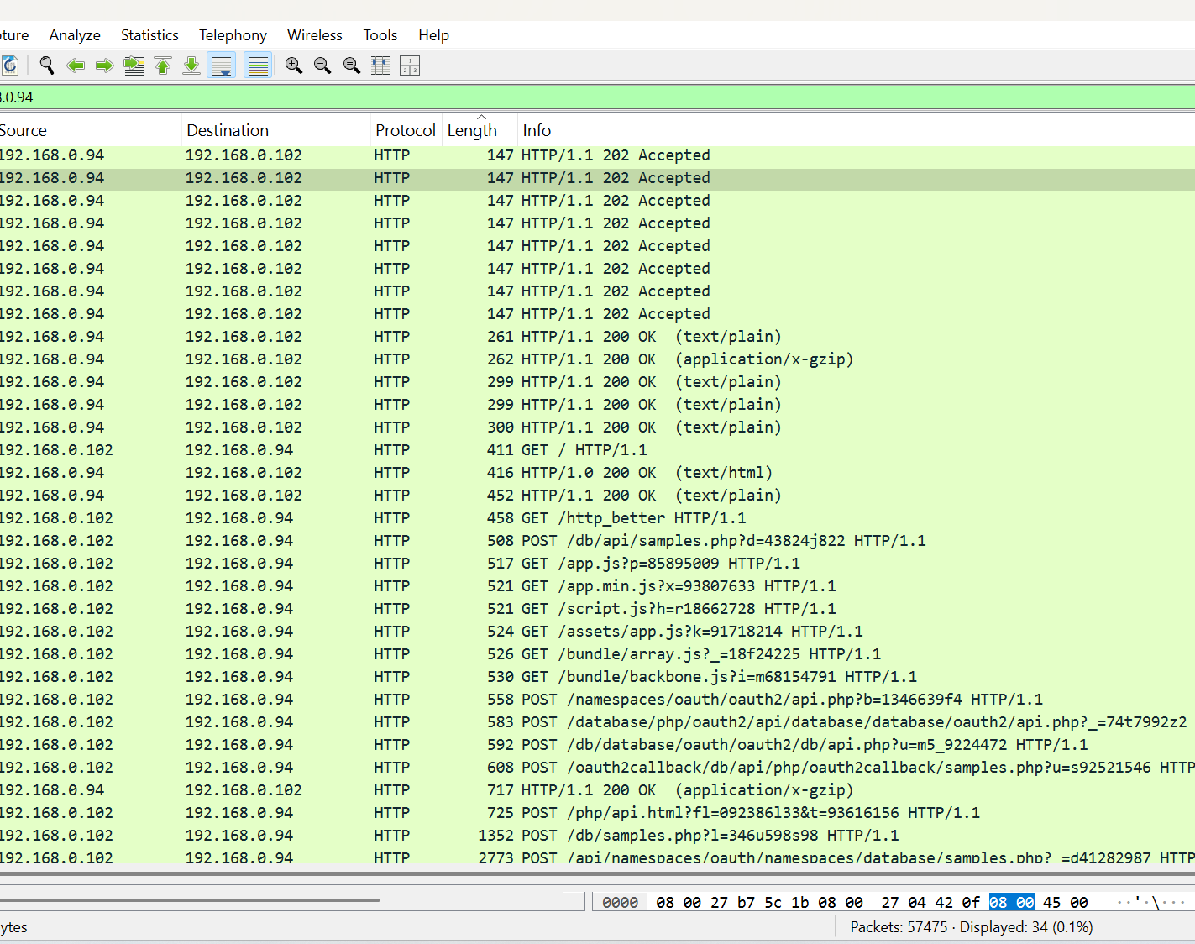
HTTP BEACONING
WIRESHARK FINDINGS
Suspicious HTTP request “/http_better” suggesting non-standard endpoint.
Repeated communication in seconds with an unknown IP’S “192.168.0.94”#
Sending continuous posts and gets requests to the same IP.
Suspicious use of long and encoded parameters.
Access to multiple javascripts payloads

Slide 3
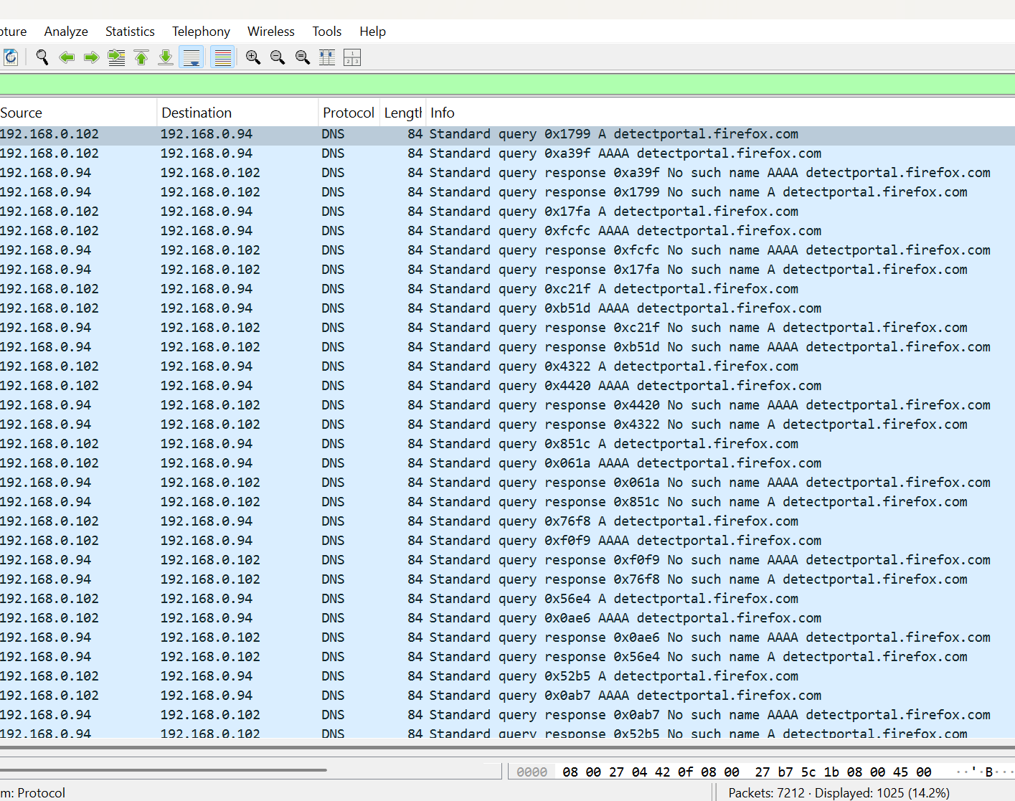
DNS BEACONING
WIRESHARK FINDINGS
DNS queries happened between milliseconds
Alternating source and destination Ips
Unusual pattern for a known domain
No corresponding HTTP/HTTPS traffic
Consistent use of both A and AAA record queries.
Identical lengths of packet

Slide 4
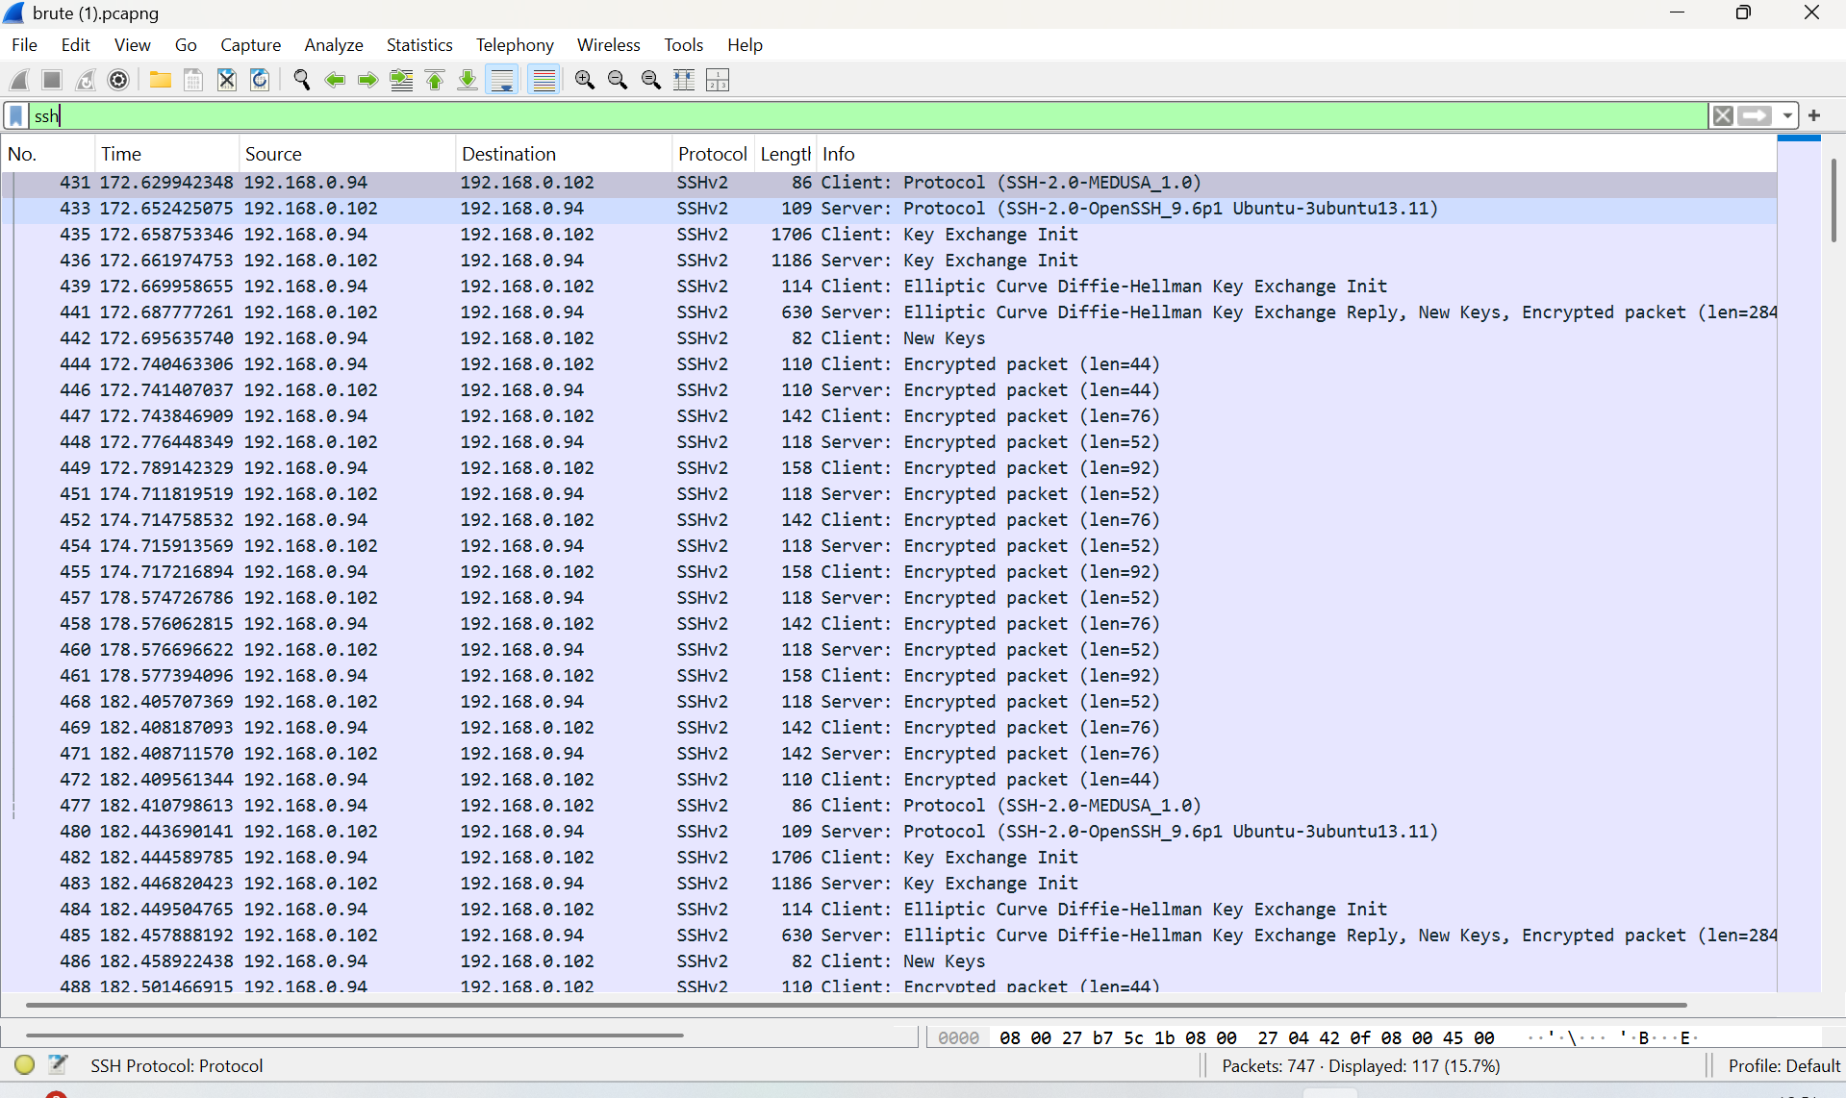
BRUTE FORCE ATTACK
WIRESHARK FINDING
The client identifies as Medusa which is a bruteforce tools.
High volume of SSH connection attempts.
Continous pattern between two IP’S in milliseconds.
Many entries like key exchange innit suggests failed attempts.
No session interaction which shows illegitimate behaviour.

Slide 5
PHASE 2
PFSENSE
After successfully carried out wireshark analysis we identify the need to block Geo-Political IP’s known for attacks and also create rules to block emerging attacks using snort
Note: Putting the operating system under pfsense being a firewall changes the OS ip address.

Slide 6
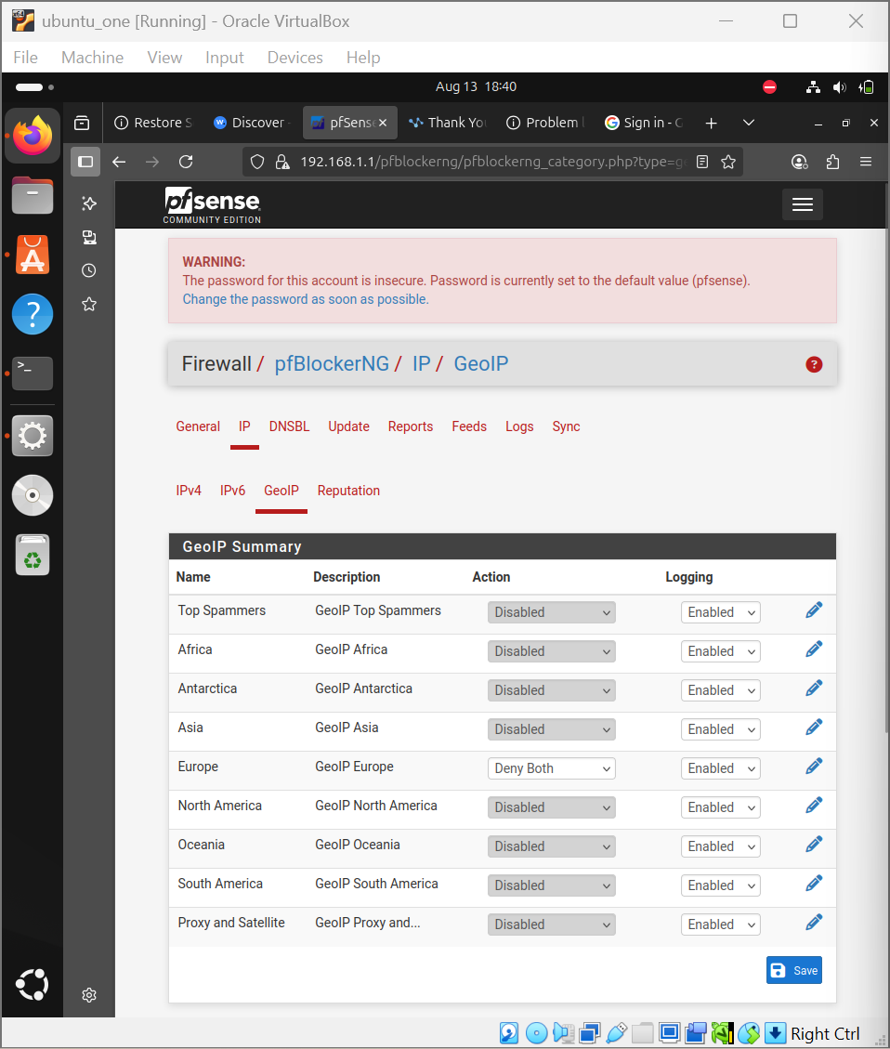
GEO-POLITCAL IP
The major country of threat is Russia.
We blocked both inbound and outbound access to and from Russia.

Slide 7
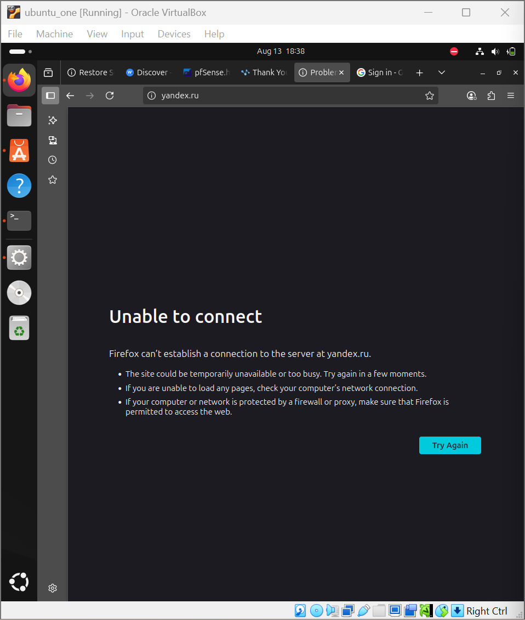
GEO IP BLOCKING
This rule was tested by trying to access Russia website “Yandex.ru”.
It was unable to connect due to the outbound restrictions.

Slide 8
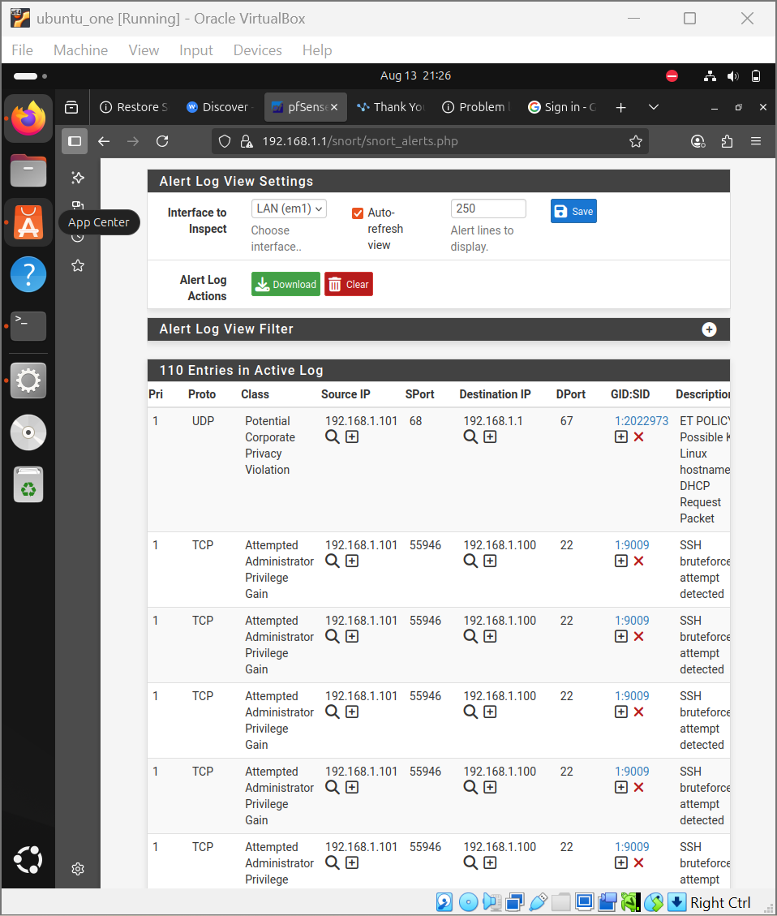
SNORT AND BRUTE FORCE DETECTION
Snort was employed to detect and prevent ssh brute force attack.
It was able to detect the ssh attempt from port 22.
It also explained the source ip which was the kali’s ip (192.168.1.101)
This information can help to further take a security action that blocks this ip.

Slide 9
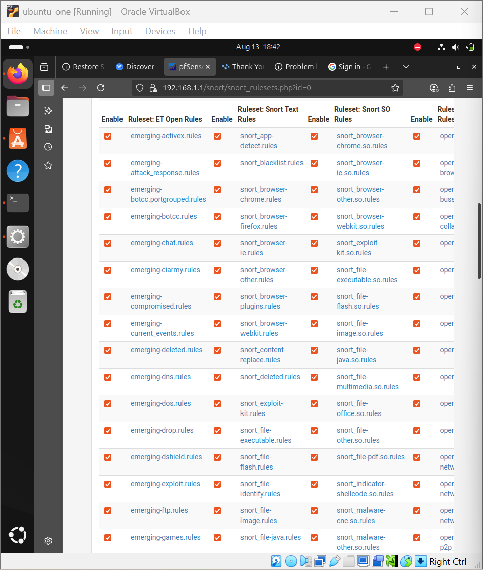
SNORT RULES TO BLOCK ANOMALIES
For a good security posture, several snort rules was employed to prevent other attacks.
These rules includes trojan, DDOS, DNS and so on.

Slide 10
PHASE 3
WAZUH SIEMS
Wazuh was employed to monitor every network traffic and also to receive logs from PFSENSE

Slide 11
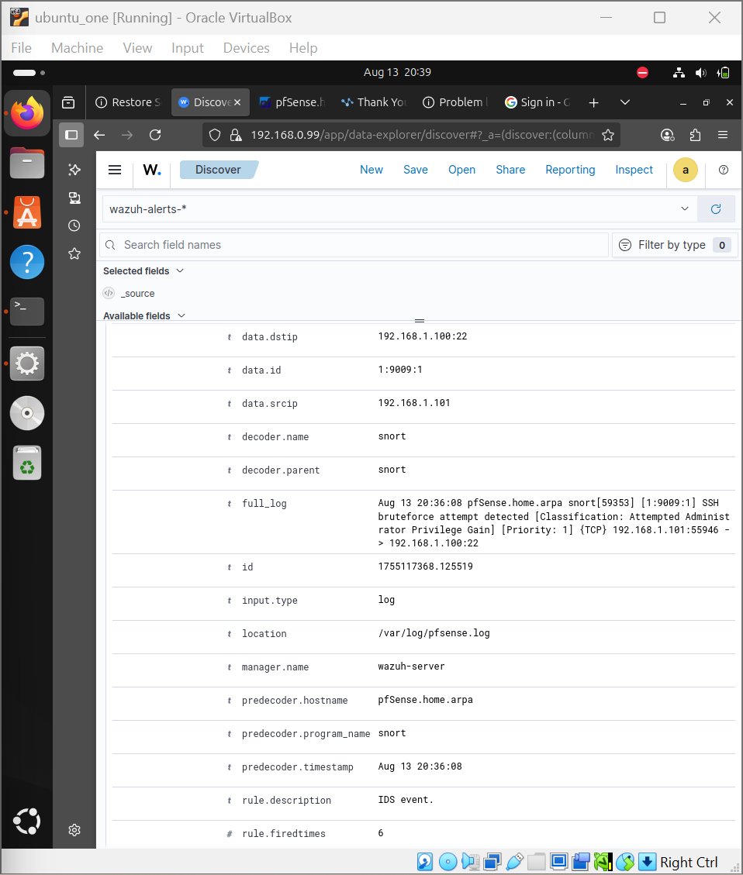
WAZUH LOGS PFSENSE
Wazuh was configure to aggregriate logs from pfsense.
This explains to us the decoder name; which was snort.
It also explains the full logs like that received from pfsense.

Slide 12
PHASE 5
FINAL INCIDENT REPORT
This section explains the security incidents, its impact and recommendation.

Slide 13

SECURITY INCIDENTS
The soc analysis carried out was able to detect active threats.
The threats includes attempted DNS beaconing, HTTP beaconing and SSH attacks.
The monitoring was able to detect a continuous attack from a specific ip which is 192.168.0.94 and 192.168.1.101.
Many of the attempts are to gain privileged access which could be escalated by creating an opening to move sensitive files

Slide 14

RECOMMENDATION
Ensure that staffs are educated about a safe use of the technology.
Ensure that rules are continuously reviewed in accordance with recent developments.
Automatically ban IP’s after repeated failures.
MFA(Multifactor Authenticator) should be employed to ensure a safe environment.
Strict and unpredictable passwords should always be used.

