Slide 1
Predicting Road Accident Severities

Slide 2
Predicting road accident severities is valuable to national governments and the general public
Road accidents are a danger to every society.
Severity of road accidents is determined by a number of factors including physical and non-physical.
Predicting severity of road accident severities would be beneficial to the public and organizations.
Help save lives and make environments safer
Help insurance companies

Slide 3
Data acquisition and cleaning
The data used for this project was the Seattle accident data from Kaggle dataset.
In total, the data contained 194,673 rows and 38 features.
Features acting as descriptors of other columns were dropped.
Cleaned data contains 180,067 rows and 31 features.

Slide 4
Feature Selection for Model
Pearson Correlation and P-value parameters were used to identify features showing high correlation with label.
No numerical feature showed moderate or high correlation with the target variable and as such categorical features were used.
The categorical features selected included; Road Conditions, Light Conditions, Collision Type, Junction Type and Weather Conditions.

Slide 5
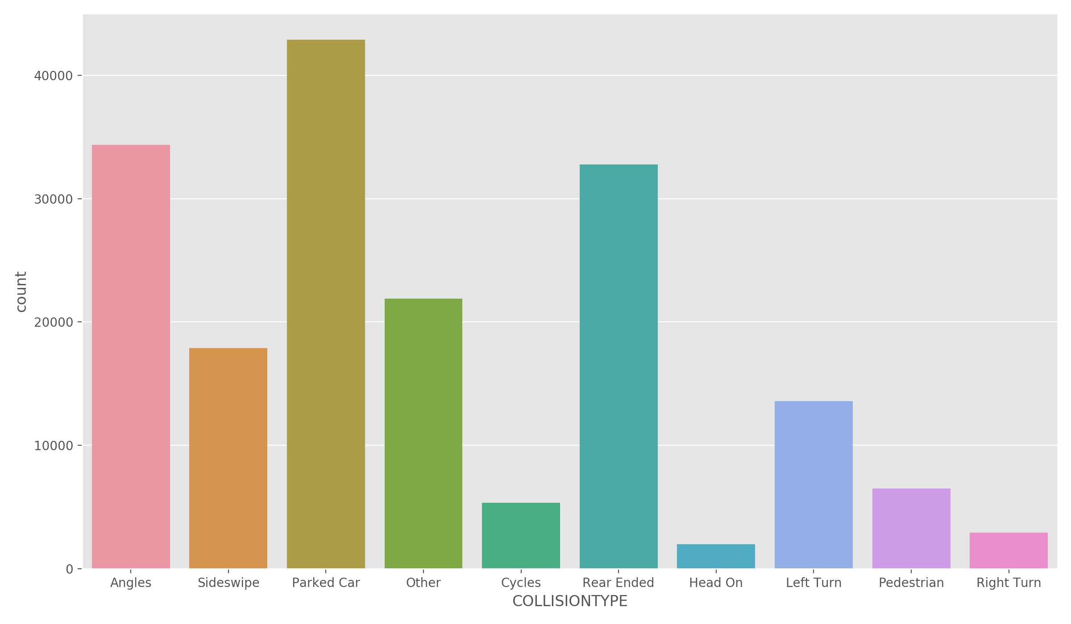
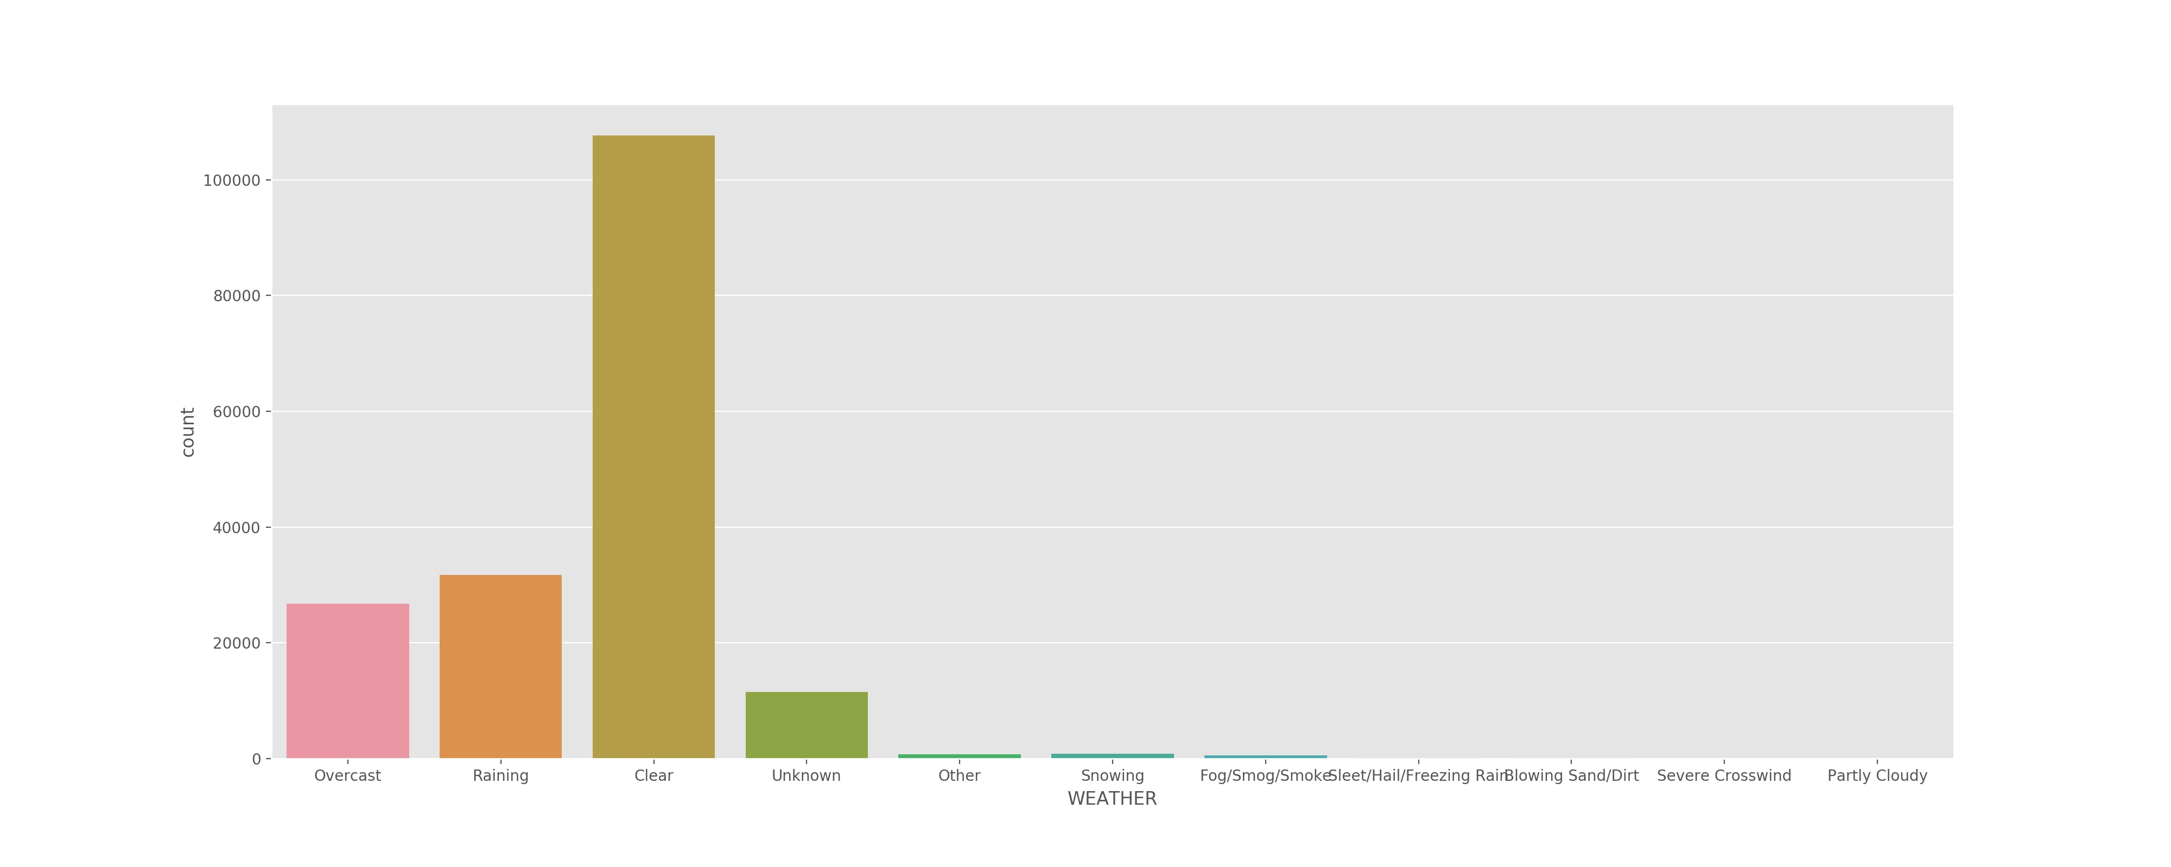
Categorical Features Selected for Model
Collision Type
Weather Conditions

Slide 6
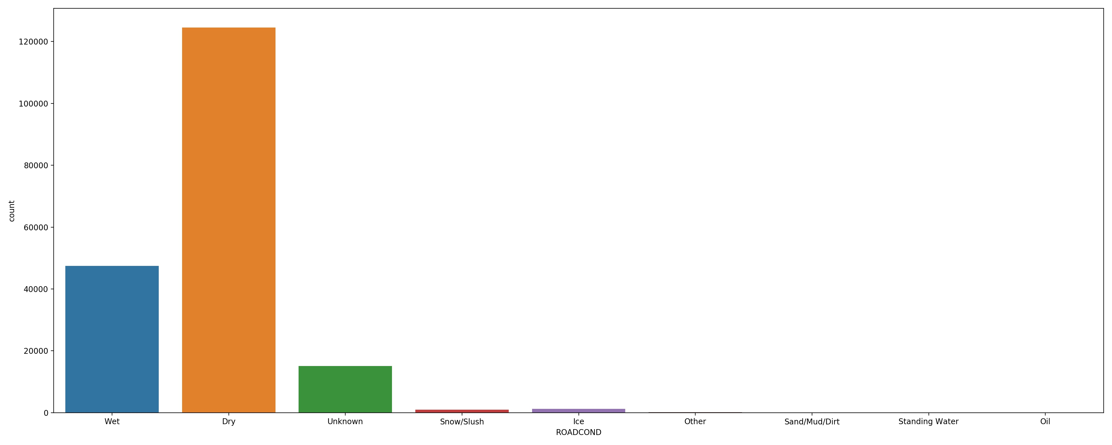
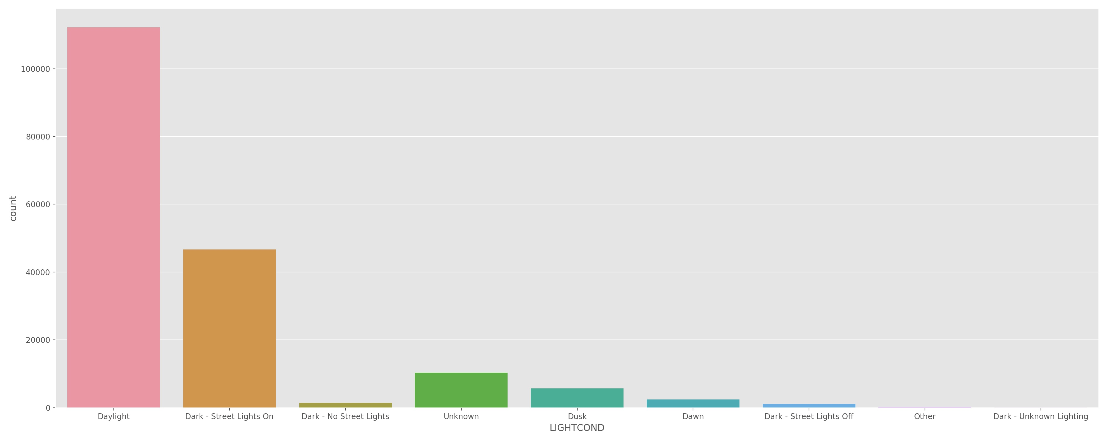
Categorical Features Selected for Model
Road Conditions
Light Conditions

Slide 7
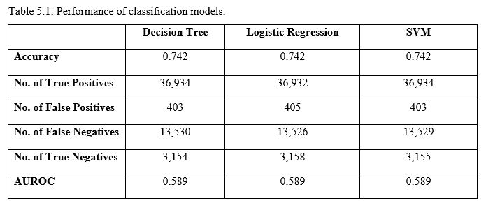
Classification Models
Accuracy: 0.742 between 3 models.
Logistic Regression performed the best among the algorithms, but the differences were quite little.
All Models have same AUROC, hence the stacking on each other.

Slide 8
Conclusion
Built useful classification models to predict road accident severities.
Accuracy of model has a lot of room for improvements (if numerical features showing high correlation are available and dataset is updated).
This model can help with the mitigation of severity of road accidents and allocate necessary resources to areas at higher risk.

