Slide 1



Optimised Deep Learning - Jean Zay
Hyperparameter Optimization
<numéro>

Slide 2
HPO = Hyperparameter Optimisation
Hyperparameters ◂
HPO ◂
2
Notes:
Cette partie présente quelques sources d’informations importantes sur les bonnes pratiques et l’état de l’art pour l’accélération de l’apprentissage en Deep Learning.

Slide 3



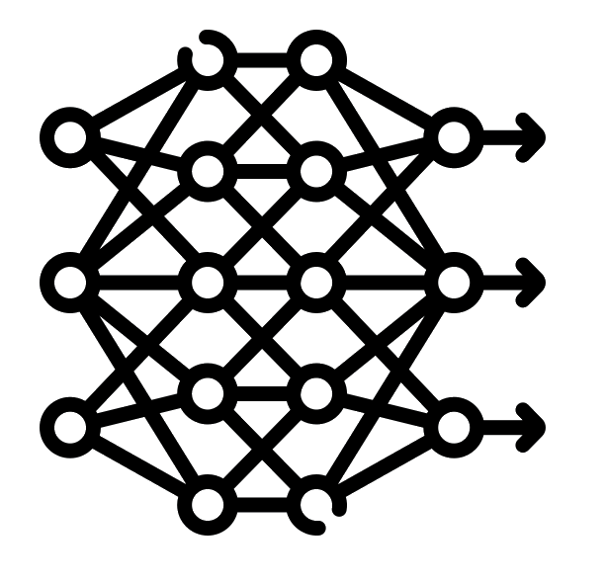
Hyperparameters
In machine learning, a hyperparameter is a parameter whose value is used to control the learning process.
By contrast, the values of other parameters (typically node weights) are derived via training.
Hyperparameters
Parameters

Slide 4

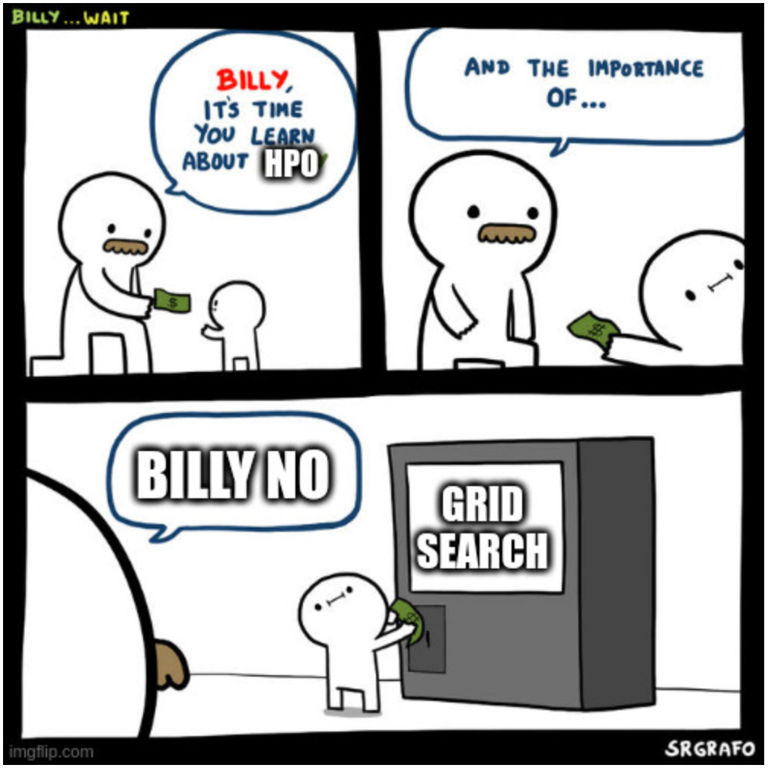

HPO : Hyperparameter Optimisation
Machine learning algorithms are highly configurable by their hyperparameters.
These parameters often substantially influence the complexity, behavior, speed as well as other aspects of the learner, and their values must be selected with care in order to achieve optimal performance.
Human trial-and-error to select these values is time-consuming, often somewhat biased, error-prone and computationally irreproducible.
Model Architecture
Dataset
Training on JZ
HPO

Slide 5

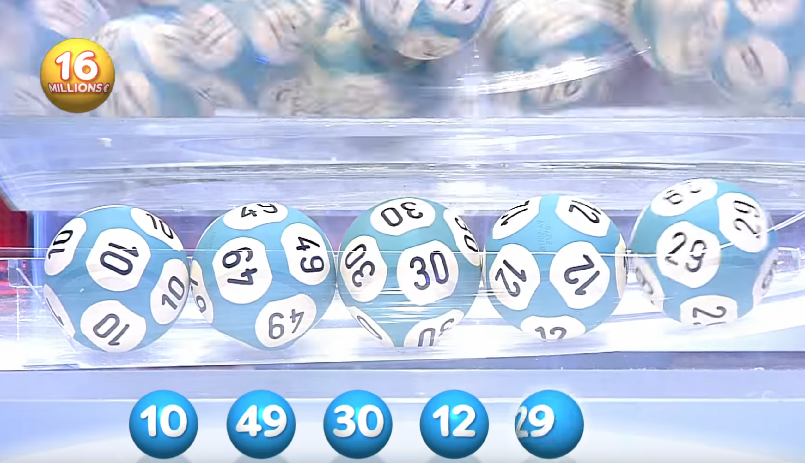
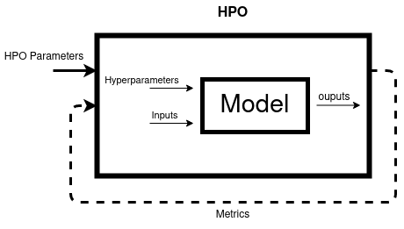


HPO
Hyperparameter Optimization == Bi-Level optimization problem

Slide 6
Search Algorithms / Samplers
Basic ◂
Manual, Grid Search, Random Search
Bayesian Optimisation ◂
Tree-structured Parzen Estimator, Gaussian Process
Heuristic ◂
Genetic Algorithm, Particle Swarm Optimization
Gradient-based Optimization ◂
6
Notes:
Cette partie présente quelques sources d’informations importantes sur les bonnes pratiques et l’état de l’art pour l’accélération de l’apprentissage en Deep Learning.

Slide 7
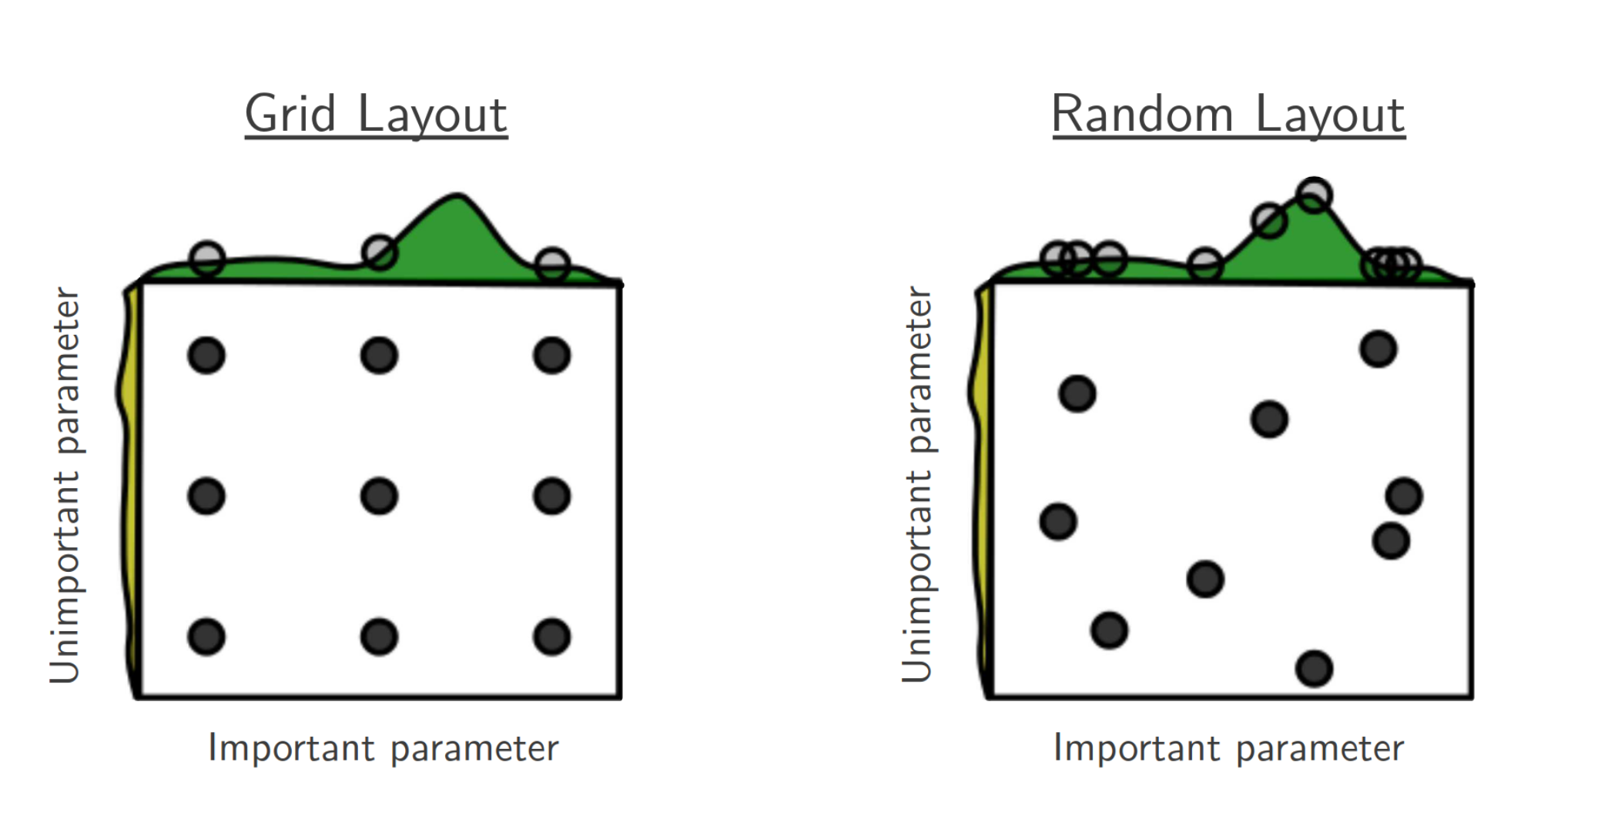
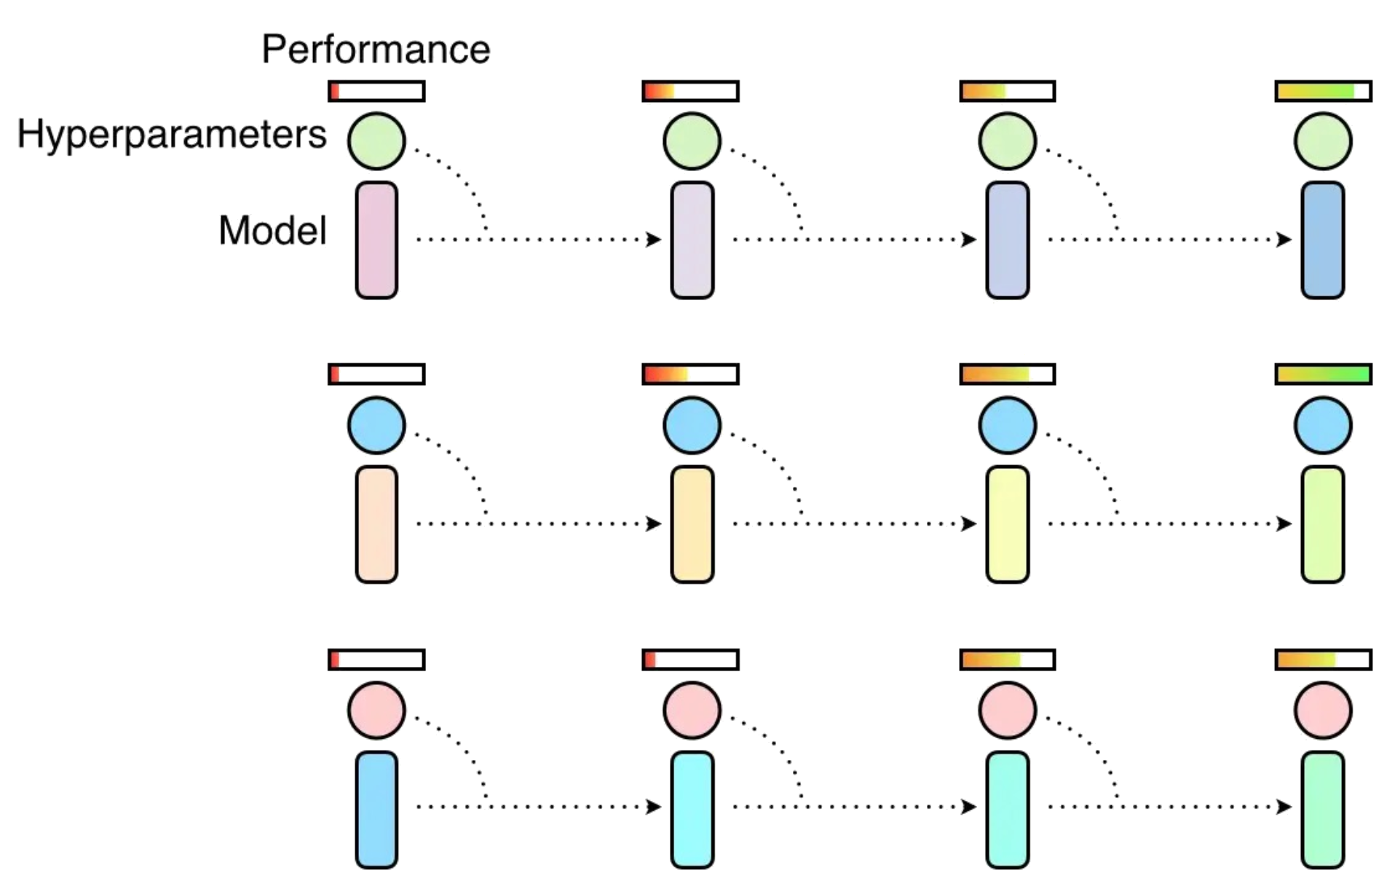

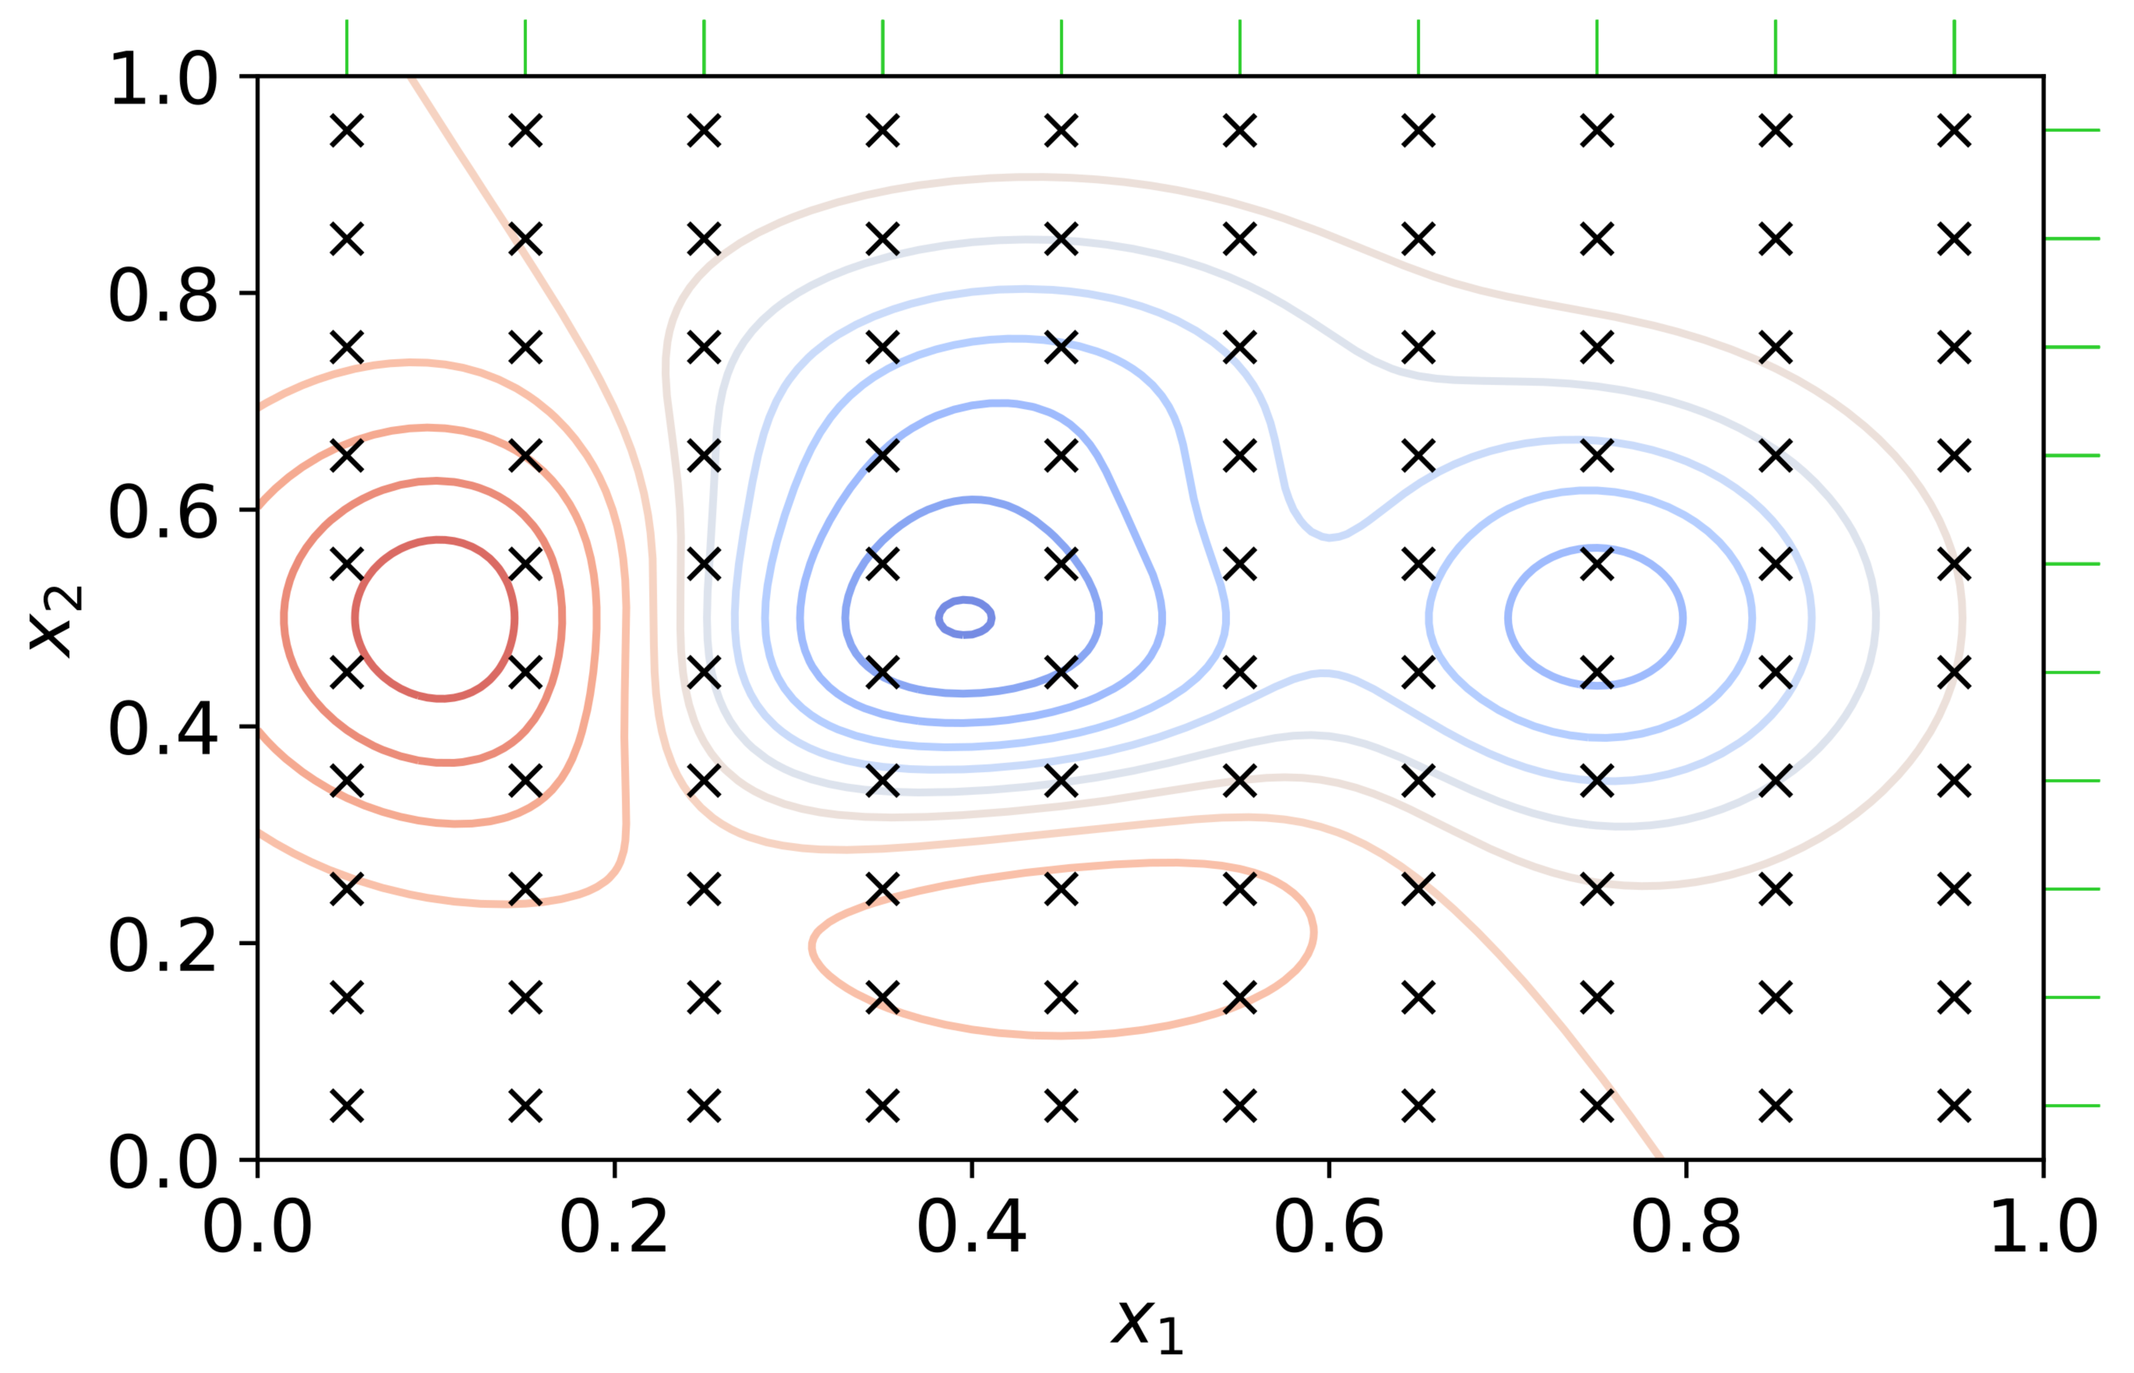
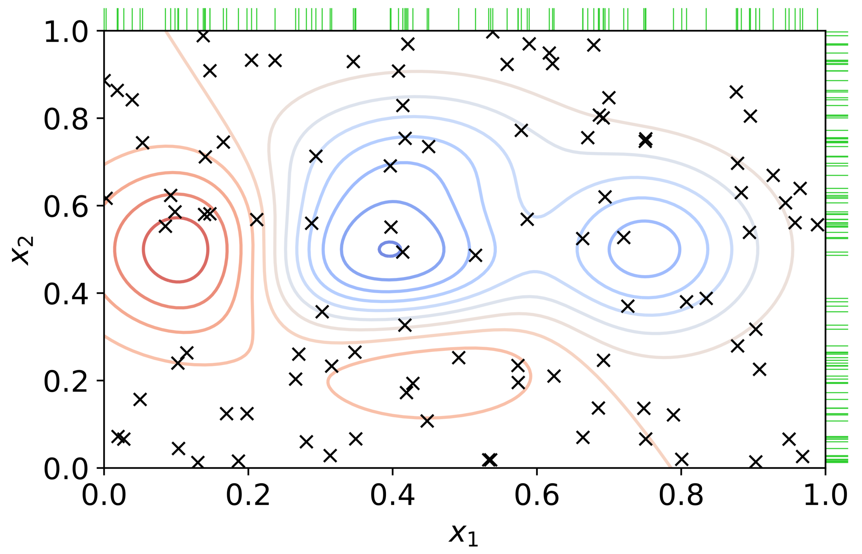
Basic : Grid & Random Search
Independent tests (which can be parallelized) which test a combination of hyperparameters.
Very costly in resources and no guarantee of improved results.
Random search is better for high dimensional space

Slide 8
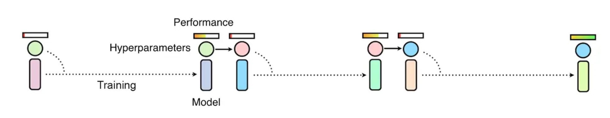
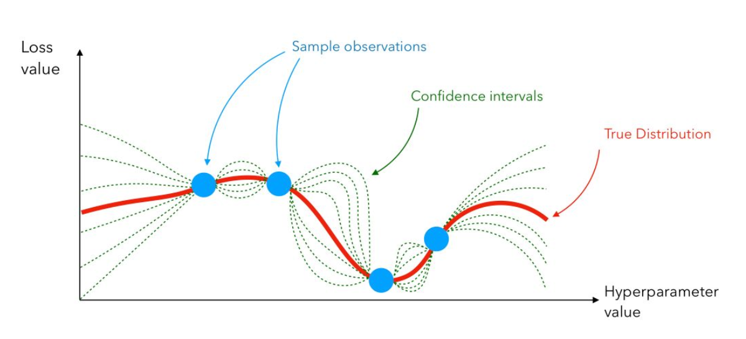
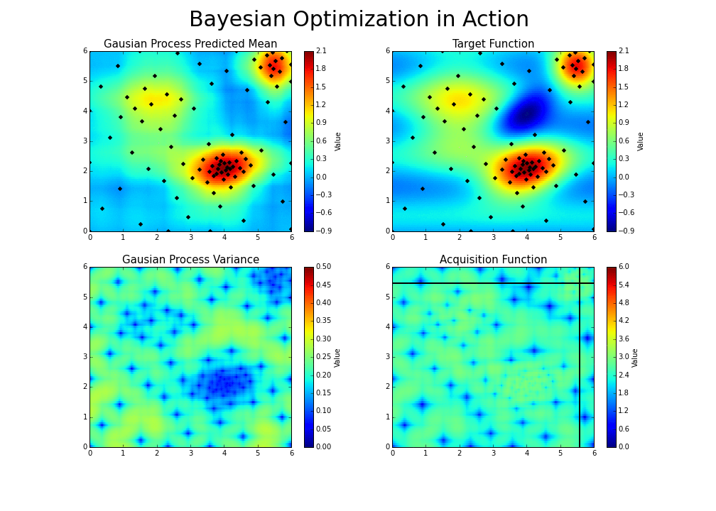
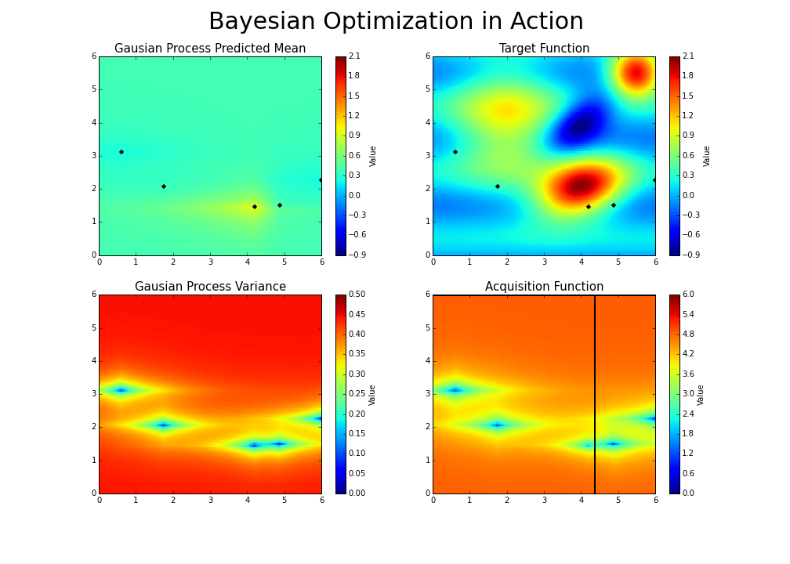
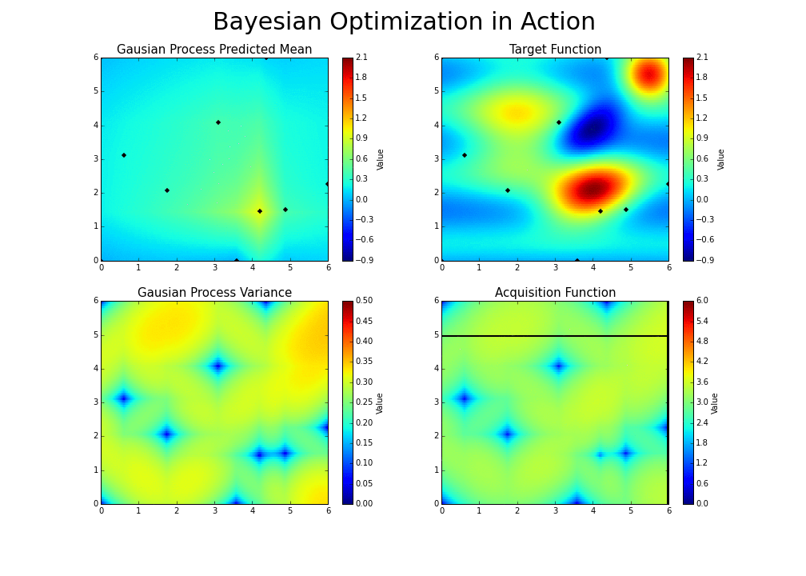
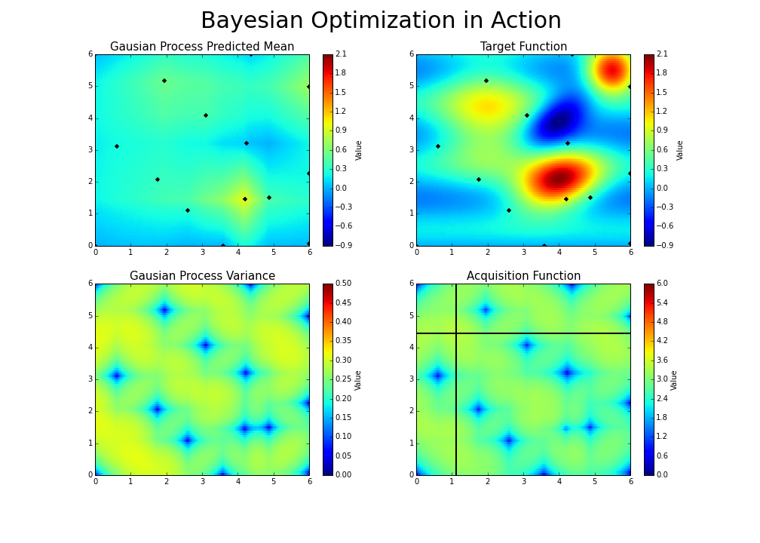
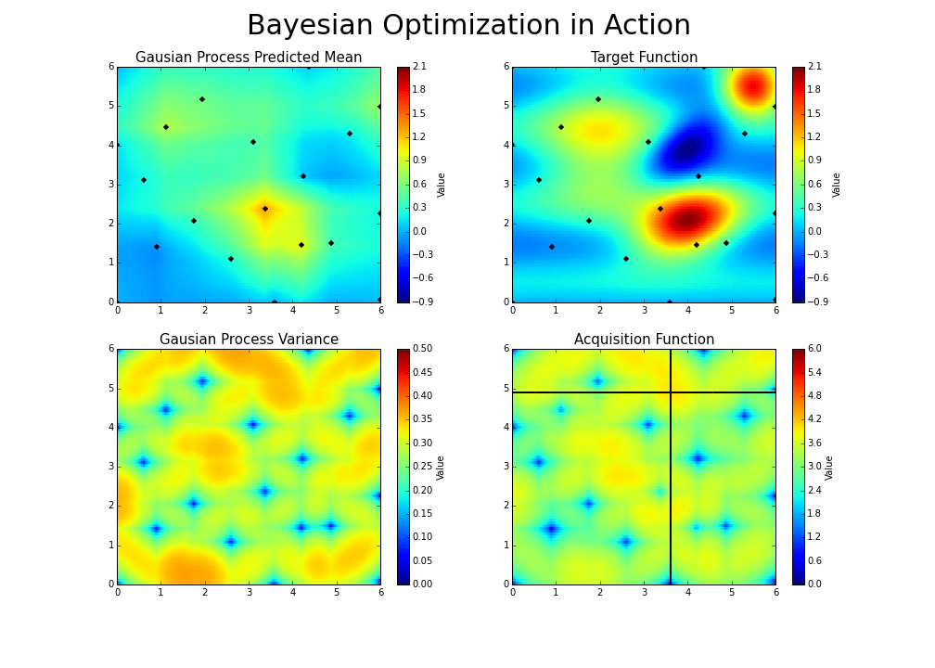
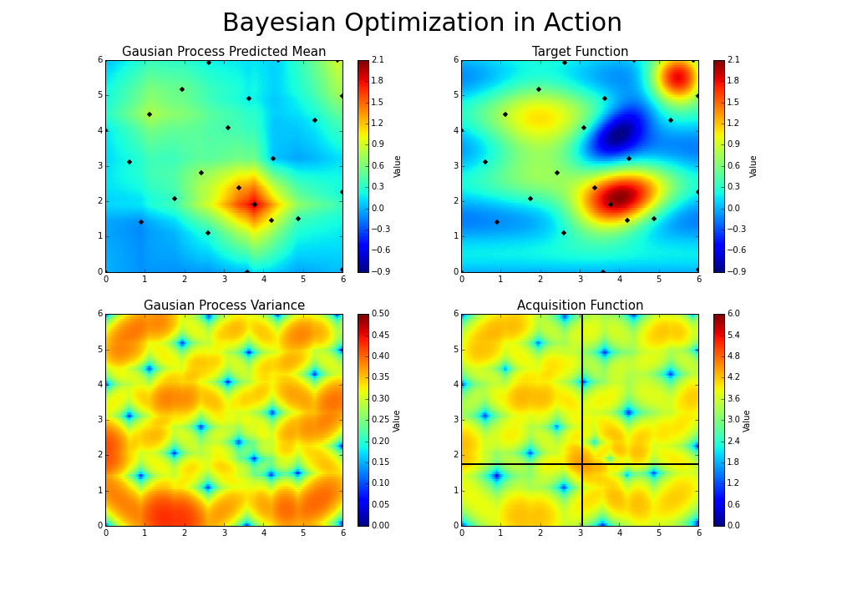
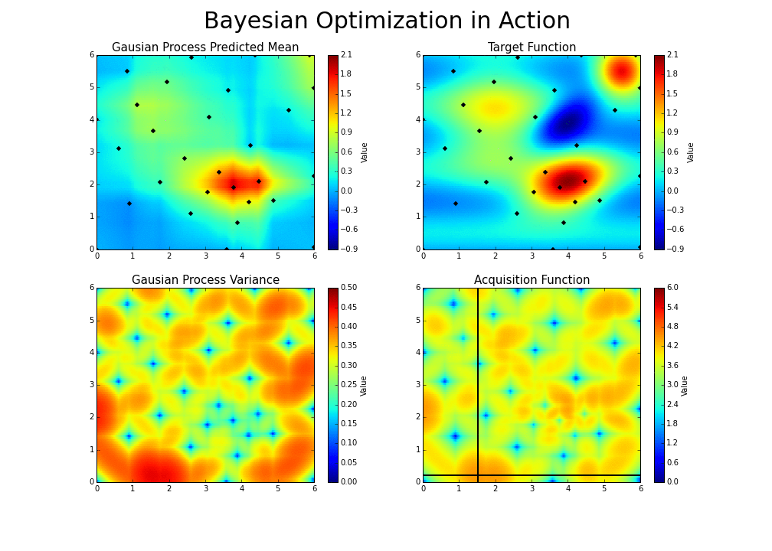
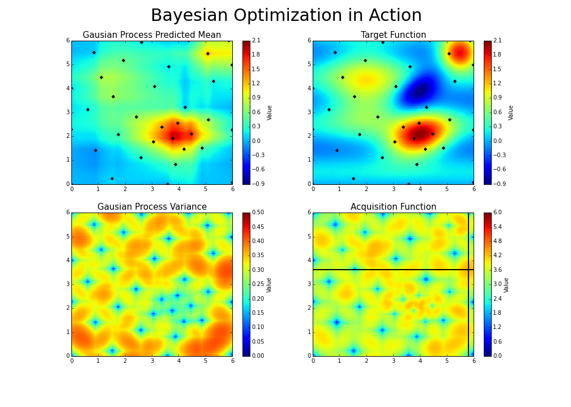
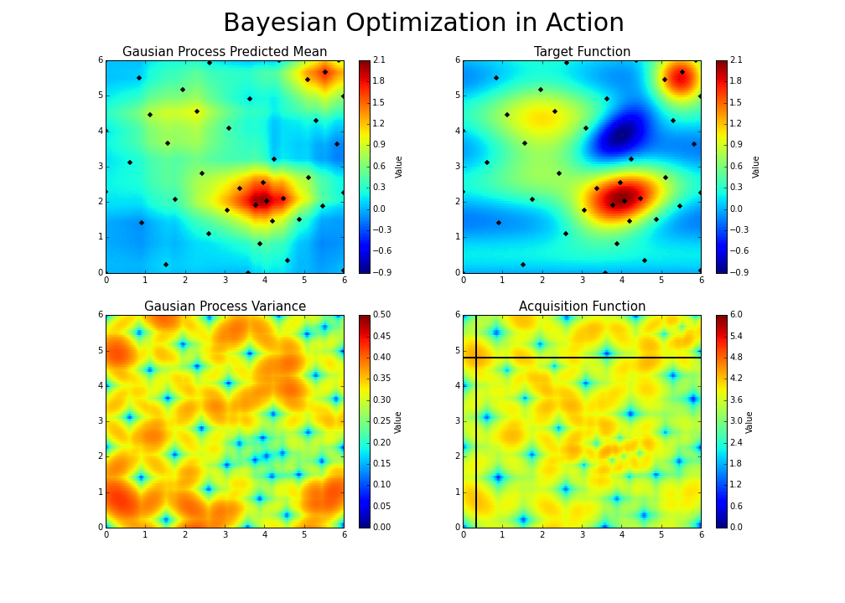
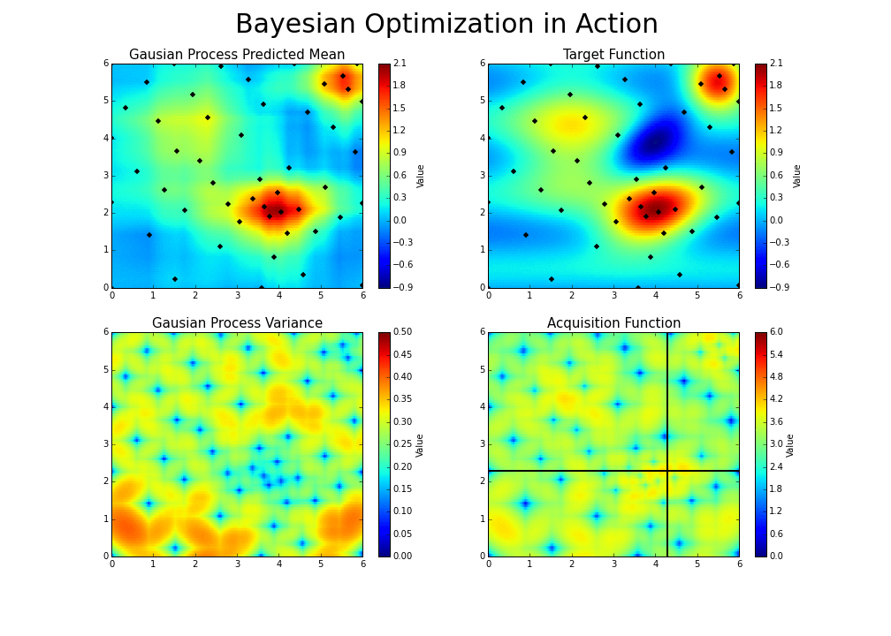
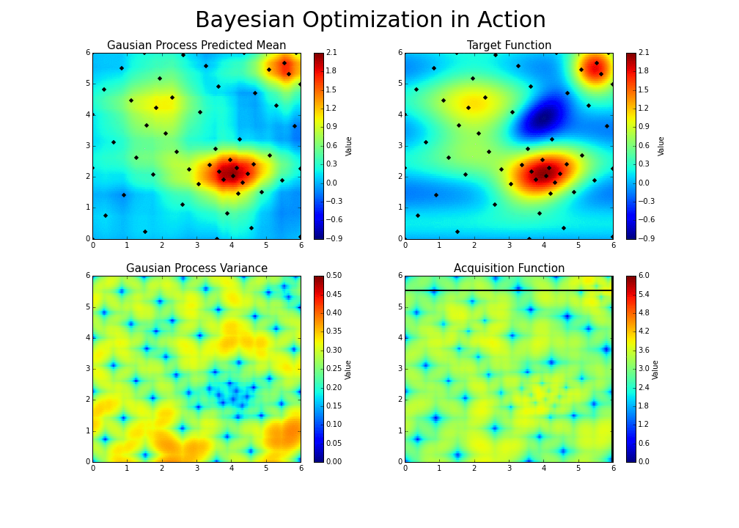
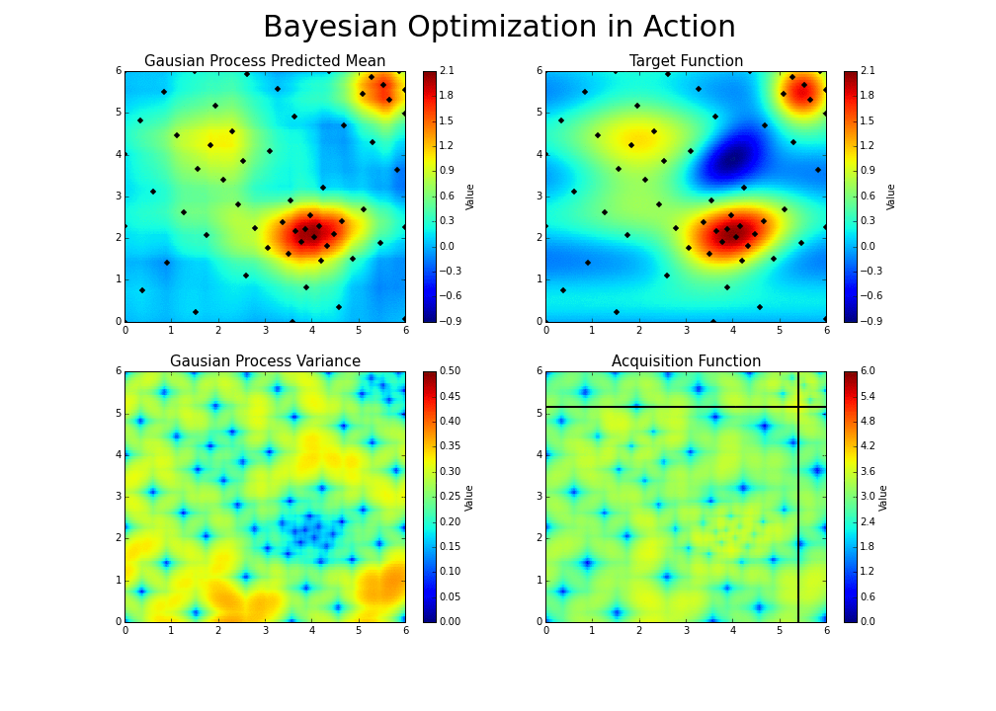
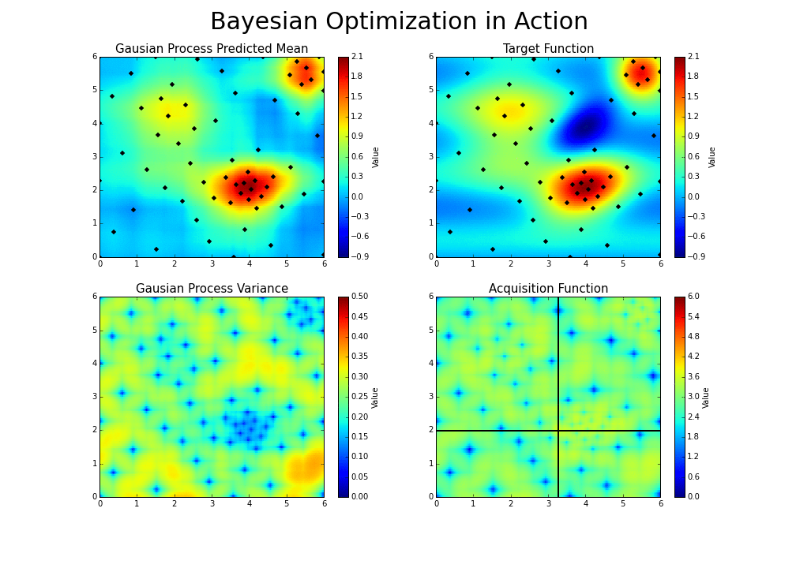
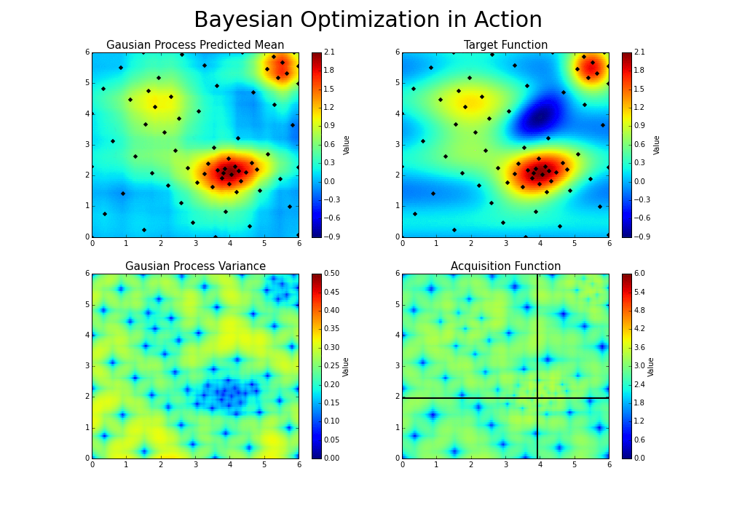
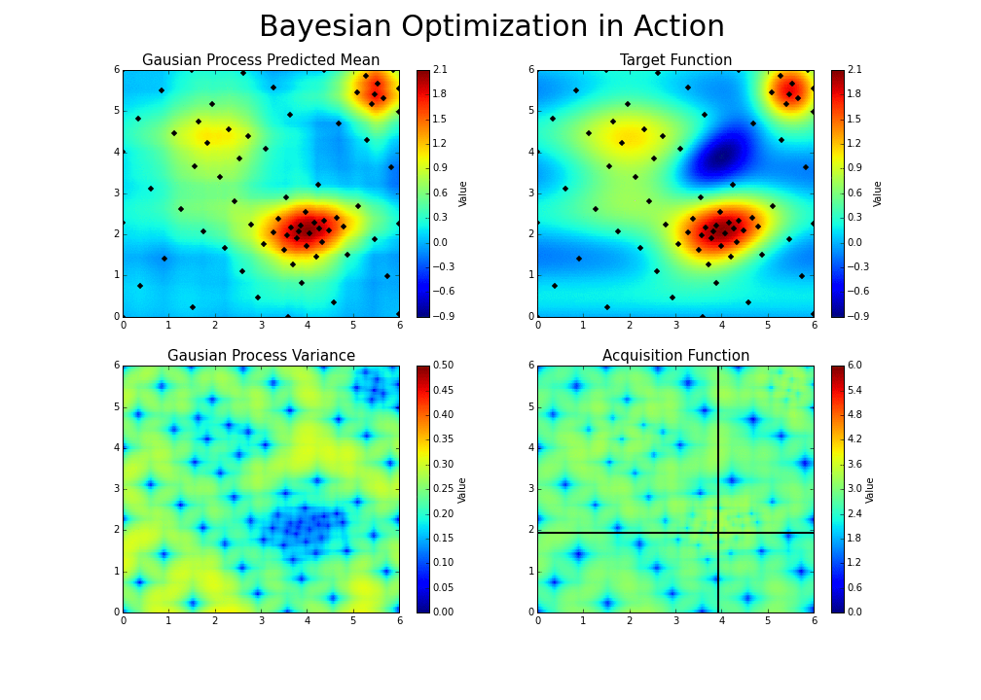
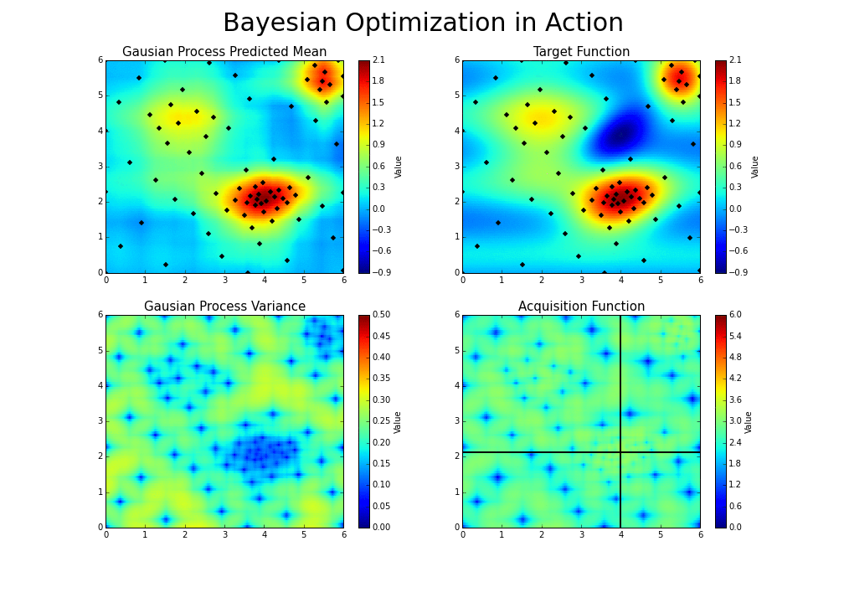
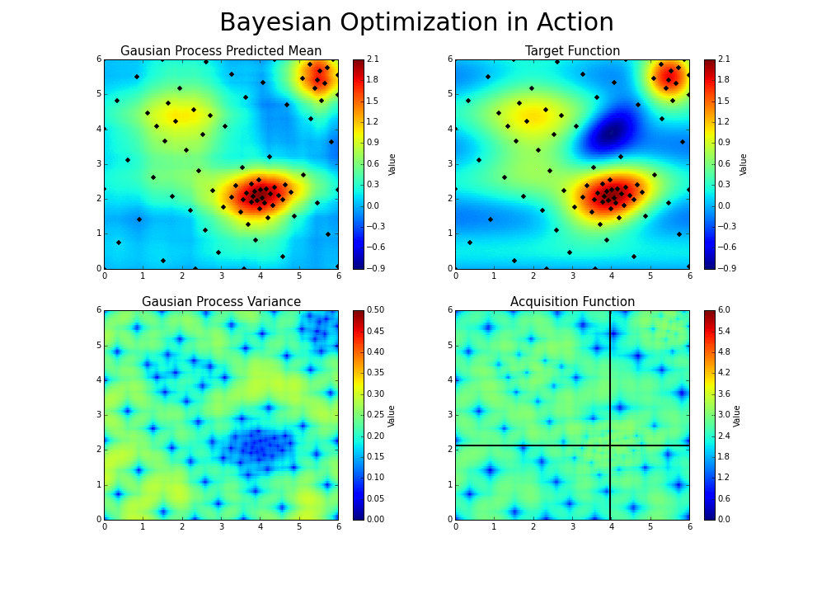
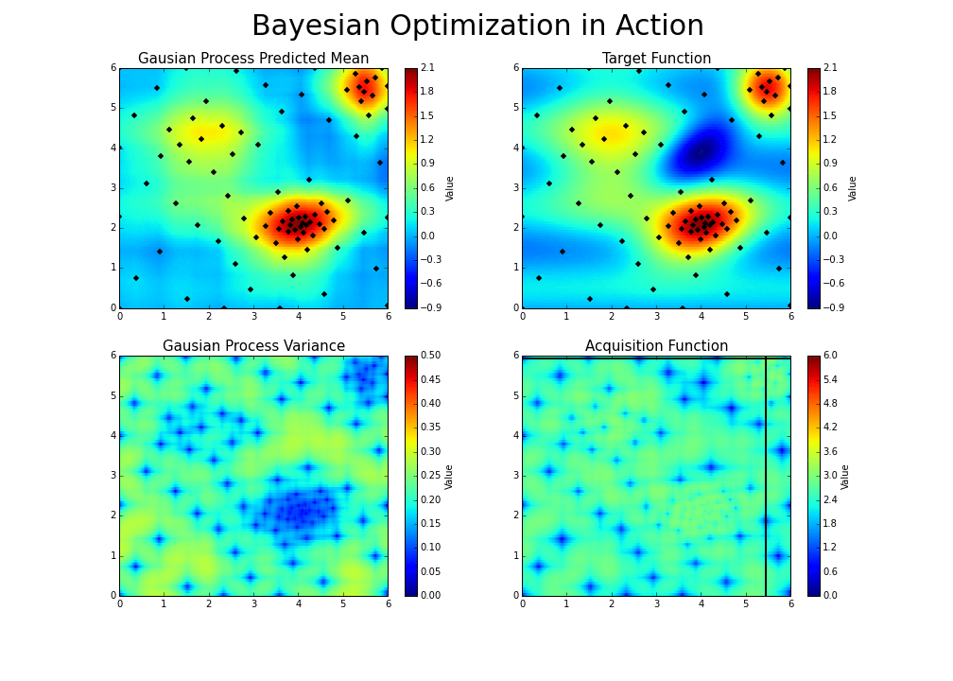

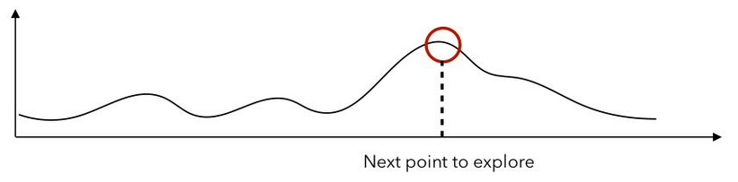
Bayesian Optimization : TPE & GP
Tree Parzen Estimator / Gaussian Process
Sequential but allows to quickly find the global optimum.
Proposes a new set of hyper parameters based on the scores obtained by the previous ones tested.
Expected metric score according to Hyper-parameters
Maximize Acquisition function e.g. Expected Improvement

Slide 9
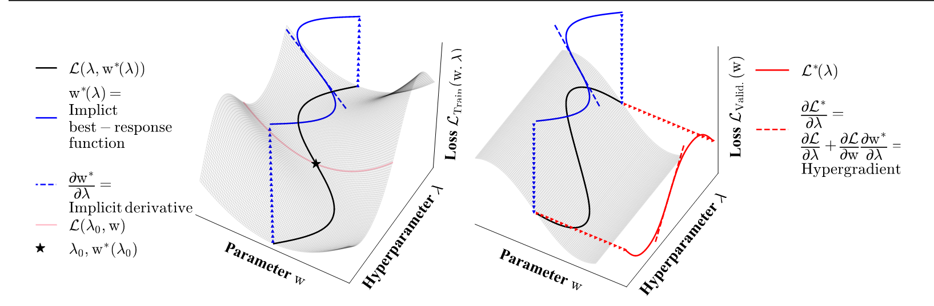
Gradient-based optimization
Optimizing Millions of Hyperparameters by Implicit Differentiation (https://arxiv.org/pdf/1911.02590.pdf)
High dimensionality
Bi-level optimisation

Slide 10
Schedulers Algorithms / Pruners
Early Stopping ◂
SHA/ASHA ◂
HyperBand ◂
10
Notes:
Cette partie présente quelques sources d’informations importantes sur les bonnes pratiques et l’état de l’art pour l’accélération de l’apprentissage en Deep Learning.

Slide 11
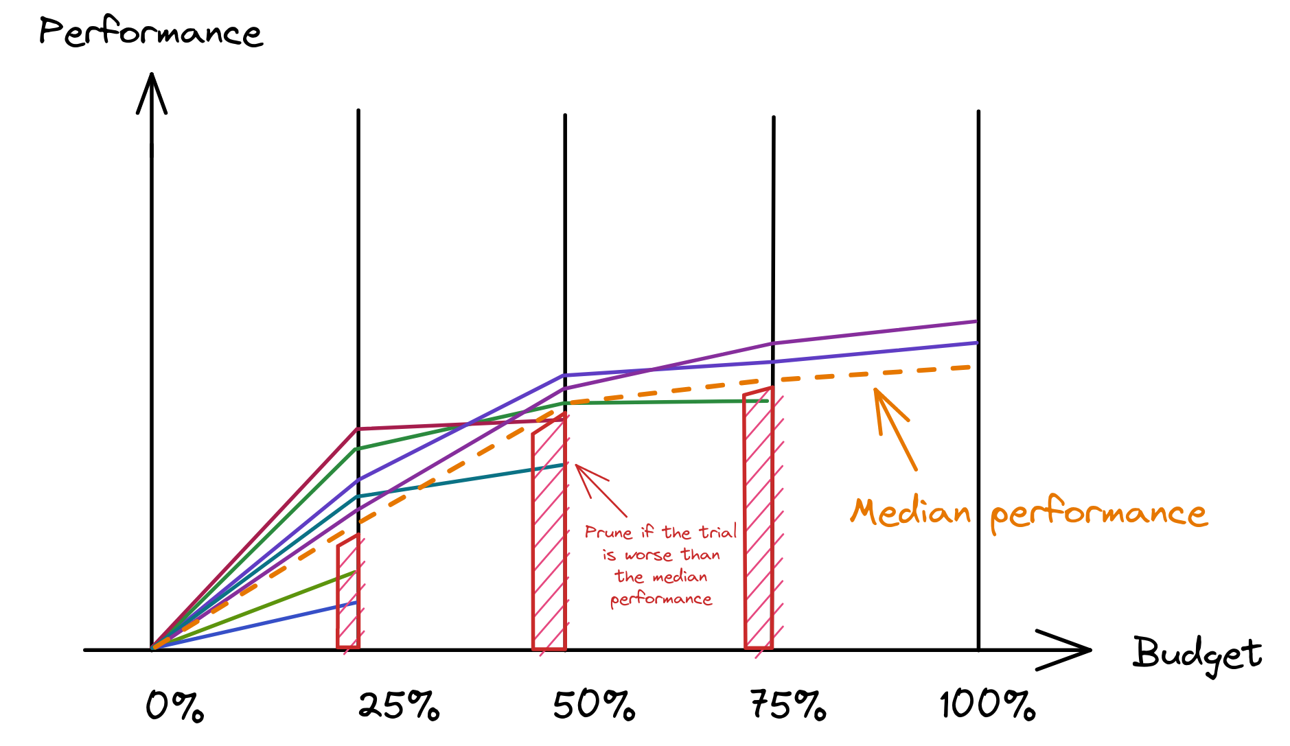
Early Stopping
Easy to implement
Save ressources & make automatic selection
Can be with acc%, time%, rank%, etc

Slide 12
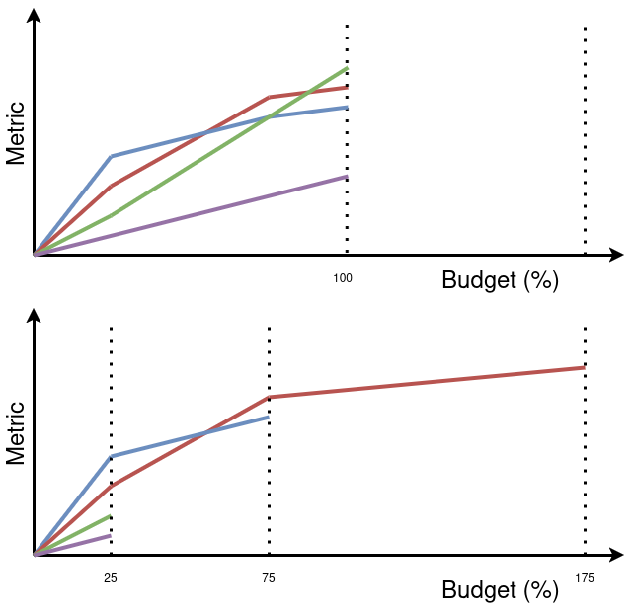
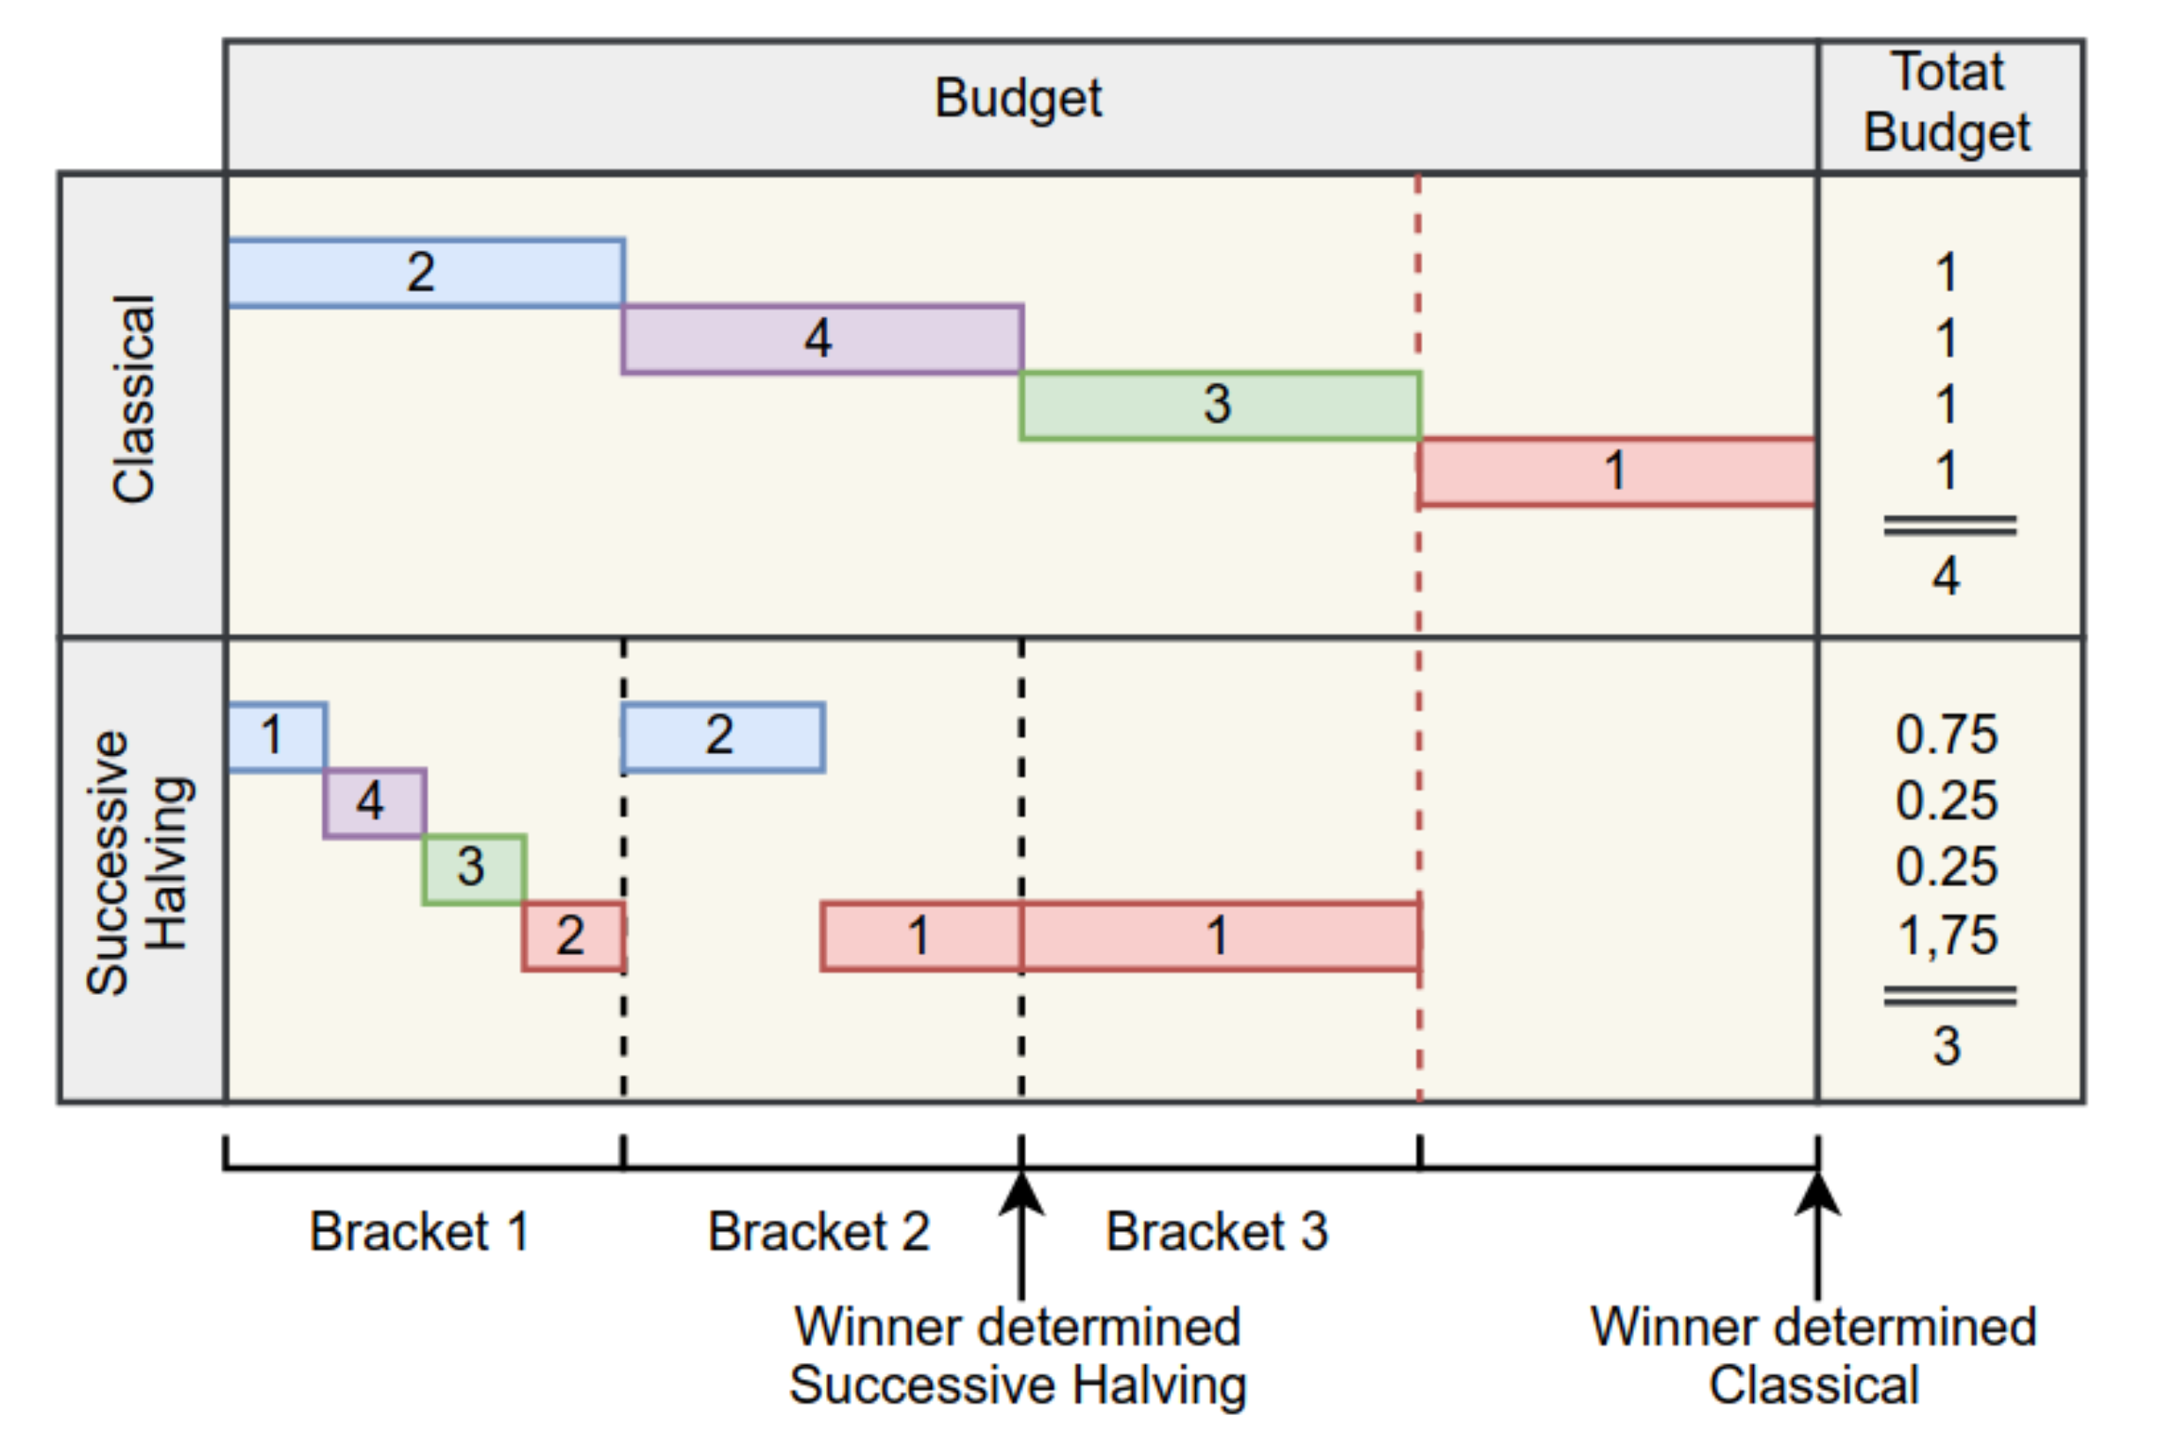
SHA : Successive Halving Algorithm
For sequentials trials
Works well with small or medium model -> Trials must be fast !

Slide 13
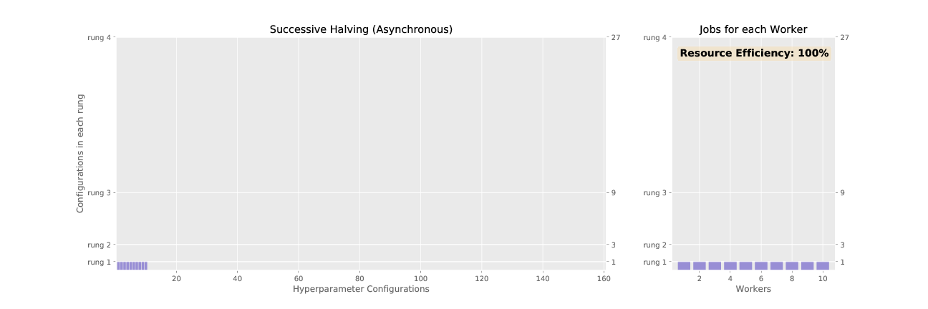
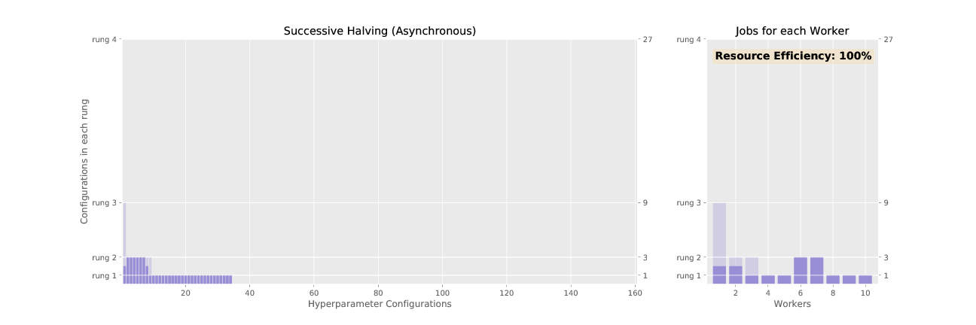
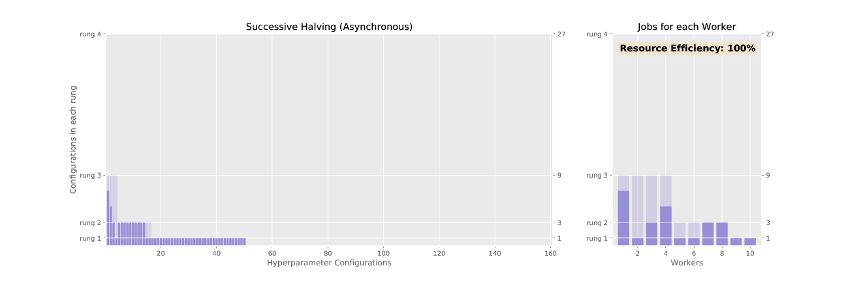
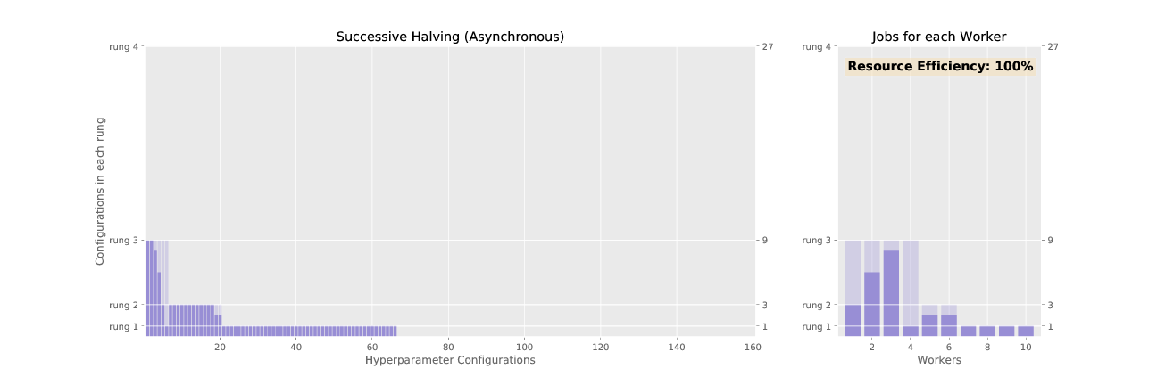
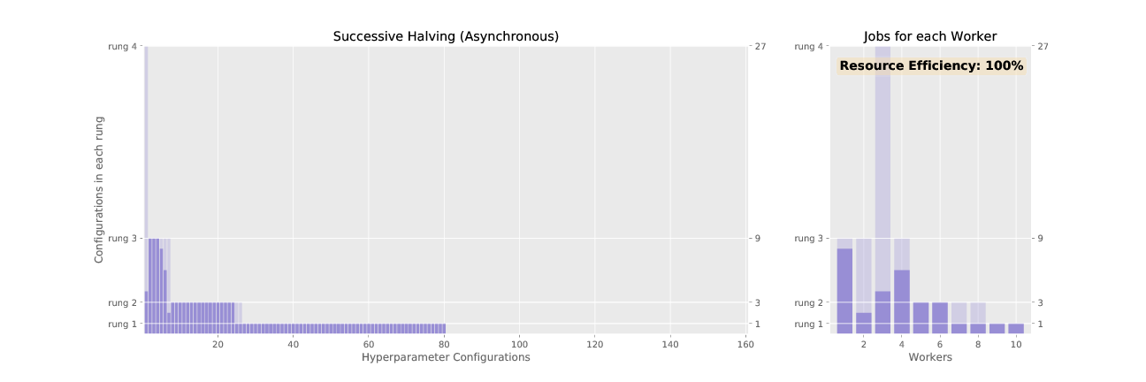
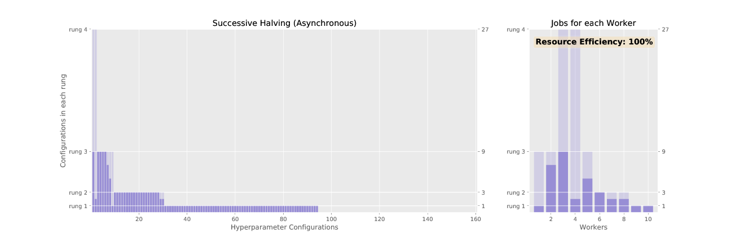
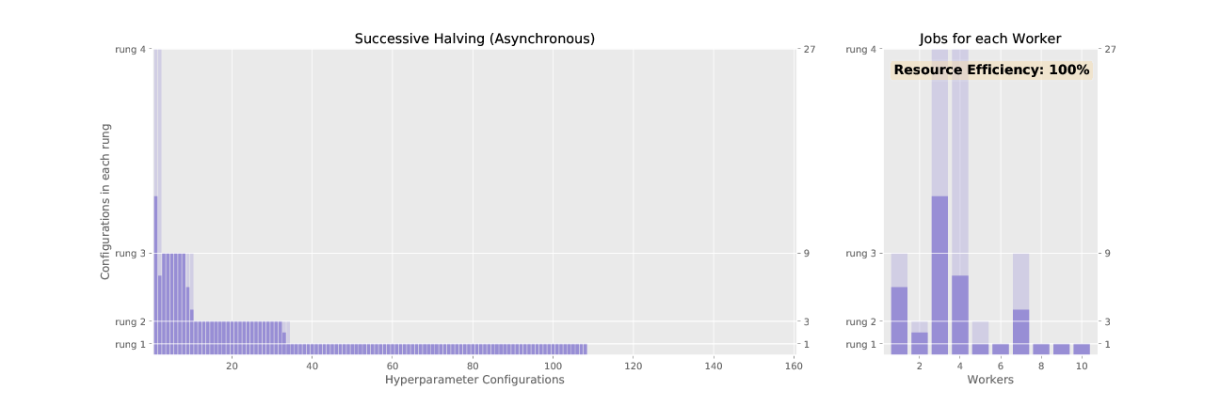
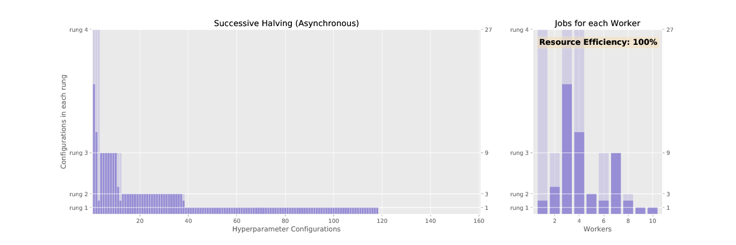
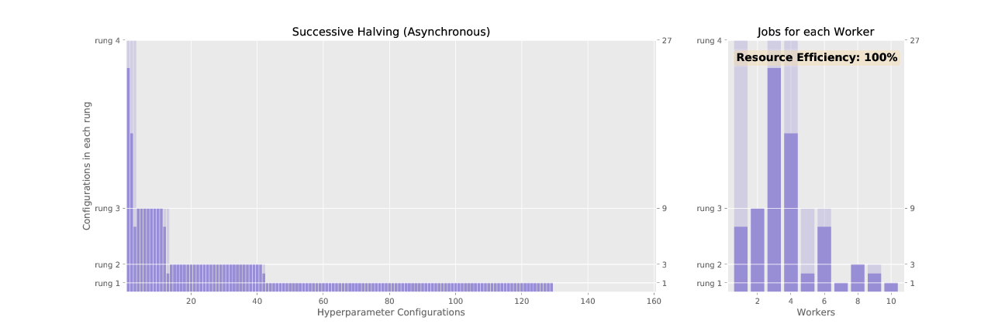
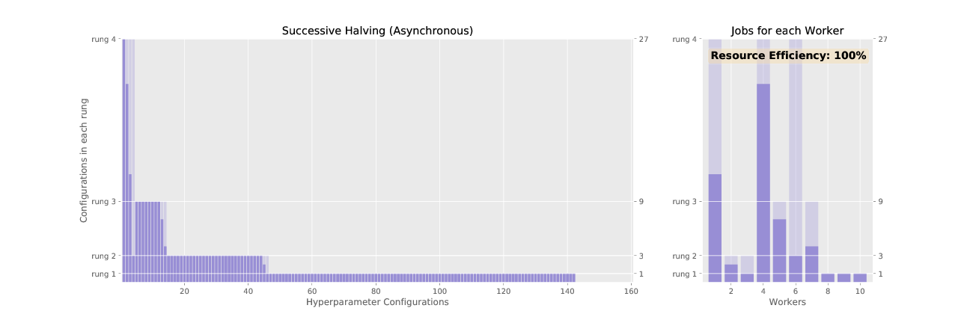
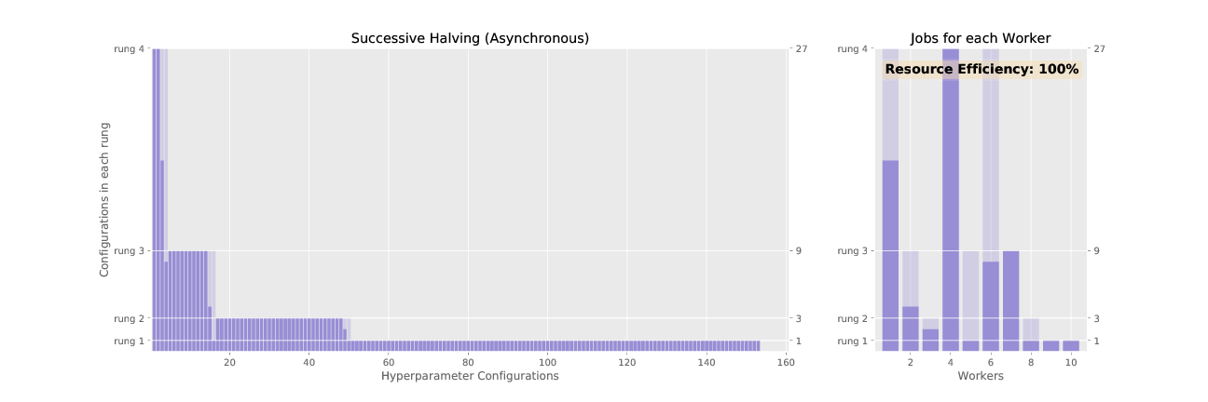
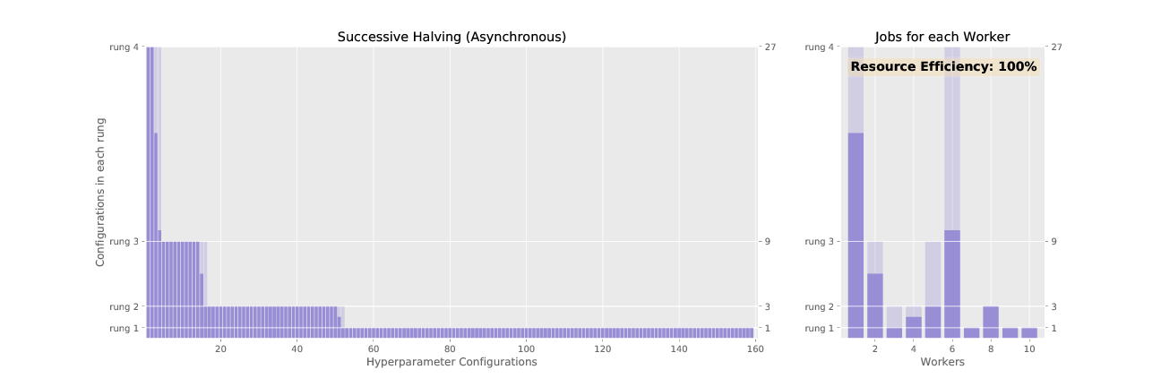
ASHA

Slide 14
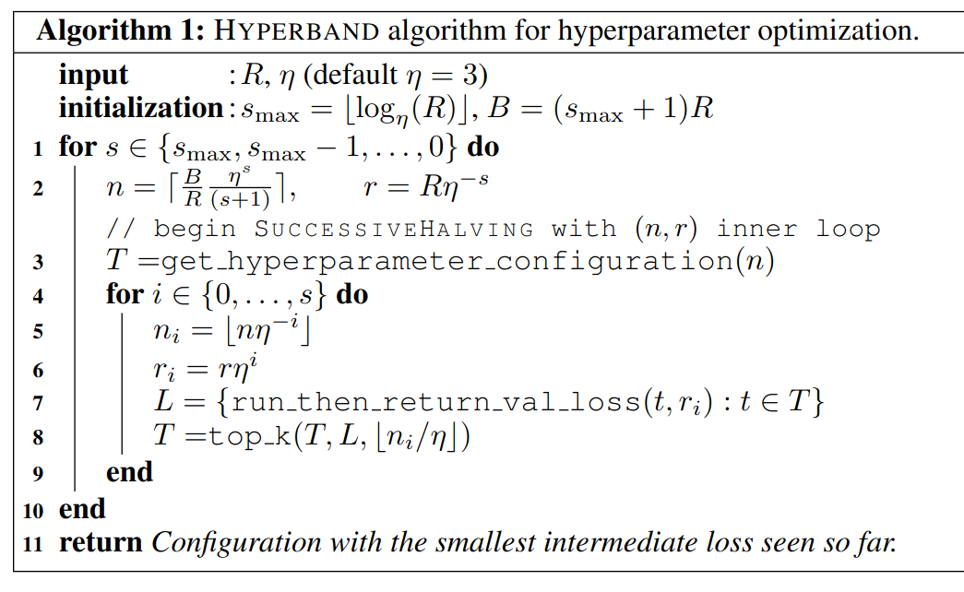
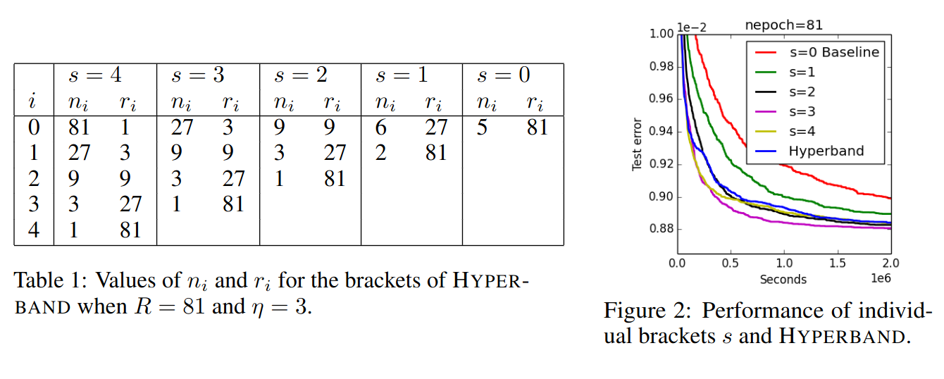
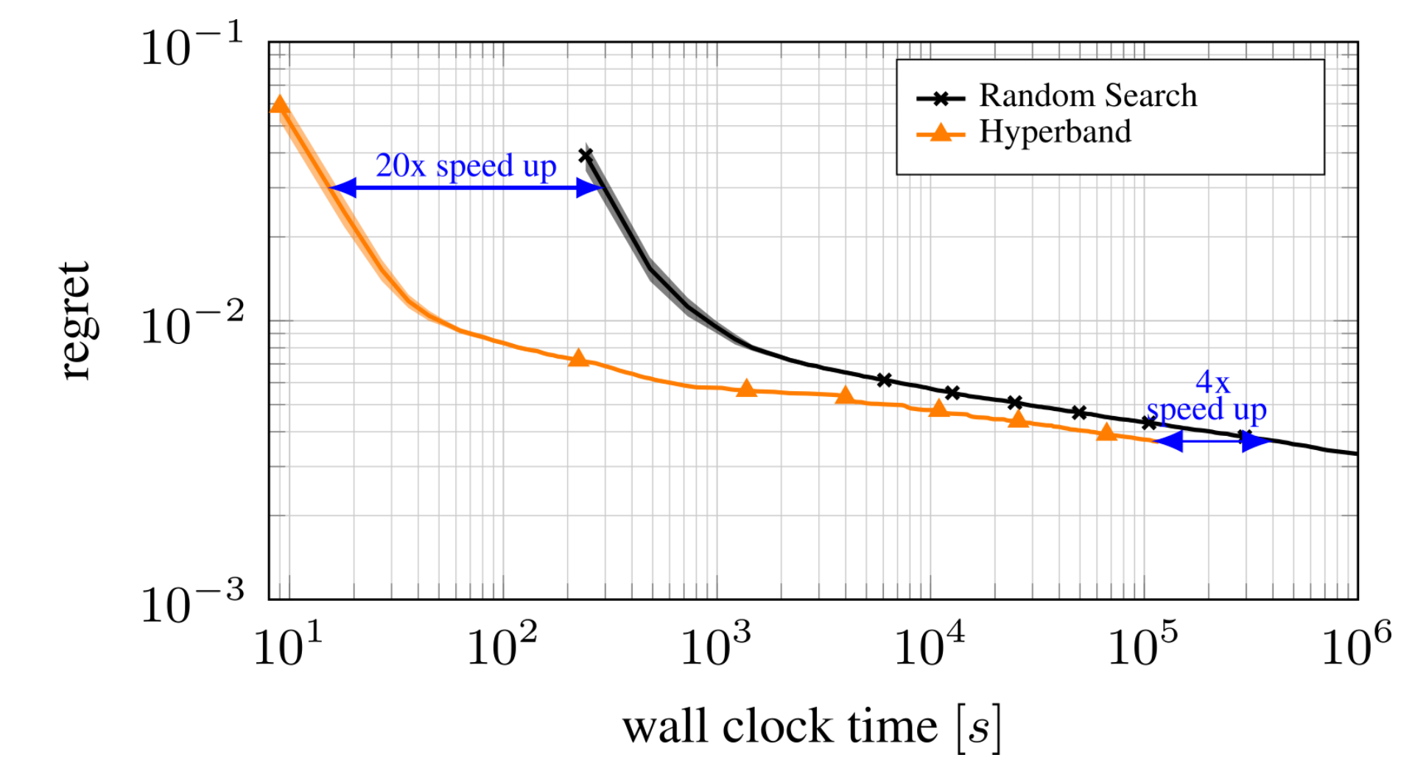
Hyperband
Repeatedly calls SuccessiveHalving but mitigate it’s drawbacks
Limited convergence

Slide 15
Advanced Algorithms
Hybrid time !
PBT ◂
BOHB, DEHB ◂
15
Notes:
Cette partie présente quelques sources d’informations importantes sur les bonnes pratiques et l’état de l’art pour l’accélération de l’apprentissage en Deep Learning.

Slide 16
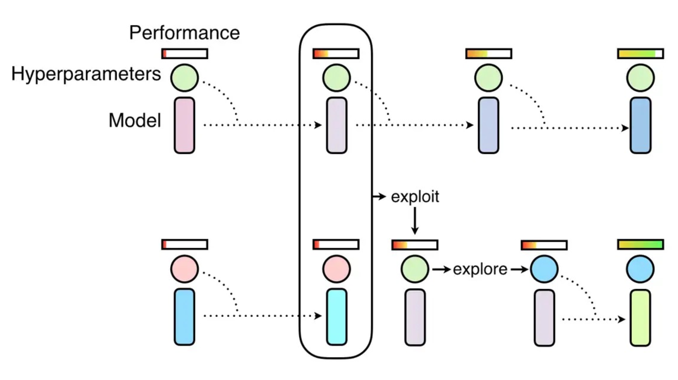
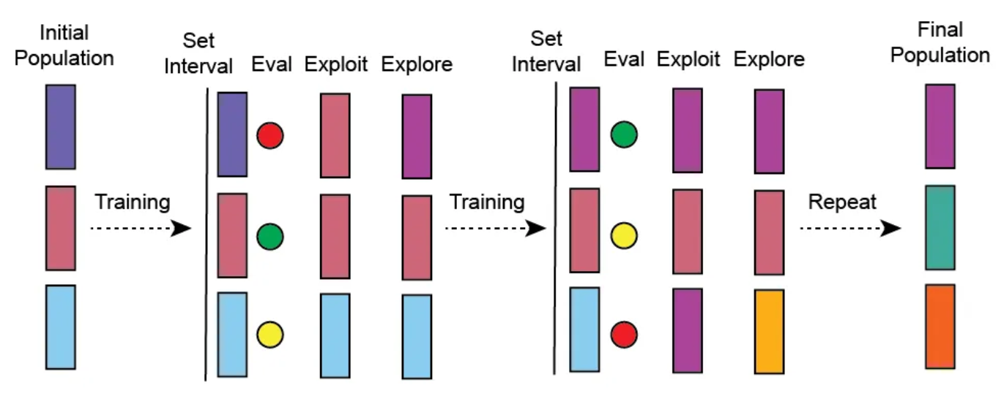
PBT : Population Based Training
Research and optimization of hyper parameters during training
For large models with long and poorly parallelizable tests on a few machines.
Exploit = Copy of the weights of the best model
Explore = Bayesian Optimization

Slide 17


BOHB, DEHB
DEHB : Differential Evolution Hyperband
BOHB : Bayesian Optimization Hyperband

Slide 18


Summary
17
Notes:
Cette partie présente quelques sources d’informations importantes sur les bonnes pratiques et l’état de l’art pour l’accélération de l’apprentissage en Deep Learning.

Slide 19
Have the right tools
HPO frameworks ◂
Visualisation & Experiments Tracking ◂
19
Notes:
Cette partie présente quelques sources d’informations importantes sur les bonnes pratiques et l’état de l’art pour l’accélération de l’apprentissage en Deep Learning.

Slide 20



HPO Frameworks & tools
Work with an objective function
Efficient Optimization Algorithms
Based on config file
Easy to use
Not only used for ML/DL
Scalable HPO framework
State of the art algorithms (PBT)
Integrates with a wide range of additional HPO tools

Slide 21



Experiments tracking
Source Control
OU
Data Version Control
Advantages :
allows you to save and order the results
allows easy comparison and visualization of results
provides all the information needed to reproduce the results

Slide 22




HPO and MLOps
As soon as our HPO requires a lot of resources (time, money or both) it is necessary to scale up and industrialize the experience process.
Taking inspiration from MLOps processes and tools is a good start
https://ml-ops.org/content/end-to-end-ml-workflow

Slide 23
Sources
Hyperparameter optimization: Foundations, algorithms, best practices, and open challenges (https://wires.onlinelibrary.wiley.com/doi/pdfdirect/10.1002/widm.1484)
https://www.automl.org/
Gradient-based Hyperparameter Optimization Over Long Horizons (https://openreview.net/pdf?id=6x8tcREIL2W)
Seld-Tuning networks : Bilevel Optimization of Hyperparameters using structured best-response functions (https://openreview.net/pdf?id=r1eEG20qKQ)
https://maelfabien.github.io/machinelearning/Explorium4/#
https://towardsdatascience.com/a-novices-guide-to-hyperparameter-optimization-at-scale-bfb4e5047150#e813
Population Based Training : https://www.deepmind.com/blog/population-based-training-of-neural-networks
Hyper-Parameter Optimization: A Review of Algorithms and Applications : https://arxiv.org/pdf/2003.05689

