Slide 1
MyMechanic Platform for book Car service

Slide 2
Introduction
You can get anything done on internet, why Not booking car service?, Where user can book service whenever user wants, taking advantage that internet is now accessible to everyone in recent years.
MyMechanic is an service web application that helps users to book any service at any time with user friendly gui. This application is best platform for not only but garages also to take their business online

Slide 3
Objectives
Provide a free car service booking to users and run business for garages.
Simplicity.
User-friendliness.
Easy Accessible.

Slide 4
Technologies
Languages:
html5, css3, javascript, bootstrap, php, mysql.
Platform :
Notepad++, xampp server.

Slide 5
Features
same platform for booking service and garages business

Slide 6
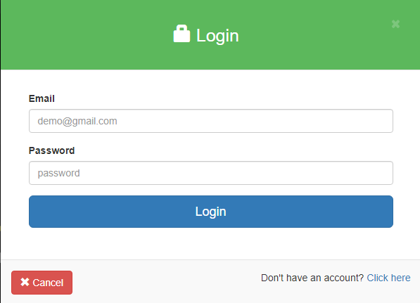
Snapshots

Slide 7
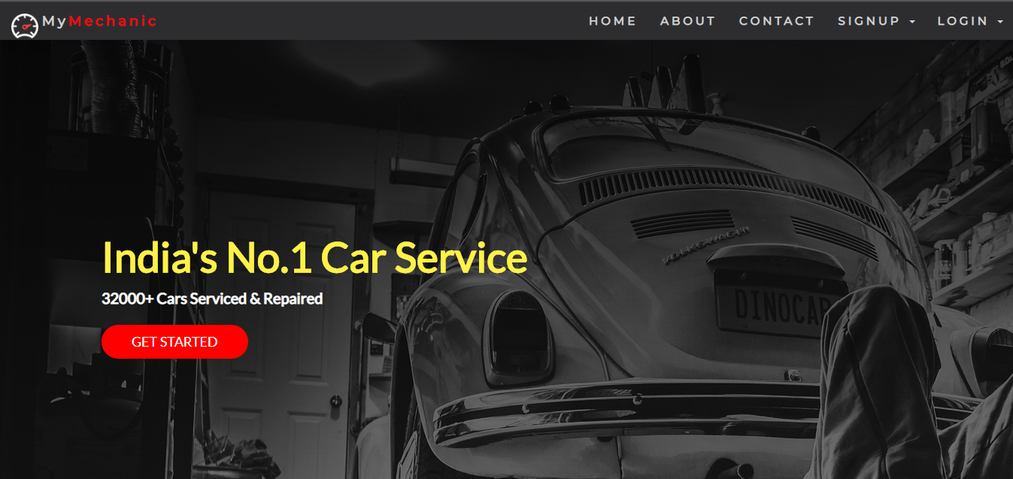
Snapshots (Continued)

Slide 8
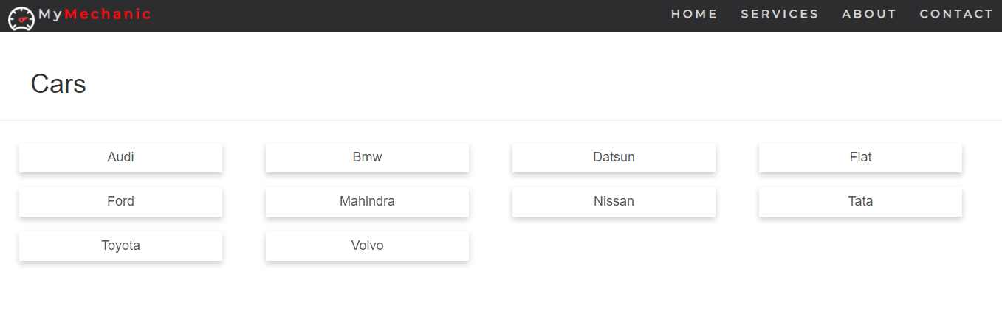
Snopshots (Continued)

Slide 9
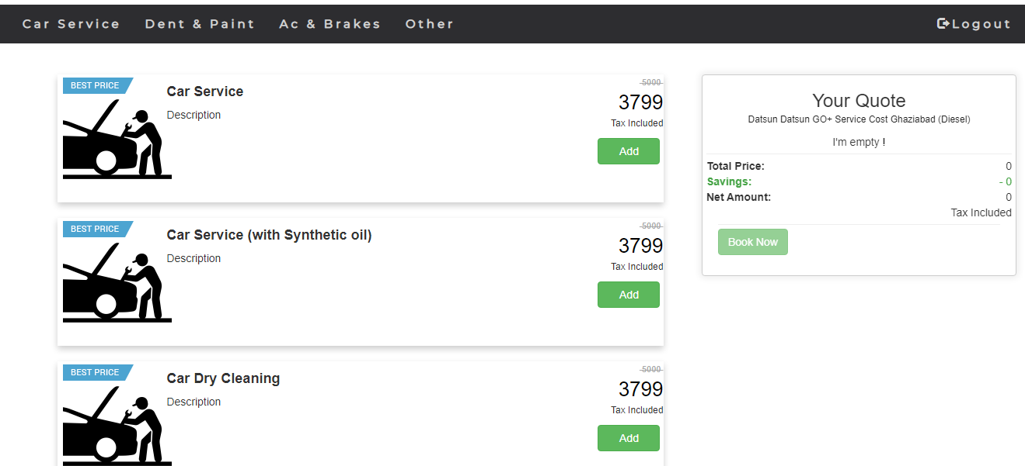
Snopshots (Continued)

Slide 10
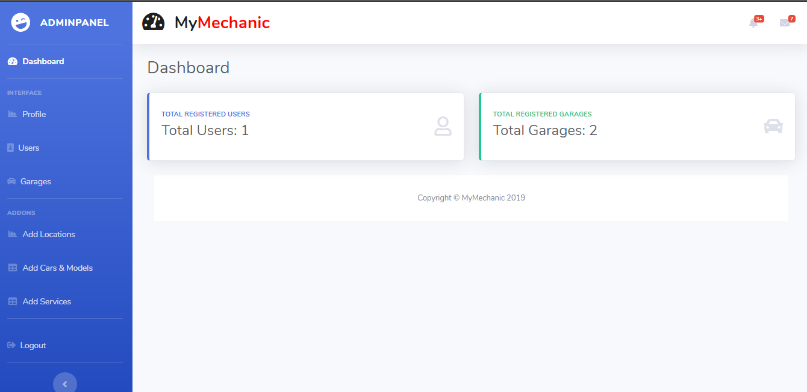
Snapshots (Continued)

Slide 11
Conclusion
This project exposed us to the latest technologies in web development, thus we have learnt a lot about software project management and new technologies .

Slide 12
Future Work
adding two wheelers and three wheelers service.
Adding direct login or signing with google account.

Slide 13
Thank You

