Slide 1
ABU-SSO
Unified Single Sign-On & Digital Campus Wallet
Idris Muhammad Abubakar • P25EGCP9003
COEN838 — Advanced Software Engineering • November 2026
abu-sso.onrender.com

Slide 2
The Problem
Fragmented digital identity at Ahmadu Bello University
• Students juggle 6 separate credentials:
• Portal · LMS · Wi-Fi · Library · Hostel · Results
• Passwords forgotten, reused, or shared
• ABU ICT flooded with password-reset requests
• Identity duplicated across systems — violates the 'once-only' principle
• Result: security risk + productivity loss

Slide 3
The Goal
• One login → all campus services
• Digital ID card with QR code for physical access
• Campus wallet for cashless payments
• Admin-managed account provisioning (matches real ABU workflow)
• Open REST API so any campus service can trust one identity

Slide 4
Scope
• In scope:
• • Authentication (matric-based login)
• • Role-based access control (student / staff / admin)
• • Digital ID card + wallet
• • Admin panel + 6 distributed SSO services
• Out of scope:
• • Real payment gateway, native mobile apps, biometrics, real ABU ERP integration

Slide 5
Requirements Engineering (Module I)
• 19 Functional Requirements (FR-01 → FR-19)
• 13 Non-Functional Requirements (NFR-01 → NFR-13)
• Elicitation: interviews + ethnography + document analysis
• UML: use case, sequence, and class diagrams
• Requirements Traceability Matrix links every FR → design → code → test

Slide 6
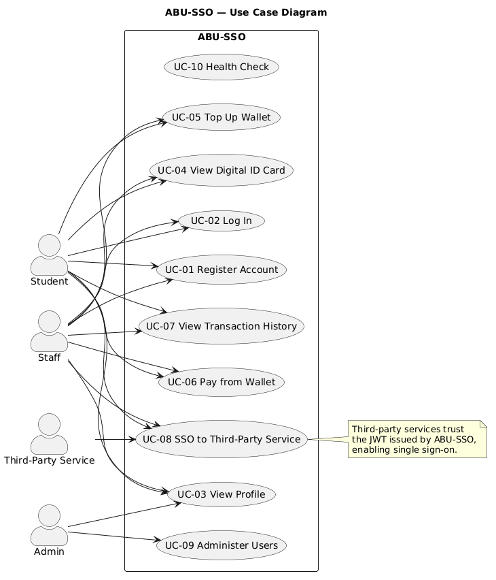
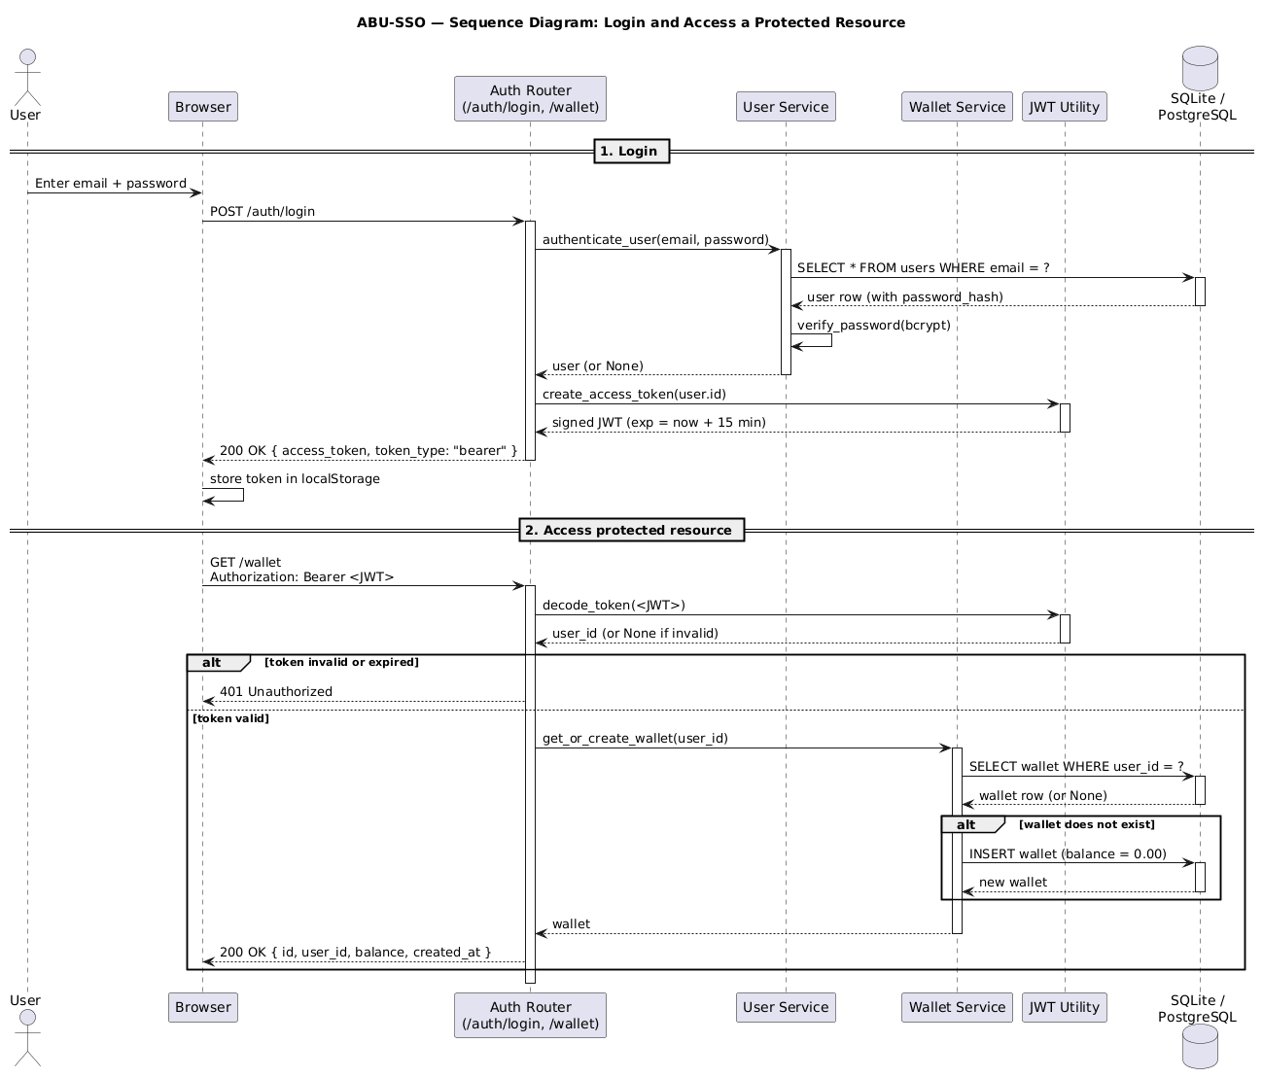
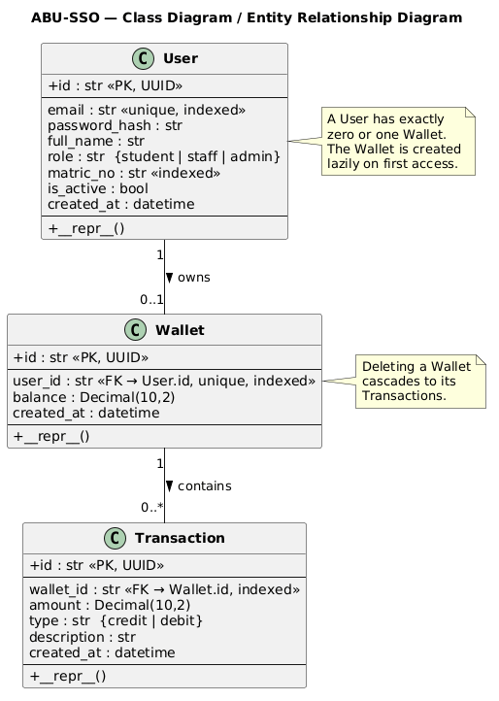
UML Diagrams
Use Case · Sequence (login) · Class diagram — see docs/diagrams/ for details

Slide 7
Architecture — Distributed SSO (Module III)
• Modular monolith IdP + 6 independent microservices
• IdP: FastAPI + SQLAlchemy + PostgreSQL
• Each service verifies JWT by calling IdP's /auth/me
• No shared session · No shared database · Stateless
• Deployed as 7 Render web services + Neon PostgreSQL

Slide 8
Data Model
• users — id, email, password_hash, matric_no (UNIQUE), role, is_active
• wallets — id, user_id (FK, UNIQUE), balance
• transactions — id, wallet_id (FK), amount, type, description, created_at
• UUID primary keys · NUMERIC(10,2) for money · cascade delete

Slide 9
Security Engineering (Module IV)
Defence-in-depth: authentication + authorization + input validation + secret management
• STRIDE threat model applied to every component
• bcrypt password hashing (cost ≥ 12)
• JWT (HS256) · 15-min expiry · ≥32-byte secret
• Role-Based Access Control via reusable middleware
• Bootstrap-only registration — no public self-registration
• Bandit SAST: 0 findings across 772 lines

Slide 10
Known Limitation — Token Transport
Explicit limitation, not an oversight — production path documented
• Current prototype: JWT passed via URL query param (?token=...)
• Why: simplest cross-origin demo between 7 services
• Risk: URLs leak via browser history, referrer headers, server logs
• Status: acknowledged in docs/SECURITY.md as prototype-only
• Production design: Backend-for-Frontend (BFF) pattern
• • Frontend never sees the JWT
• • Token stored in HttpOnly cookie managed by BFF
• • Or OIDC with short-lived authorization codes

Slide 11
Authentication & Authorization Flow
• 1. User submits matric + password
• 2. bcrypt verifies password
• 3. IdP issues signed JWT (sub, iat, exp)
• 4. Client stores token, sends as Bearer header
• 5. Protected routes call Depends(get_current_user)
• 6. Admin routes call Depends(require_role('admin'))
• 7. Non-admins get HTTP 403 Forbidden

Slide 12
Testing & Quality Assurance (Module II)
• 121 automated tests across 4 layers
• • 7 unit · 51 service · 21 integration
• • 37 authorization matrix (RBAC coverage)
• • 5 system (Playwright browser-driven E2E)
• 96% line coverage (target: 70%)
• Bandit SAST: 0 findings
• GitHub Actions CI on every push — ~50s runtime

Slide 13
Authorization Matrix — Live Evidence
• 6 authenticated endpoints × 401 without token
• 6 admin endpoints × 401 without token
• 6 admin endpoints × 403 for student role
• 6 admin endpoints × 403 for staff role
• 6 mock services × 401 without token
• 6 mock services × reject invalid token

Slide 14
Continuous Integration
• GitHub Actions on every push to main
• Job 1: unit + service + integration (116 tests)
• Job 2: E2E Playwright (5 tests)
• Avg runtime: ~50 seconds
• Red build blocks merge
• Auto-deploy to Render on green

Slide 15
UI Overview — What Users See
• Login page: matric + password form (no email)
• Dashboard:
• • Welcome banner (name, role, matric)
• • Campus wallet (balance + recent transactions)
• • Digital ID card + QR code
• • Six service cards — one login opens each
• Admin panel: user list, create-user form, role changer, activate/deactivate, wallet top-up, system stats

Slide 16
Live Demonstration
• https://abu-sso.onrender.com/login
• Login: ADMIN/001 / admin123
• Dashboard shows wallet, QR ID card, 6 service cards
• Click any service → opens independently authenticated
• Six services deployed on separate URLs

Slide 17
Demo Access — Live URLs
• Identity Provider: abu-sso.onrender.com
• Portal: abu-sso-portal.onrender.com
• LMS: abu-sso-lms.onrender.com
• Library: abu-sso-library.onrender.com
• Hostel: abu-sso-hostel.onrender.com
• Wi-Fi: abu-sso-wifi.onrender.com
• Result Checker: abu-sso-results.onrender.com
• Admin login: ADMIN/001 / admin123

Slide 18
Implementation Stats
• 17 API endpoints in the IdP
• 6 distributed SSO microservices
• 121 automated tests · 96% coverage
• 0 SAST findings (Bandit)
• 12 engineering documents
• Deployed: Render (7 web services) + Neon PostgreSQL

Slide 19
Risk Register (Module V)
• R1: JWT secret leak → .env, rotation, ≥32-byte key
• R2: Weak passwords → enforced min length
• R3: SQLite concurrency → documented PostgreSQL migration
• R4: Deadline overrun → Agile increments
• R5: Exam-day network → offline backup + recording
• R6: Dependency CVE → monthly pip-audit
• R7: Unauthorized data access → get_current_user scoping
• R8: Render cold start → documented + 30s warm-up

Slide 20
Maintenance Plan
• Corrective 20% — bug fixes, CVE patches
• Adaptive 20% — new Python, OIDC, browser support
• Perfective 50% — audit log, rate limiting, mobile UI
• Preventive 10% — pip-audit, refactor, secret rotation
• Quality gates: 121 tests + 70% coverage + Bandit clean

Slide 21
Documentation Delivered
• SRS · RTM · Design · Security · Technical Report
• Test Results · User Manual · Risk & Maintenance
• Presentation Guide · AI Use Declaration
• 3 UML diagrams (use case, sequence, class)
• All PDFs generated for hard-copy submission

Slide 22
AI Use Declaration
• Full disclosure in docs/AI_USE_DECLARATION.md
• AI used as: conversational coding tutor
• • Environment setup · error explanation · pattern suggestions
• All engineering decisions are the candidate's own:
• • Architecture · testing strategy · deployment · documentation narrative
• Every AI-suggested fix verified by running the code
• No AI used during timed assessments

Slide 23
Lessons Learned
• Iteration beats planning — features added incrementally
• Tests pay for themselves — caught real bugs
• Automate CI early — saves hours
• Documentation forces clarity
• Security is a process — Bandit found issues, bootstrap pattern closed a real vulnerability
• Cloud complexity is manageable — Render + Neon both free

Slide 24
Future Work
• OIDC / OpenID Connect with RS256 asymmetric keys
• Audit log table for admin actions
• Rate limiting via slowapi
• Refresh tokens for better UX
• Real payment gateway integration
• Native mobile app reusing the same API

Slide 25
Conclusion
• Delivered a complete, deployed, tested SSO system
• 19/19 functional requirements implemented
• 121 automated tests · 96% coverage · 0 SAST findings
• 6 distributed microservices prove real SSO
• Live on the public internet
• Ready for examination

Slide 26
Thank You
Questions?
github.com/idrismakr-png/abu-sso • abu-sso.onrender.com

