Slide 1
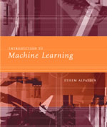
INTRODUCTION TO
Machine Learning
Lecture Slides for
ETHEM ALPAYDIN
© The MIT Press, 2004
alpaydin@boun.edu.tr
http://www.cmpe.boun.edu.tr/~ethem/i2ml

Slide 2
CHAPTER 15:
Combining Multiple Learners

Slide 3
Rationale
No Free Lunch thm: There is no algorithm that is always the most accurate
Generate a group of base-learners which when combined has higher accuracy
Different learners use different
  Algorithms
  Hyperparameters
  Representations (Modalities)
  Training sets
  Subproblems

Slide 4
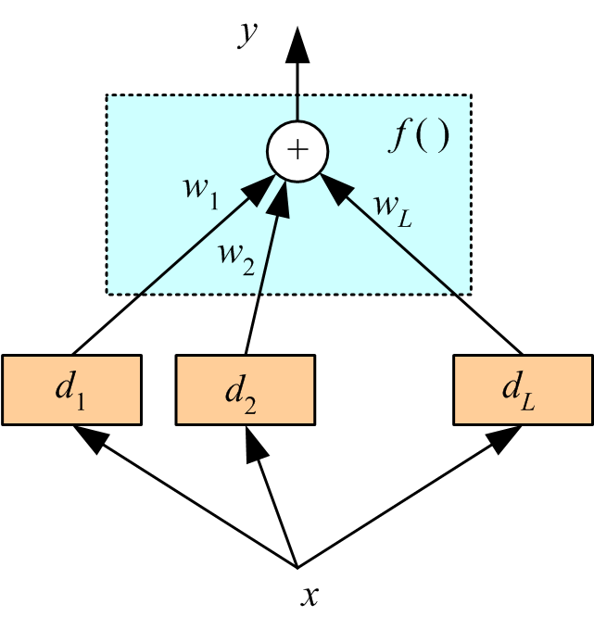
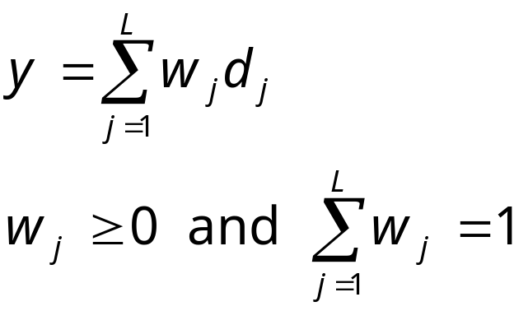
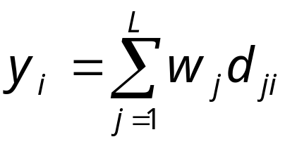
Voting
Linear combination
Classification

Slide 5
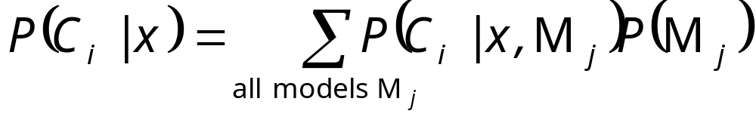
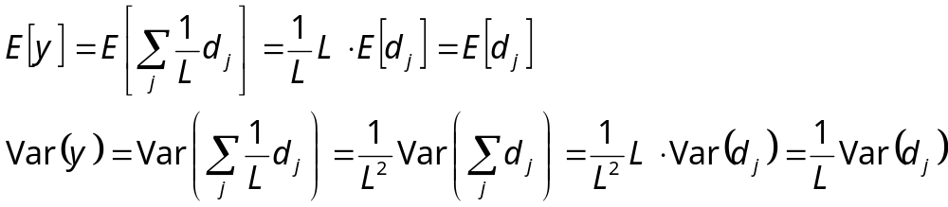
Bayesian perspective:
If d_{j} are iid
Bias does not change, variance decreases by L
Average over randomness

Slide 6
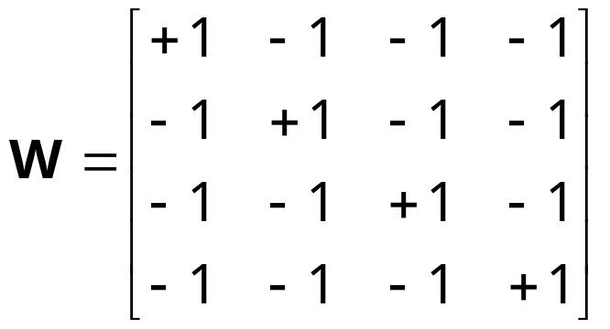
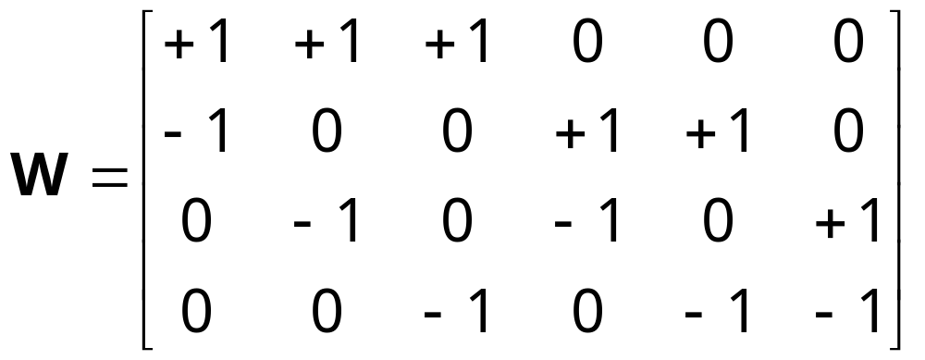
Error-Correcting Output Codes
K classes; L problems (Dietterich and Bakiri, 1995)
Code matrix W codes classes in terms of learners
One per class
L=K
Pairwise
L=K(K-1)/2

Slide 7
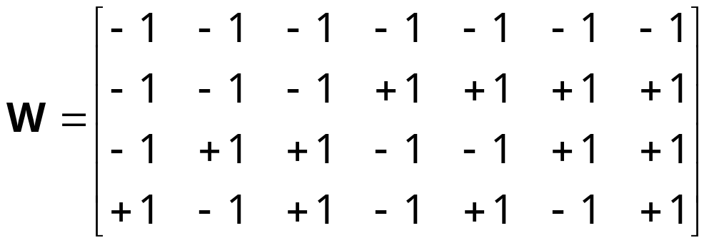
Full code L=2^{(K-1)}-1
With reasonable L, find W such that the Hamming distance btw rows and columns are maximized.
Voting scheme
Subproblems may be more difficult than one-per-K

Slide 8
Bagging
Use bootstrapping to generate L training sets and train one base-learner with each (Breiman, 1996)
Use voting (Average or median with regression)
Unstable algorithms profit from bagging

Slide 9
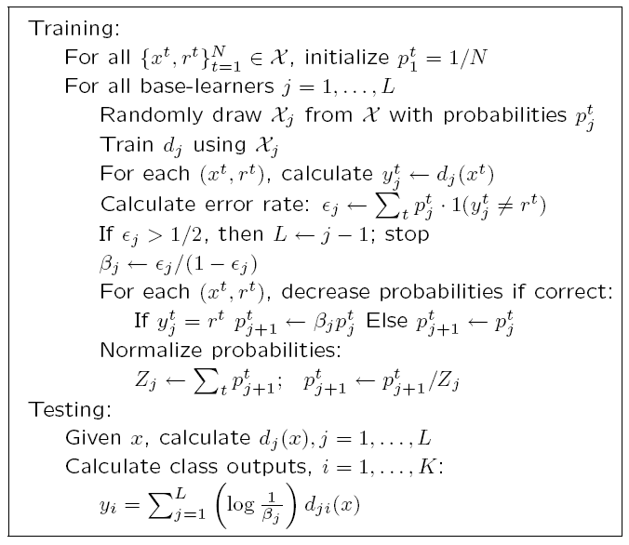
AdaBoost
Generate a sequence of base-learners each focusing on previous one’s errors
(Freund and Schapire, 1996)

Slide 10
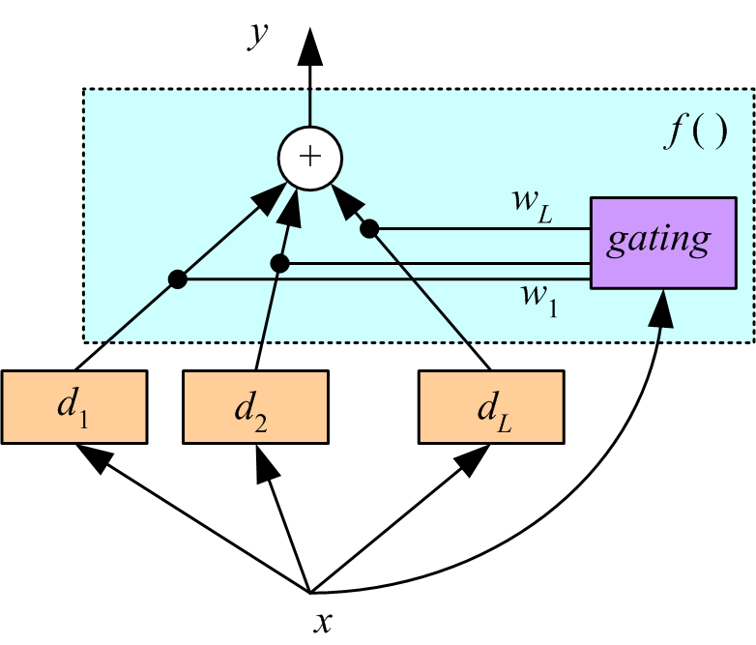
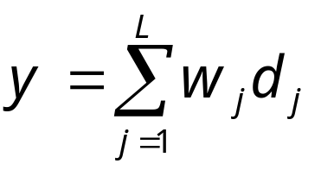
Mixture of Experts
Voting where weights are input-dependent (gating)
(Jacobs et al., 1991)
Experts or gating
can be nonlinear

Slide 11
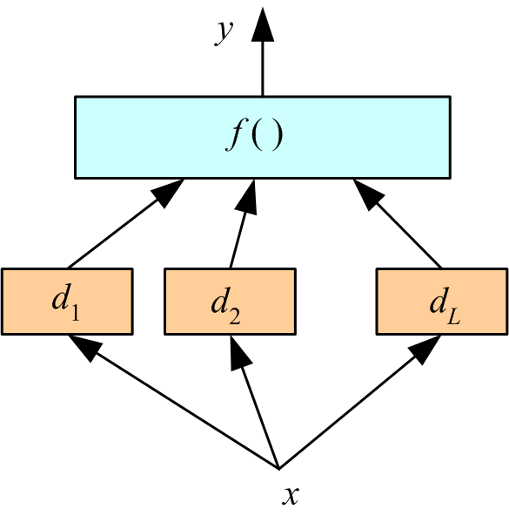
Stacking
Combiner f () is another learner (Wolpert, 1992)

Slide 12
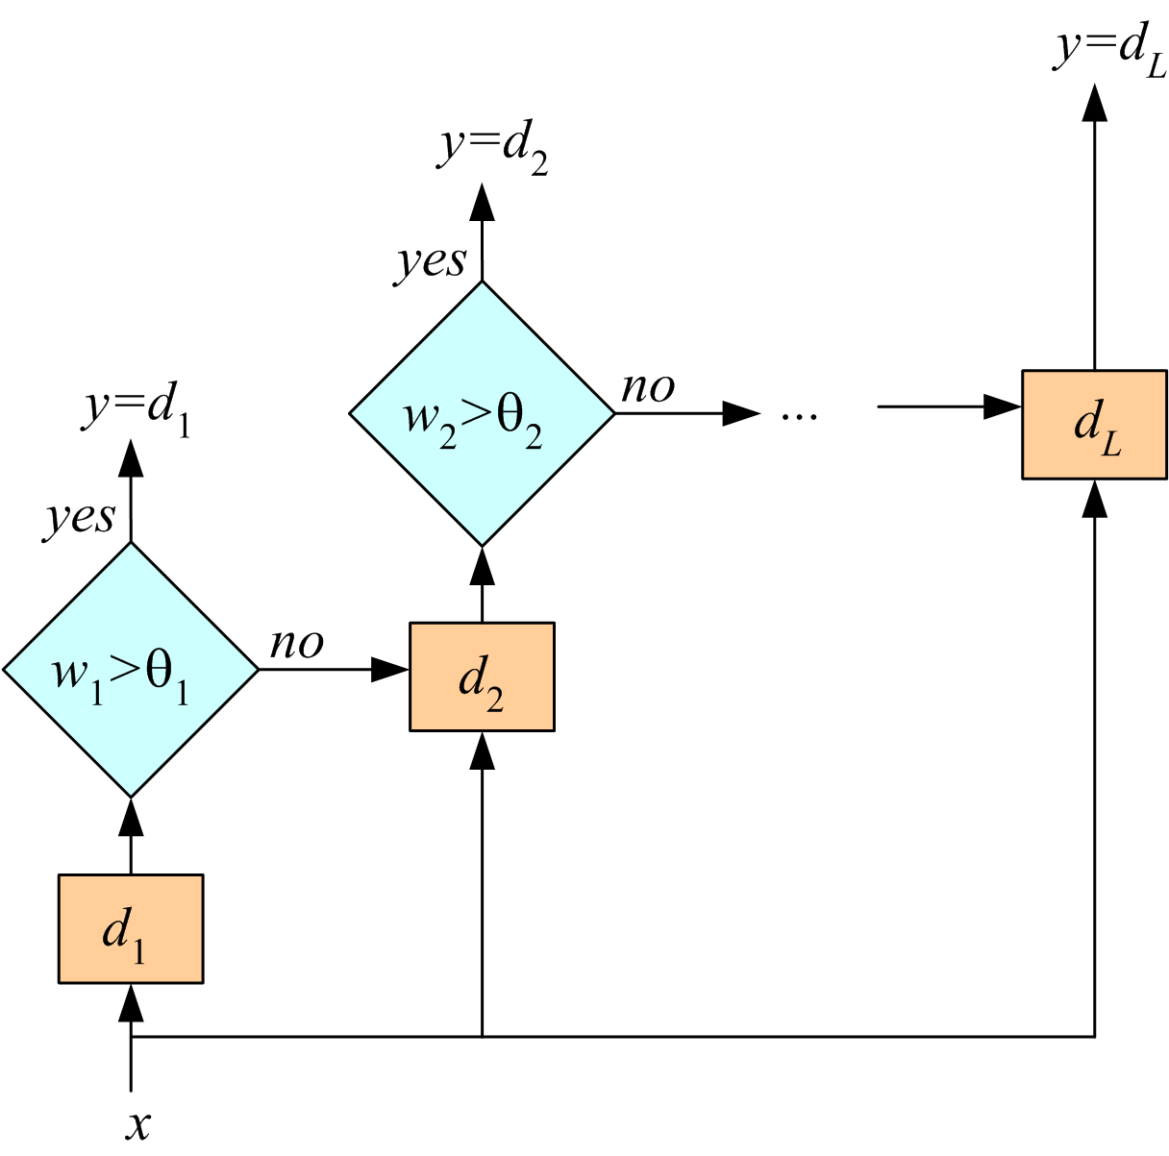
Cascading
Use d_{j} only if preceding ones are not confident
Cascade learners in order of complexity

