Slide 1

ENHANCING CROP PREDICTION THROUGH AGRICULTURAL ENVIRONMENT CHARACTERISTICS: EXPLORING FEATURE SELECTION TECHNIQUES AND CLASSIFIERS
Presented By
S. Idrus Basha
Reg no: 22091F0016
Under The Esteemed Guidance
Mr. V. Raja Sekhar (MCA,M.TECH)
Assistant Professor, Dept. of CSE
DEPARTMENT OF MASTER OF COMPUTER APPLICATIONS
RAJEEV GANDHI MEMORIAL COLLEGE OF ENGINEERING & TECHNOLOGY(AUTONOMOUS)
NANDYAL-518501, (Estd-1995)

Slide 2
INDEX
Abstract
Introduction
Existing System
Proposed System
Software Design
Modules
Proposed Algorithms
SLDC
UML Diagrams
Software and Hardware Requirements

Slide 3
Abstract
Research in agriculture is expanding. Specifically, crop prediction is important in agriculture and mostly depends on soil and environmental factors including temperature, humidity, and rainfall. Previously, farmers could choose the crop to be grown, track its development, and select when it was ready for harvest.
However, the farming community finds it challenging to do so these days due to the quick changes in environmental conditions. As a result, machine learning techniques have supplanted prediction in recent years, and this work has employed several of them to calculate crop production.
A machine learning (ML) model must function with a high degree of precision, hence it is essential to use effective feature selection techniques to transform the raw data into a dataset that is suitable for machine learning and is easily calculable.

Slide 4
Introduction
In agriculture, crop prediction is a complex process, and several models have been put out and examined in this regard.
Both biotic and abiotic variables affect plant development and quality as well as how the environment is shaped. There are three categories of biotic factors: chemical, physical, and other.
The following physical factors have been identified: soil type, topography, soil rockiness, atmosphere, water chemistry, particularly salinity; mechanical vibrations (noise, vibration); radiation (e.g., ionizing, electromagnetic, ultraviolet, and infrared); climatic conditions (temperature, humidity, air movements, and sunlight).
The following chemical factors include nitrogen oxides and derivatives, fluorine and its compounds, lead and its compounds, cadmium and its compounds, nitrogen fertilizers, pesticides, and carbon monoxide. Priority environmental toxins include sulphur dioxide and its derivatives and PAHs.
The others are dioxins and furans, asbestos, arsenic, mercury, and toxins [3]. In addition, bedrock, relief, climate, and water are biotic variables. Circumstances, each of which has an impact on its qualities. Factors that contribute to soil formation and agricultural value have a variety of effects [4].

Slide 5
Existing System
There are three areas in which the methodology improves upon current practices. They are
First, a functional methodology is proposed using a distant detecting network.
Next, a new dimensionality reduction process is introduced that combines long-term memory and a convolutional neural network (CNN).
Lastly, the spatio-transient structure of the data is examined and improved in accuracy using a Gaussian process.
It provides details on handling tactics, order and approval processes, precision assessment, CDL(Cropland Data Layer) item specifics, and the process for estimating product costs. The use of Landsat to obtain satellite imagery that enables environmental remote sensing was suggested by Hansen and Loveland.

Slide 6
Disadvantages
The RECURSIVE FEATURE ELIMINATION (RFE) feature of the system is not implemented.
The system is not put into use strategies for sampling that are used in pre-processing to optimize prediction performance and balance the dataset

Slide 7
Proposed System
The vote of flexible, impartial, indistinct classifiers in decision trees is the basis of the Boruta classification algorithm, which is based on random forests. By estimating the loss of classification accuracy brought on by the random permutation of attributes inside objects, the significance of a feature is determined.
To calculate the Z score, which measures average changes in mean accuracy loss among crops, the average loss of accuracy is divided by the standard deviation. This yields the average and standard deviation of the accuracy loss.
To create a `shadow' attribute, the values of the initial attributes are randomly rearranged across objects for each tree. The significance of each attribute is assessed by analyzing all the system's attributes; because fluctuations are random, the shadow attributes serve as a guide to identify the most significant ones. As expected, the shadow attributes have a significant impact on accuracy, so values will be shuffled repeatedly to achieve the best outcomes.

Slide 8
Advantages
The RFE method begins with the complete dataset and is a wrapper feature selection strategy. Using a ranking mechanism that is essential to the RFE technique, the dataset is ranked from best to worst depending on which salient characteristics are chosen.
The primary benefit of the RFE over other techniques is its ability to definitively confirm each feature's function in processing the model's output and to exclude features only on the basis of their effectiveness.

Slide 9
System Design
Actual Problem
The actual problem addressed by crop prediction systems based on characteristics of the agricultural environment is the uncertainty and risk faced by farmers in determining the optimal crop choices for their specific conditions. Farmers need to make informed decisions regarding which crops to plant based on factors such as soil quality, weather patterns, market demand, and expected yield. However, this decision-making process is complex and often involves a significant amount of uncertainty.

Slide 10
Solution:
Data Integration: Aggregating and integrating diverse datasets related to soil characteristics, weather conditions, historical crop yields, market prices, and agronomic practices.
Feature Selection: Identifying the most relevant features or variables that influence crop performance using techniques such as correlation analysis, feature importance ranking, and dimensionality reduction.
Model Development: Training machine learning models, such as decision trees, random forests, support vector machines, or neural networks, to predict crop yields or types based on the selected features.
Validation and Evaluation: Assessing the performance of the models using cross-validation techniques and relevant evaluation metrics to ensure their accuracy and reliability.
Deployment and Integration: Integrating the trained models into user-friendly software platforms or decision support systems that provide farmers with actionable recommendations for crop selection and management.
Continuous Improvement: Updating the models periodically with new data and insights to adapt to changing environmental conditions and improve predictive accuracy over time.

Slide 11
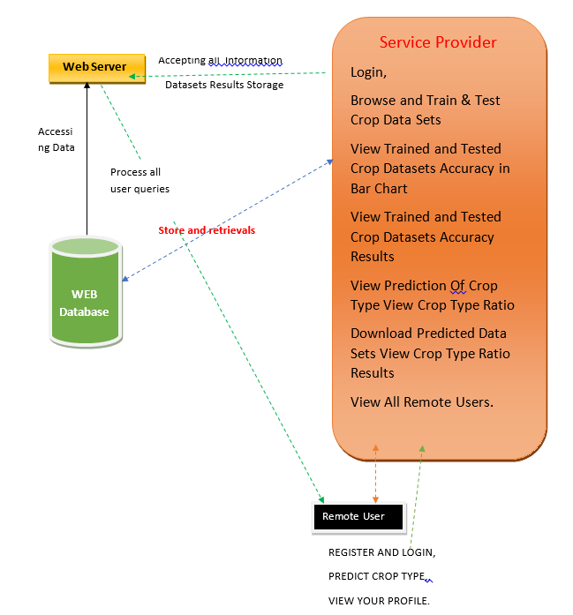
Architecture

Slide 12
Modules
1. Service Provider
In this module, the Service Provider has to login by using valid user name and password. After login successful he can do some operations such as
Login, Browse and Train & Test Crop Data Sets, View Trained and Tested Crop Datasets Accuracy in Bar Chart, View Trained and Tested Crop Datasets Accuracy Results, View Prediction Of Crop Type ,View Crop Type Ratio, Download Predicted Data Sets, View Crop Type Ratio Results, View All Remote Users.
2. View and Authorize Users
In this module, the admin can view the list of users who all registered. In this, the admin can view the user’s details such as, user name, email, address and admin authorizes the users.
3. Remote User
In this module, there are n numbers of users are present. User should register before doing any operations. Once user registers, their details will be stored to the database. After registration successful, he has to login by using authorized user name and password. Once Login is successful user will do some operations like REGISTER AND LOGIN, PREDICT CROP TYPE, VIEW YOUR PROFILE

Slide 13
Proposed Algorithms
1. Decision tree classifiers
Decision tree classifiers are used successfully in many diverse areas. Their most important feature is the capability of capturing descriptive decision making knowledge from the supplied data. Decision tree can be generated from training sets. The procedure for such generation based on the set of objects (S), each belonging to one of the classes C1, C2… Ck is as follows:
Step 1. If all the objects in S belong to the same class, for example Ci, the decision tree for S consists of a leaf labelled with this class
Step 2. Otherwise, let T be some test with possible outcomes O1, O2,…, On. Each object in S has one outcome for T so the test partitions S into subsets S1, S2,… Sn where each object in Si has outcome Oi for T. T becomes the root of the decision tree and for each outcome Oi we build a subsidiary decision tree by invoking the same procedure recursively on the set Si.
2. K-Nearest Neighbours(KNN)Algorithm:
K-Nearest Neighbor is one of the simplest Machine Learning algorithms based on Supervised Learning technique.
K-NN is a non-parametric algorithm.
lazy learner
K-NN algorithm can be used for Regression as well as for Classification but mostly it is used for the Classification problems.

Slide 14
Naive Bayes is a simple yet powerful algorithm used in machine learning for classification tasks. At its core, Naive Bayes relies on Bayes' theorem, which calculates the probability of a hypothesis given the evidence.
Understanding Bayes Theorem: Bayes' theorem is a fundamental concept in probability theory that calculates the probability of a hypothesis (H) given some evidence (E). It is represented as: P(H|E) = (P(E|H) * P(H)) / P(E), where:
P(H|E) is the probability of the hypothesis given the evidence.
P(E|H) is the probability of the evidence given the hypothesis.
P(H) is the prior probability of the hypothesis.
P(E) is the prior probability of the evidence.
Applying Naive Bayes for Classification: In the context of classification tasks, Naive Bayes makes the "naive" assumption that the features (or variables) are independent of each other given the class label. Despite this simplification, Naive Bayes often performs well in practice and is computationally efficient.
Making Predictions: Once the model is trained, you can use it to make predictions on new, unseen data. Naive Bayes calculates the probability of each class given the features of the input data using Bayes' theorem. The class with the highest probability is then assigned as the predicted class label for the input data.

Slide 15
3. Random Forest Algorithm:
Random forest is a commonly-used machine learning algorithm.
The first algorithm for random decision forests was created in 1995 by Tin Kam Ho using the random subspace method, which, in Ho's formulation, is a way to implement the "stochastic discrimination" approach to classification proposed by Eugene Kleinberg.
Random forests are frequently used as "blackbox" models in businesses, as they generate reasonable predictions across a wide range of data while requiring little configuration

Slide 16
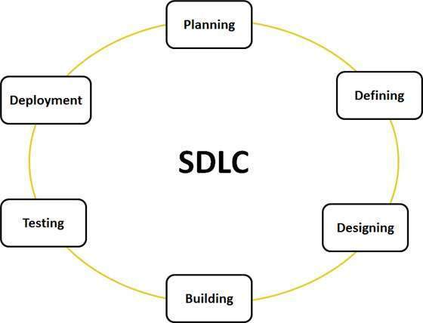
Software Development Life Cycle

Slide 17
UML DIAGRAMS

Slide 18
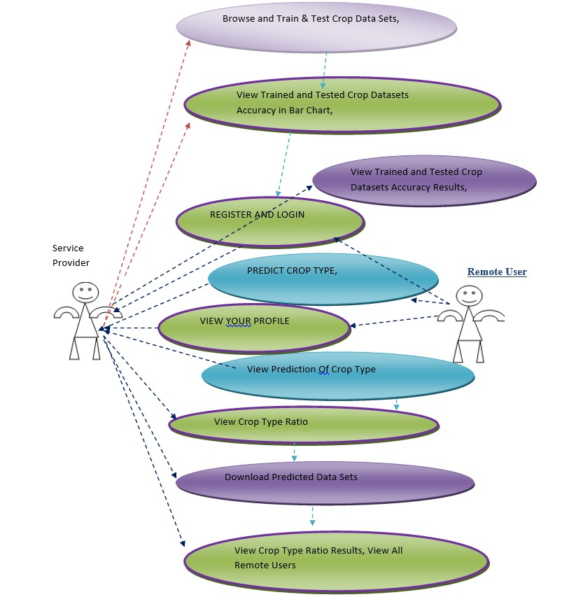
USE CASE DIAGRAM

Slide 19
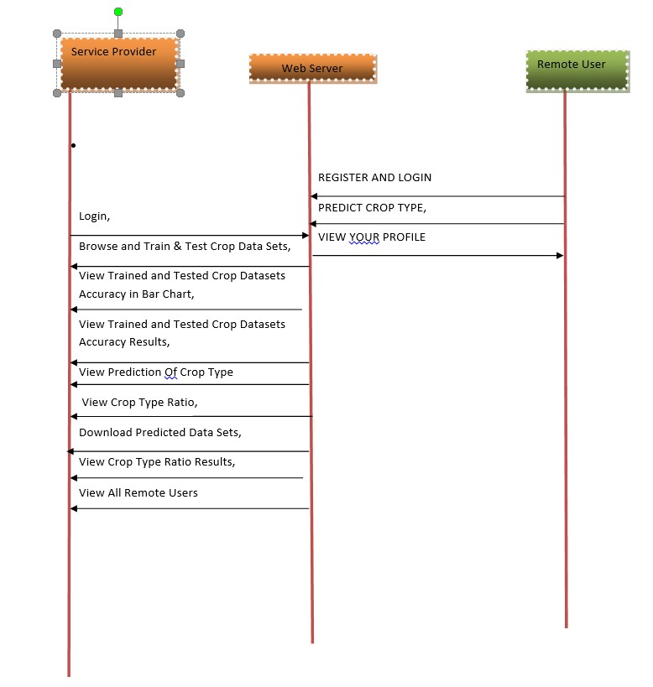
SEQUENCE DIAGRAM

Slide 20
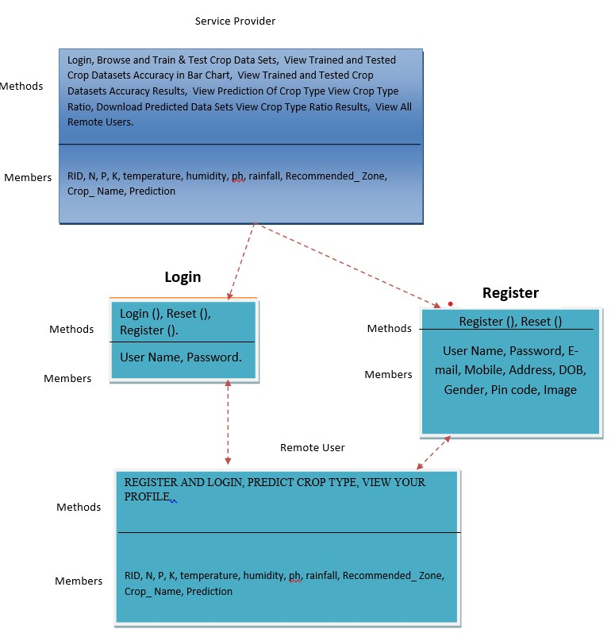
CLASS DIAGRAM

Slide 21
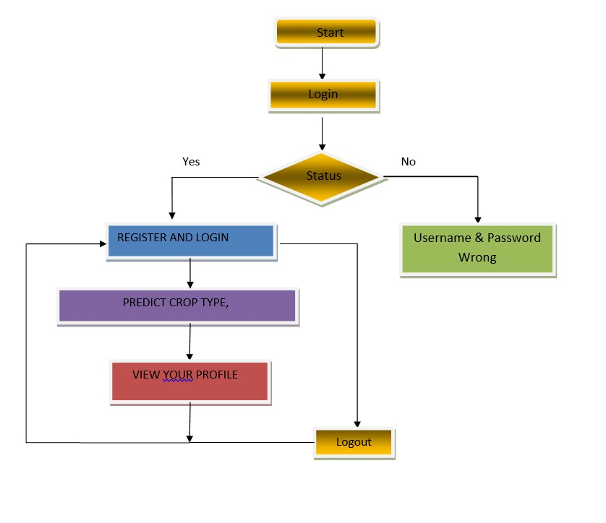
FLOW CHART DIAGRAM

Slide 22
System Specifications
Software Requirements
Operating System : Windows 10/11
Programming : Python
Front End : Python
Hardware Requirements
Processor : Intel core i5
RAM : 4 GB
Hard disk : 512 GB

Slide 23


