Slide 1

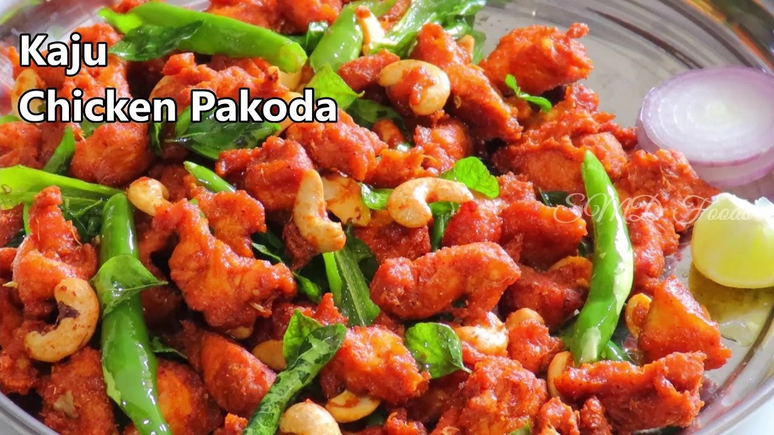
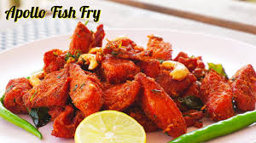
TODAY’S SPECIAL
KAJU CHICKEN PAKODA
APOLLO FISH FRY

