Slide 1
CineMatch:
Movie Recommendation System
Inchara M P (2023BCS0129)
Jadi Hemarupini (2023BCS0126)
Deepanjali Tudu (2023BCS0066)
Praneetha Pillai (2023BCS0207)

Slide 2
Problem Statement
Objective
Too many movies available (50,000+)
Users can’t easily find what to watch
Most systems recommend only popular movies
Need better and personalised recommendations
Analyse movie dataset
Build recommendation system using TF-IDF
Use similarity to suggest movies
Improve recommendation quality

Slide 3
Dataset
Source: TMDB (Kaggle)
45,000+ movies
Important fields: title, genres, overview
Data needed cleaning before use
link:https://www.kaggle.com/datasets/rounakbanik/the-movies-dataset?select=movies_metadata.csv

Slide 4
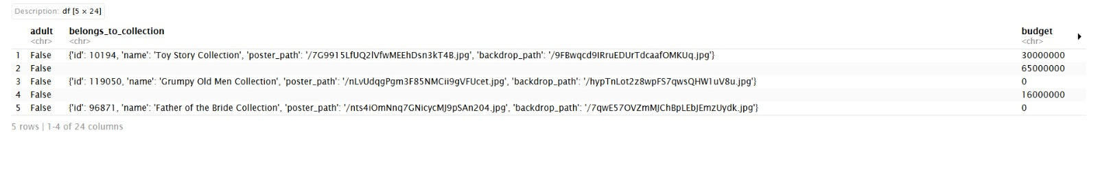
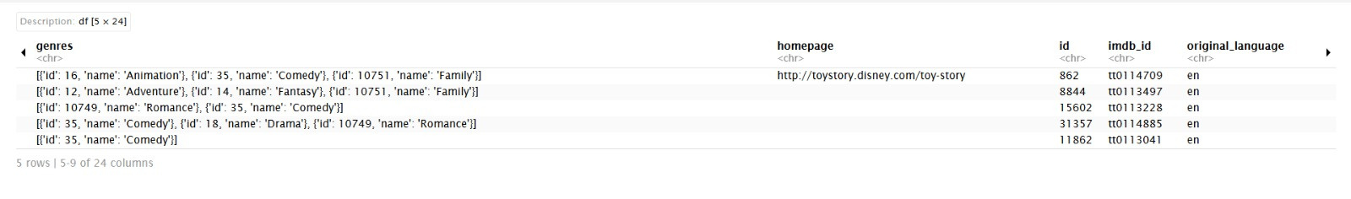
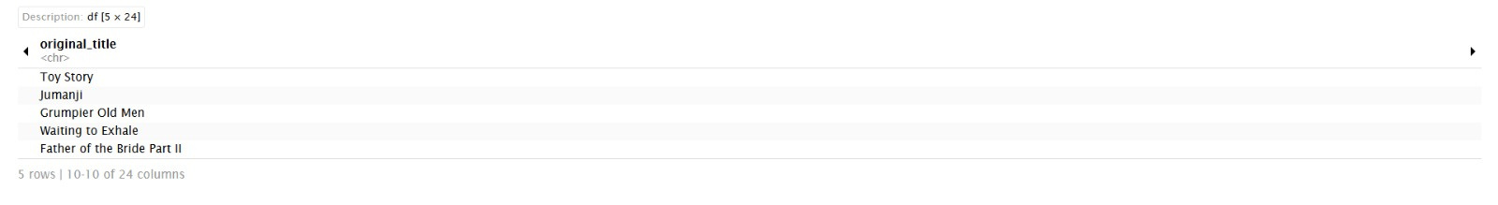
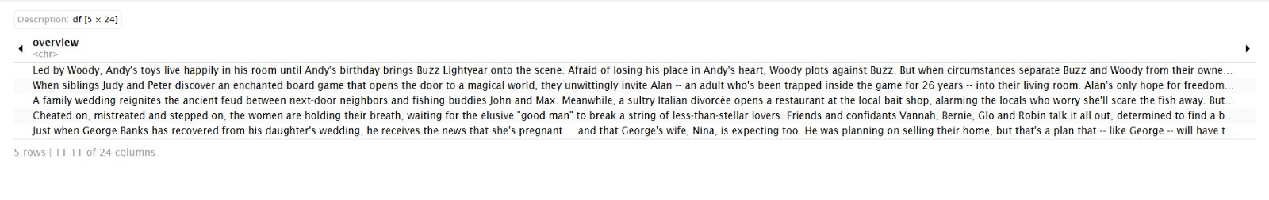

Slide 5
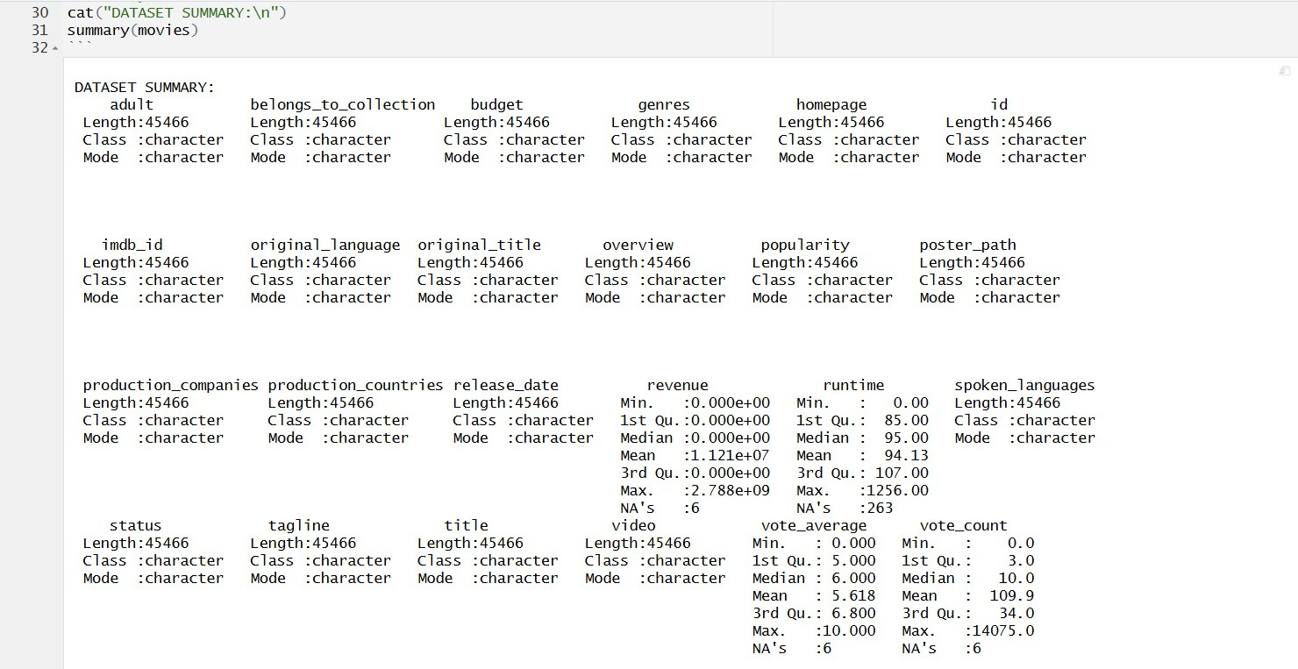

Slide 6
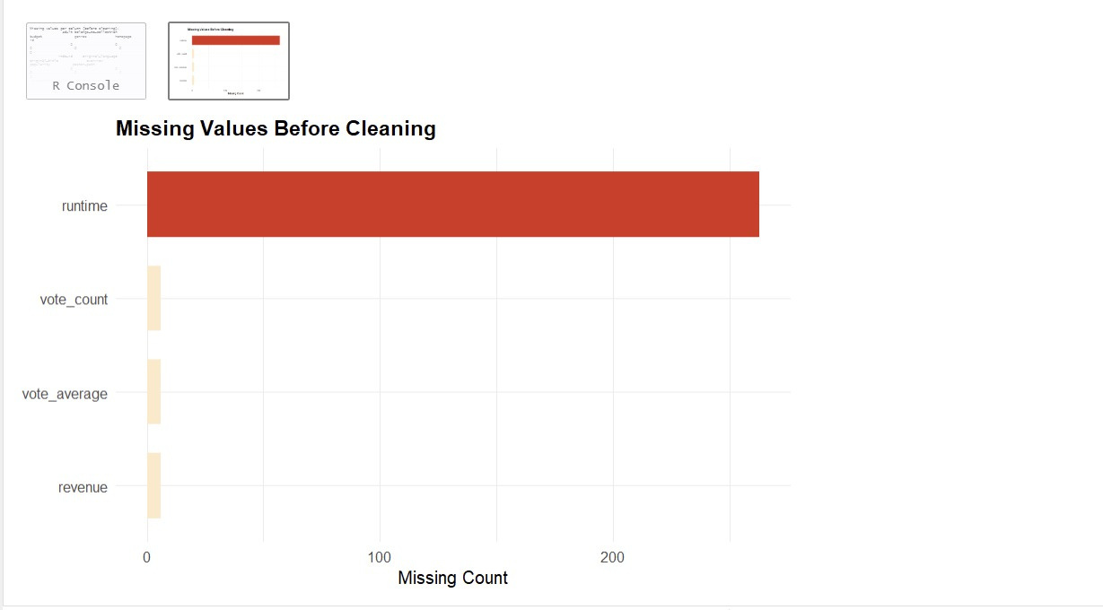
Missing Value Analysis
Identified missing values across all columns before cleaning
Columns with significant missing data: overview, genres, popularity
Visualised distribution of missingness to prioritise cleaning steps

Slide 7
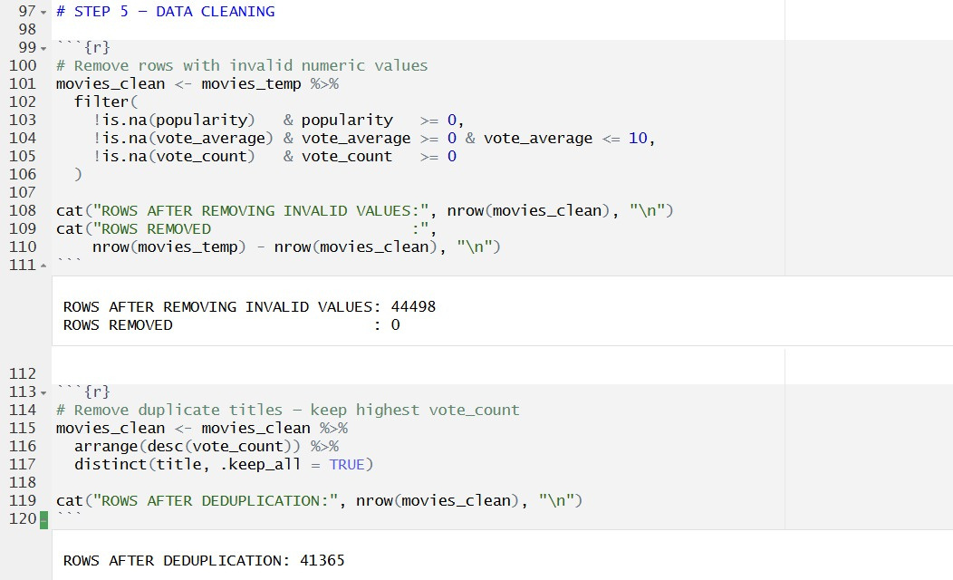
Data Cleaning
Removed rows with missing title, genre, or overview (nchar > 10)
Identified and removed non-numeric popularity values
Filtered invalid ranges: vote_average 0–10, popularity ≥ 0
Deduplicated by title — kept row with highest vote_count
Raw 45,000 → cleaned dataset ready for modelling

Slide 8
Data Preprocessing
Data preprocessing was performed to prepare the dataset for modeling.
Handling missing values
Cleaning and formatting text data
Extracting genre information
Creating content feature (genres + overview)
Raw Data → Clean Data → Feature Creation

Slide 9
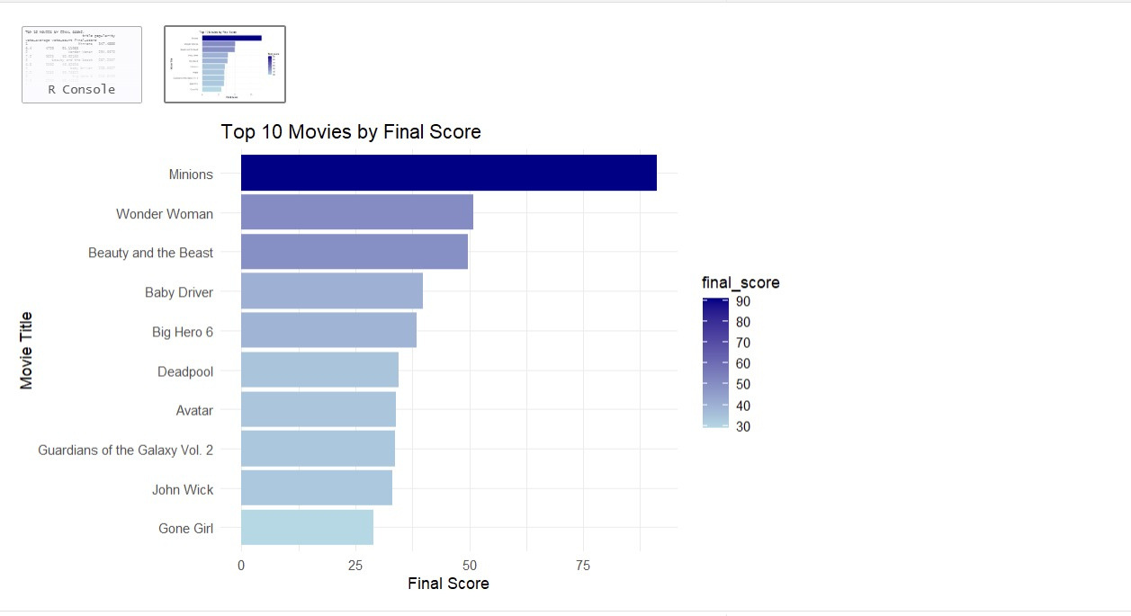
Feature Engineering
Scaled popularity, rating, votes
Used log transform
Created final_score
Used for ranking movies

Slide 10
Exploratory Data Analysis
Visualizations Used
• Ratings Distribution (Histogram)
• Popularity Distribution (Boxplot)
• Rating vs Popularity (Scatter Plot)
• Genre Distribution (Bar Chart)
Observations
• Ratings mostly between 6–7 (normal distribution)
• Popularity is highly skewed with few extreme values
• Weak relation between rating & popularity
• Drama, Comedy, Thriller are most common genres

Slide 11
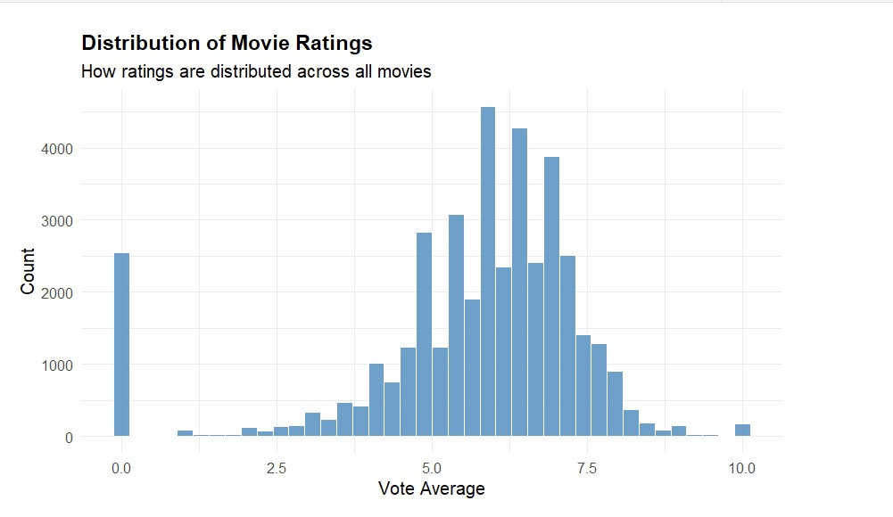
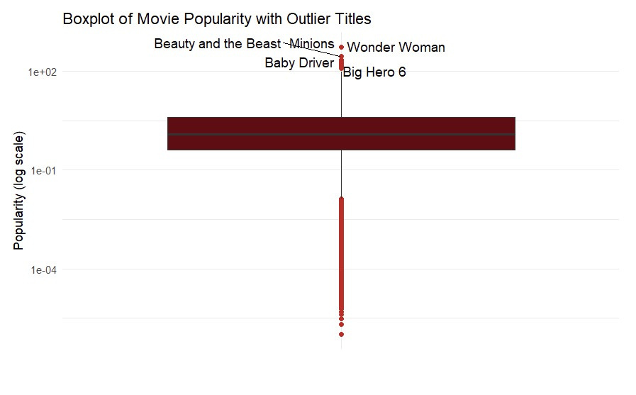
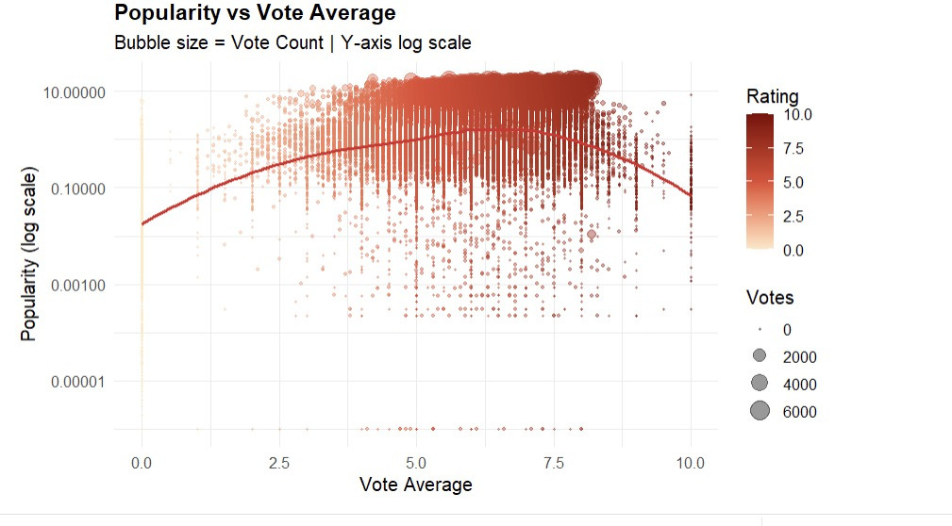
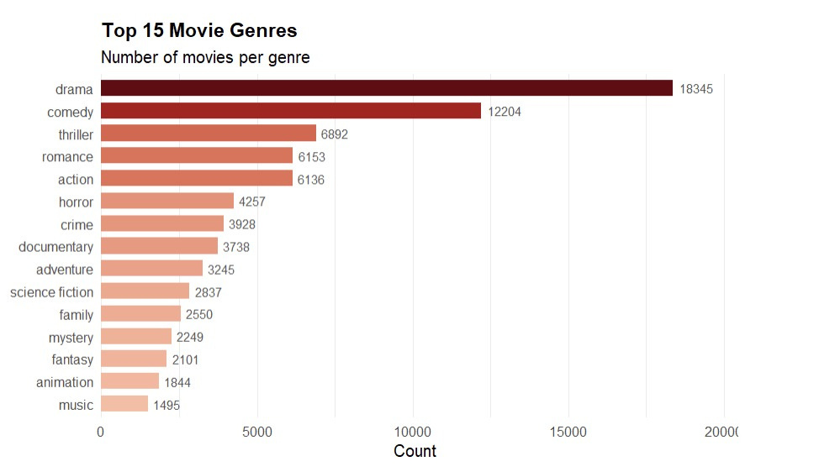

Slide 12
Text Preprocessing Pipeline
Pipeline
Raw Text → Lowercase → Remove Punctuation/Numbers
→ Remove Stop Words → Remove Noise Words → Strip Whitespace → Corpus
Content Used
Combined: genres, keywords, tagline, overview
Genres repeated twice to increase importance
Noise Words Removed
film, movie, story, life, world
man, woman, one, two
find, must, new, will
Result
Clean text data ready for TF-IDF

Slide 13
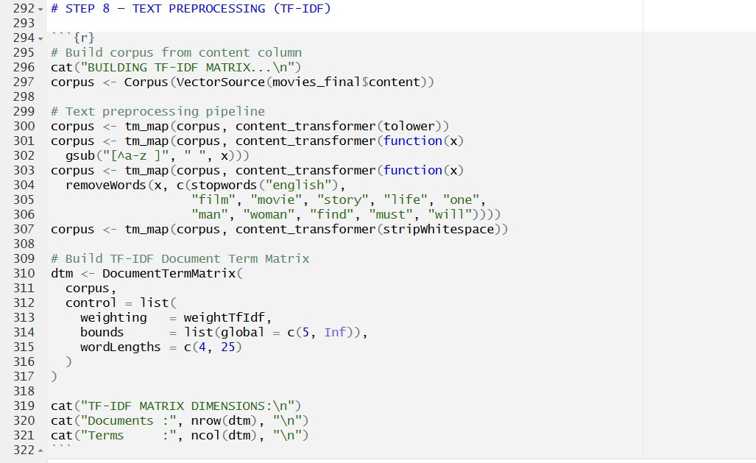

Slide 14
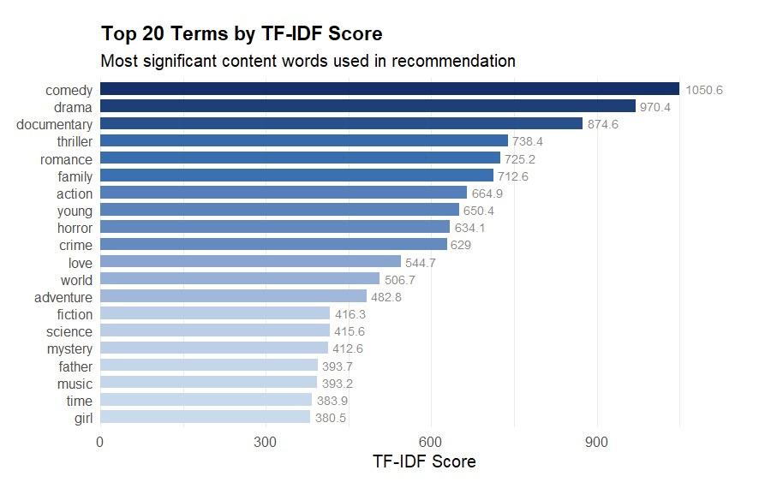
TF-IDF Vectorisation
TF-IDF = Term Frequency × Inverse Document Frequency
• Gives higher weight to words frequent in one movie but rare overall
• Parameters: minimum 2 documents per term, word length ≥ 3
• Result: sparse matrix (3000 × 8037)
• Each row represents a movie as
a weighted term vector

Slide 15
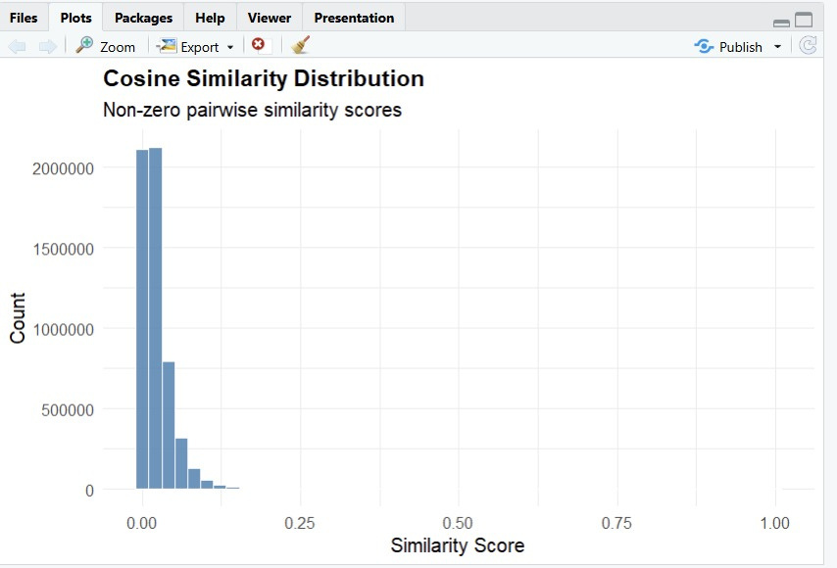
Cosine Similarity Matrix
TF-IDF matrix normalised (L2 norm per row)
Cosine similarity = dot product of two normalised vectors
Result: 3,000 × 3,000 pairwise similarity matrix
Value of 1 = identical content, 0 = no overlap
Matrix computed as: tfidf_norm %*% t(tfidf_norm)

Slide 16
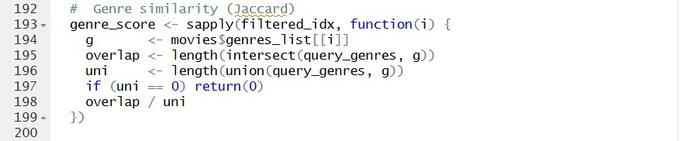
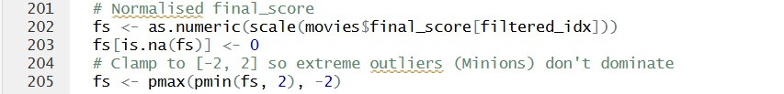
Hybrid Model
Signal Weight
----------------------------------------------
Cosine similarity (TF-IDF content) 55%
Jaccard genre similarity 40%
Normalised final score (quality) 5%

Slide 17
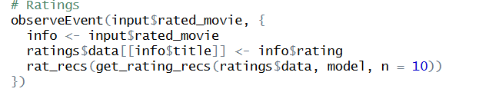
Rating-Based Personalisation
• User rates movies (1–5 stars)
• System builds user profile from liked movies
• profile = Σ (rating/5) × similarity
• Recommends movies based on user preferences

Slide 18
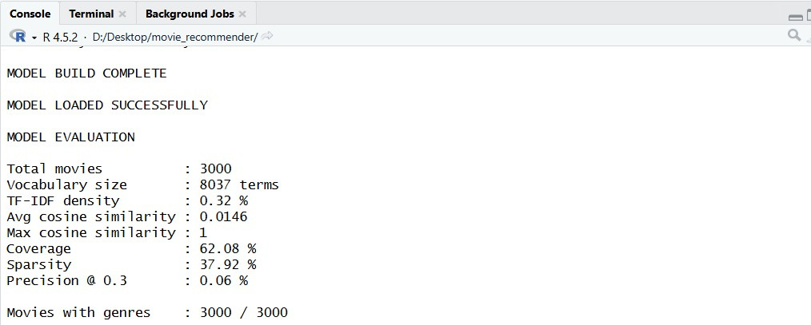
Model Evaluation
Key Findings
• Genre is the strongest signal for recommendations
• Popularity is highly skewed → log transform is needed
• TF-IDF (min 2 terms) gives better results than stricter limits
• Fixing genre parsing improved recommendation accuracy
• Similarity matrix is sparse → movies share less common words

Slide 19
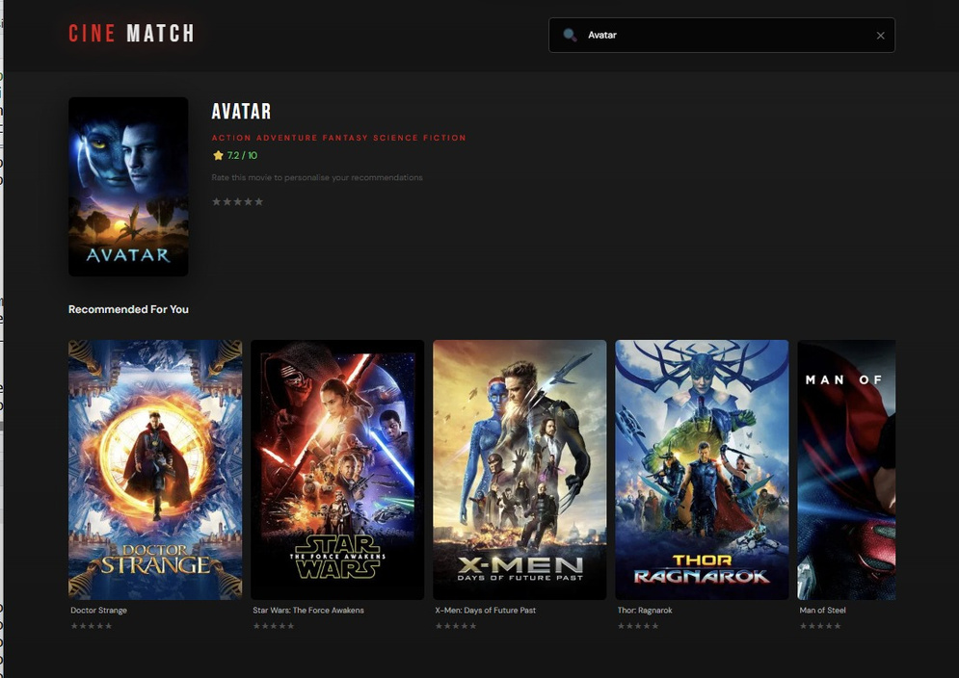
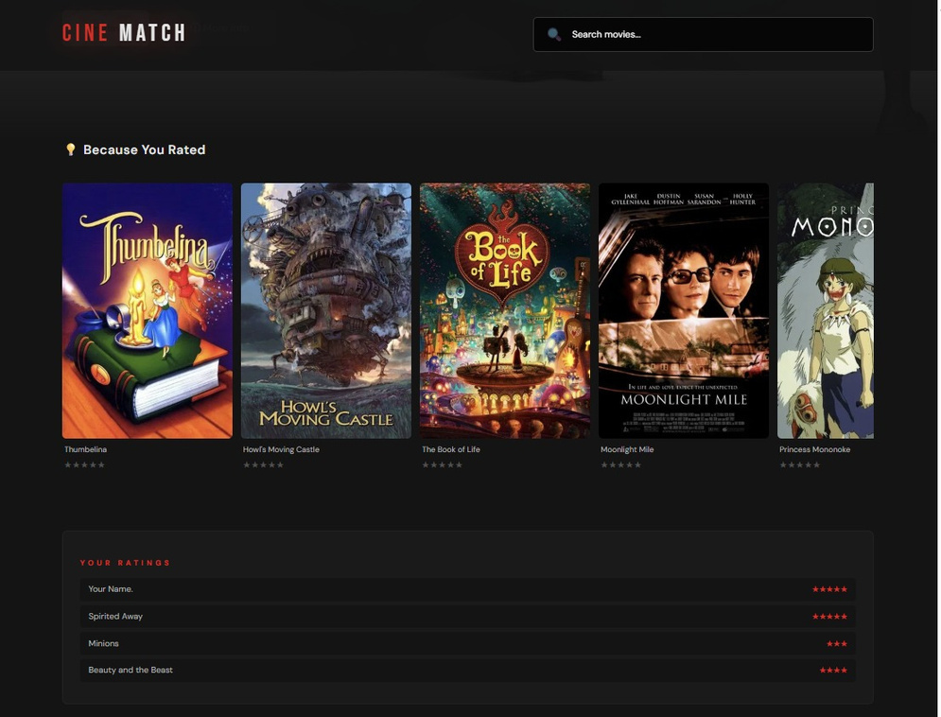
App Demo
Recommendations for the selected movie
Recommendations based on ratings

Slide 20
Github Link:
github.com/idsaturn07/movie_recommendation_system_in_R
Thank You

