Slide 1
HyeonJin Sim System Semiconductor Engineering University of Sangmyung
BUS MATRIX
summer 2023

Slide 2
Contents
이전까지 진행 상황
INTERNAL SRAM CONTROLLER
EXTERNAL SRAM CONTROLLER
BUS MATRIX Block diagram
BUS MATRIX 진행 방법 및 검증 방법

Slide 3
이전까지 진행 상황
TESTBENCH
TESTBENCH
TOP
TOP
ADP
INTERNAL
SRAM
CONTROLLER
ADP
EXTERNAL
SRAM
CONTROLLER
EXTERNAL
SRAM
SRAM
<INTERNAL SRAM CONTROLLER>
<EXTERNAL SRAM CONTROLLER>

Slide 4
BUS MATRIX Block diagram
TESTBENCH
TOP
BUS
MATRIX
INTERNAL
SRAM
CONTROLLER
ADP
SRAM
EXTERNAL
SRAM
CONTROLLER
SRAM
<BUS MATRIX Block diagram>

Slide 5
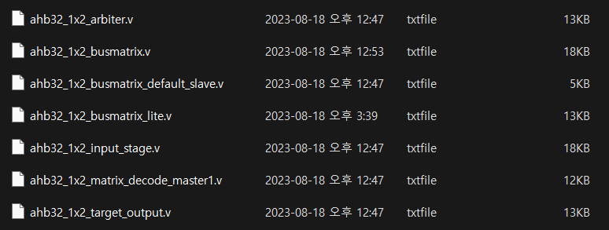
BUS MATRIX 진행 방법 및 검증 방법
STEP 0. 1X2 BUS MATRIX 생성
PERL 파일 실행
Slave_0_addr = 32’h0000_0000~32’h0FFF_FFFF
Slave_1_addr = 32’h1000_0000~32’h1FFF_FFFF

Slide 6
BUS MATRIX 진행 방법 및 검증 방법
STEP 1. Block diagram
ADP(TESTBENCH)
TOP
BUS
MATRIX
INTERNAL
SRAM
CONTROLLER
SRAM
EXTERNAL
SRAM
CONTROLLER
SRAM

Slide 7
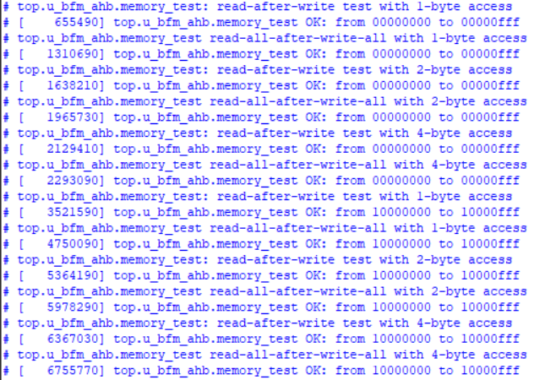
BUS MATRIX 진행 방법 및 검증 방법
STEP 1. 검증
내부 SRAM Controller 주소
외부 SRAM Controller 주소

Slide 8
BUS MATRIX 진행 방법 및 검증 방법
STEP 2. Simulation
TESTBENCH
TOP
BUS
MATRIX
INTERNAL
SRAM
CONTROLLER
ADP
SRAM
EXTERNAL
SRAM
CONTROLLER
SRAM
<BUS MATRIX Block diagram>

Slide 9
BUS MATRIX 진행 방법 및 검증 방법
STEP 2. Simulation testbench task
task host_to_fpga;
input [7:0] char_in;
begin
serial_in = 0;
#(BAUD_TIME);
// Data bits (payload)
for (i = 0; i < 8; i = i + 1)
begin
serial_in = char_in[i];
#(BAUD_TIME);
end
// Stop bit
serial_in = 1;
#(BAUD_TIME);
$display("[time %t, sim. cycle %d] [Host (tb) --> FPGA_SERIAL_RX] Sent char 8'h%h", $time, cycle, char_in);
repeat (2) @(posedge clk);
end
endtask
task fpga_to_host;
input [7:0] expected_char;
begin
while (TxD === 1) begin
@(posedge clk);
end
for (j = 0; j < 10; j = j + 1) begin
char_out[j] = TxD;
#(BAUD_TIME);
end
if (expected_char === char_out[8:1])
test_status = "PASSED";
else
test_status = "FAILED";
begin
$display(“[ %s ]“, test_status);
end
endtask
<TX task>
<RX task>

Slide 10
BUS MATRIX 진행 방법 및 검증 방법
STEP 2. Simulation testvector file (python file)
fork
begin
host_to_fpga("A");
host_to_fpga("0");
host_to_fpga("\n");
end begin
wait_char(LF);
wait_char(CR);
wait_char(PROMPT);
end
join
fork begin
host_to_fpga("W");
host_to_fpga("b");
host_to_fpga("d");
host_to_fpga("6");
host_to_fpga("4");
host_to_fpga("4");
host_to_fpga("4");
host_to_fpga("a");
host_to_fpga("7");
host_to_fpga("\n");
end begin
wait_char(LF);
wait_char(CR);
wait_char(PROMPT);
end
join
fork
begin
host_to_fpga("A");
host_to_fpga("0");
host_to_fpga("\n");
end begin
wait_char(LF);
wait_char(CR);
wait_char(PROMPT);
end
join
fork begin
host_to_fpga("R");
host_to_fpga("\n");
end
begin
fpga_to_host("R");
fpga_to_host(" ");
fpga_to_host("0");
fpga_to_host("x");
fpga_to_host("b");
fpga_to_host("d");
fpga_to_host("6");
fpga_to_host("4");
fpga_to_host("4");
fpga_to_host("4");
fpga_to_host("a");
fpga_to_host("7");
end
join
<WRITE_UART_TESTBENCH>
<READ_UART_TESTBENCH>

Slide 11
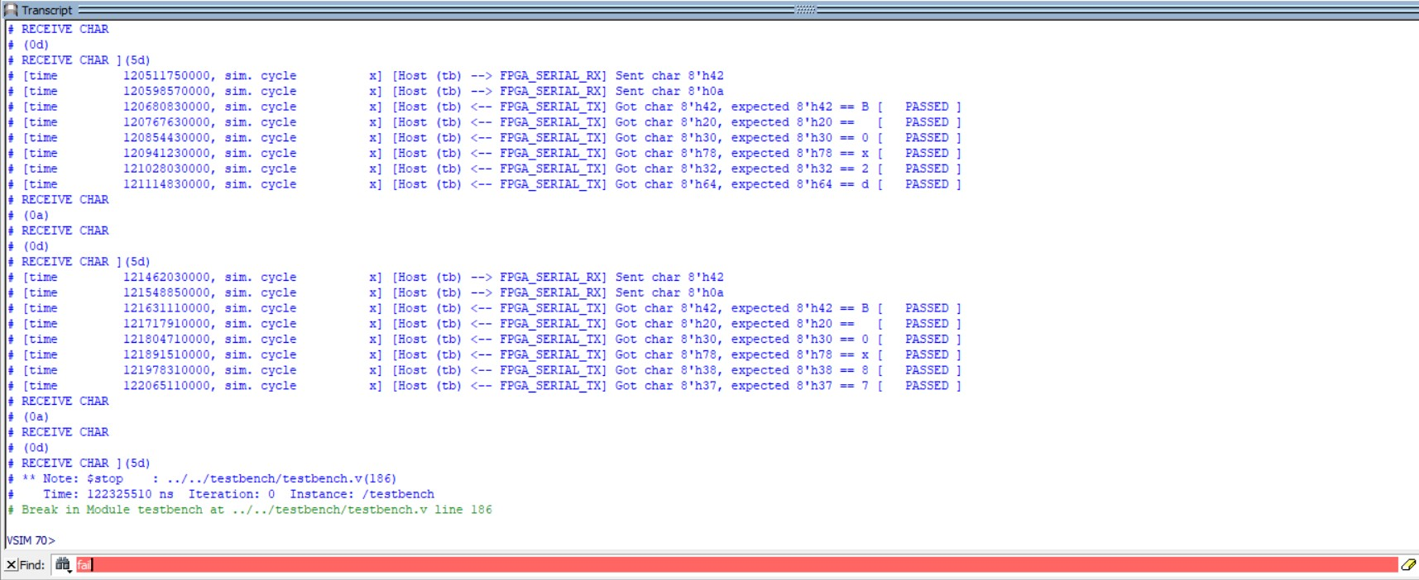
BUS MATRIX 진행 방법 및 검증 방법
STEP 2. Simulation testbench 결과

Slide 12
BUS MATRIX 진행 방법 및 검증 방법
STEP 3. FPGA 합성
TESTBENCH
TOP
BUS
MATRIX
INTERNAL
SRAM
CONTROLLER
ADP
SRAM
EXTERNAL
SRAM
CONTROLLER
SRAM
<BUS MATRIX Block diagram>

Slide 13
BUS MATRIX 진행 방법 및 검증 방법
STEP 3. FPGA 합성 검증(C++)
INTERNAL SRAM CONTROLLER
32’h0000_0000 ~ 32’h0000_03FF까지 쓰기
32’h0000_0000 ~ 32’h0000_03FF까지 읽기
32’h0000_0000 ~ 32’h0000_03FF까지 쓰고 읽기
EXTERNAL SRAM CONTROLLER
32’h1000_0000 ~ 32’h1000_03FF까지 쓰기
32’h1000_0000 ~ 32’h1000_03FF까지 읽기
32’h1000_0000 ~ 32’h1000_03FF까지 쓰고 읽기

Slide 14
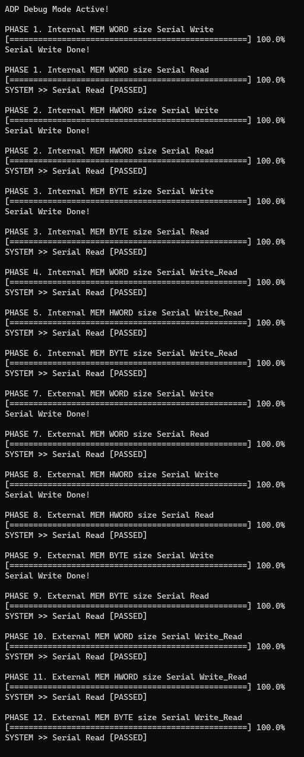
BUS MATRIX 진행 방법 및 검증 방법
STEP 3. FPGA 합성 검증

Slide 15
감사합니다.

