Slide 1
202121369 오호빈 System Semiconductor Engineering University of Sangmyung
2023 SUMMER Bootcamp
CPU Seminar
Summer vacation 2023

Slide 2
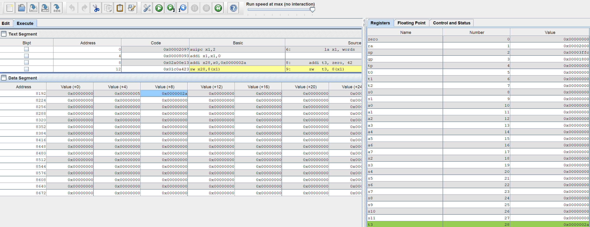



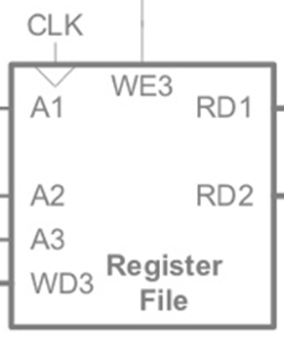
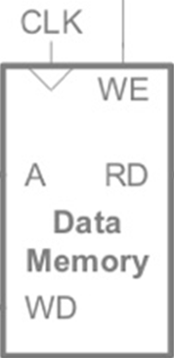
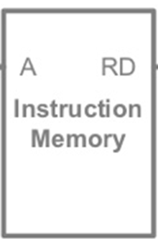
Week01
RISC-V Assembly Language
Digital Building block design & Simulation

Slide 3
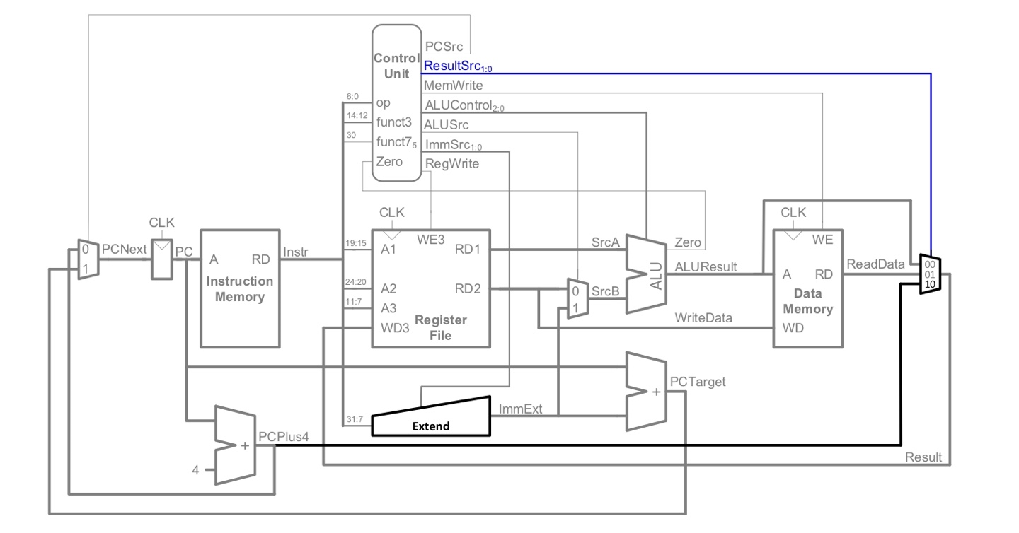
Week02
Single Cycle Processor design [14 Instruction]
LW
SW
BEQ
ADD
AND
SUB
SLT
OR
ADDI
JAL
XOR
SLL
SRL
BNE

Slide 4
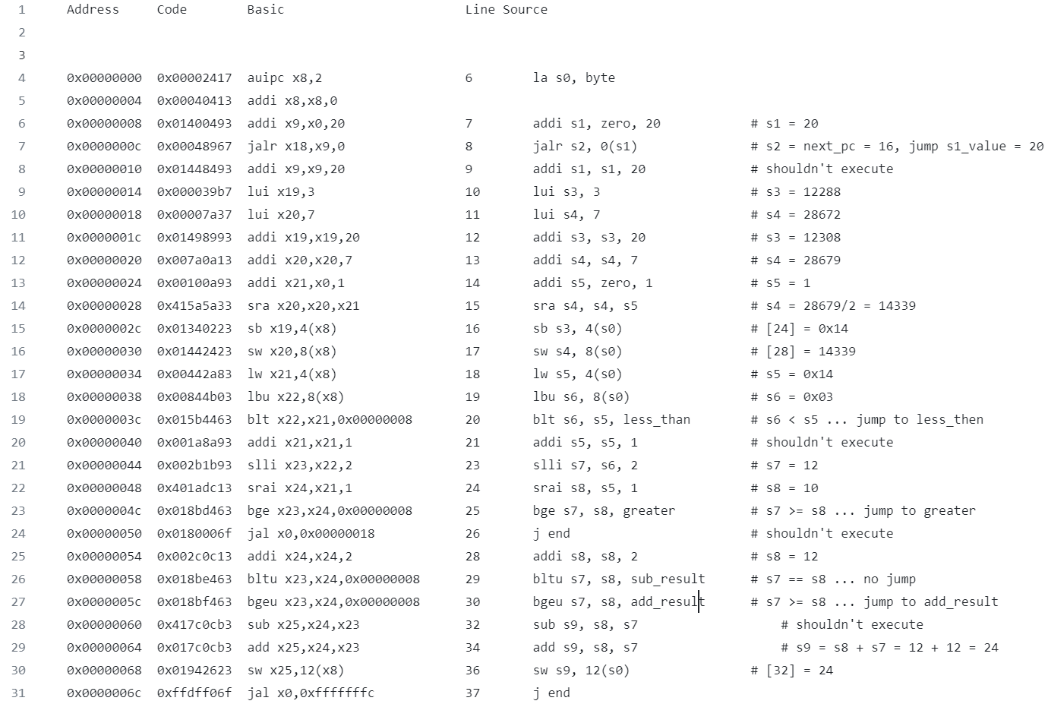
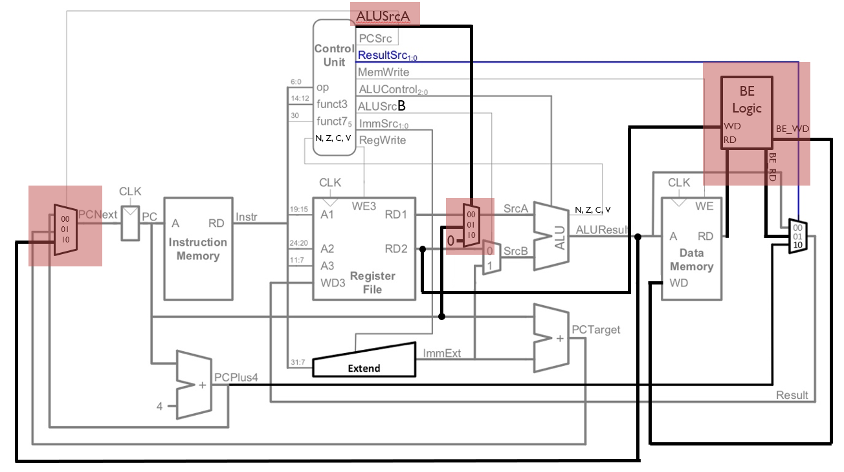
Week03
Single Cycle Processor design [26 Instruction] & Make test vector(asm)
LW
SW
BEQ
ADD
AND
SUB
SLT
OR
ADDI
JAL
XOR
SLL
SRL
BNE
LUI
SRA
LBU
BLT
BLTU
BGE
BGEU
JALR
AUIPC
SB
SLLI
SRAI

Slide 5
Week04
Single Cycle Processor design [37 Instruction] + Csr Register = Single Cycle Processor finish
Add register for Next step(Pipeline Processor)
ALUSrcA
LW
SW
BEQ
ADD
AND
SUB
SLT
OR
ADDI
JAL
XOR
SLL
SRL
BNE
LUI
SRA
LBU
BLT
BLTU
BGE
BGEU
JALR
AUIPC
SB
SLLI
SRAI
LB
LH
LBU
LHU
SH
SLTI
SLTIU
XORI
ORI
ANDI
SRLI
B
BE
Logic
N, Z, C, V
WD
BE_WD
RD
BE_RD
00
01
10
00
01
10
N, Z, C, V
0
Csr
tohost_csr
csr

Slide 6
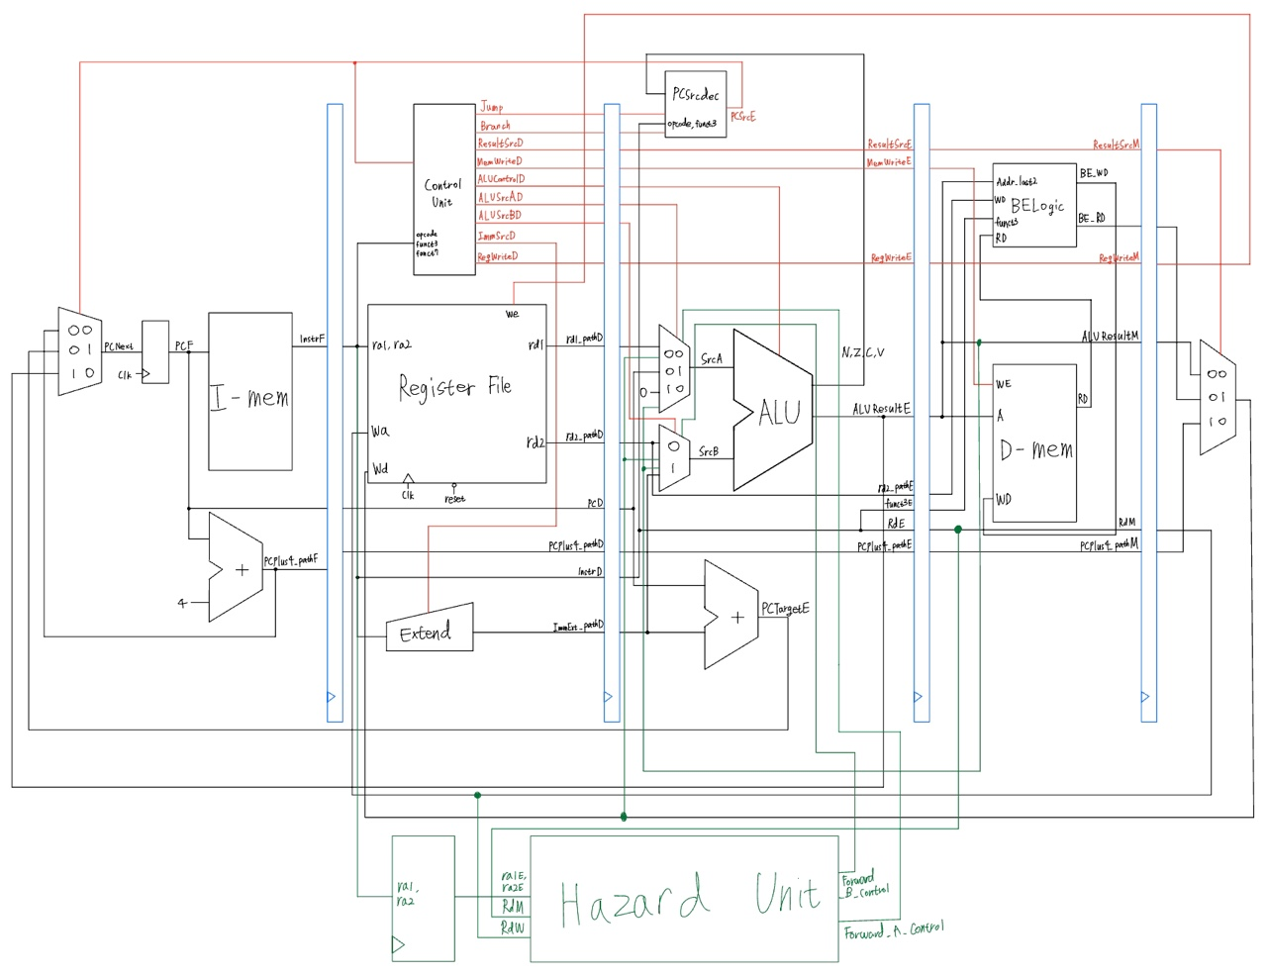
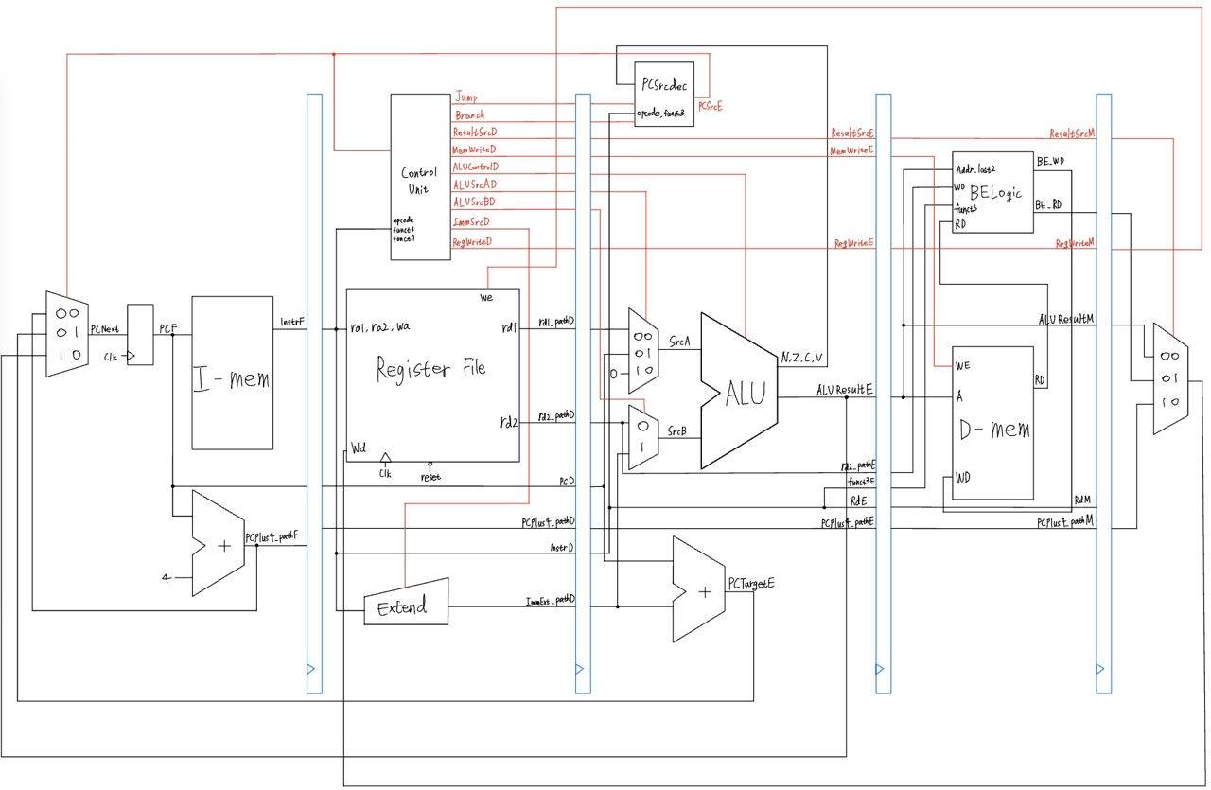
Week05
Pipeline Processor design
Data Hazard, Control Hazard
Data(Load use) Hazard, Control Hazard

Slide 7
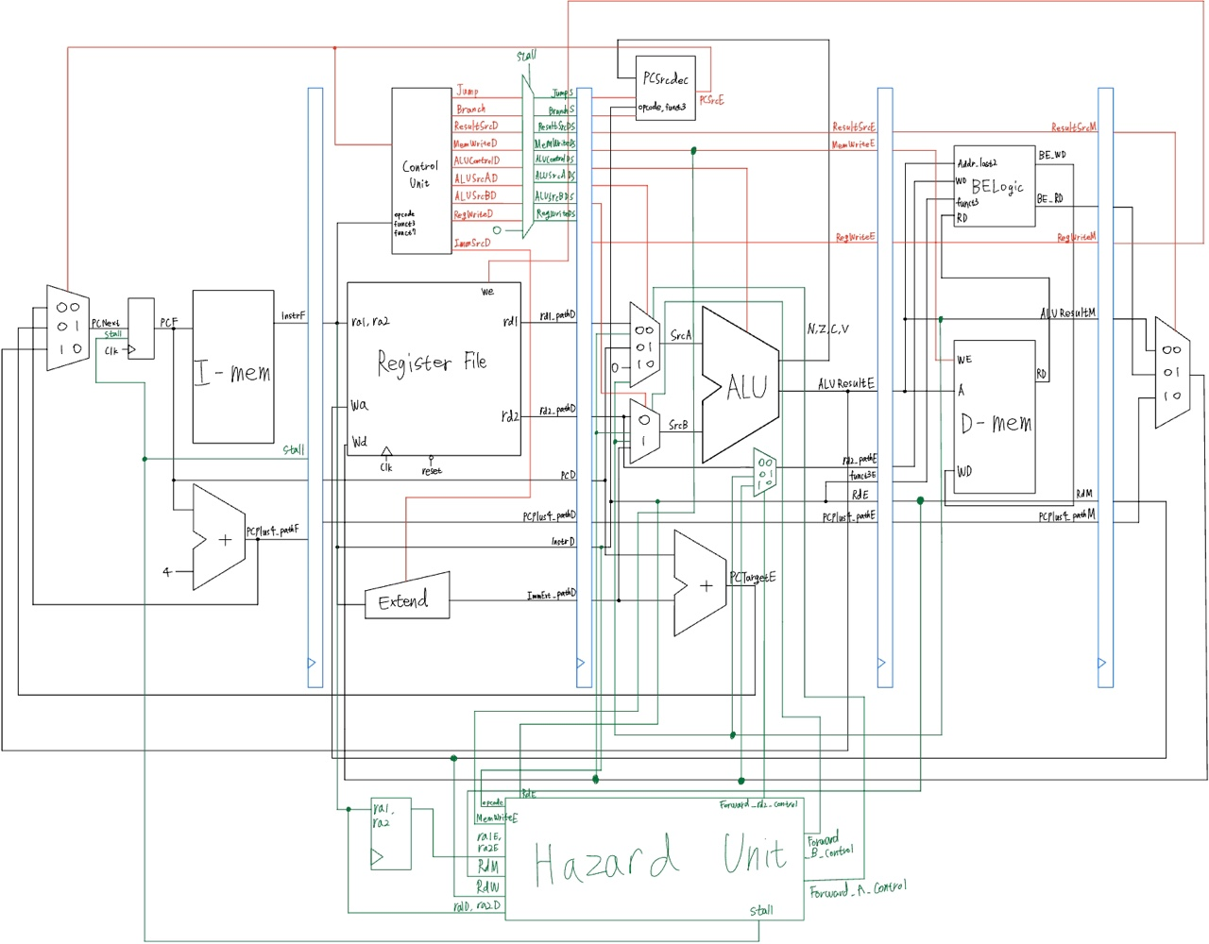
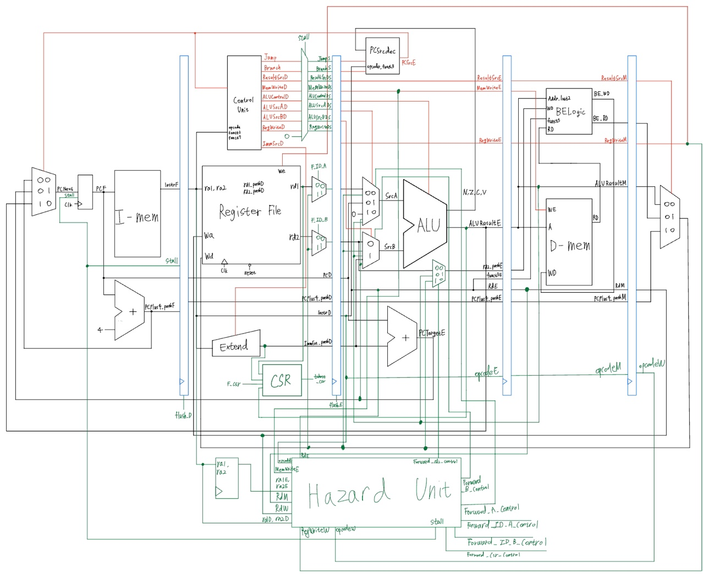
Week05
Pipeline Processor design
Control Hazard, Data Hazard
Control Hazard

Slide 8
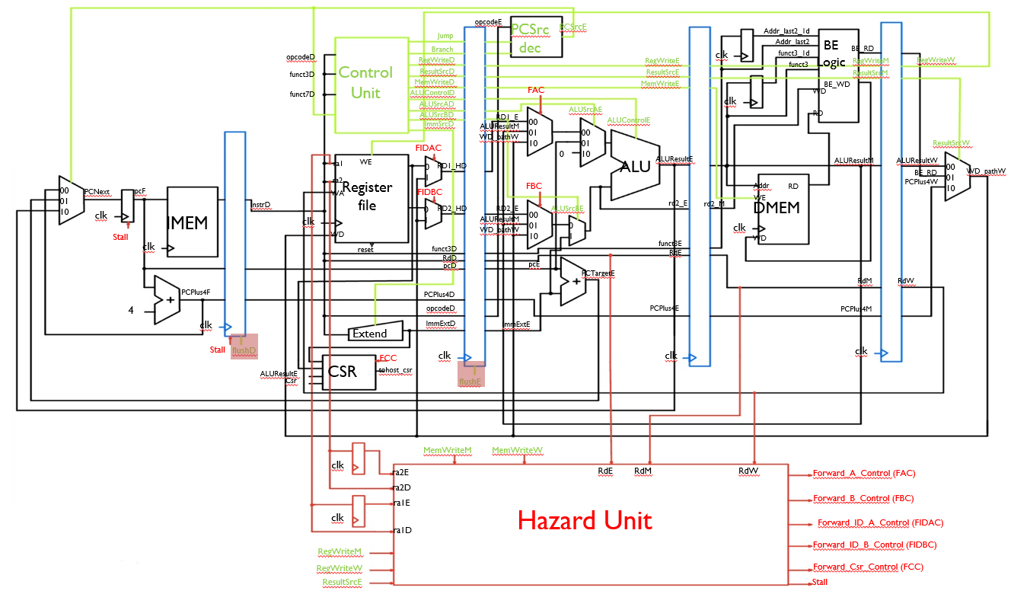
Week06
Pipeline Processor finish

Slide 9
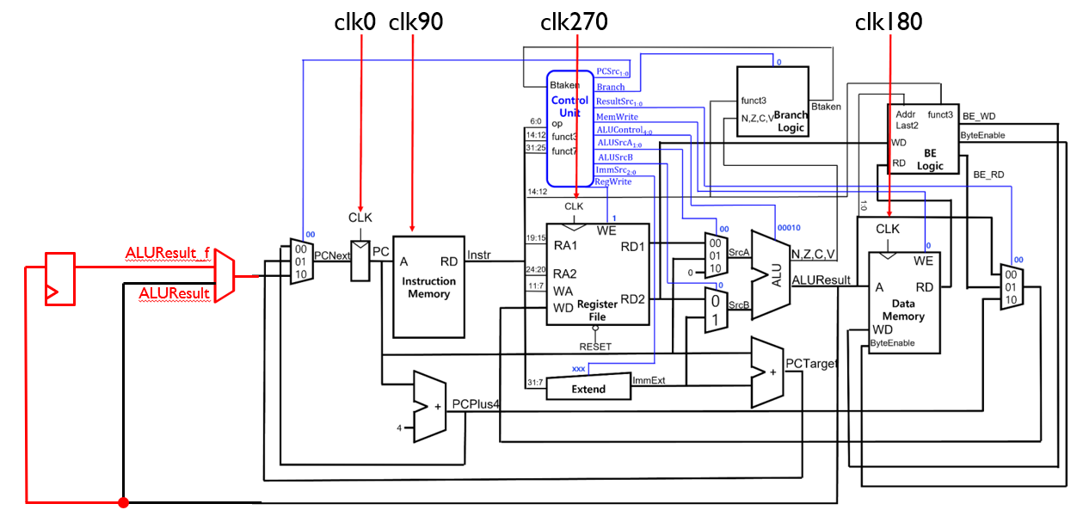
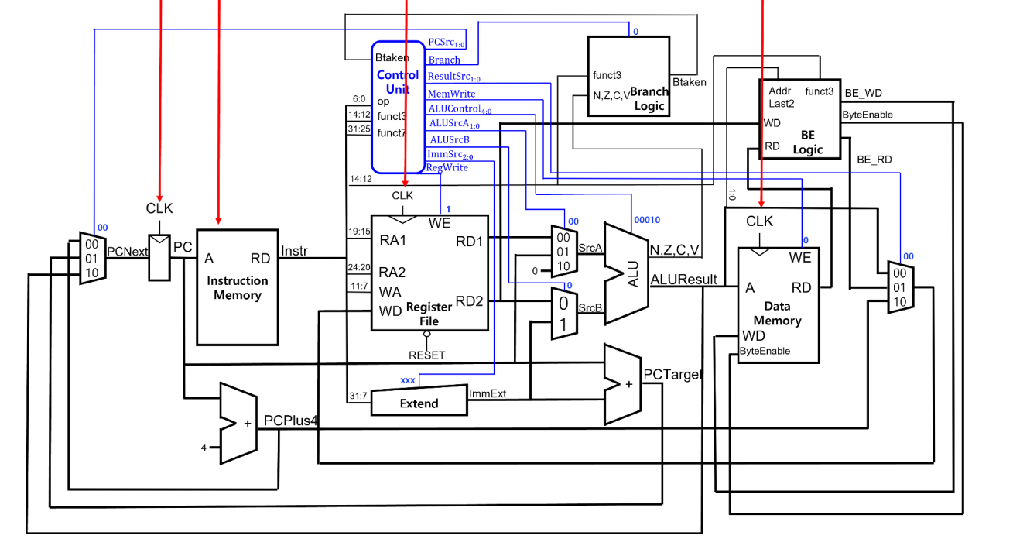
Week06
Async Memory Sync Memory
- Single Cycle Processor : use Multi Phase Clk
clk0
clk90
clk270
clk180
JALR
issue

Slide 10
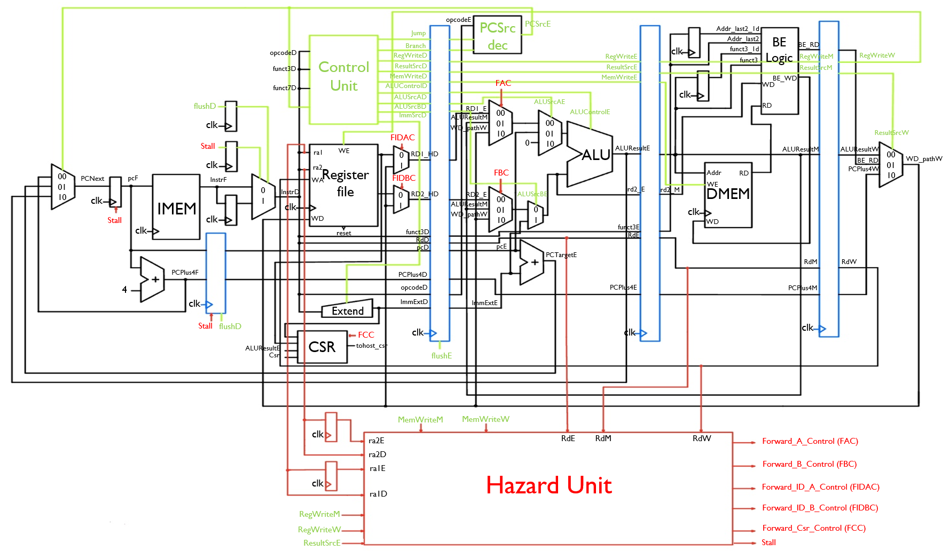
Week07
Async Memory Sync Memory
- Pipeline Processor
I-Mem/D-Mem
read 1clk delay

Slide 11
Reference
UC Berkely EECS 151. Introduction to Digital Design and Integrated Circuits
원리부터 설계까지 쉽고 명확한 컴퓨터구조 - 서태원
Q&A

