Slide 1
201921390 윤승재 System Semiconductor Engineering University of Sangmyung
2023 Summer Vacation Bootcamp
Summer 2023

Slide 2
Contents
2023 Summer Vacation Bootcamp Progress
APB Master Bridge
Block diagram
AHB Slave
Block diagram
SRAM Controller
Block diagram
Problem
Solution
Verification method
Reference

Slide 3
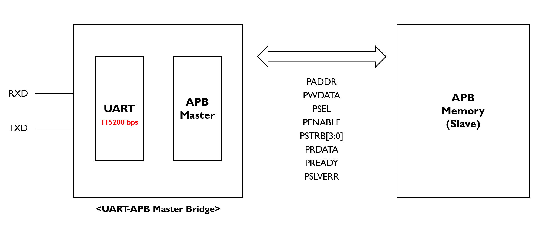
APB Master Bridge
Block Diagram

Slide 4
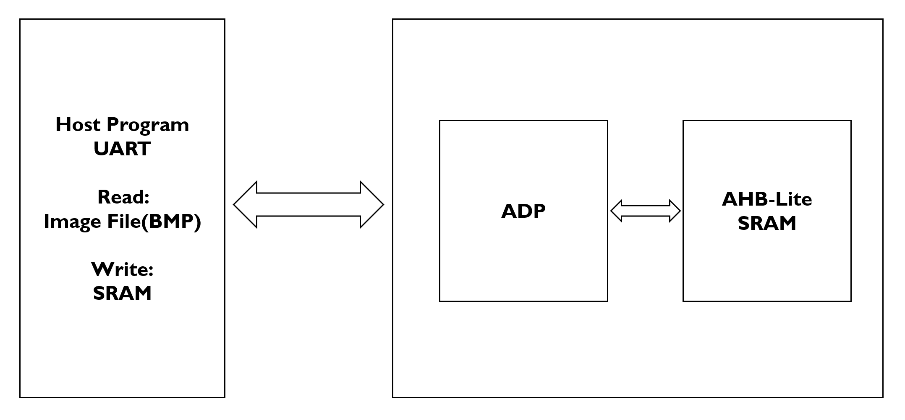
AHB Master Bridge
Block Diagram

Slide 5
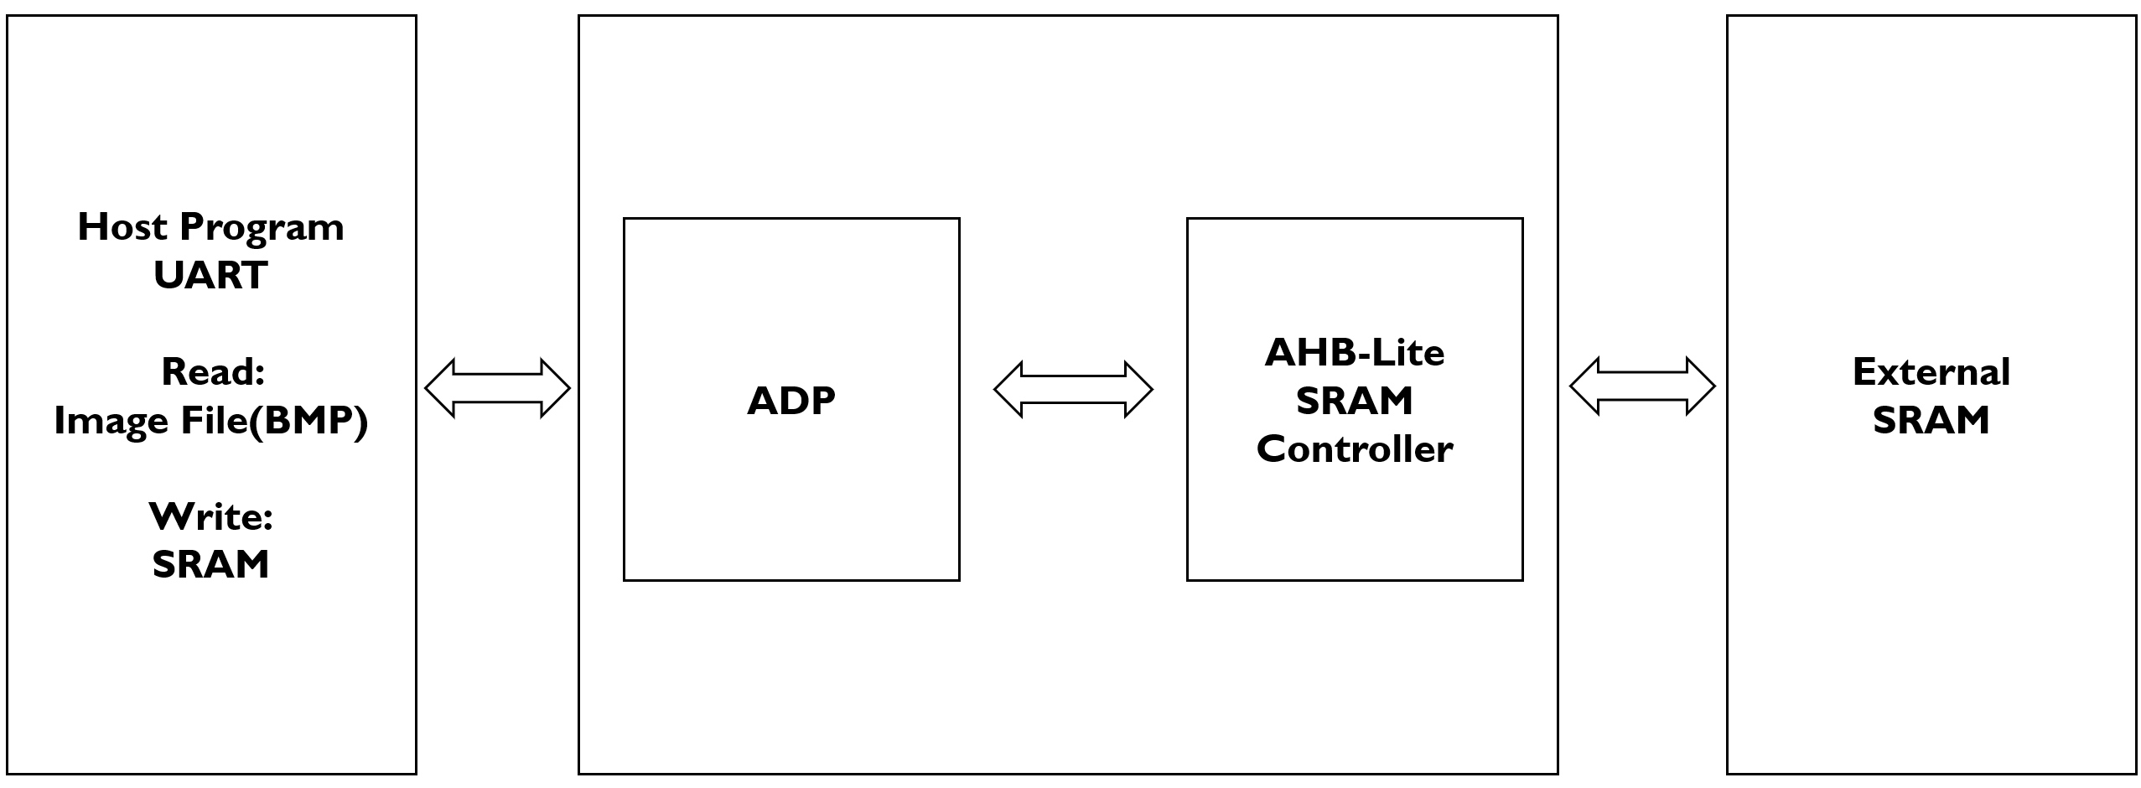
Sram Controller
Block Diagram

Slide 6
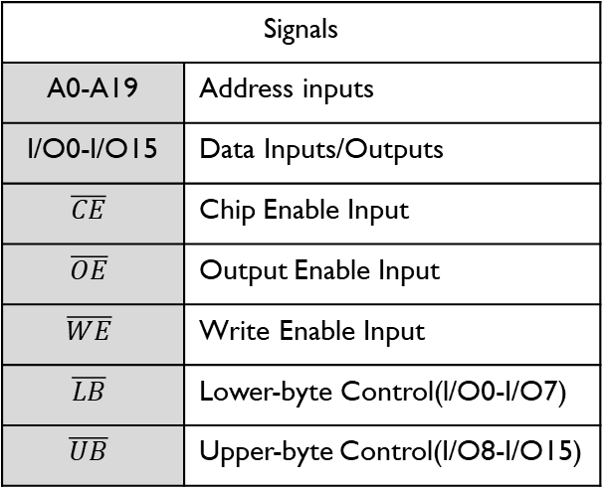





Sram Controller
DECODER
1024K x 16
MEMORY ARRAY
A0-A19
Signals
A0-A19 | Address inputs
I/O0-I/O15 | Data Inputs/Outputs
$$\overline{CE}$$ | Chip Enable Input
$$\overline{OE}$$ | Output Enable Input
$$\overline{WE}$$ | Write Enable Input
$$\overline{LB}$$ | Lower-byte Control(l/O0-I/O7)
$$\overline{UB}$$ | Upper-byte Control(I/O8-I/O15)
VDD
GND
I/O0-I/O7
Lower Byte
I/O
DATA
CIRCUIT
COLUMN I/O
I/O8-I/O15
Upper Byte
$$\overline{CE}$$
CONTROL
CIRCUIT
$$\overline{OE}$$
$$\overline{WE}$$
$$\overline{LB}$$
$$\overline{UB}$$

Slide 7
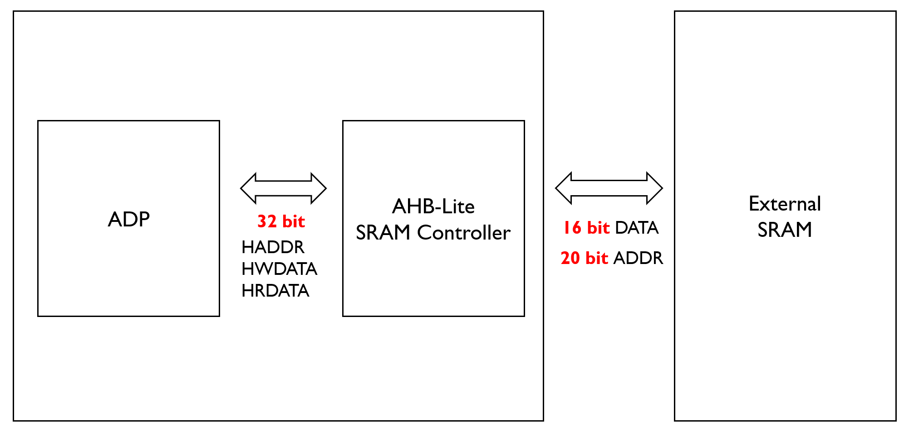
Sram Controller
Problem

Slide 8
Sram Controller
Solution
Address & Data
+1
<Byte>
<DATA>
+1
<Half word>
<Address>
[21:1] Address
+1
+1
<Word>
2
1

Slide 9
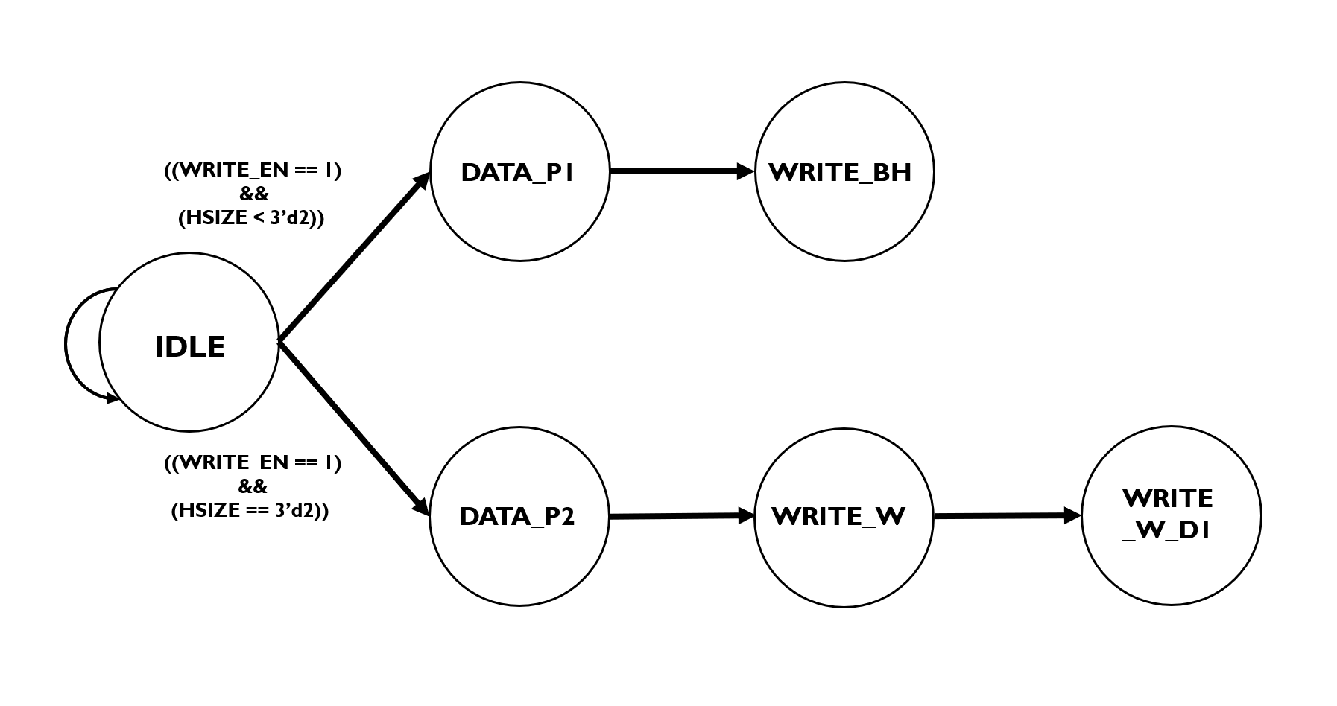
Sram Controller
State Machine
write

Slide 10
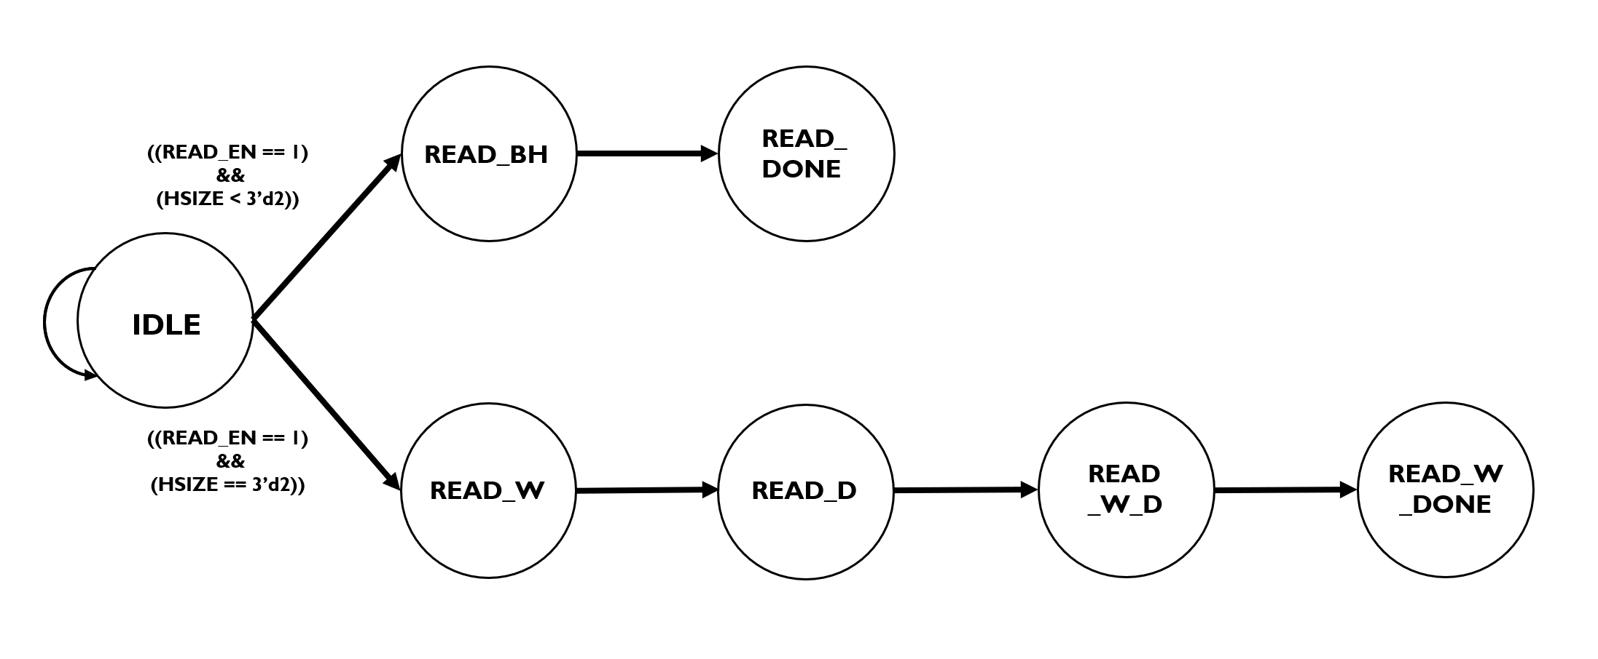
Sram Controller
State Machine
read

Slide 11
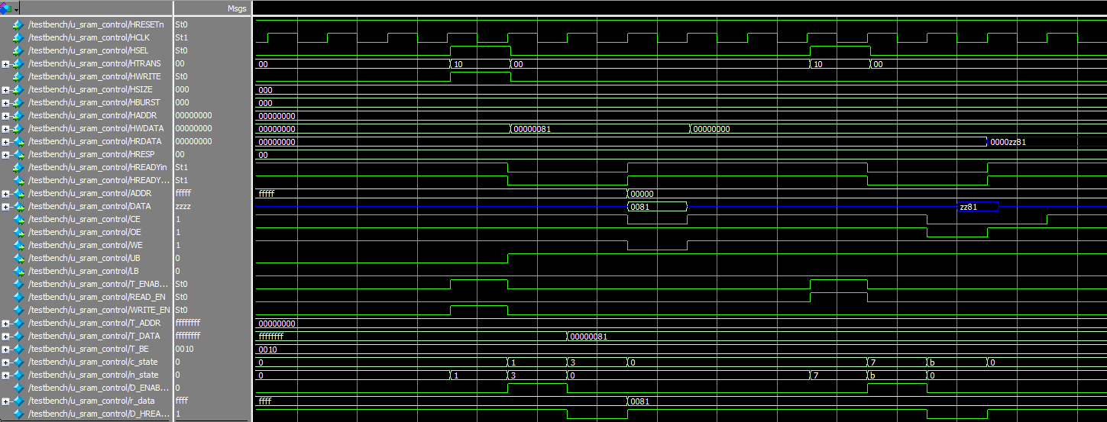
Sram Controller
Verification Method
Simulation

Slide 12
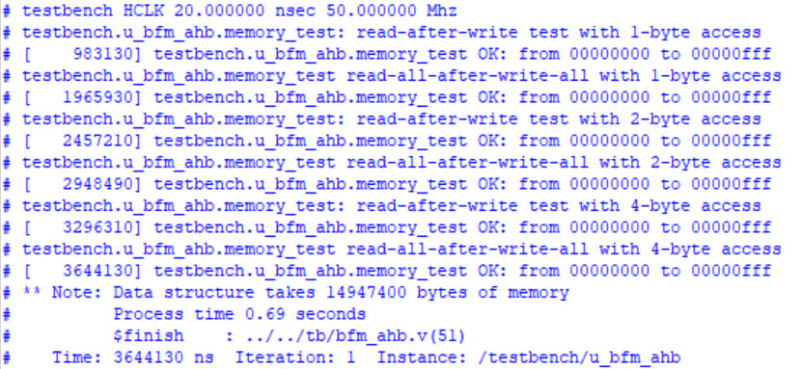
Sram Controller
Verification Method
Display

Slide 13
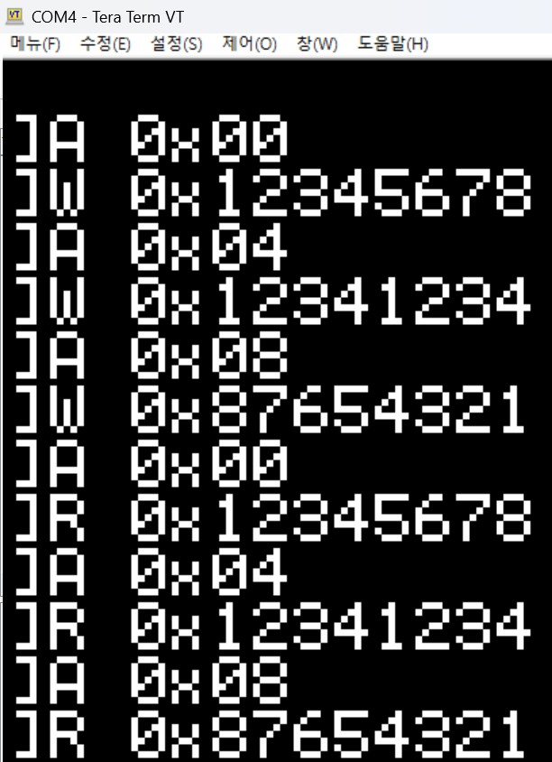
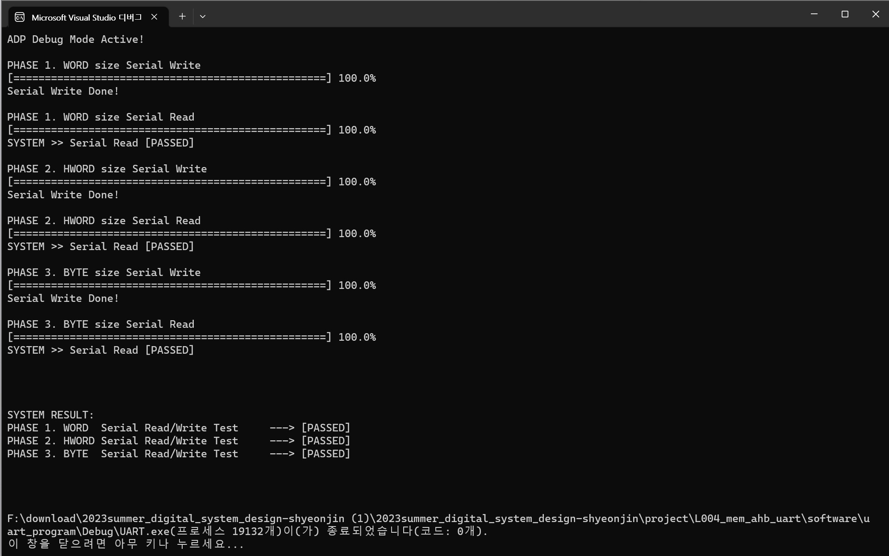
Sram Controller
Verification Method
Board Synthesis

Slide 14
감사합니다.

Slide 15
Reference
SRAM
file
2023_Summer_Project_rev4 (by Yongwoo Kim)
file

