Slide 1
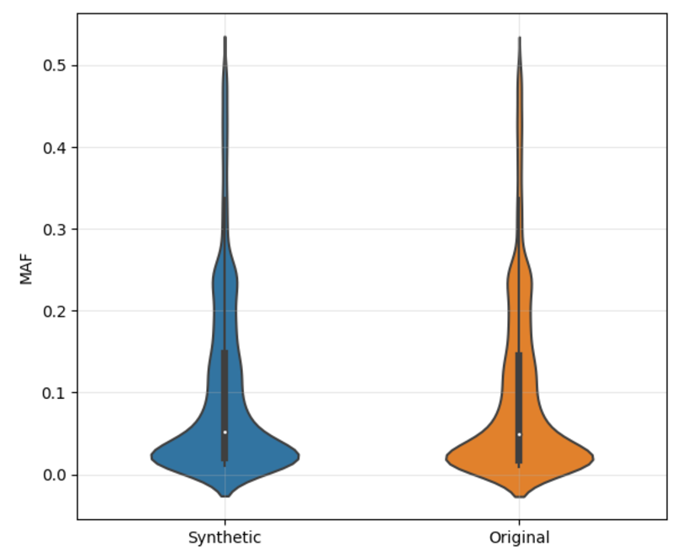
MAF Values
Synthetic
Original

