Slide 1
Predicting Fraction Collections with Machine Learning
Project Summary

Slide 2
Approach
Binary classification model created using ML.NET
The following features were used
Max Absorbance
Method
Product
Presence of a post-synth sci mod on the oligo
Ship OD and ship nanomole guarantees

Slide 3
Model statistics
Model ROC-AUC is 0.9001
1.0 is a perfect score
0.5 is the same accuracy as a coin flip
Model PR-AUC is 0.69
Model strongly favors catching positives
MaxAbsorbance is the dominant feature by a wide margin
The model ranks well overall but still produces many false positives on borderline absorbance values

Slide 4
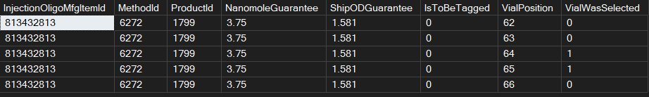
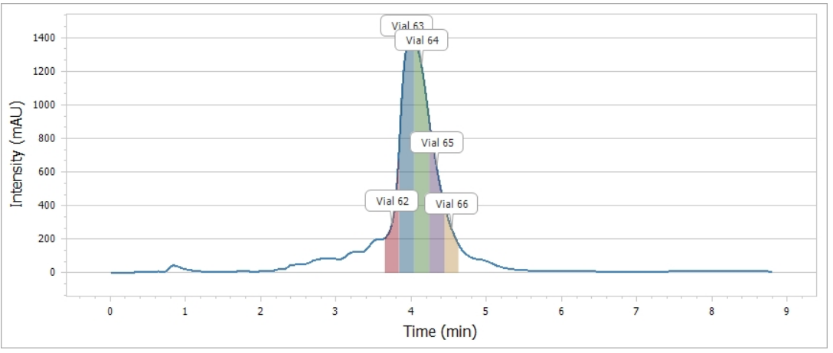
Test data

Slide 5
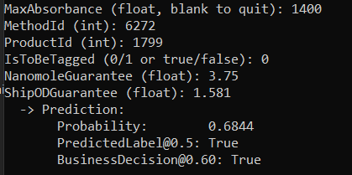
Test prediction for positives
Using data for Vial 64
Absorbance is ~1400 (from peak height of chromatogram)
Model predicted true with a probability of 0.68
Matches HPLC operator decision

Slide 6
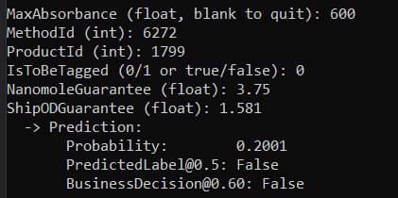
Test prediction for negatives
Using data for Vial 62
Absorbance is ~600 (from peak height of chromatogram)
Model predicted false with a probability of 0.2
Matches HPLC operator decision

Slide 7
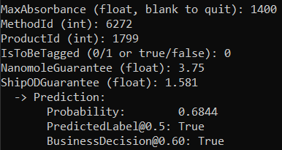
Test prediction for borderline case
Using data for Vial 63
Absorbance is ~1400 (from peak height of chromatogram)
Model predicted true with a probability of 0.68
Does not match HPLC operator decision
Values for this vial matched vial 64

Slide 8
Lessons
Model accuracy gets better with more historical data and more features
A balanced data set leads to better models
A single dominant feature can dramatically influence models
Predictions can be compared to acceptable business thresholds
Example: a model can return true with a 0.55 probability, but HPLC can set their threshold to 0.7 to ensure selecting good predictions

