Slide 1
Predictive Bio-Models Hackathon Project Presentation
He Zhang Bioinformatics
Bilel Hichri IT
Joseph Volker IT
Notes:
AI-generated content may be incorrect. ---

Slide 2
Problem
Over-collection of fractions wastes direct materials, increases processing labor and machine time, and causes throughput bottlenecks
Incorrect fraction selections also lead to oligo failures requiring rework, which drives late deliveries
HPLC QC failures create review, remake, and delivery-risk decisions after designs have already entered production
Examine the possibility of using machine learning models for the following:
HPLC fraction collections
sgRNA synthesis failure prediction
Notes:
The problem section focuses on clearly defining the challenge that the team chose to address during the hackathon. A strong problem statement is essential because it guides all subsequent decisions and ensures that the solution remains relevant and meaningful. In this case, the team identified a specific issue that has practical importance, either in a real-world scenario or within a defined user group. The problem description includes context about why the issue exists, who is affected by it, and the consequences of leaving it unresolved. By outlining these factors, the team demonstrates both awareness and empathy toward the stakeholders involved. Additionally, the problem is framed in a way that is measurable or observable, making it easier to evaluate the effectiveness of the proposed solution. This section also highlights any constraints or challenges encountered, such as limited time, resources, or incomplete data, which are typical in hackathon settings. By presenting a well-structured problem statement, the team establishes credibility and sets a strong foundation for the rest of the presentation. Ultimately, this slide aims to answer the key question: what problem did we take on, and why does it matter?

Slide 3
Approach for HPLC fraction collection
Binary classification model using the ML.NET framework created by CoPilot
~200k records used for model training and testing
The following features were used
Max absorbance
Method
Product
Presence of a post-synth mod on the oligo
Ship OD and ship nanomole guarantees

Slide 4
Model statistics
Model ROC-AUC is 0.9001
1.0 is a perfect score
0.5 is the same accuracy as a coin flip
Model PR-AUC is 0.69
Model strongly favors catching positives
Max absorbance is the dominant feature by a wide margin
The model ranks well overall but still produces many false positives on borderline absorbance values

Slide 5
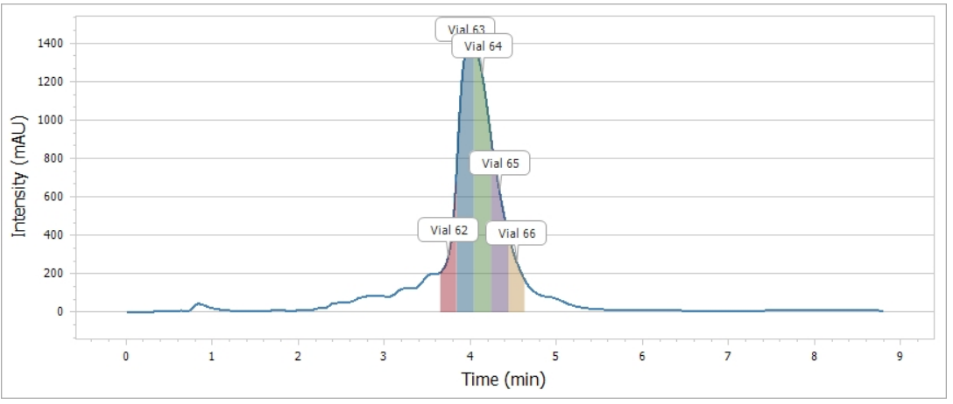
Test data
Test oligo and its fractions
HPLC operator selected vials 64 and 65

Slide 6
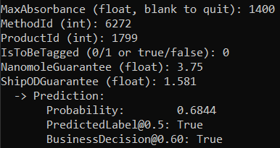
Test prediction results
For position test, the model predicted true
Matches HPLC decision
For negative test, the model predicted false
Matches HPLC decision
For borderline case, the model predicted true
Does not match HPLC operator decision

Slide 7
sgRNA Data, Feature Families, and Modeling Approach
Problem scale, target variables, feature families, and the best-performing model families.
2,646
86
161
20
5-fold
binary-labeled rows
Fail rows
features
models
CV
source Pass/Fail endpoint
3.25% baseline failure rate
sequence-derived numeric inputs
readable cross-endpoint signals
grouped by sequence
Target variables:
UHPLC % MainPeak: Quantitative trait representing the percentage of the chromatographic signal attributed to the primary compound
Need Review: Rule-derived label calculated using sgRNA length and ‘UHPLC % MainPeak’.
Pass/Fail: Human-reviewed binary label indicating final sample status.
Feature families: sequence size, base composition, motif and run structure, modification burden, positional chemistry, and parser completeness.
Best-performing classification moels: Histogram Gradient Boosting, L1 logistic
Best-performing purity model: ExtraTrees, Histogram Gradient Boosting
3

Slide 8
Key Performance
Out-of-fold metrics for the best current model or feature set by endpoint.
Endpoint | Feature set | Best current model | PR-AUC | ROC AUC | F1 score
Pass/Fail | 161 features | HGB (Hist Gradient Boosting) | 0.1087 | 0.6304 | 0.1165
Pass/Fail | 71 features (Correlation-pruned) | HGB | 0.1139 | 0.6529 | 0.0800
Pass/Fail | 9 features | L1 logistic | 0.1078 | 0.5483 | 0.0693
Pass/Fail | 5 features | HGB | 0.0895 | 0.6071 | 0.0307
Endpoint | Feature set | Best current model | PR-AUC | ROC AUC | F1 score
Need_Review | 161 features | HGB | 0.4054 | 0.7741 | 0.3545
Need_Review | 71 features (Correlation-pruned) | HGB | 0.4082 | 0.7719 | 0.3467
Need_Review | 9 features | HGB | 0.3749 | 0.7677 | 0.3529
Need_Review | 5 features | HGB | 0.3635 | 0.7832 | 0.3070
Endpoint | Feature set | Best current model | RMSE | R2 | Person r | Spearman r
MainPeak | 161 features | Extra Trees | 6.0574 | 0.7005 | 0.8370 | 0.7750
MainPeak | 40 features | Extra Trees | 6.0998 | 0.6963 | 0.8345 | 0.7710
MainPeak | 9 features | HGB | 6.2635 | 0.6797 | 0.8245 | 0.7557
MainPeak | 5 features | HGB | 6.4344 | 0.6620 | 0.8137 | 0.7531
4

Slide 9
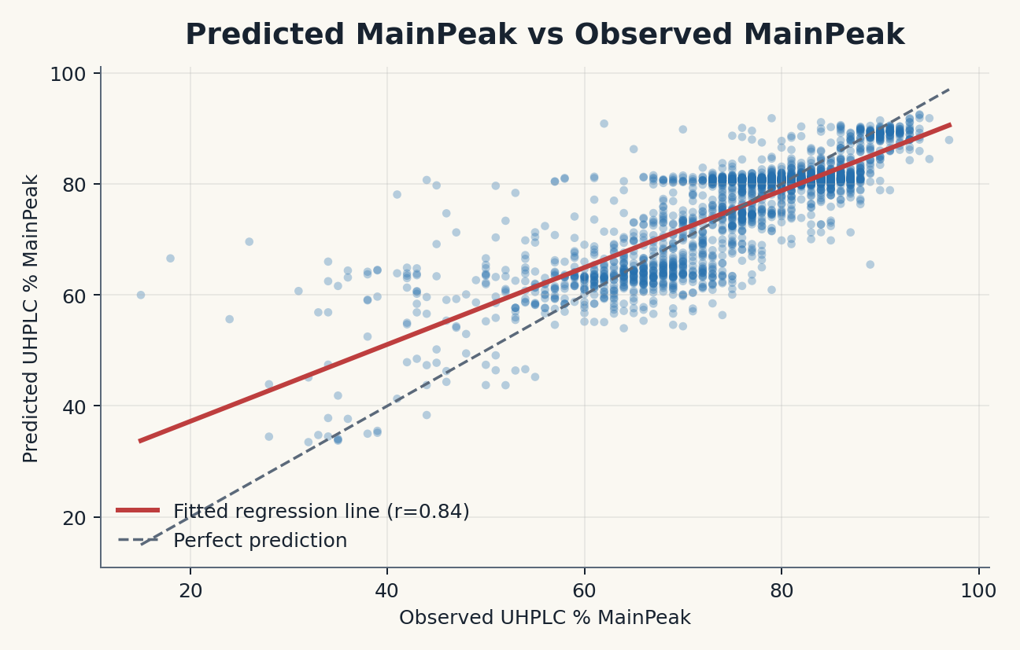
Feature Insights and Purity Signal
MainPeak prediction gives a quantitative view of sequence-derived purity signal.
The observed-vs-predicted plot uses full-feature ExtraTrees MainPeak predictions with a fitted regression line and a perfect-prediction reference.
MainPeak keeps quantitative purity information that binary Pass/Fail labels discard.
Top-40 ExtraTrees-selected features nearly match the full model: RMSE 6.0998 vs 6.0574.
LNA Span Fraction
rC Token Count
U Base Count
Longest lC Run
Longest rU Run
lG Token Fraction
RNA Count in Middle Region
3' Star Modification Count
Standard Deviation of Modified Token Positions
Compact interpretation
The 9-feature panel is the best lightweight cross-endpoint explanation set, while the 71-feature HGB remains the best Pass/Fail ranking option.
5

Slide 10
Lessons
Model accuracy gets better with more historical data and more features
A balanced data set leads to better models
A single dominant feature can dramatically influence models
Predictions can be compared to acceptable business thresholds
Example: a model can return true with a 0.55 probability, but HPLC can set their threshold to 0.7 to ensure selecting good predictions

